Slide 1
PSA implementation of the Independent Core Cooling and new EOPs/SAMGs at Oskarshamn 3
Paper FR84

Slide 2
What we do
We actively challenge convention to achieve great things. We believe in working hand in hand with clients to tackle complex and multi-layered challenges head-on. Our deep knowledge and earned expertise is driven by a profound passion for achieving engineering excellence. We improve your operational performance, mitigate risk, optimise cost and facilitate better decision making, in an ever-changing world.
Improve operational performance
Optimise costs
Reduce risk
Informed decision making
www.vysusgroup.com

Slide 3
Presentation outline
Introduction
Project planning
General overview and adaptation of the PSA model
Some results
Challenges and conclusions

Slide 4
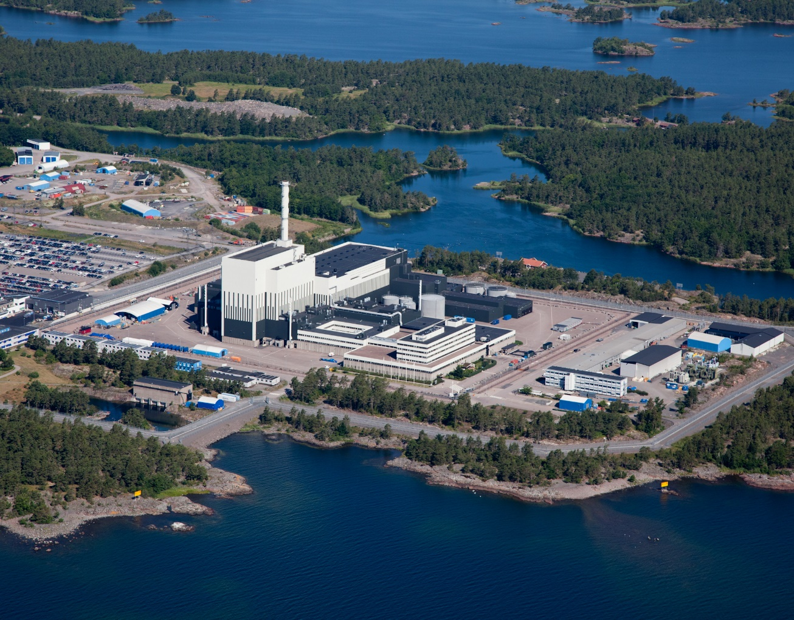
Introduction
All nuclear power plants in Sweden need to be equipped with an Independent Core Cooling function (ICC, “OBH” in Swedish) by December 31st 2020.
The Oskarshamn unit 3 NPP has been equipped with the ICC system powered by its own dedicated diesel generator and cooling water supply capable of keeping the core cooled for a duration of at least 72 hours without relying on the external electrical grid or any other auxiliary power supply (ELAP) and to withstand a Loss of Ultimate Heat Sink (LUHS).
A significant effort during the process has been to update the Safety Analysis Report (SAR), including the baseline PSA, Emergency Operating Procedures (EOP) and to create new Severe Accident Management Guidelines (SAMG).
Several projects were performed in parallel to handle the different tasks to achieve the ambitious targets above. This presentation focus on the challenges that were encountered in the development of PSA and how they were managed.

Slide 5
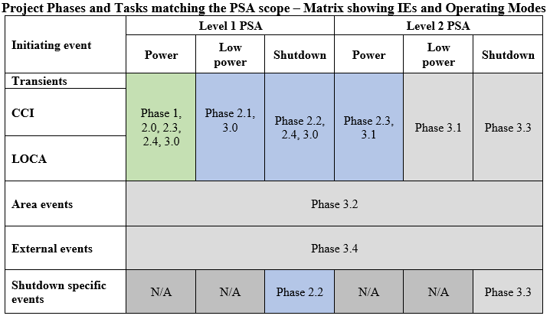
Project planning
An initial project planning was established with the requirement of meeting the project milestones set by the Swedish Radiation Authority (SSM) by the deadline of December 2020.
The plan stretched between the end of 2018 until 2020 with some additional work regarding the update of PSA documentation planned for 2021.
PSA update was decided to also include support to the verification and validation of the EOP and SAMG.
Three project phases with additional sub activities were identified for development of the PSA and support to the EOPs and SAMGs, each phase to be addressed on a yearly basis matching the PSA scope for the Oskarshamn 3 NPP.
Phase 1 – FMEA, reliability analysis and first CDF estimation including OBH (2018-2019)
Phase 2 - Development of the PSA study for O3 to include OBH (2019-2020)
Phase 3 - Further development of the PSA study for O3 to include OBH (2020-2021)

Slide 6
General overview and adaptation of the PSA model – Phase 1 (1)
FMEA
The work with FMEA identified about 20 different components’ failure modes that were relevant for implementation in the PSA. Several component types not included in the existing FMEA were identified for which failure data estimation was needed i.e., electrical components that are de-energized during normal operation, MG set, a diesel-powered centrifugal pump and a minimum flow check valve.
Preliminary reliability study
The reliability of the OBH function depends entirely on the reliability of the independent core cooling system, which is a one-train system, which means that the different types of single failures in the system are the most probable causes of errors.
The component that in the analysis contributed the most to the unavailability of OBH was the diesel-driven pump in the independent core cooling system (failure data adopted based on data for diesel-powered fire water pumps, which may be considered too conservative for the analysis).
Manual actions did not show to be of large significance in the analysis. This is because different types of technical errors in the ICC system dominated so strongly the result.
The reliability of OBH is of the same order of magnitude as for single trains in the Auxiliary Feedwater (AFW) and the Emergency Core Cooling System (ECCS).

Slide 7
General overview and adaptation of the PSA model – Phase 1 (2)
Initial estimation of core damage frequency
Calculated CDF for consequences loss of core cooling (CC) and loss of residual heat removal (RHR) showed a significant decrease. This mainly since a large contribution to the CDF in the unchanged PSA model came from sequences leading to loss of CC.
First update of the PSA study based OBH design and new EOPs draft including first review of manual actions
The task performed resulted in the following achieved milestones:
Preliminary evaluation of the impact of the new EOPs.
Update of success block diagrams for level 1 PSA with regards to the new core cooling options (ICC and other CC-alternatives).
Identification of updated and new deterministic calculations to support PSA sequence analysis.
Evaluation of the impact on CDF for internal events due to the implementation of ICC, changes in EOPs and additional manual actions.
Several findings from the evaluations performed with PSA were discussed together with personnel in charge of updating the EOPs to give feedback for further update of the new procedures e.g. the additional requirements on pressure relief systems as precondition for OBH operation, changes related to the independent RHR system actuation before core damage.

Slide 8
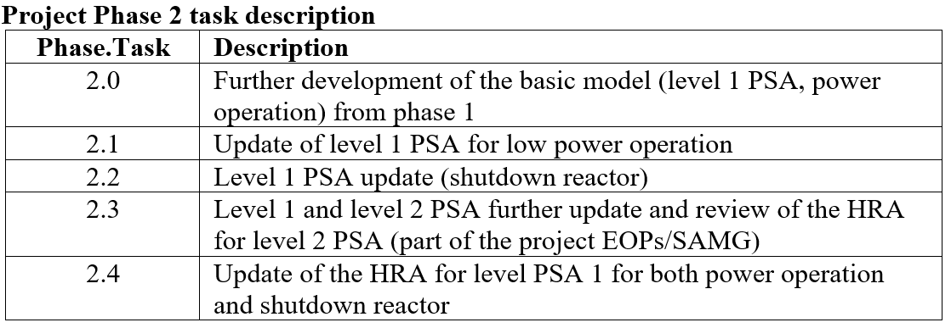
General overview and adaptation of the PSA model – Phase 2
As a follow up after phase 1, phase 2 of the project focused on incorporating the OBH function in level 1 PSA.
In parallel, work on analyzing the effect of the new EOPs on sequences as well as a first update of level 2 PSA in relation to the updated SAMGs proceeded.
Several modelling and project planning related challenges were addressed, for example, the fact that a new version of MAAP was validated and used as reference, a major change in the definition of SAMGs for O3 compared to previously adopted procedures for severe accident mitigation.

Slide 9
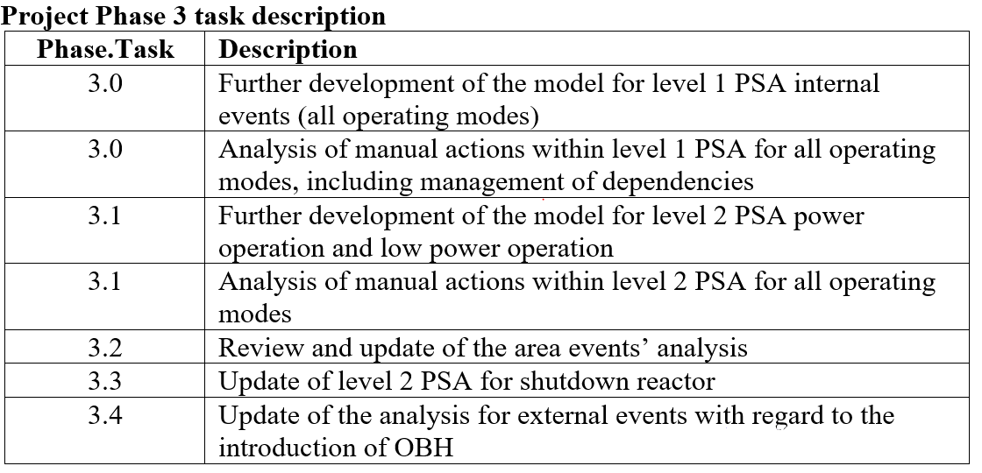
General overview and adaptation of the PSA model – Phase 3
In phase 3 of the project the focus was on reviewing and further updating the model for level 1 and level 2 PSA
Final implementation of the OBH function (including all relevant affected systems) was done according to:
final technical specifications and as-build information for systems.
following the updated EOPs and the new SAMGs which were to be finalized at that time.
This work was done for all operating modes included in the scope for the PSA for O3.
Work for updating the analysis for area events and external events was performed.

Slide 10
Other related studies
Other studies related to the OBH and EOPs/SAMGs implementation were performed during 2020-2021:
Analysis and model update related to changed pump curve for the ICC system.
Analysis of room cooling requirements for areas containing OBH components.
Implementation of manual actions including dependencies in the PSA model - according to the analysis developed during phase 3.
Reliability analysis regarding availability, operational safety and maintenance (refer to paper AN79).
Merger of PSA models – ordinary/as-built PSA with PSA-model developed during the OBH project.
Several results’ comparisons between baseline PSA with as-built system configuration and PSA at different stages of the implementation of the OBH function and EOPs/SAMGs were done, both in terms of CDF and for the total frequency of unacceptable releases (level 2 PSA)*.
* The frequency for unacceptable releases is a different risk metric compared to LERF and it is the one adopted in Sweden for level 2 PSA results’ presentation to SSM. The existing definitions of an unacceptable release are directly or indirectly based on the Swedish government decision in 1985 regarding severe accident mitigation, i.e., “0,1 % of an 1800 MWt core”, corresponding to a release of 100 TBq of Cs-137.

Slide 11
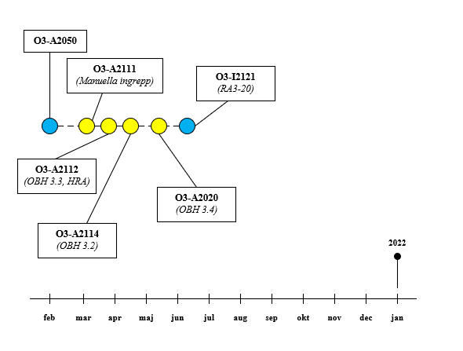
Timeline PSA model updates (2018-2021)

Slide 12
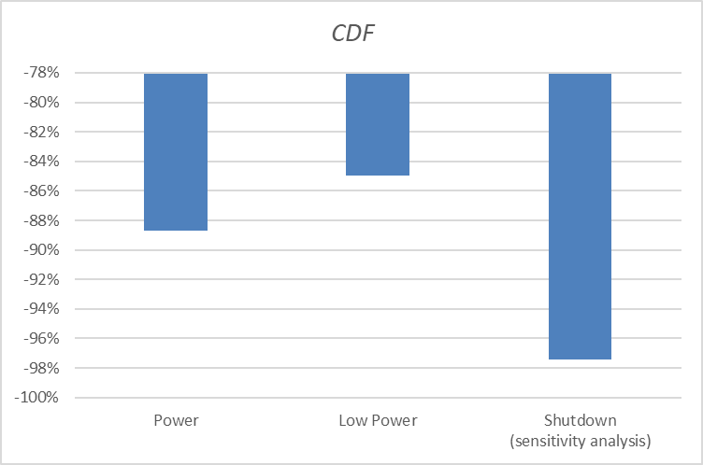
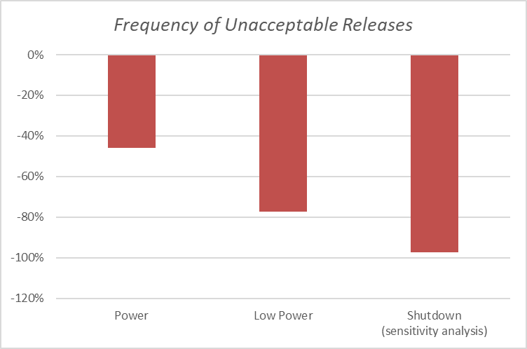
Results
Although the project was aiming at implementing the OBH function in the PSA model, several other aspects were accounted for and included in the PSA i.e., new EOPs, SAMGs and additional updates due to yearly plant changes.
Here a result comparison which focuses solely on the effect and contribution of the OBH function, and the effect of new procedures (EOPs/SAMG) is shown.
The combined CDF for power operation and low power operation decreased by 88% compared to before the PSA update due to OBH and EOPs/SAMG.
The combined frequency of unacceptable releases during power operation and low power operation decreased by 57% after the introduction of OBH.
For shutdown reactor, OBH cannot be credited directly in the baseline analysis due to the acceptance criteria regarding manual operations in this operating mode. Results for the sensitivity analysis performed where OBH is credited are shown.

Slide 13
Challenges – some examples (1)
New approach and interface between EOPs and SAMGs and changes in CC/RHR alternatives
SAMGs was introduced for the first time at O3 - previously addressed with several system-oriented procedures not described and structured in a systematic way as it is usually done for EOPs.
Replacing the old procedures with more consistent SAMGs was a major step forward for safety which required a lot of effort by all personnel working in the project (SAMR project).
By means of workshops between plant personnel and experts responsible of updating the PSA, the major differences were identified, discussed, and tackled e.g., the actuation of different CC alternatives in different sequences.
Specific analyses performed with MAAP5 were done to assess the system requirements for the new systems to correctly model these into the sequences in the PSA.
Low-Power and High-Power mode for the ICC Injection
The diesel-pump driven ICC system introduced with the OBH function can operate at two different flow levels depending on the reactor water level and subsequent need during an accidental scenario i.e., high-power and low-power mode.
Operator procedures are in place to avoid injecting water with a water level in the reactor vessel exceeding the maximum allowed for the system.
HRA identified a set of manual actions with related Human Error Probabilities (HEPs) which led to a sequence analysis far more detailed than initially expected.

Slide 14
Challenges – some examples (2)
Feed Water Tank
The feed water tank (water filled from the main feedwater) is a passive and pressure-driven system function. This function was never modelled in the PSA as it is not a viable CC function for the mission time for the level 1 PSA (20 hours).
CC alternatives introduced in the EOPs and modelled in the PSA creates preconditions for sequences in which timing for manual actions is facilitated - this passive system can alone keep the core cooled for at least 2 hours when no other CC system is available.
The implementation of the feed water tank in the PSA model creates new possibilities and generates a more complex HRA and sequence description demanding a more detailed modelling and thorough description in the PSA documentation.
Multiple Ongoing Large Projects and their effect on PSA update tasks
At least two other important development projects were ongoing at the same time as the OBH project at OKG during 2018-2020 dealing with the update of EOPs and SAMGs (project KENT and SAMR).
Personnel from several departments at OKG was involved in such projects and, on some occasions, the same resources needed to take part in all these projects.
At the same time, a new version of MAAP (MAAP5.0.3+) was under validation and verification and was decided to be adopted as the version in which all deterministic analyses should be run to support PSA and other analyses.

Slide 15
Conclusions
The plant is still found to have good safety barriers after the introduction of OBH and new EOPs/SAMGs as there are very large margins against acceptance criteria for PSA for O3.
The introduction of OBH and the new EOPs/SAMGs led to a significant increase in reactor safety for all operating modes as the risk of core damage and unacceptable releases decreased since the OBH function adds an additional safety barrier which strengthens the plant resilience for the majority initiating events.
The risk contributions for area events can be neglected in the evaluation of the NPP as a whole.
Concerning the external events, the barriers have been improved through the introduction of OBH and new EOPs/SAMGs.
Overall, it is seen that the introduction of OBH and of new EOPs and SAMGs provides an extra safety barrier against both core damage (level 1 PSA) and radiological releases (level 2 PSA).
The fact that in many event combinations (sequences) it is possible to identify OBH as an additional barrier also means that the PSA study verifies that the OBH function is in fact independent from other system functions which also were included in the PSA model due to the updated emergency procedures.

Slide 16
Francesco Di Dedda
Senior Consultant / Team Manager
+46 (0)70 340 01 67
Francesco.DiDedda@vysusgroup.com
Anders Olsson
Principal Consultant / VP Nuclear
+46 (0)70 733 43 08
Anders.Olsson@vysusgroup.com

