Slide 1
Identification of safety relevant activities of train crews using the Functional Resonance Analysis Method (FRAM)
Szymon Haładyn, Artur Kierzkowski, Tomasz Kisiel, Franciszek Restel, Agnieszka Tubis, Łukasz Wolniewicz
Wroclaw University of Science and Technology, Faculty of Mechanical Engineering, Department of Technical Systems Operation and Maintenance

Slide 2
Introduction
The rail transportation system safety is influenced by: environmental, technical, human, and organizational issues. In training rail personnel, it is important to select the activities assigned to be performed within the job and the scenarios to be trained.

Slide 3
Train crew
A train is manned by a train crew consisting of a traction crew and additionally conductors. Passenger trains should be manned by a conductor consisting at least of a train manager unless his operational tasks are performed by another employee or technical equipment. Passenger trains may run without a train manager if closing and opening of doors is provided by an automatic system and this is signaled to the driver.

Slide 4
Train crew
Employees serving passengers must follow strict procedures to ensure high levels of service, safety and punctuality of trains. Human factors research is crucial to understand the aspects that affect safety and work culture.
The authors of publications conducted:
an experience study among train crews and built people models to describe how train crews perceive their responsibilities and the implementation of new technologies at work,
test train driving skills in a modern (display-based) and traditional way,
noted that about 70-90% of accidents in transportation are, directly or indirectly, the result of human error,
railroad accident was analyzed that was influenced by a human factor related to the train crew,
developed a simulation model of the workload associated with on-board ticket sales by train conductors,
research of level of passenger service provided by on-board staff.

Slide 5
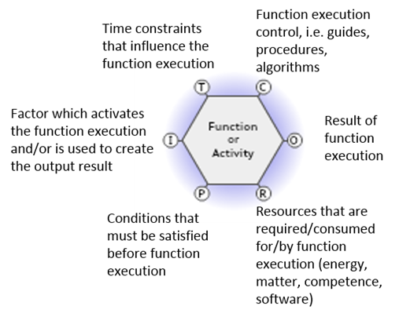
Functional resonance analysis method
In this method, the focus is on the behaviour of the system as an effect of the various functions and interactions between functions, rather than on the decomposition of the system into structural components. The FRAM model consists of functions and interactions between them. The graphical image of the functions with the aspects are shown in figure.

Slide 6
Problem and method
The research problem is to select the activities among those assigned to the position of train manager and the scenarios on which the training process should be focused.
The research method is as follows: the structure of train driver activities and the interactions between them are modeled using the functional resonance analysis method. The activities are represented by FRAM functions.
Based on the interviews conducted in the train manager community, the key activities during the work were determined and the relationships between them were investigated using the FRAM model. It was assumed that training should be focused on them.

Slide 7
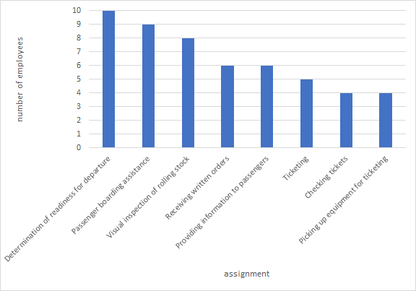
Interviews with train managers
Interviews were conducted with 10 train crew members. Questions were asked about a nominal workday and the most important activities. In terms of the most important activities, employees could list an unlimited number of activities.

Slide 8
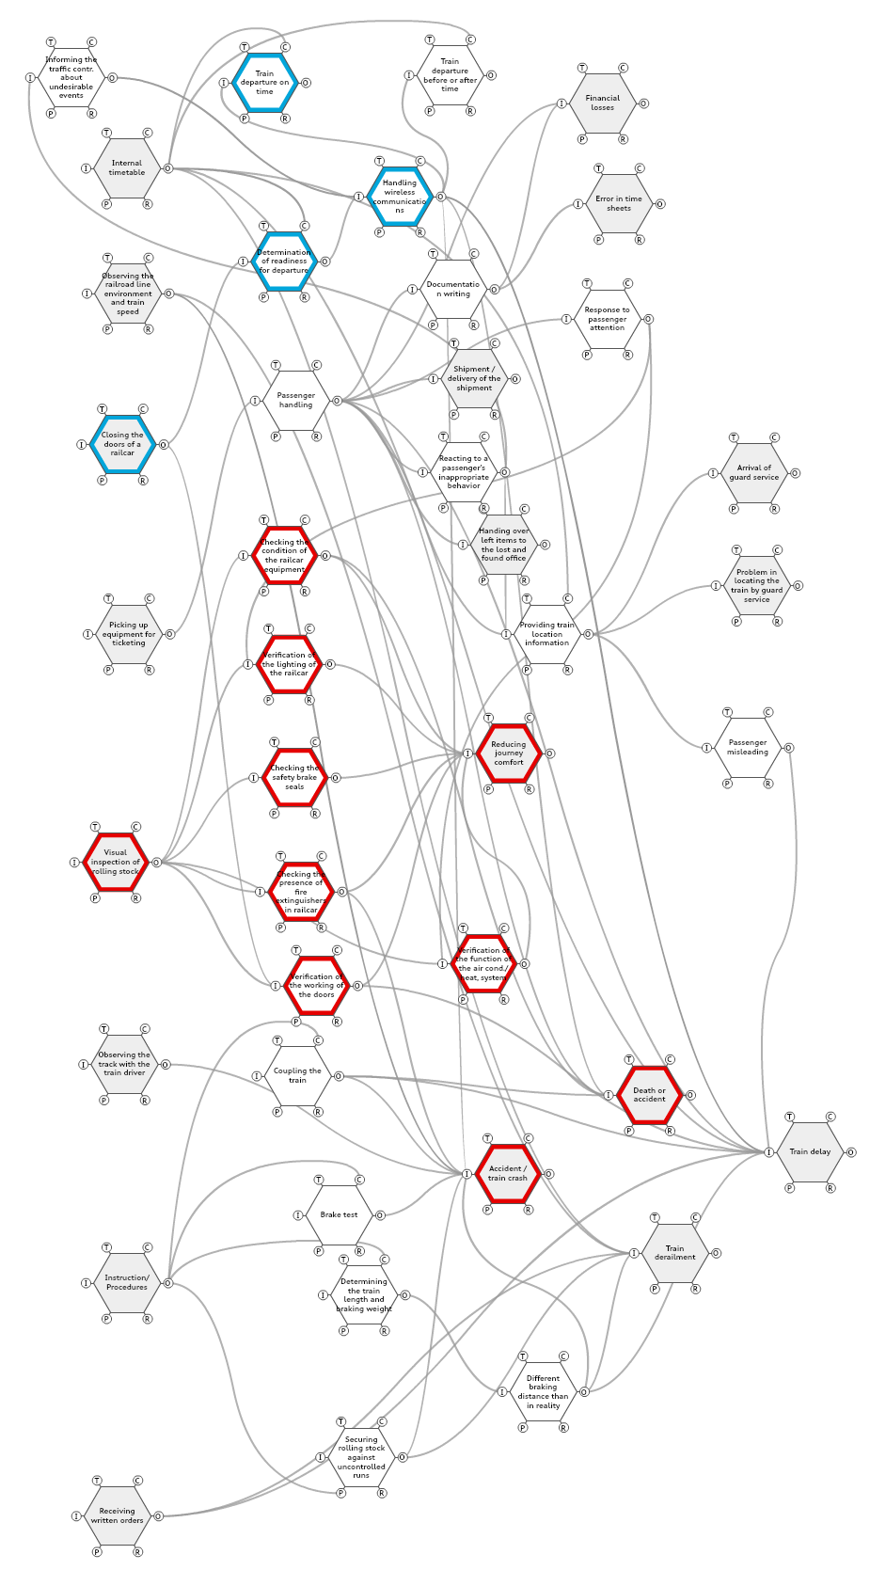
Train manager's activity FRAM model
The constructed FRAM model consists of 20 functions related to the activities performed by the train manager. In addition, 21 functions were identified that are in addition to other parameter functions.

Slide 9
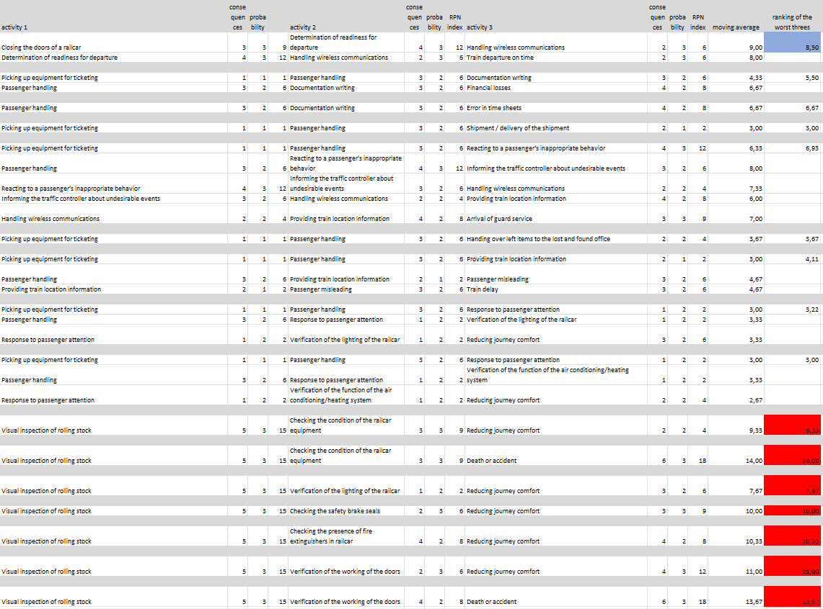
Selection of train manager activities in the training process
A detailed preliminary hazard analysis (PHA) was performed, where each function was assigned 1 to 5 undesirable situations and the one with the worst rate was selected. We then extracted strings of functions from the FRAM model from the beginning to the end, assigned indicator values to the functions, and then counted moving averages for always three consecutive functions. Then we ranked the worst threes that overlapped at most with one extreme function. From these, 8 was selected for the purpose of building training scenarios.

Slide 10
An immersive training system for railroad personnel using virtual reality technology

Slide 11
Conclusion
For train crew members, safety and professional service to travelers are important aspects.
Using the performed staff interviews, the PHA analysis and the FRAM model, an approach was presented to find the most important scenarios for training of staff in Virtual Reality.
For the FRAM model of train manager timing and precision description has been implemented by the risk number resulting from the PHA analysis. Thus, variabilities of activities in terms of timing and precision have been estimated in form of a risk measure.
Finally we are able to rank the most important scenarios in terms of risk, that we can in the next step implement to the elaborated VR environment to teach the staff.

Slide 12
Thank you for your attention!

