Slide 1
Development of Genetic Algorithms for Plant Reload Optimization for an Operating Pressurized Water Reactor
Eunseo So, Yunyeong Heo , Mohammad G. Abdo* , Andrea Alfonsi, and Yong-Joon Choi
Idaho National Laboratory

Slide 2
Background and Objective
The fuel is ~20% of the total generating cost
  Cost of a typical fuel reload for a LWR is about $50M
Need of innovative fuel reload analysis platform
  Traditional methods (developed decades ago) is labor-intensive and time-consuming
  Automatized simulation based generic fuel reload analysis platform
Development of innovative plant fuel reload optimization platform
  Applicable to load follow and flexible operations, ATF, high burn-up and longer cycle
  Aims 5-10% reduction in fuel reload costs ($2.5−5M)
Cost summary ($/MWh) in 2019
Type | Sites | Fuel | Capital | O&M | Total
All U.S. | 58 | $6.15 | $5.71 | $18.55 | $30.41
BWR | 22 | $6.07 | $5.83 | $19.62 | $31.52
PWR | 37 | $6.20 | $5.65 | $18.00 | $29.85
Source: NEI, Nuclear Cost in Context, Oct. 2020

Slide 3
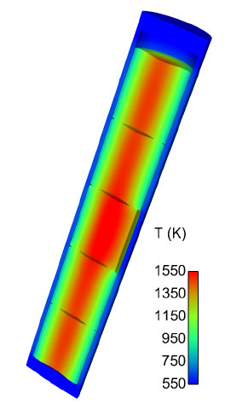
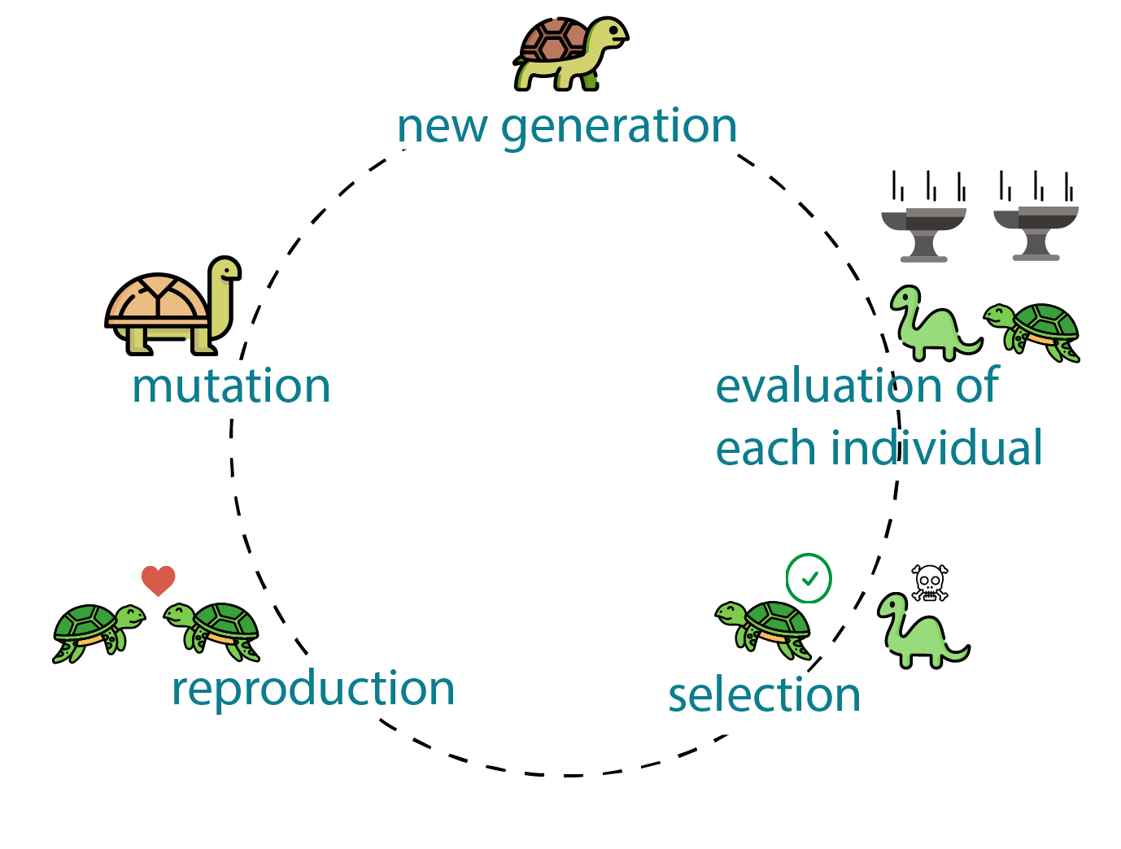
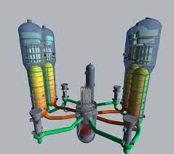
Optimization of Reactor Fuel Reload
RISA Pathway plant fuel reload optimization framework
  Provides optimized reactor core configuration with key safety parameters
  Flexible code independent framework
  Consider uncertainties in all driven physics
  Applicable to risk-informed approach
Genetic Algorithm (GA) produces high-quality optimization solutions
  Based on metaheuristic evolutionary algorithm
  Artificial Intelligence (AI) approach
  Suitable for high order combination problems
    >10e30 combinations for 17×17 quarter of core
Multi-physics simulation
  Core configuration
  Fuel performance
  System analysis
GA

Slide 4
Technology Roadmap
Phase 3 (FY22-23)
Application of risk-informed method
Phase 1 (FY19-20)
Methodology development
Phase 2 (FY21-22)
Framework Improvement
Phase 3 (FY22-23)
Demonstration of benefits
Phase 4 (FY24-25)
Improvement and expansion
Phase 1 (FY19-20)
Framework development
Setup tools and methods
Set plant based scenarios
Simulate DBA with deterministic method
Use fixed core loading pattern
Evaluate recoverable margin
Update tools and methods
Optimization method for fuel reloading pattern
Analyze uncertainties
Assess constraints and issues of tools
Apply risk-informed approach
Improve of optimization method (ML/AI)
Demonstrate generic optimization framework
Maximize capability of framework
Initiation BWR and ATF core optimization
Assess economic benefits
Demonstration with ATFs
Demonstration for BWRs
Demonstrate with equilibrium scenarios
Finalize framework for the use in license applications
Planning & development
Early demonstration
Industry engagement
Industry deployment
Reaching higher maturity for industry (utilities/vendors) engagement from 2021

Slide 5
Schematic of Optimization Platform
Optimization Platform
RAVEN
GA operation
Simulation control
Input and output
Uncertainty propagation
Risk-informed analysis
System Analysis
Core Design
Fuel Performance
RELAP5-3D
SIMULATE
PARCS
VERA
TRANSURANUS
BISON

Slide 6
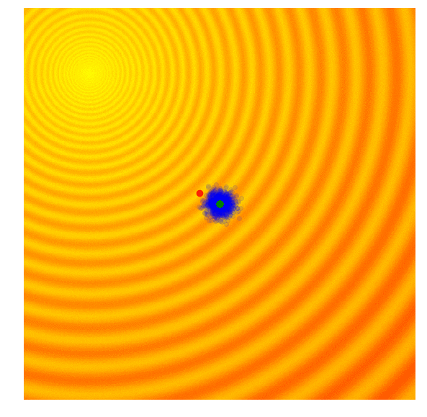
Genetic Algorithm Optimization
Converging
Reactor core optimization needs balance between economics and safety
  Searching for equilibrium fuel cycle core
  Multiple parameters to be considered
    neutronics, thermal-hydraulics, fuel/core performance, accident analysis, economics, etc
Classical approach by iterative methods
  Constraints due to complex correlations in design parameters, core performance dependency and nonlinearities
AI based optimization methodology was found effective for optimization problems
  Genetic Algorithm (GA) is one of most used methodology
  Select best results from set of potential solutions
    Based on Darwin’s theory of evolution of species
Source: A Visual Guide to Evolutionary Strategies. https://blog.otoro.net/2017/10/29/visual-evolution-strategies.
Notes:
Minimization problem: searching minimal value
Yellow circle: Each iteration (objective functions)
Green dots: Best 20 solutions from the populations
Red dot: Best solution

Slide 7
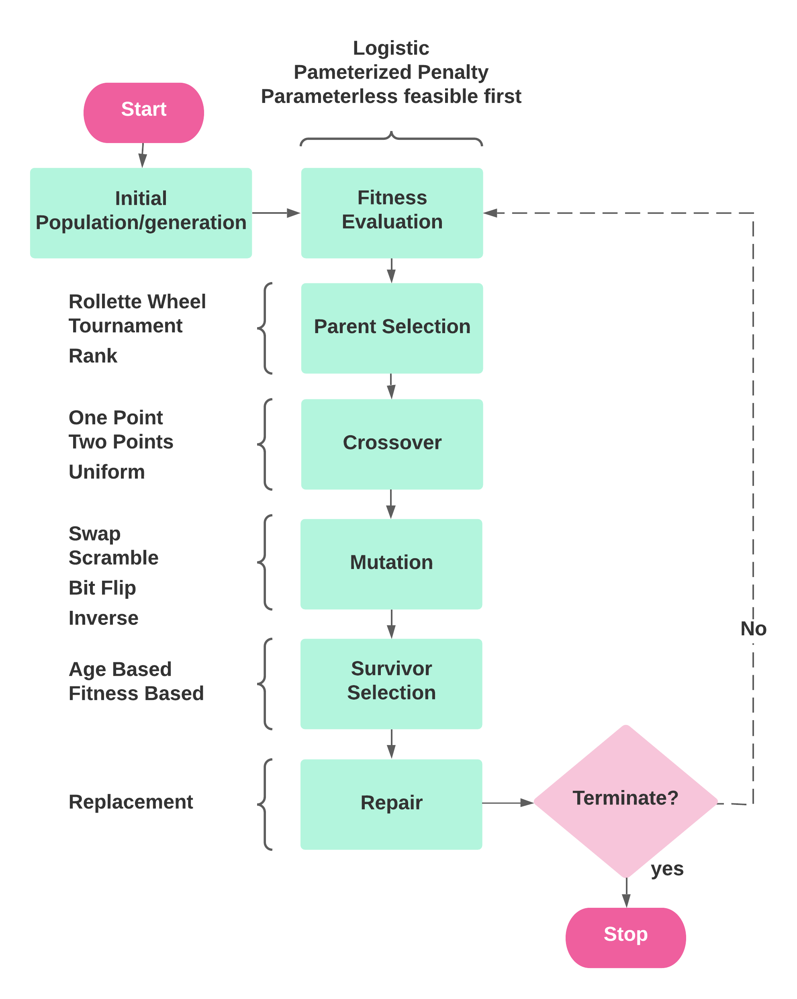
Benefits of Genetic Algorithm
GA mimics natural selection and evolution
  Not require any calculation of derivatives.
  Easier for non-linear and non-convex problems by random evolution
  Removes biased results → Good non-convex problems
  “Black-box” approach → No need of physical equations
GA iterates groups of solutions
  Set initial list of solutions (neutronics, thermal-hydraulics, etc)
  Evaluate and determine potential solutions
  Random select best solution by
    Clone, cross-over, and mutation operations.
Can handle both constrained and unconstrained problems.
Works with continuous and discrete variables
Notes:
Example
Define 10 parameters from 10 solutions (neutronics, TH, etc) -> 100 population
Select best fit 4
Mate each 2 (by combination) to produce children

Slide 8
Step 1:
Set Initial Population & Fitness
User to set list of initial population (set of solutions)
  Example shows 7 sets of solutions (so-called chromosome)
  Or population can be randomly generated
Each chromosome has 5 genes (variable)
  Allele is the value of variable
User to set fitness (user criteria)
  Or default fitness from library
 | G1 | G2 | G3 | G4 | G5
ch1
ch2 | 2 | 5 | 1 | 8 | 4
ch3
ch4
ch5
ch6
ch7
Chromosome (solution)
2 | 5 | 1 | 8 | 4
Population
2
Gene (variable)
2
Allele (value of variable)

Slide 9
Step 2: Selection of Parent
Parent Selectors:
Roulette Wheel
Tournament Selection
Rank Selection
Individual | Fitness
P1 | 5
P2 | 8.2
P3 | 1.4
P4 | 0.98
P5 | 2
P6 | 2.3

Slide 10
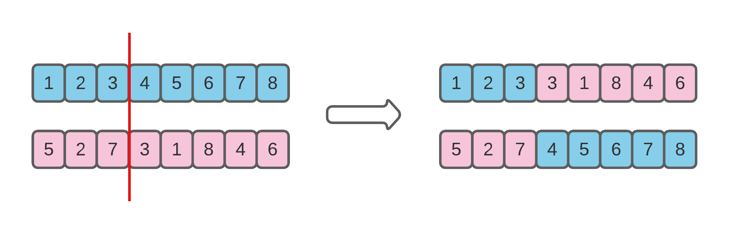
Step 3: Generate Crossover
User defined probabilistic choice and/or random base
Crossover (the Children):
    One Point
    Two points
    Uniform
Notes:
One point: Single location cut -> We selected this for simple use
Two point: Two
Uniform: Random

Slide 11
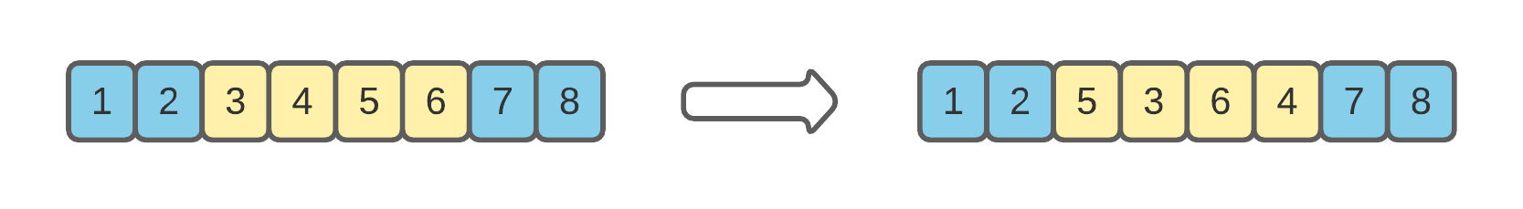
Step 4: Generate Mutation
User defined probabilistic choice and/or random base
Mutation (the Children):
    Swap
    Scramble
    Bit Flip
    Inversion

Slide 12
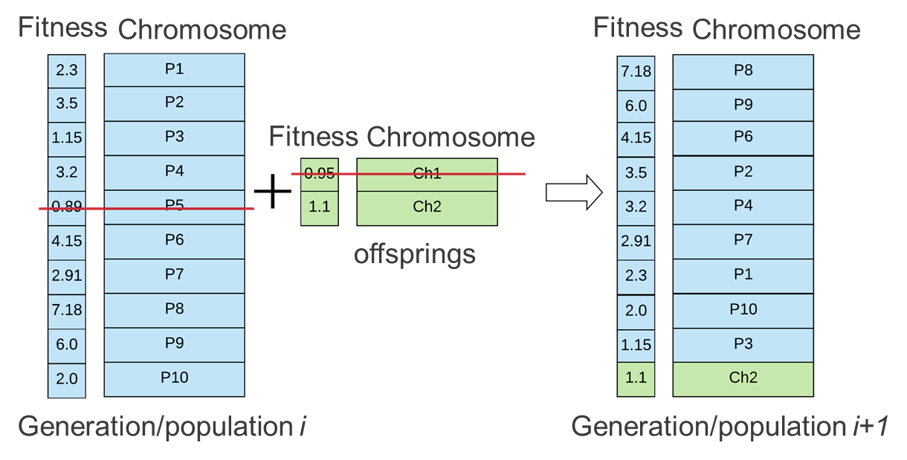
Step 5:
Select Survivor (Best Solution)
  Survivor Selection:
  Fitness Based
  Age Based

Slide 13
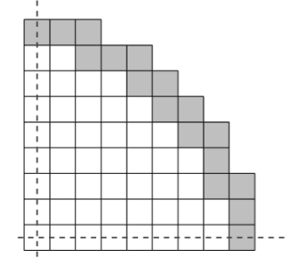
Initial Loading Simplified Problem
Settings:
  1/4th of the core (PWR)
  56 variables (56 assembly locations to arrange)
  5 Materials (5 assembly types to “choose” from):
    Material - 1: Enrichment 2.2% in U235, No bp
    Material – 2: Enrichment 2.5% in U235, No bp
    Material – 3: Enrichment 2.5% in U235, bp (8.e-06 #/(cm*barn))
    Material – 4: Enrichment 3.5% in U235, No bp
    Material – 5: Enrichment 3.5% in U235, bp (8.e-06 #/(cm*barn))
  Objective:
    Maximization of cycle length
    The cycle length is determined based on a criticality search calculation if SB ≤ 5 ppm, cycle ends
Schematic of quarter core
(Materials 1-5 are added randomly as an initial population)
SB: Soluble Boron

Slide 14
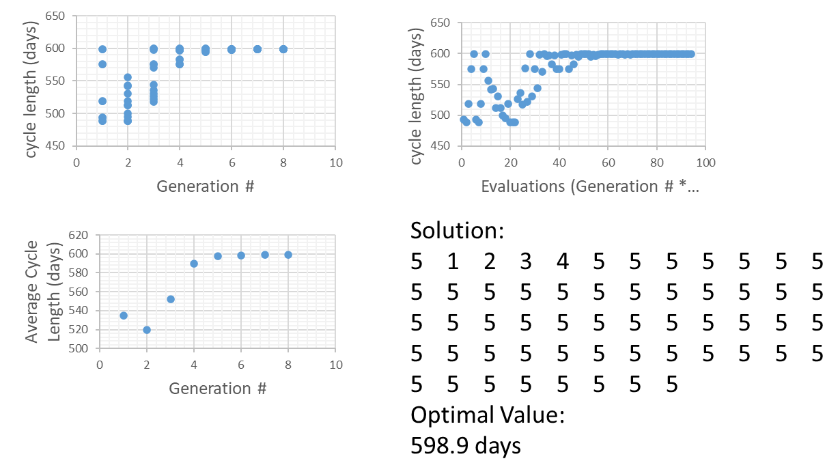
PWR ¼ Core Demonstration

Slide 15
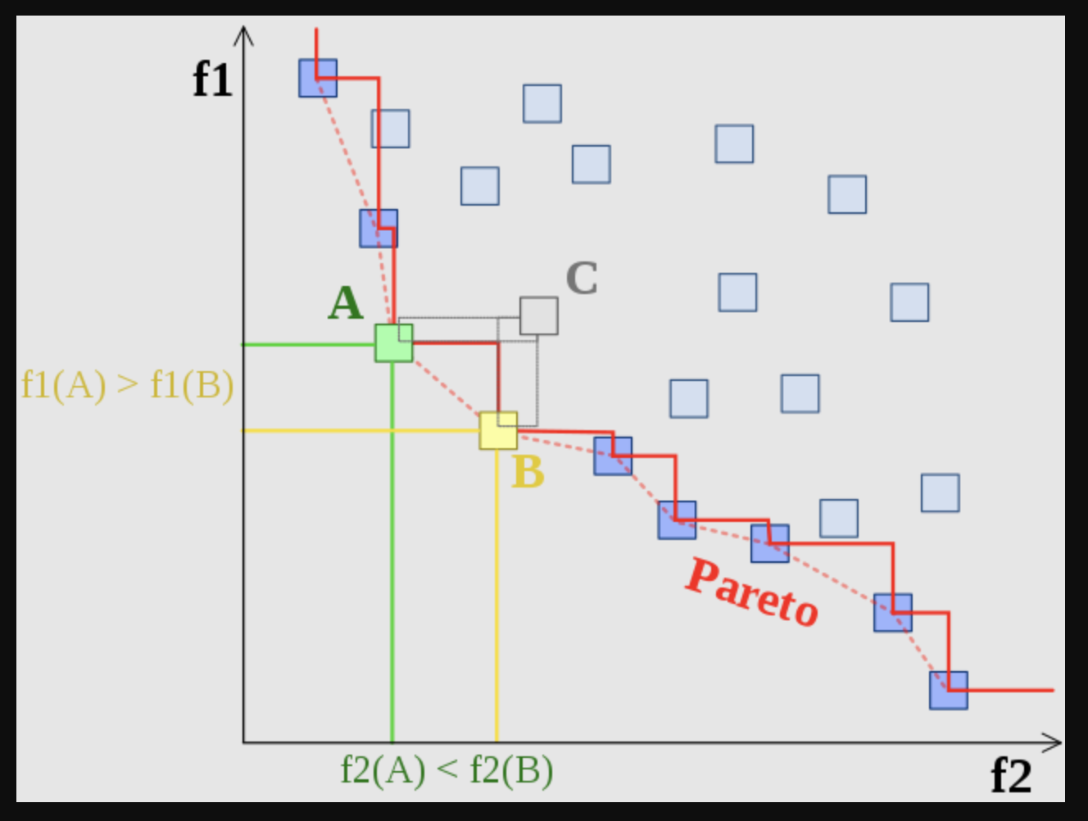
Future Works
Coupling CASMO/SIMULATE, and TRANSURANUS with RAVEN
Multi-objective optimization:
  Non-dominated sorted Genetic Algorithms (NSGA-II).
  Pareto Frontier Utility (already implemented)
Unit tests and regression tests.
Validation using optimization benchmark problems.
Building Reduced Order Models (if needed)
Applying to fuel reload problem and validate against chapter 15 scenarios.
Re-analyze using ATF, and 24-month cycles
Documentation, manuals, reports, and milestones.
f1 and f2 are two objective functions to be minimized, Points A, and B are non-dominated points, but C is, that’s why the Pareto frontier only passes through points that are not dominated by others.
https://commons.wikimedia.org/wiki/File:Front_pareto.svg

Slide 16
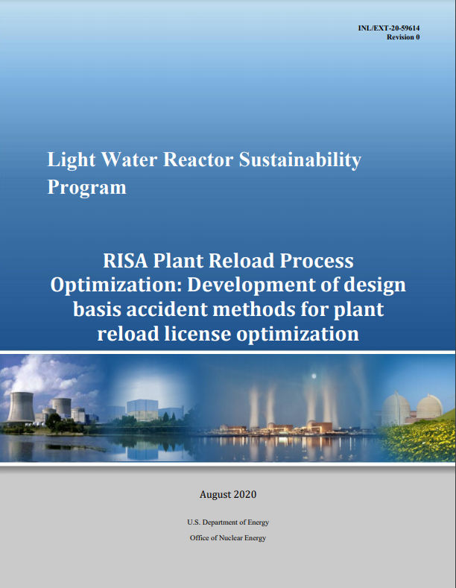
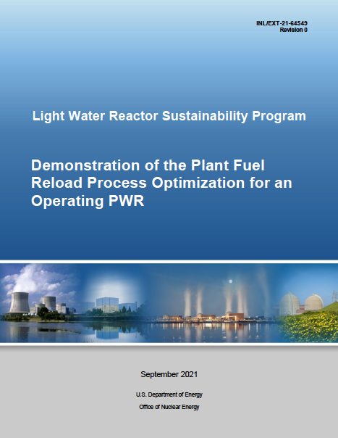
Concluding Remarks
Genetic Algorithm and optimization platform
  Development and demonstration of multi-objective optimization process
  Development of simulation acceleration method based on AI
  Development of improved RAVEN infrastructure for performance of neutronics and thermo-hydraulic analyses.
PWR design basis accident (DBA) scenario analysis
  Assessment of ten limited scenarios within optimization framework
  Improvement of framework for future risk-informed application
  Demonstration of uncertainties in DBA

Slide 17
Current and Future Works
Current Works (Publications in September 2022)
  Assessment and benchmark on available simulation tools (completed)
    Reactor core design (SIMULATE, VERA, PARCS)
    Fuel performance (BISON, TRANSURANOS)
  Development and demonstration of a risk-informed approach for the regulatory-required fuel reload safety analyses (on-going)
    Improvement of GA, Risk-informed multi-physics uncertainty analysis of DBA
Future Plans
  Enhancement of RELAP5-3D for full range uncertainty analysis
  Development of GA with multi-objective optimization
  Economic benefit assessment for the new fuel management plan
  Extension to other core configurations (i.e., PWR with ATFs and 24-month refueling cycle, generic BWR)
  Demonstration of industry use case for equilibrium scenarios
  Demonstration of ready-for-deployment framework to the industry
  Deliver a Topical Report (TR) including all regulatory-required steps for a typical License Amendment Request

