Slide 1

Deeper Investigation of Repairability of failures
(DIOR)
Presenter: Mattias Håkansson
Risk Pilot: Mattias Håkansson, Erik Sparre, Carl Eriksson, Jacob Larsson
AFRY: Gunnar Johanson
Project financed by the Nordic PSA Group (NPSAG)

Slide 2
Risk Pilot
Risk Pilot is a consulting company that helps companies to develop and design safe and profitable businesses, systems and products.
We are consultants in Risk Management, Systems Engineering and Human Factors.
We provide services and knowledge in Licensing, Analysis, Construction and Human Factors for the energy sector (nuclear power).
Swedish based with offices in the three largest cities; Stockholm, Gothenburg and Malmoe.

Slide 3
Background
Component repair and restoration in PSA is generally not modelled.
  Available repair time is limited.
  Repair not governed by procedures and difficult to justify.
Modeling of long-term scenarios need repair for realistic modeling:
  Actual demand data should be used, but is limited.
  Available data is mainly failures during surveillance tests.
Purpose of DIOR:
  Investigate available repair data
Notes:
i.e., core damage would occur before the repair is completed.
Repair is an action that is not always governed by procedures and thus difficult to justify where alternate equipment is used as a first priority upon failure.
surveillance test: the need for repair is not as pressing and thus not reflective of accident conditions.

Slide 4
Objective and data
Objective
Analyze repair and restore for single and common cause failures
Analyze repair and restore times for single failures
Difference between single failure and CCF based on repair and restore
Conclusions on recoverability and its applicability on plant PSA models
Data
TUD – primary source in Sweden and Finland for single failures
ICDE – data collection for understanding CCF
Diesel generators, Centrifugal pumps and Batteries.
Notes:
Times: to be credited for accident conditions
if there are differences between single failures and CCFs when considering recovery via restore or repair of the components
ICDE (International Common Cause Failure Data Exchange)

Slide 5
Method
Classify reported failures regarding restorability and repairability
  1 – Minor failures with as simple corrective action - restore
  2 – The corrective action require more knowledge than ”1” - repair
  3 – Replacement or repair of the whole unit or essential components – repair
Waiting time 4 hours for restore and 8 hours for repair.
Division by failure modes
Identification of detection method
  Demand, Monitored or Other
Single failures:
Active repair time and downtime
Perform statistical analysis and data fitting
Modelling of repair failure probability
  Lognormal or exponential distr.
CCF:
  Failure timing – shock or non-shock.
  No statistical analysis.
Notes:
Are there recoverability differences between single failures and CCFs?
What type of event are the CCFs categorized as, shock or non-shock, and how common are the two types respectively? → Failure timing

Slide 6
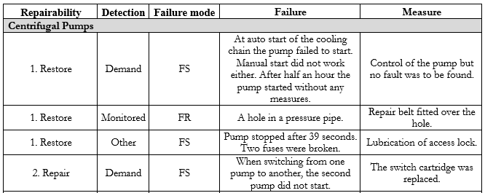
Example of single failure reports (pumps)

Slide 7
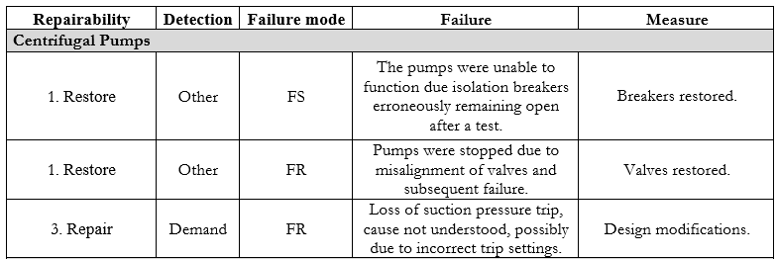
Example of complete CCF reports (pumps)

Slide 8
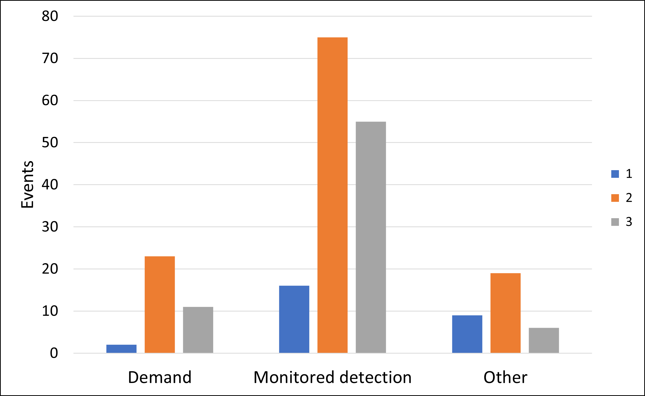
Results – Single failures (1/2)
Failure mode | Repairability | Events | Mean
Failure to run | 1 - Restore | 7 | 6%
 | 2 - Repair | 50 | 43%
 | 3 - Repair | 59 | 51%
 | All categories | 116
Failure to start | 1 - Restore | 20 | 20%
 | 2 - Repair | 67 | 67%
 | 3 - Repair | 13 | 13%
 | All categories | 100
Notes:
Table: Distribution of classes for restore/repair.
Figure upper left: Restorable events.
Figure upper right: Repair event per failure mode. Most events in bins 1-5 and 6-10 hours.
Figure at bottom: Mode of detection per class. Few demand events. Highlights the problem of using demand data only.

Slide 9
Results – Single failures (2/2)
Failure to run
Restore have few data points (only 7 failures).
The lognormal distribution performs better compared to the exponential distribution.
Notes:
Failure probaiblity distributions.
Figure top: Case restore (waiting time 4h).
Figure bottom: Case repair class 2 or 3. Waiting time 8h.

Slide 10
Results – CCF
Repair class 1:
  In 21/47 events, the pumps could be restored to working condition.
  Verification of operability important.
Repair class 2:
  5/47 events.
  The longest downtime was 6 hours.
Repair class 3:
  9/11 of the demand events, with failure mode failure to run, involved severe component failure.
  The rest of class 3 events were, e.g., electrical and design faults.
Only one event was a non-shock
  Timing of failures is not relevant to consider.
Failure mode | Repairability | Events | Mean
All | 1 - Restore | 21 | 45%
 | 2 - Repair | 5 | 11%
 | 3 - Repair | 21 | 45%
 | All categories | 47
Notes:
Timing: Individual failures in a CCF group.
Table: High share of restore!!
Figure: Many Demand events with critical failures.

Slide 11
Summary and conclusions
Distribution fitting:
Exponential and lognormal distribution
  Exponential simple – one parameter (the mean). Estimation using Bayesian inference.
  Lognormal – often used in modelling of duration of human activities. Estimation using Maximum likelihood.
Conclusions:
  Both distributions work.
  Lognormal is better with large data samples.
  Exponential preferred in future modelling due to its simplicity.
  Are the results skewed by the inclusion of periodic testing in the analysis?
Restore/Repair probability:
  The active repair time is complemented by an estimated waiting time:
    4 hours for restore and 8 hours for repair.
  The waiting time must be studied in more detail in future work.
    Availability of staff, accessibility, spare parts etc.
Division by failure modes:
Restore more common for failure to start, resulting in shorter MTTR and lower severity.
Timing of failures:
Hypothesis
  Early failures less severe and easier to repair.
  Late failures would give us longer available times.
But, most failure events lack time-point of failure.
CCF:
Timing between component failures.
  Shock events – time for restore and repair would not be extended.
  Non shock events – longer available time.
Failure to run: High proportion are shock-failures.
Conclusion:
  Timing of failure not relevant for CCF for failure to run because of high portion of shock events.
Notes:
Bayesian inference is a method of statistical inference in which Bayes' theorem is used to update the probability for a hypothesis as more evidence or information becomes available.
Maximum likelihood estimation (MLE) is a method of estimating the parameters of an assumed probability distribution, given some observed data. This is achieved by maximizing a likelihood function so that, under the assumed statistical model, the observed data is most probable.
Om tid finns över:
Restorability and Repairability
For centrifugal pumps, the share of restorable CCF events is much higher compared to the single failure analysis. A high share of the pre-initiator human failure events (HFEs) is possible to restore, i.e., root cause “Human action” or “Procedure”.
These events have a significant impact on the CCF reliability parameters, but they can be restored by simple operator actions to working conditions if the available time is sufficient.
For repair, the single failures of centrifugal pumps tend to be more likely to be “easily repaired” (severity class 2) compared to the CCF events.

Slide 12


Thank you for your attention!
Questions?
Mattias Håkansson
Mattias.hakansson@riskpilot.se
+46 72 252 22 15

