Slide 1
Application of Orthogonal-Defect Classification for Software Reliability Analysis
Edward Chen North Carolina State University
Han Bao Idaho National Laboratory
Tate Shorthill University of Pittsburgh
Carl Elks Virginia Commonwealth University
Athira Varma Jayakumar Virginia Commonwealth University
Nam Dinh North Carolina State University
6/30/2022

Slide 2
Risk Assessment Framework for Digital I&C Systems Developed in LWRS Program
Goals of LWRS-RISA Efforts on Digital I&C (DI&C) Risk Assessment:
Develop an advanced risk assessment framework to support industry’s transition from analog to digital technologies for safety-related I&C systems
Develop an integrated platform that includes all aspects of a typical risk assessment: hazard analysis, reliability analysis, and consequence analysis
Provide a systematic, verifiable and reproducible approach based on technically-sound methodologies
Failure Modes
System Failure Probabilities
Probabilistic Estimation of Failure Consequences
Designs of Digital I&C Systems and Plants
LWRS-developed DI&C Risk Assessment Framework
Hazard Analysis
Reliability Analysis
Consequence Analysis
RESHA
(Redundancy-Guided System-Theoretic Hazard Analysis)
PRA + UQ
(Probabilistic Risk Assessment + Uncertainty Quantification)
Multiscale Quantitative Reliability Analysis
BAHAMAS
(Bayesian and HRA-Aided Method for the Reliability Analysis of Software)
Suggestions to optimize designs and upgrades by quantitatively reducing risks and costs
ORCAS
(Orthogonal Defect Classification for Assessing Software Reliability)
CCF Modeling and Estimation
2
Notes:
In IRADIC, a redundancy-guided systems-theoretic method for hazard analysis was developed for supporting I&C designers and engineers to address both hardware and software CCFs and qualitatively analyze their effects on system availability. It also provides a technical basis for implementing, following reliability and consequence analyses of unexpected software failures. It integrates STPA, FTA and HAZCADS and effectively identifies software CCFs by reframing STPA in a redundancy-guided way.
The second part of IRADIC is reliability analysis with the tasks of quantifying the probabilities of failures from the hazard analysis and failure of entire DI&C systems. In IRADIC, two methods have been developed for different application conditions: one of them is called BAHAMAS for limited-data conditions and another is called ORCAS for data-rich analysis.
As the third and final part, consequence analysis is to be implemented to evaluate the impact of consequences from digital failures on plant responses.

Slide 3
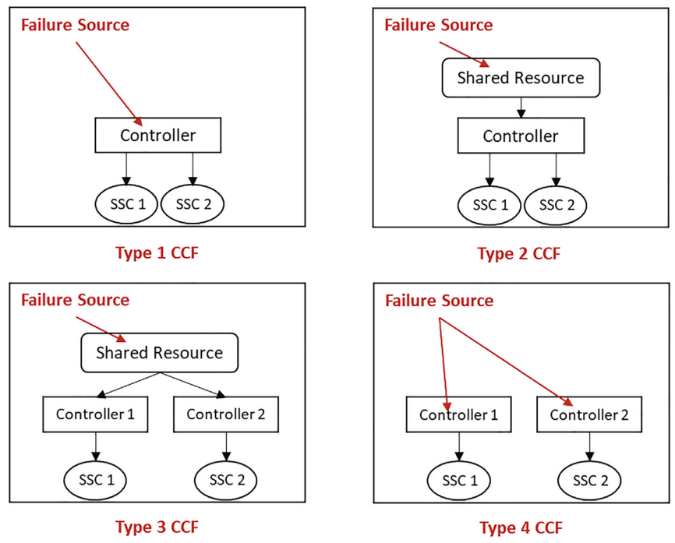
Introduction and Problem Description
Issue description:
Software failure on DI&C (e.g., PLC, OS, FPGA, etc.)
Emergent from mixing heterogenous equip.
Component failure prob. $≈$ 0
System failure prob. != 0
Common cause failures (CCF)
Existing methods:
Systems theoretic process analysis (STPA from MIT, 2012) [3]
Introduced Unsafe Control Actions as software failure events
Hazard & Consequences Analysis for Digital Systems (HAZCADS from EPRI, 2021)[4][5]
Combined Unsafe Control Actions w/ Fault Trees.
Digital Reliability Assessment Methodology (DRAM from EPRI, 2021) [6]
Qualitatively ranked risk from DI&C components using Safety Integrity Levels (SIL).
Orthogonal Defect Classification for Reliability Assessment in Software (ORCAS from INL, 2021)
Quantifies risk from DI&C components based on SDLC information.
Software failures are problematic for licensing and introduce hidden risks for safety critical applications.

Slide 4
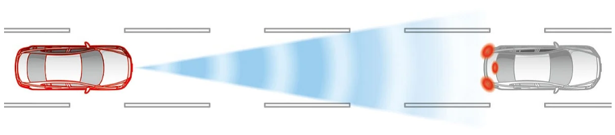
Software Failures in DI&C Systems
STPA – Software ‘failure’ is due to inadequate constraints leading to ‘misbehaviors’ and loss [3]
Rules for operation during development were not strict enough (i.e., loophole)
Misbehaviors = Unsafe Control Actions (UCA)
 | Type A | Type B | Type C | Type D
Unsafe Control Action (UCA) Loss Context | Control action not provided when required context. | Control action provided when not required causing hazard. | Control action is early, late, or out-of-order. | Control action is stopped too soon or applied too long.
Auto emergency braking (AEB)
Brake when collision imminent and not user initiated
 | Type A | Type B | Type C | Type D
Unintentional collision during autopilot on highway | AEB does not detect car in front and crashes during traffic jam. | AEB brakes when squirrel detected and car behind rear ends. | AEB brake initiation is late causing minor collision with car in front. | AEB brake is too weak or not enough causing minor collision with car in front.
UCAs are undesirable, cause losses, and stem from various sources including inadequate constraints. How can we quantify the probability a UCA will occur?

Slide 5
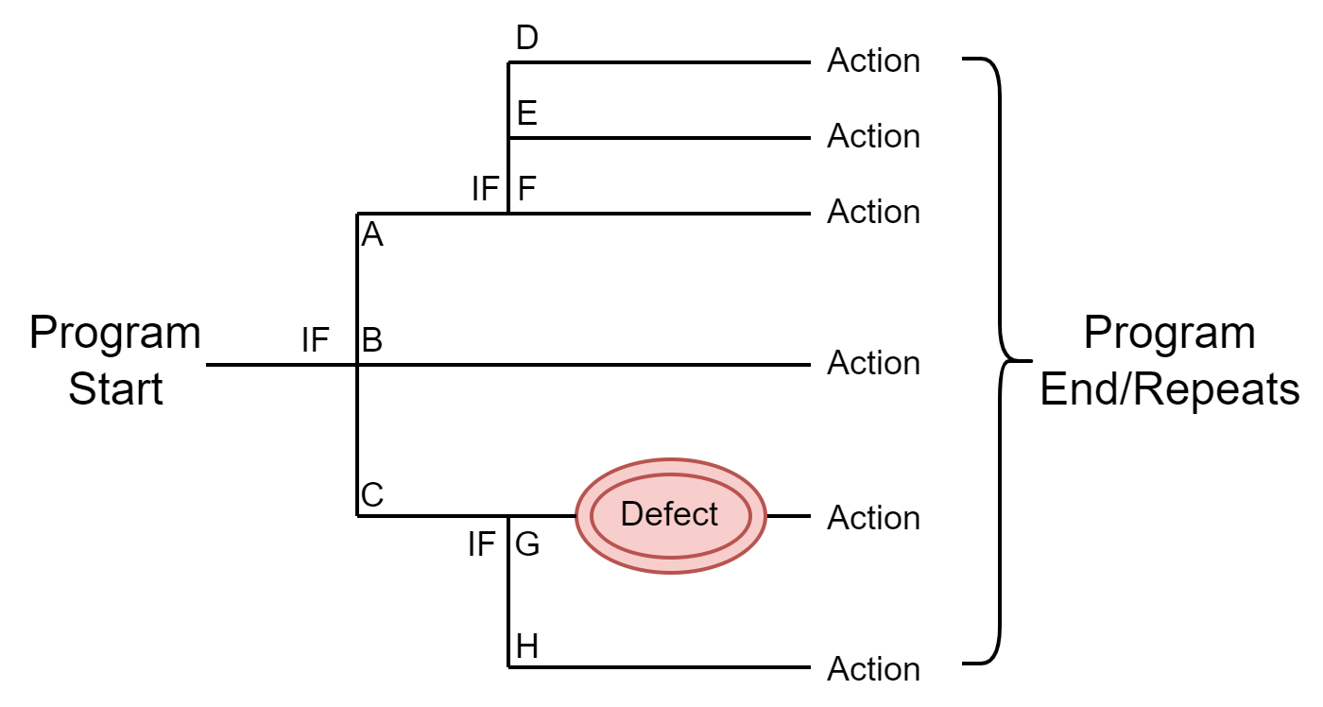
Theory behind Software Failure
Does software fail probabilistically or deterministically?
Deterministic = will always happen given the same input conditions
Probabilistic = estimate of occurrence based on numerous conditional factors
Truth = if failure conditions were known then errors can be 100% repeated
Assumption: Omniscient knowledge of conditions for failure paths
If known, then defect is removed!
Factors that influence a program:
Human, input type, environment, version, compatibility, sequence, load, etc.
Failure of software is based on the highly complex interacting factors that cannot be known perfectly in advance. Failure prob. can only be estimated based on conditional correlated factors

Slide 6
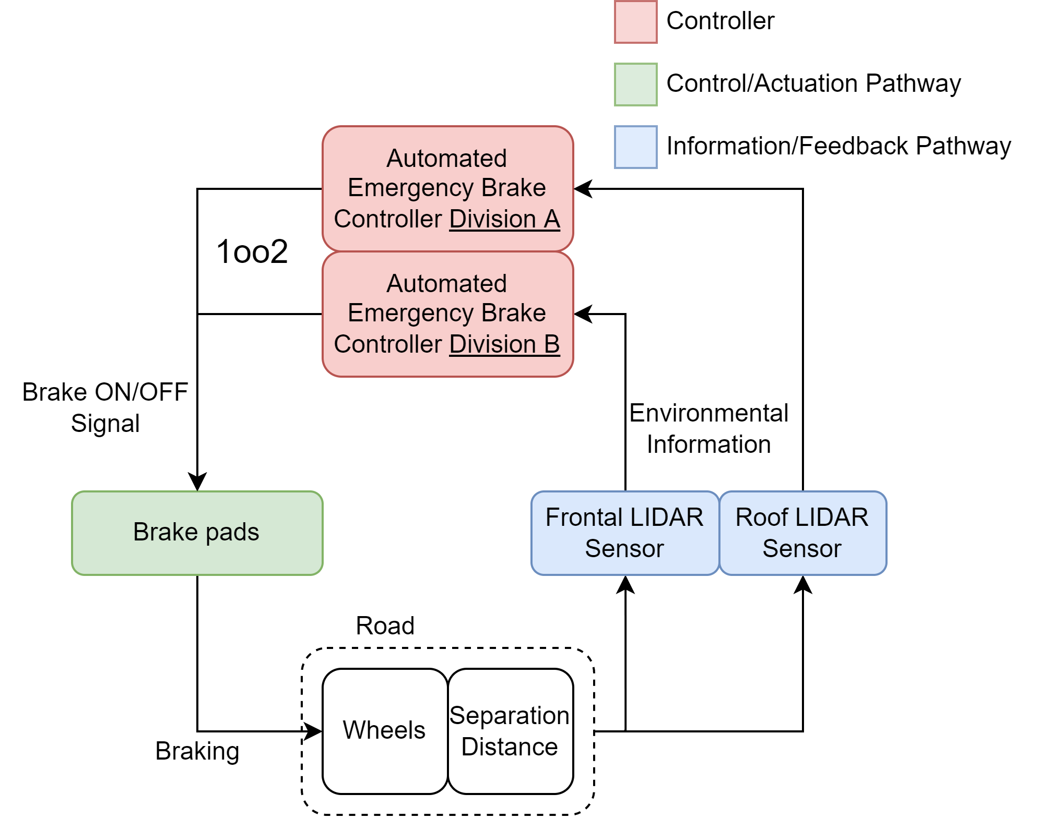
Deterministic vs Probabilistic Example
Suppose a software defect in the AEB exists that:
Fails when it rains
What is the failure probability of the software?
Deterministic -> Always (100%)
Mitigation actions are required to demonstrate sufficient consideration
Cost -> Significant as complexity grows w/o sufficient justification
Invalidating scenarios
What if you lived in a desert (e.g., Egypt?)
Probabilistic -> It depends on conditional knowledge
@ what point is it feasibly improbable?
P(UCA-A), P(UCA-B), P(UCA-C), P(UCA-D)??
Probabilistic assessment of software failure is intended to reduce cost just like how PRA was used to reduce structural protection & redundancy costs (e.g., ROOAM)

Slide 7
Methods that Don’t Work and Why
Observation: COTS do not fail when tested in an isolated environment but fail when integrated with other components (emergence).
Software defects detected in-development are removed.
Req. specified by user will be tested and achieved. However, req. may still be inadequate (imperfect knowledge)
1. Testing verification methods conducted post-development
Methods that rely on defect data (i.e., SRGM) by extension will also not work (no failure data available for modeling) [30]
Individual components post-development do not fail
2. Good programming practices (GPP) used to predict software reliability
Methods that rely exclusively on GPP metrics for prediction aren’t accurate (RePS) [27]
Software function/structure relationships are NOT transferrable to other software
Bugs per line of code, Cyclomatic complexity, traceability
Transparency in the SDLC is the only way to adequately assess software reliability. Post assessment lacks sufficient information without considerable conservatism & assumptions.

Slide 8
Orthogonal Defect Classification [28]
Orthogonal defect classification [28]:
Software defects with shared characteristics are grouped together (classification)
Function, checking, algorithm, etc.
Defects with shared characteristics cause the same software failure modes (UCA)
Defect Class (Abridged) | Classification Description
Function | Significantly affects capability, interfaces, functionality, etc. s.t a formal design change is required. The program is missing a key overlooked functionality.
Algorithm | Efficiency or correctness problems that affect the task performance. Equation is not completely correct.
Checking | Missing or incorrect validation of parameters in conditional statements. Conditions in IF statement is lacking.
Grouping allows generalized assessment on how each class impacts the code useability
ODC allows semantic classification of common software defects into specific categories. Think labelling errors in an essay (i.e., grammatical vs syntaxial)

Slide 9
Data Collection & Correlation
Defects with shared characteristics cause the same UCA
What info can be used to correlate development & software reliability?
Defect Data Correlation:
402 defects were collected from 3 database management software, 1 autonomous car software, and 1 microcontroller operating system
MongoDB [29], Cassandra[29], Hbase[29], OpenPilot, Zephyr (open source github repositories)
Algorithm Defect Class
Assignment Defect Class

Slide 10
Data Collection & Correlation
1. The relationship between defect class detected and UCA caused holds true for 5 different pieces of software.
Consistent with ODC theory [13] regarding software defect classes
2. A global relationship table is constructed for all defect classes & UCA types
If a Timing defect exists, it has a 52.4% chance to cause a UCA-C;
P(UCA-C|Timing) **conditional probability**
Defect Class | UCA-A | UCA-B | UCA-C | UCA-D
Algorithm Defect | 0.320 | 0.140 | 0.350 | 0.190
Assignment Defect | 0.288 | 0.667 | 0.045 | 0.000
Checking Defect | 0.360 | 0.244 | 0.256 | 0.140
Function Defect | 0.389 | 0.222 | 0.241 | 0.148
Interface Defect | 0.347 | 0.533 | 0.080 | 0.040
Timing Defect | 0.190 | 0.048 | 0.524 | 0.238
Conditional probability table
b) BUT, what is the probability of a Timing defect?? P(Timing) **class probability**
A relationship between UCA type and defect class exists. If we know the prob. that a specific defect class exists in the software, we can determine the prob. it will cause a UCA

Slide 11
Class Probability
Github tracks when issues were detected and resolved
Mean time to failure (MTTF) and Mean time to repair (MTTR)
Software reliability growth curves can be used to model trend of defect class detection rate over software development lifecycle
Predicts remaining # of hidden defects & probability of defect existing.
Probability of Timing Defect @ Next Hour of Execution on MongoDB, P(Timing)
S-curve Predicted Timing defects on MongoDB

Slide 12
Case Study: VCU Smart Sensor

Slide 13
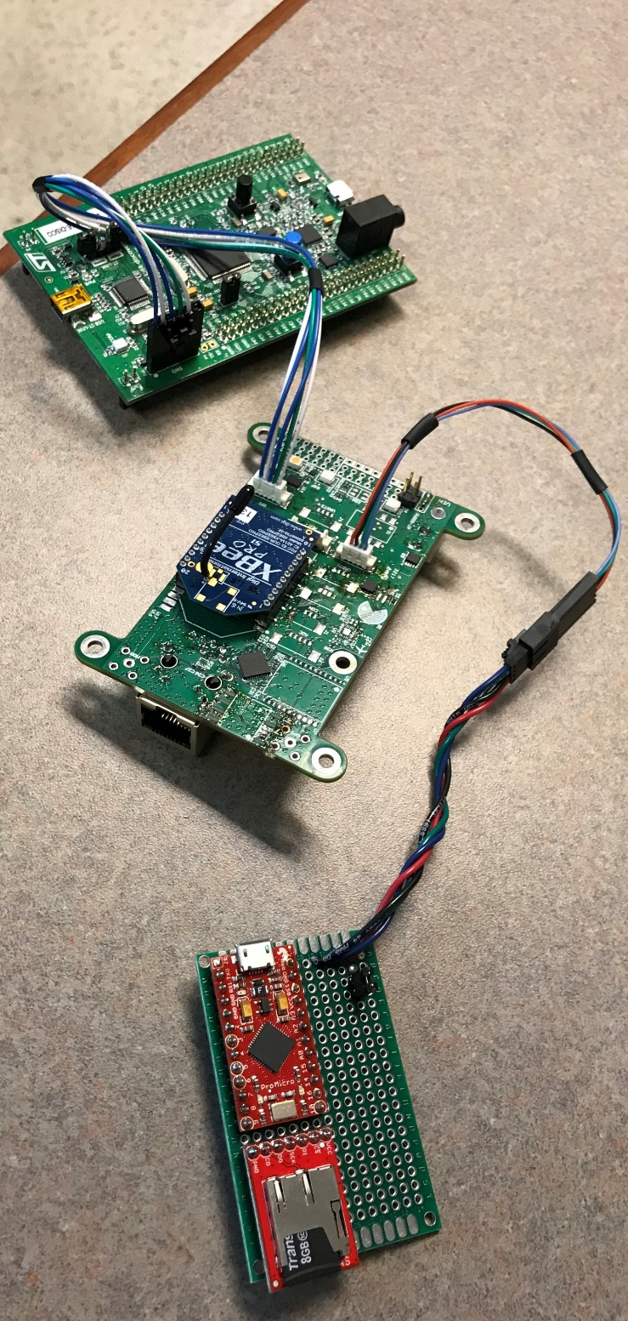
Case Study VCU Smart Sensor
Function:
Provide accurate pressure & temp. measurements for altitude calculation for flight controller
Characteristics:
Light-weight operating system (Chibi-OS) [11]
Software controlled w/ communication capability
STM32f4 Debugging Board
VCU Smart Sensor Board
Block diagram of smart sensor [12]
Preliminary Information:
Original VCU drone sensor had an estimated operational failure rate of 1 in 10,000 hours or $F\left(t\right)=1×{10}^{−4}$ / hour
Emulated Barometric Pressure Sensor (MS5611)
Experimental setup of VCU smart sensor [12]

Slide 14
STPA Software Failure Modeling of VCU Device
Standard STPA representation cannot be used here:
No control actions, only information flow
Unsafe information flow -> software failure modes of information control free DI&C systems (EC303)
Altitude | UIF – A | UIF – B | UIF – C | UIF – D
Incorrect information to dependent devices | Altitude reading is not provided when near ground | N/A (spurious) | Altitude reading is not in sync with reality (too late) | Altitude reading is too high or low than true value (too much/too little)
Objective:
How are latent hidden defects related to each failure mode?
How can we quantify these software failure modes?

Slide 15
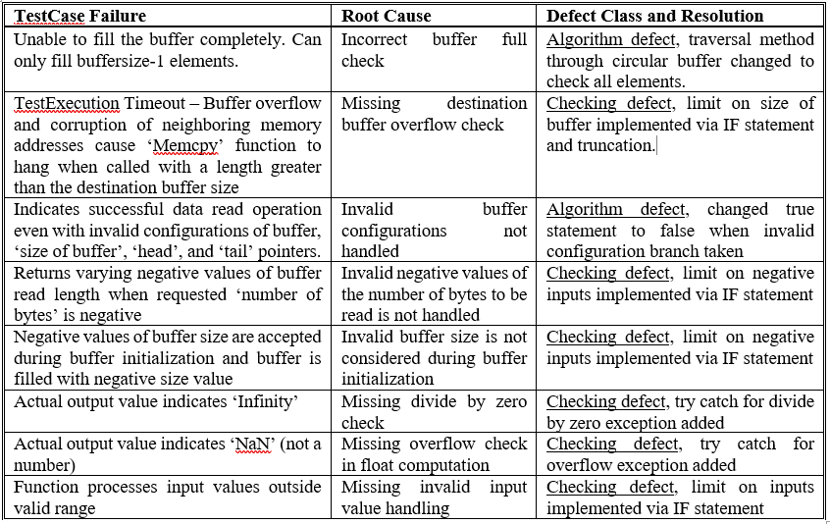
Software Failure Mode Quantification
2 algorithm and 6 checking defects were discovered over 10,146 tests
$$P\left(Checking\right)=5.614e{10}^{−4}$$
$$P\left(Algorithm\right)=1.871e{10}^{−4}$$
$P\left(UIF\text{−}A\right)=0.32×1.871e{10}^{−4}=5.989e{10}^{−5}$
$P\left(UIF\text{−}B\right)=0.14×N/A=0$
$P\left(UIF\text{−}C\right)=0.35×1.871e{10}^{−4}=6.550e{10}^{−5}$
$P\left(UIF\text{−}D\right)=0.19×1.871e{10}^{−4}=3.556e{10}^{−5}$
$$P\left(UIF\text{−}A\right)=2.62e{10}^{−4} /hr$$
Defect Class | UIF-A | UIF-B | UIF-C | UIF-D
Algorithm Defect | 0.320 | 0.140 | 0.350 | 0.190
Assignment Defect | 0.288 | 0.667 | 0.045 | 0.000
Checking Defect | 0.360 | 0.244 | 0.256 | 0.140
Function Defect | 0.389 | 0.222 | 0.241 | 0.148
Interface Defect | 0.347 | 0.533 | 0.080 | 0.040
Timing Defect | 0.190 | 0.048 | 0.524 | 0.238
$$P\left(UIF\right)=5.854e{10}^{−4} /hr$$

Slide 16
Using Failure Probability in Fault Trees
Integrated FT constructed based on smart sensor design
3 software failure modes exist that cause losses
Comparable to VCU’s operational failure rate of
$F\left(t\right)=1×{10}^{−4}$ /hour
Cell for Checking defect
Table 2. Probability of software failure modes based on test data base provided by VCU

Slide 17
Discussion & Conclusion
Demonstrated a relationship between UCA and defect class exists
Developed a conditional probability table for all defect classes & UCA types
Presented a framework for quantifying UCA failure modes using the defect cond. table
Conducted case study on a smart sensor system & demonstrated comparable results
Defect Class | UCA-A | UCA-B | UCA-C | UCA-D
Algorithm Defect | 0.320 | 0.140 | 0.350 | 0.190
Assignment Defect | 0.288 | 0.667 | 0.045 | 0.000
Checking Defect | 0.360 | 0.244 | 0.256 | 0.140
Function Defect | 0.389 | 0.222 | 0.241 | 0.148
Interface Defect | 0.347 | 0.533 | 0.080 | 0.040
Timing Defect | 0.190 | 0.048 | 0.524 | 0.238
Q&A
Notes:
Future work?

Slide 18
Acknowledgements
The research activities and achievements presented in this work were funded under the Risk Informed Systems Analysis (RISA) Pathway of the United States Department of Energy Light Water Reactor Sustainability Program.
This information was prepared as an account of work sponsored by an agency of the U.S. Government under DOE Contract No. DE-AC07-05ID14517. Neither the U.S. Government nor any agency thereof, nor any of their employees, makes any warranty, express or implied, or assumes any legal liability or responsibility for the accuracy, completeness, or usefulness of any information, apparatus, product, or process disclosed, or represents that its use would not infringe privately owned rights. References herein to any specific commercial product, process, or service by trade name, trademark, manufacturer, or otherwise, does not necessarily constitute or imply its endorsement, recommendation, or favoring by the U.S. Government or any agency thereof. The views and opinions of authors expressed herein do not necessarily state or reflect those of the U.S. Government or any agency thereof.

Slide 19
References
[1] Nuclear Regulatory Commission, "Incorporation by Reference of Institute of Electrical and Electronics Engineerings Standard 603-2009, SECY-15-0106," Nuclear Regulatory Commission, Washington, 2016.
[2] Nuclear Regulatory Commission, "Guidance for Evaluation of Defense in Depth and Diversity to Address Common-Cause Failure due to Latent Design Defects in Digital Safety Systems, BTP 7-19," Nuclear Regulatory Commission, Washington, 2021.
[3] N. G. Leveson and J. P. Thomas, "STPA Handbook," MIT Partnership for Systems Approaches to Safety and Security, Cambridge, 2018.
[4] Electric Power Research Institute, "Hazard Analysis Methods for Digital Instrumentation and Control Systems - Revision 1," Electric Power Research Institute, Washington, 2021.
[5] A. D. Williams and A. J. Clark, "Using Systems Theoretic Perspectives for Risk-Informed Cyber Hazard Analysis in Nuclear Power Facilities," in 29th Annual INCOSE International Symposium, Orlando, 2019.
[6] Electric Power Research Institute, "Digital Reliability Analysis Methodology," Electric Power Research Institute, Washington, 2021.
[7]International Electrotechnical Commission, "IEC 61508-1:2010," International Electrotechnical Commission, Geneva, 2010.
[8] J. D. Musa and K. Okumoto, "A Logarithmic Poisson Execution Time Model for Software Reliability Measurement," Institute of Electrical and Electronics Engineers, Whippany, 1984.
[9] H. S. Son, H. G. Kang and S. C. Chang, "Procedure for Application of Software Reliability Growth Models to NPP PSA," Nuclear Engineering and Technology, vol. 41, no. 8, pp. 1065-1072, 2009.
[10] A. Jayakumar, D. R. Kuhn, B. Simons, A. Collins, S. Gautham, R. Hite, R. N. Kacker, A. Rajagopala and C. Elks, "A Pseudo Exhaustive Software Testing Framework for Embedded Digital Devices in Nuclear Power," National Institute of Standards and Technology, Gaithersburg, 2021.
[11] G. D. Sirio, "ChibiOS/RT The Ultimate Guide," ChibiOS EmbeddedWare, 2020. [Online]. Available: https://www.chibios.org/dokuwiki/doku.php?id=chibios:documentation:books:rt:start. [Accessed 2022].
[12] C. Elks, C. Deloglos, A. Jayakumar, A. Tantawy, R. Hite and S. Guatham, "Specification of a Bounded Exhaustive Testing Study for a Software-based Embedded Digital Device," Idaho National Laboratory, Idaho, 2018.
[13] R. Chillarege, I. S. Bhandari, J. K. Chaar, M. J. Halliday, D. S. Moebus, B. K. Ray and M.-Y. Wong, "Orthogonal Defect Classification - A Concept for In-Process Measurements," International Institute of Electrical Engineers Transactions on Software Engineering, vol. 18, no. 11, pp. 943-956, 1992.
[14] International Business Machines, "Orthogonal Defect Classification v5.2 for Software Design and Code," International Business Machines, Armonk, 2013.
[15] M. Butcher, H. Munro and T. Kratschmer, "Improving software testing via ODC: Three Case Studies," IBM Systems Journal, vol. 41, no. 1, pp. 31-44, 2002.
[16] H. Bao, T. Shorthill and H. Zhang, "Redundancy-guided System-theoretic Hazard and Reliability Analysis of Safety-related Digital Instrumentation and Control Systems in Nuclear Power Plant," Idaho National Laboratory, Idaho, 2020.

Slide 20
References
[17] H. Bao, T. Shorthill, E. Chen and H. Zhang, "Quantitative Risk Analysis of High Safety-significant Safety-related Digital Instrumentation and Control Systems in Nuclear Power Plants using IRADIC Technology," Idaho National Laboratory, Idaho Falls, 2021.
[18] H. Bao, H. Zhang and K. Thomas, "An Integrated Risk Assessment Process for Digital Instrumentation and Control Upgrades of Nuclear Power Plants," Idaho National Laboratory, Idaho Falls, 2019.
[19] E. Chen, H. Bao, H. Zhang, T. Shorthill and N. Dinh, "Systems-theoretic hazard analysis of digital human-system interface relevant to reactor trip," in 12th Nuclear Plant Instrumentation, Control and Human-Machine Interface Technologies, 2021.
[20] H. Bao, H. Zhang, T. Shorthill and S. Lawrence, "Quantitative Evaluation of Common Cause Failures in High Safety-significant Safety-related Digital Instrumentation and Control Systems in Nuclear Power Plants," 7 April 2022. [Online]. Available: https://arxiv.org/abs/2204.03717. [Accessed 2022].
[21] H. Zhang, H. Bao, T. Shorthill and E. Quinn, "An Integrated Risk Assessment Process of Safety-Related Digital I&C Systems in Nuclear Power Plants," 17 Dec 2021. [Online]. Available: arXiv preprint arXiv:2112.09287. [Accessed 2022].
[22] T. Shorthill, H. Bao, H. Zhang and H. Ban, "A redundancy-guided approach for the hazard analysis of digital instrumentation and control systems in advanced nuclear power plants," Nuclear Technology, vol. 208, no. 5, pp. 892-911, 2021.
[23] H. Bao, T. Shorthill and H. Zhang, "Hazard analysis for identifying common cause failures of digital safety systems using a redundancy-guided systems theoretic approach," Annals of Nuclear Energy, vol. 148, no. 1, p. 107686, 2020.
[24] R. N. K. Y. L. Richard D. Kuhn, "Practical Combinatorial Testing," National Institute of Standard Technology, 2010.
[25] K. J. Hayhurst, D. S. Veerhusen, J. J. Chilenski and L. K. Rierson, "A Practical Tutorial on Modified Condition / Decision Coverage," National Aeronautics and Space Administration, Washington, 2001.
[26] S. C. Reid and S. Shrivenham, "An Empirical Analysis of Equivalence Partitioning, Boundary Value Analysis and Random Testing," in Proceedings Fourth International Software Metrics Symposium, Como, 1997.
[27] M. Li and C. S. Smidts, "A Ranking of Software Engineering Measures Based on Expert Opinion," Institute of Electrical and Electronics Engineers Transactions on Software Engineering, vol. 29, no. 9, pp. 811-824, 2003.
[28] R. Chillarege, "Orthoginal Defect Classification," in Handbook of Software Reliability Engineering, McGraw-Hill Book Company, 1996, pp. 359-399.
[29] J. Agnelo, N. Laranjeiro and J. Bernardino, "Using Orthoginal Defect Classification to Characterize NoSQL Database Defects," The Journal of Systems and Software, vol. 159, 2020.
[30] M. C. Kim, S. C. Jang and J. Ha, "Possibilities and Limitations of Applying Software Reliability Growth Models to Safety-Critical Software," Nuclear Engineering and Technology, vol. 39, no. 2, pp. 129-132, 2007.
[31] A. Wood, "Software Reliability Growth Models," Hewlett-Packard, Palo Alto, 1996.
[32] T. Shorthill, H. Bao, H. Zhang and H. Ban, "A Novel Approach for Software Reliability Analysis of Digital Instrumentation and Control Systems in Nuclear Power Plants," Annals of Nuclear Energy, vol. 158, 2021.

