Slide 1
Failure Mechanism Traceability and Application in Human System Interface of Nuclear Power Plants using RESHA
Edward Chen North Carolina State University
Han Bao Idaho National Laboratory
Tate Shorthill University of Pittsburgh
Carl Elks Virginia Commonwealth University
Nam Dinh North Carolina State University
6/30/2022

Slide 2
Risk Assessment Framework for Digital I&C Systems Developed in LWRS Program
Goals of LWRS-RISA Efforts on Digital I&C (DI&C) Risk Assessment:
Develop an advanced risk assessment framework to support industry’s transition from analog to digital technologies for safety-related I&C systems
Develop an integrated platform that includes all aspects of a typical risk assessment: hazard analysis, reliability analysis, and consequence analysis
Provide a systematic, verifiable and reproducible approach based on technically-sound methodologies
Failure Modes
System Failure Probabilities
Probabilistic Estimation of Failure Consequences
Designs of Digital I&C Systems and Plants
LWRS-developed DI&C Risk Assessment Framework
Hazard Analysis
Reliability Analysis
Consequence Analysis
RESHA
(Redundancy-Guided System-Theoretic Hazard Analysis)
PRA + UQ
(Probabilistic Risk Assessment + Uncertainty Quantification)
Multiscale Quantitative Reliability Analysis
BAHAMAS
(Bayesian and HRA-Aided Method for the Reliability Analysis of Software)
Suggestions to optimize designs and upgrades by quantitatively reducing risks and costs
ORCAS
(Orthogonal Defect Classification for Assessing Software Reliability)
CCF Modeling and Estimation
2
Notes:
In IRADIC, a redundancy-guided systems-theoretic method for hazard analysis was developed for supporting I&C designers and engineers to address both hardware and software CCFs and qualitatively analyze their effects on system availability. It also provides a technical basis for implementing, following reliability and consequence analyses of unexpected software failures. It integrates STPA, FTA and HAZCADS and effectively identifies software CCFs by reframing STPA in a redundancy-guided way.
The second part of IRADIC is reliability analysis with the tasks of quantifying the probabilities of failures from the hazard analysis and failure of entire DI&C systems. In IRADIC, two methods have been developed for different application conditions: one of them is called BAHAMAS for limited-data conditions and another is called ORCAS for data-rich analysis.
As the third and final part, consequence analysis is to be implemented to evaluate the impact of consequences from digital failures on plant responses.

Slide 3
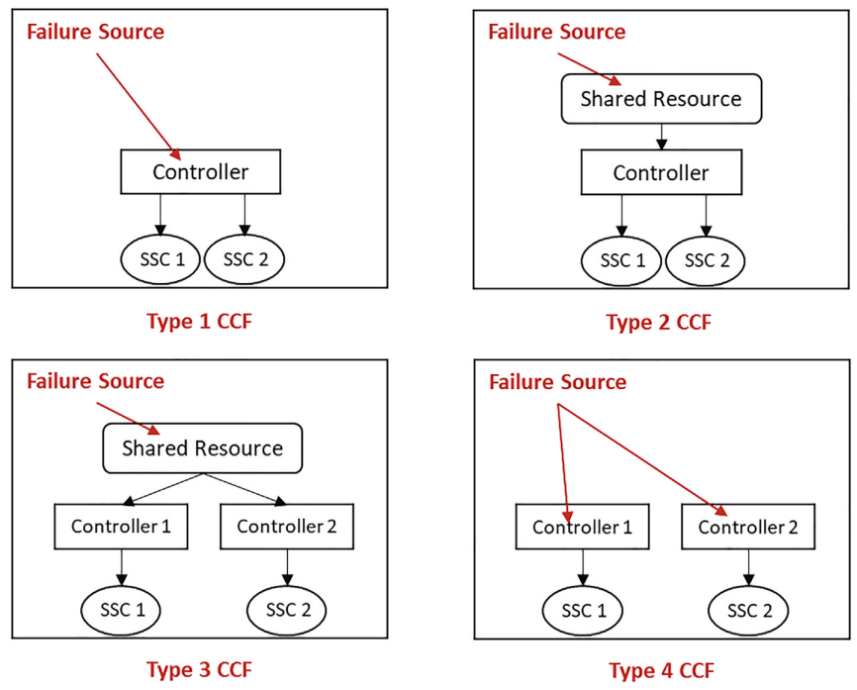
Introduction and Problem Description
Issue description:
Software failure on DI&C (e.g., PLC, OS, FPGA, etc.)
Emergent from mixing heterogenous equip.
Component failure prob. $≈$ 0
System failure prob. != 0
Common cause failures (CCF)
Inadequate evidence for licensing (CFR 50.59) [1]
Difficult justify sufficient coverage & consideration
Types of CCF [5]
Existing methods:
Failure mode & effects analysis (FMEA)
Systems theoretic process analysis (STPA from MIT, 2012) [2]
Introduced Unsafe Control Actions as software failure events
Hazard & Consequences Analysis for Digital Systems (HAZCADS from EPRI, 2021) [3]
Combined Unsafe Control Actions w/ Fault Trees
Redundancy-guided Systems-theoretic Hazard Analysis (RESHA from INL, 2020) [4][5]
Risk contributions from different parts of the system + redundancy
Software failures are problematic for licensing and introduce hidden risks for safety critical applications that cannot be detected through component testing (emergence)

Slide 4
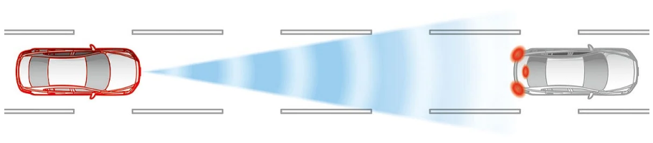
Software Failures in DI&C Systems
STPA – Software ‘failure’ is due to inadequate constraints leading to ‘misbehaviors’ and loss [2]
Rules for operation during development were not strict enough (i.e., loophole)
Misbehaviors = Unsafe Control Actions (UCA)
 | Type A | Type B | Type C | Type D
Unsafe Control Action (UCA) Loss Context | Control action not provided when required context. | Control action provided when not required causing hazard. | Control action is early, late, or out-of-order. | Control action is stopped too soon or applied too long.
Auto emergency braking (AEB)
Brake when collision imminent and not user initiated
How does it “know” when to brake? What could go wrong?
 | Type A | Type B | Type C | Type D
Unintentional collision during autopilot on highway | AEB does not detect car in front and crashes during traffic jam. | AEB brakes when squirrel detected and car behind rear ends. | AEB brake initiation is late causing minor collision with car in front. | AEB brake is too weak or not enough causing minor collision with car in front.
UCAs are undesirable, cause losses, and stem from various sources including inadequate constraints. What is their origin?

Slide 5
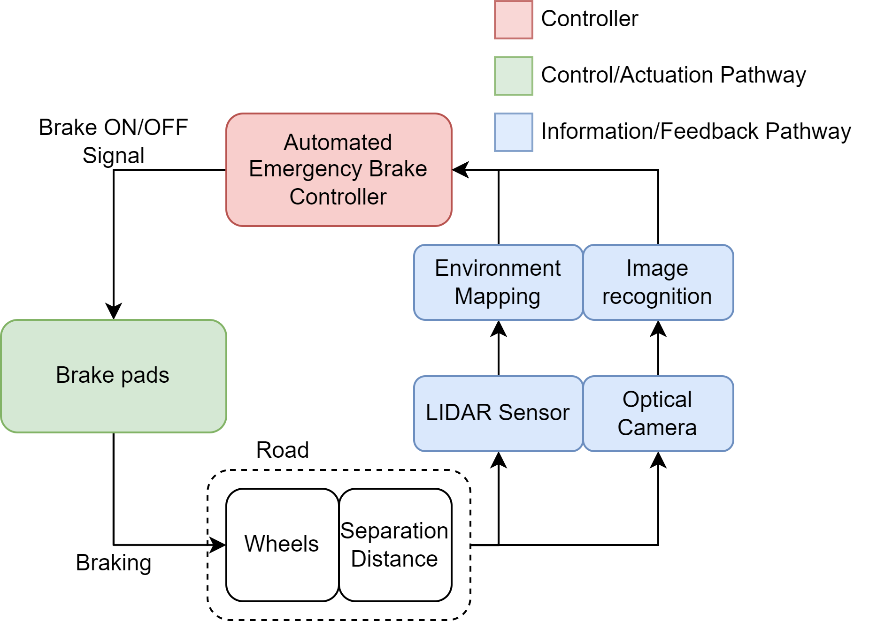
Example
Scenario 1:
Software on AEB contains a defect that fails when raining.
Result:
It is raining, AEB fails to engage for oncoming car, collision occurs.
Scenario 2:
Software on the LIDAR contains a defect that when raining obscures environment mapping.
Result:
It is raining, LIDAR assumes car is there due to defective range finding. AEB triggers spuriously
Scenario 3:
Optical camera is dirty, and LIDAR has height limit.
Result:
Optical camera is blind. A small child is on the road below LIDAR scanning range. AEB does NOT engage and a collision occurs.
UCAs technically cover all loss scenarios listed BUT:
Failures of subsystems/dependences cause 2/3 cases & exterior to controller.
Tracing of failures in dependences in feedback pathway is convoluted especially in modern DI&C systems. Proof that all considerations were made is required.

Slide 6
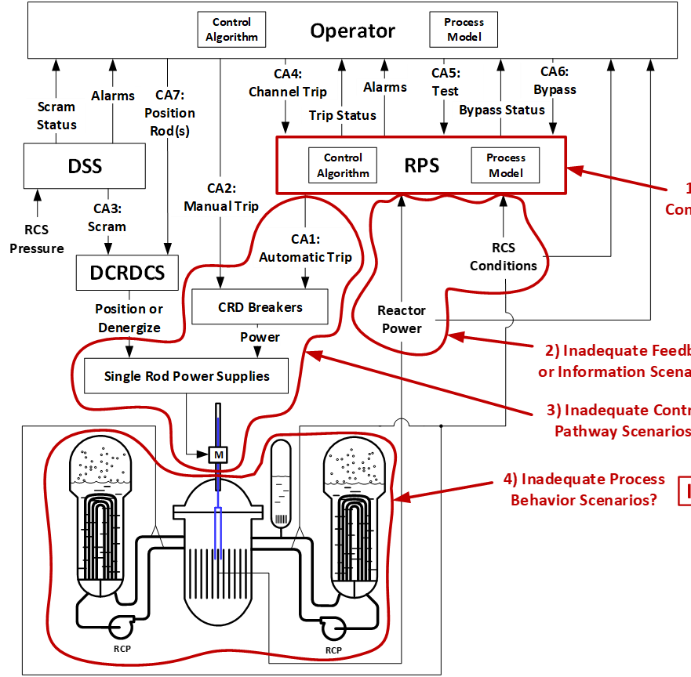
Loss Scenario Tracing
Causal factors / failure mechanisms
for unsafe operator bypass UCA
Operator UCA | Causal Factors: Inadequate feedback or information scenarios (IFI)
Operator provides channel trip when channel is not in bypass (UCA-B, spurious) | Operator is presented with too much information regarding bypass conditions
 | Operator is told to insert a channel trip by somebody else
 | Operator is provided with wrong or conflicting information regarding bypass conditions PPC says channel is bypassed and bypass status light says it is not bypassed Bypass light says it is bypassed and PPC says it isn’t
Step 4: Identify loss scenarios & relevant failure mechanisms that lead to loss
ICB
IFI
ICP
What’s missing?
Were all IFI scenarios considered? (completeness)
Which failures of the feedback path would lead to these loss scenarios? (traceability)
Which one of these failure mechanisms are more relevant than others? (importance)
IPB
Reactor Example [3]

Slide 7
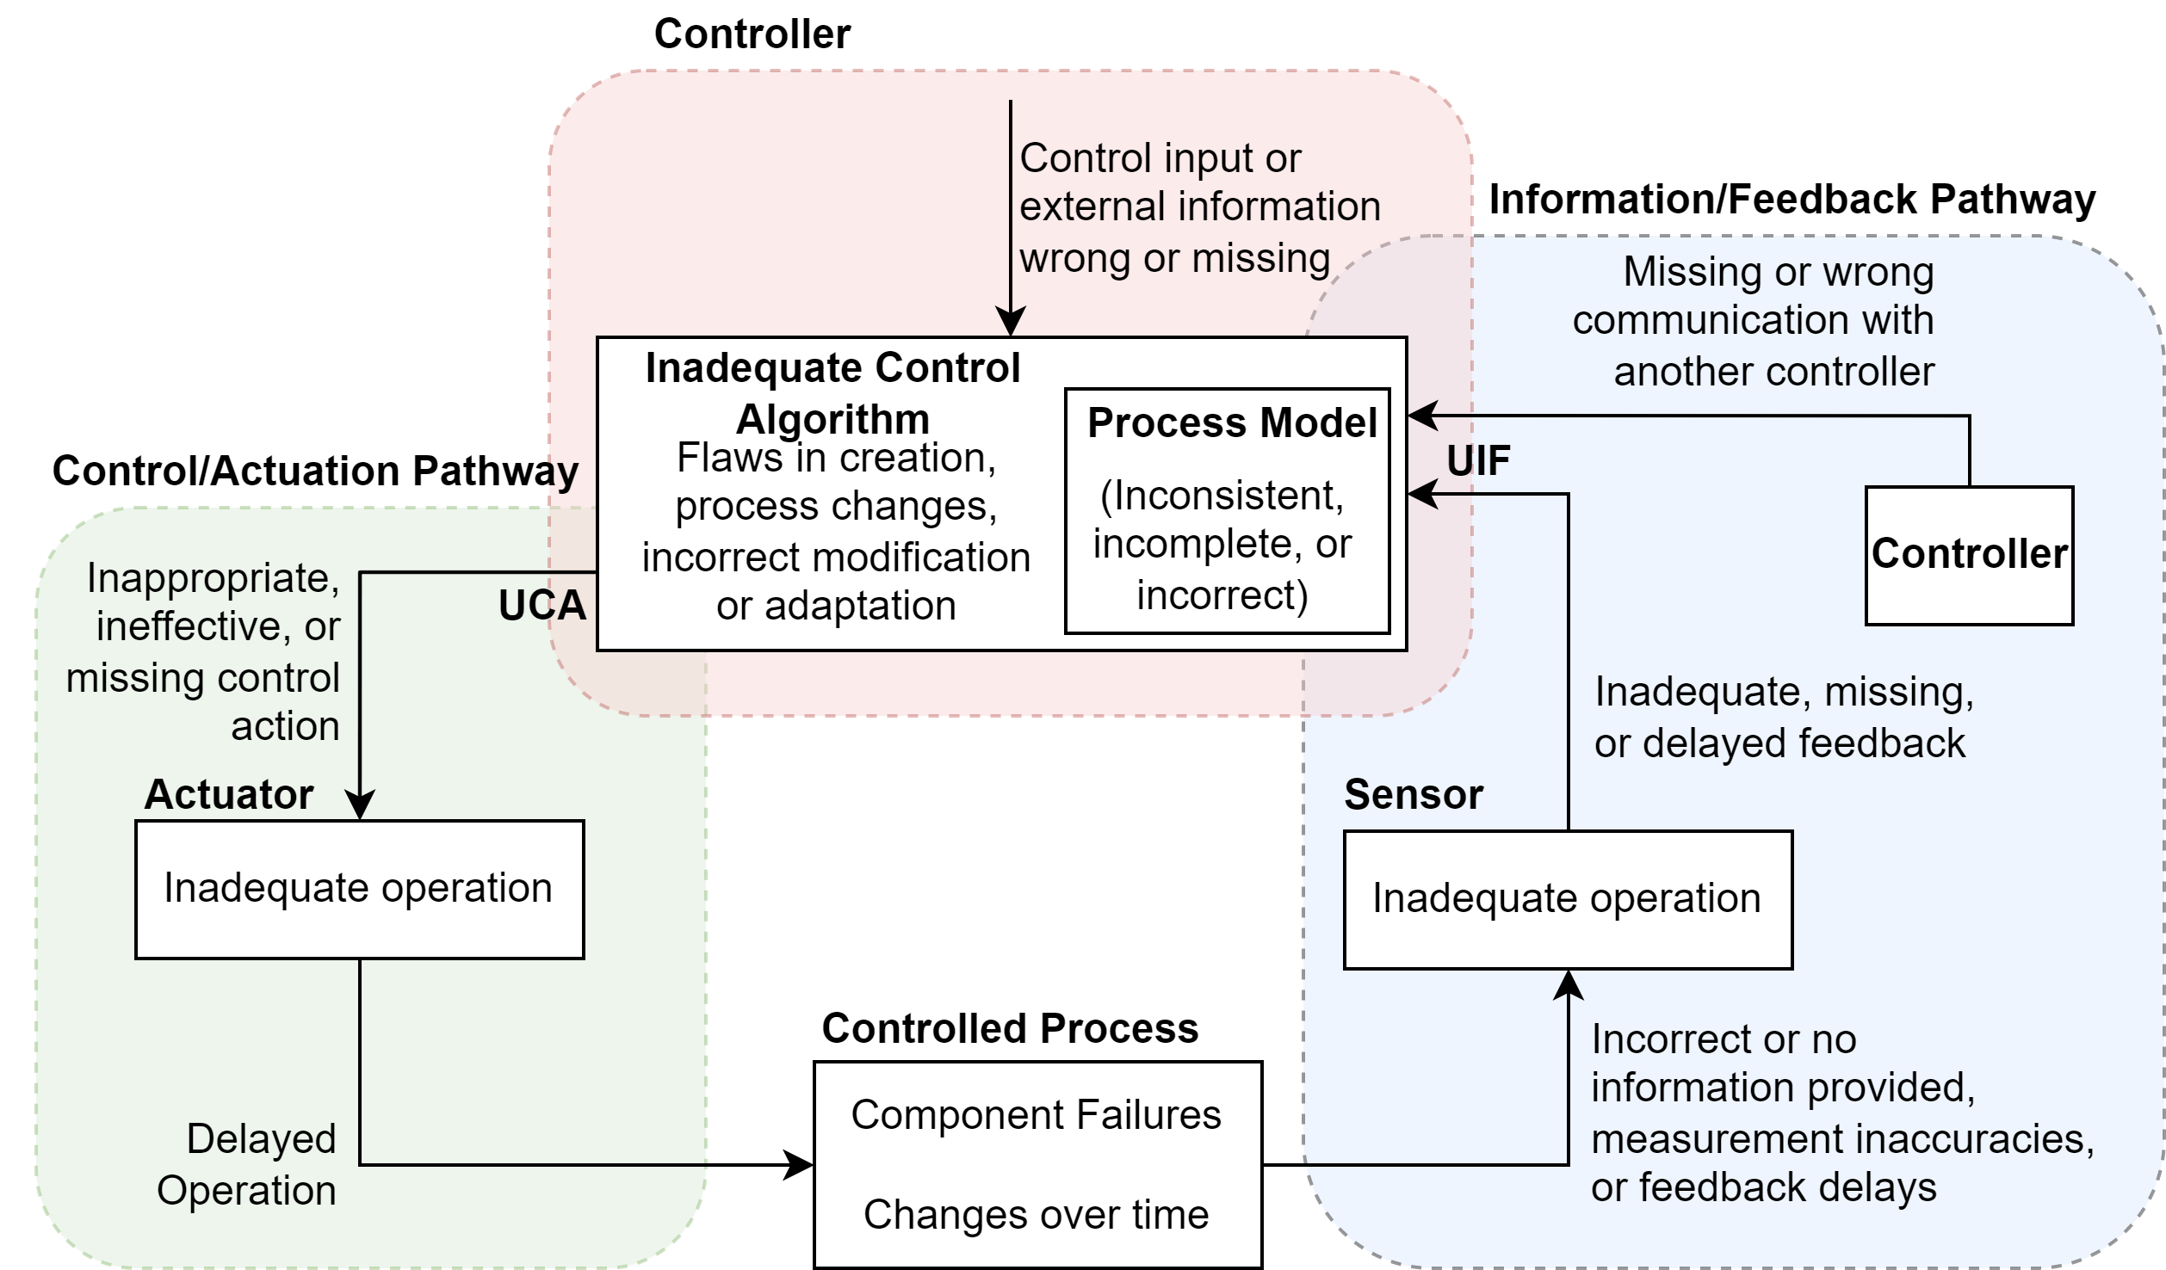
Failure Mechanisms Leading to UCAs
What are the causes of software failure?
Internal mechanisms:
Inadequate control algorithm
Action
Inconsistent process model
Belief
**Related to software of controller**
External mechanism:
Incorrect/inadequate feedback
Awareness
**Related to upstream dependencies**
 | Type A | Type B | Type C | Type D
Unsafe Control Action (UCA) | Control action not provided when required context. | Control action provided when not required causing hazard. | Control action is early, late, or out-of-order. | Control action is stopped too soon or applied too long.
Unsafe Information Flow (UIF) | Feedback is missing when required context. | Feedback is provided when not required causing hazard. | Feedback is early, late, out-of-sync, or out-of-order. | Feedback value is too low, too high, NaN, or Inf.
UIFs are introduced as software failures in the upstream dependencies to controllers

Slide 8
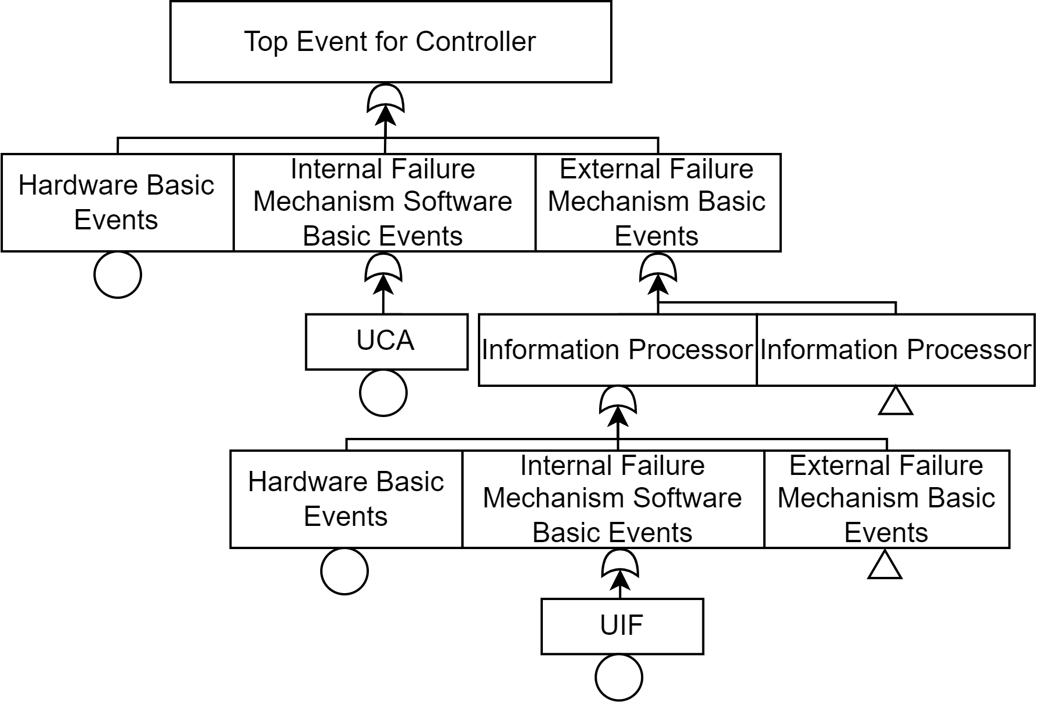
UIFs and UCAs in Fault Trees
 | Type A | Type B | Type C | Type D
Unsafe Control Action (UCA) | Control action not provided when required context. | Control action provided when not required causing hazard. | Control action is early, late, or out-of-order. | Control action is stopped too soon or applied too long.
Unsafe Information Flow (UIF) | Feedback is missing when required context. | Feedback is provided when not required causing hazard. | Feedback is early, late, out-of-sync, or out-of-order. | Feedback value is too low, too high, NaN, or Inf.
Methodology:
Identify boundary of target control block diagram
Construct hardware FT
Identify relevant UCA/UIF from control block diagram
Integrate UCA/UIF into hardware FT.
Identify potential software CCFs through duplicate UCA/UIF in FT.
Solve for minimum cutsets/SPOFs
We can integrate UCAs/UIFs into existing hardware fault trees that clearly express source of failure, due to internal defects or external dependencies.

Slide 9
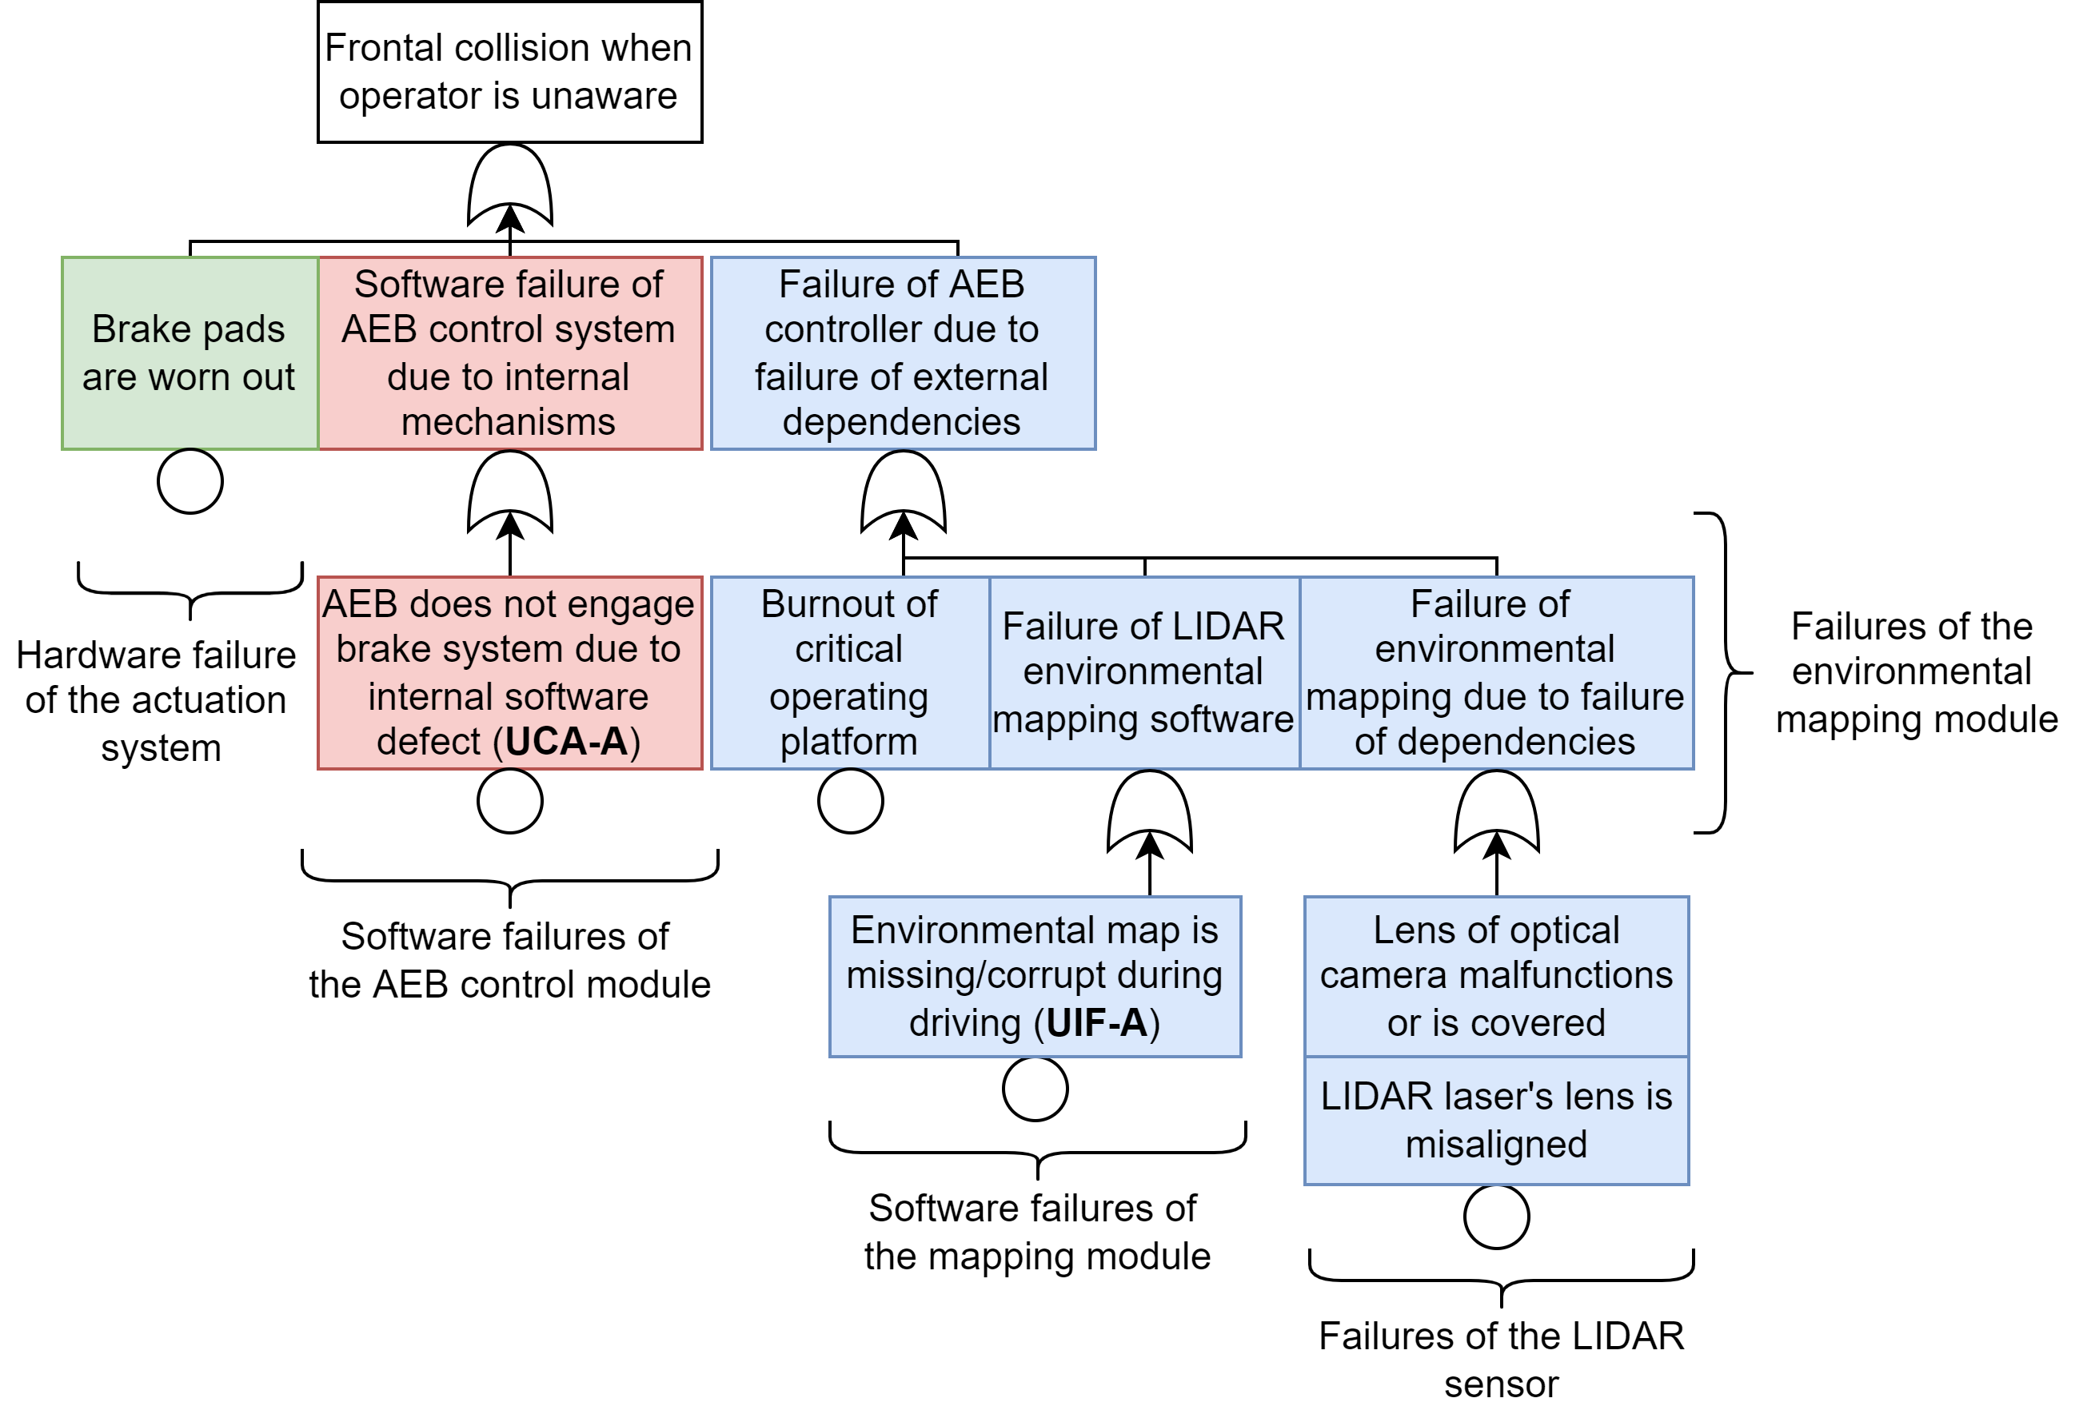
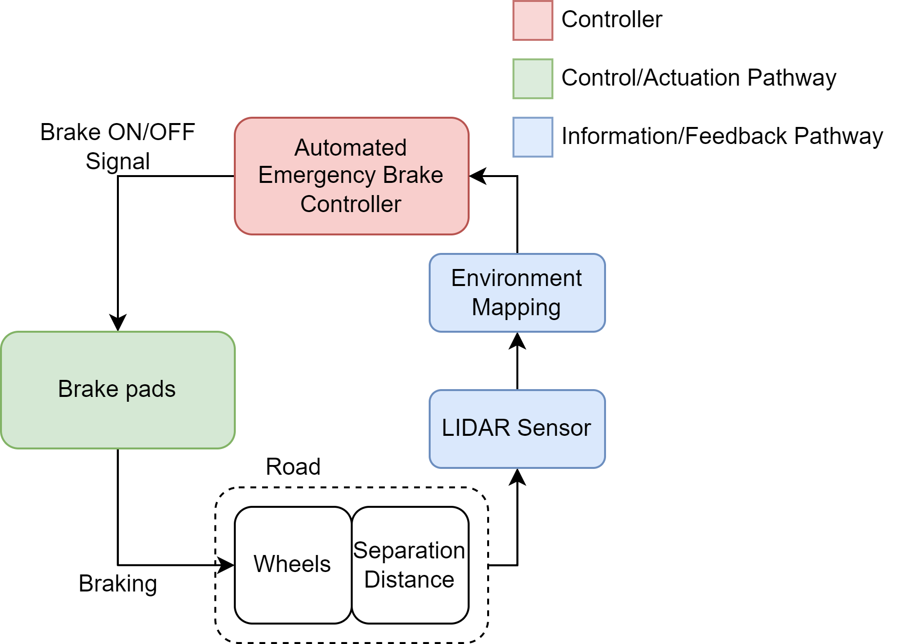
Example FT
Top event:
Frontal collision when operator is unaware
What software failures will lead to this event?
Missing or incorrect environmental mapping information results in incorrect belief models of the controller. The controller behaves as it is programmed but a loss still occurs.

Slide 10
Comparison between Failure Modeling
Conventional STPA+FT modeling
Only UCAs are considered for failures of controllers
Novel RESHA w/ UIF + FT modeling
UCAs are failures of controllers
UIFs are failures of upstream dependencies
Internal & external mechanisms are lumped together when determining relevancy of UCA.
Failure mechanism are listed based on expert elicitation but without rule of completeness.
Failures in control-free information systems cannot be represented as no UCA exists.
Internal & external mechanisms are separated. Different mechanism groups are considered for various UIF/UCAs.
Failure mechanisms of all relevant devices are organized in a fault tree and traceability follows linear causality.
Allows failure representation in control-free information systems (i.e., monitoring system).
RESHA with UIFs provides enhanced traceability of all potential failure modes for both controllers and dependencies. Risk contribution can be calculated based on FTs.

Slide 11
Case Study – Representative Advanced Redundant and Diverse HSI
based off the Qualified Indication and Alarm System for Safety (QIAS-P) from APR1400 [6]

Slide 12
Advanced Redundant and Diverse HSI (APR-1400)
Characteristics:
Multiple layers of information processing and augmentation
Multiple redundant information monitoring systems
QIAS-P provides information such as CET, primary coolant saturation margin etc.
DI&C System Level Diagram [6]
QIAS-P = Qualified Instrumentation and Alarm System (Safety)
QIAS-N = Qualified Instrumentation and Alarm System (Non-Safety)
IPS = Information processing system (Non-Safety)
DIS = Diverse Instrumentation System (satisfies SECY-SRM-93-087)
Notes:
In the APR-1400 DI&C system, multiple primary and secondary sources of information provide information to various safety features. The qualified indication and alarm system (QIAS-P) is one of the integral monitoring systems for safety-critical systems. Its also interesting to note that there is also a diverse information and actuation system which meets one of the SECY-SRM-93-087 requirements for speculated CCF in DI&C systems.

Slide 13
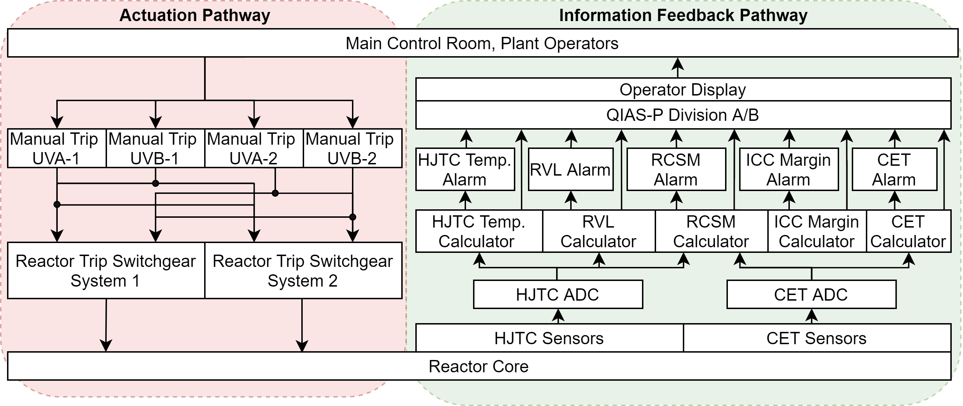
Advanced Redundant and Diverse HSI
Information level
Redundancy level
Alarm level
Processing level
Sensor level
Control loop of the HSI system based off the APR1400 QIAS-P system
Would only UCAs assessment be sufficient for such a system?
No! Only control action is the operator manual trip
How can we represent software failures in such HSI systems?

Slide 14
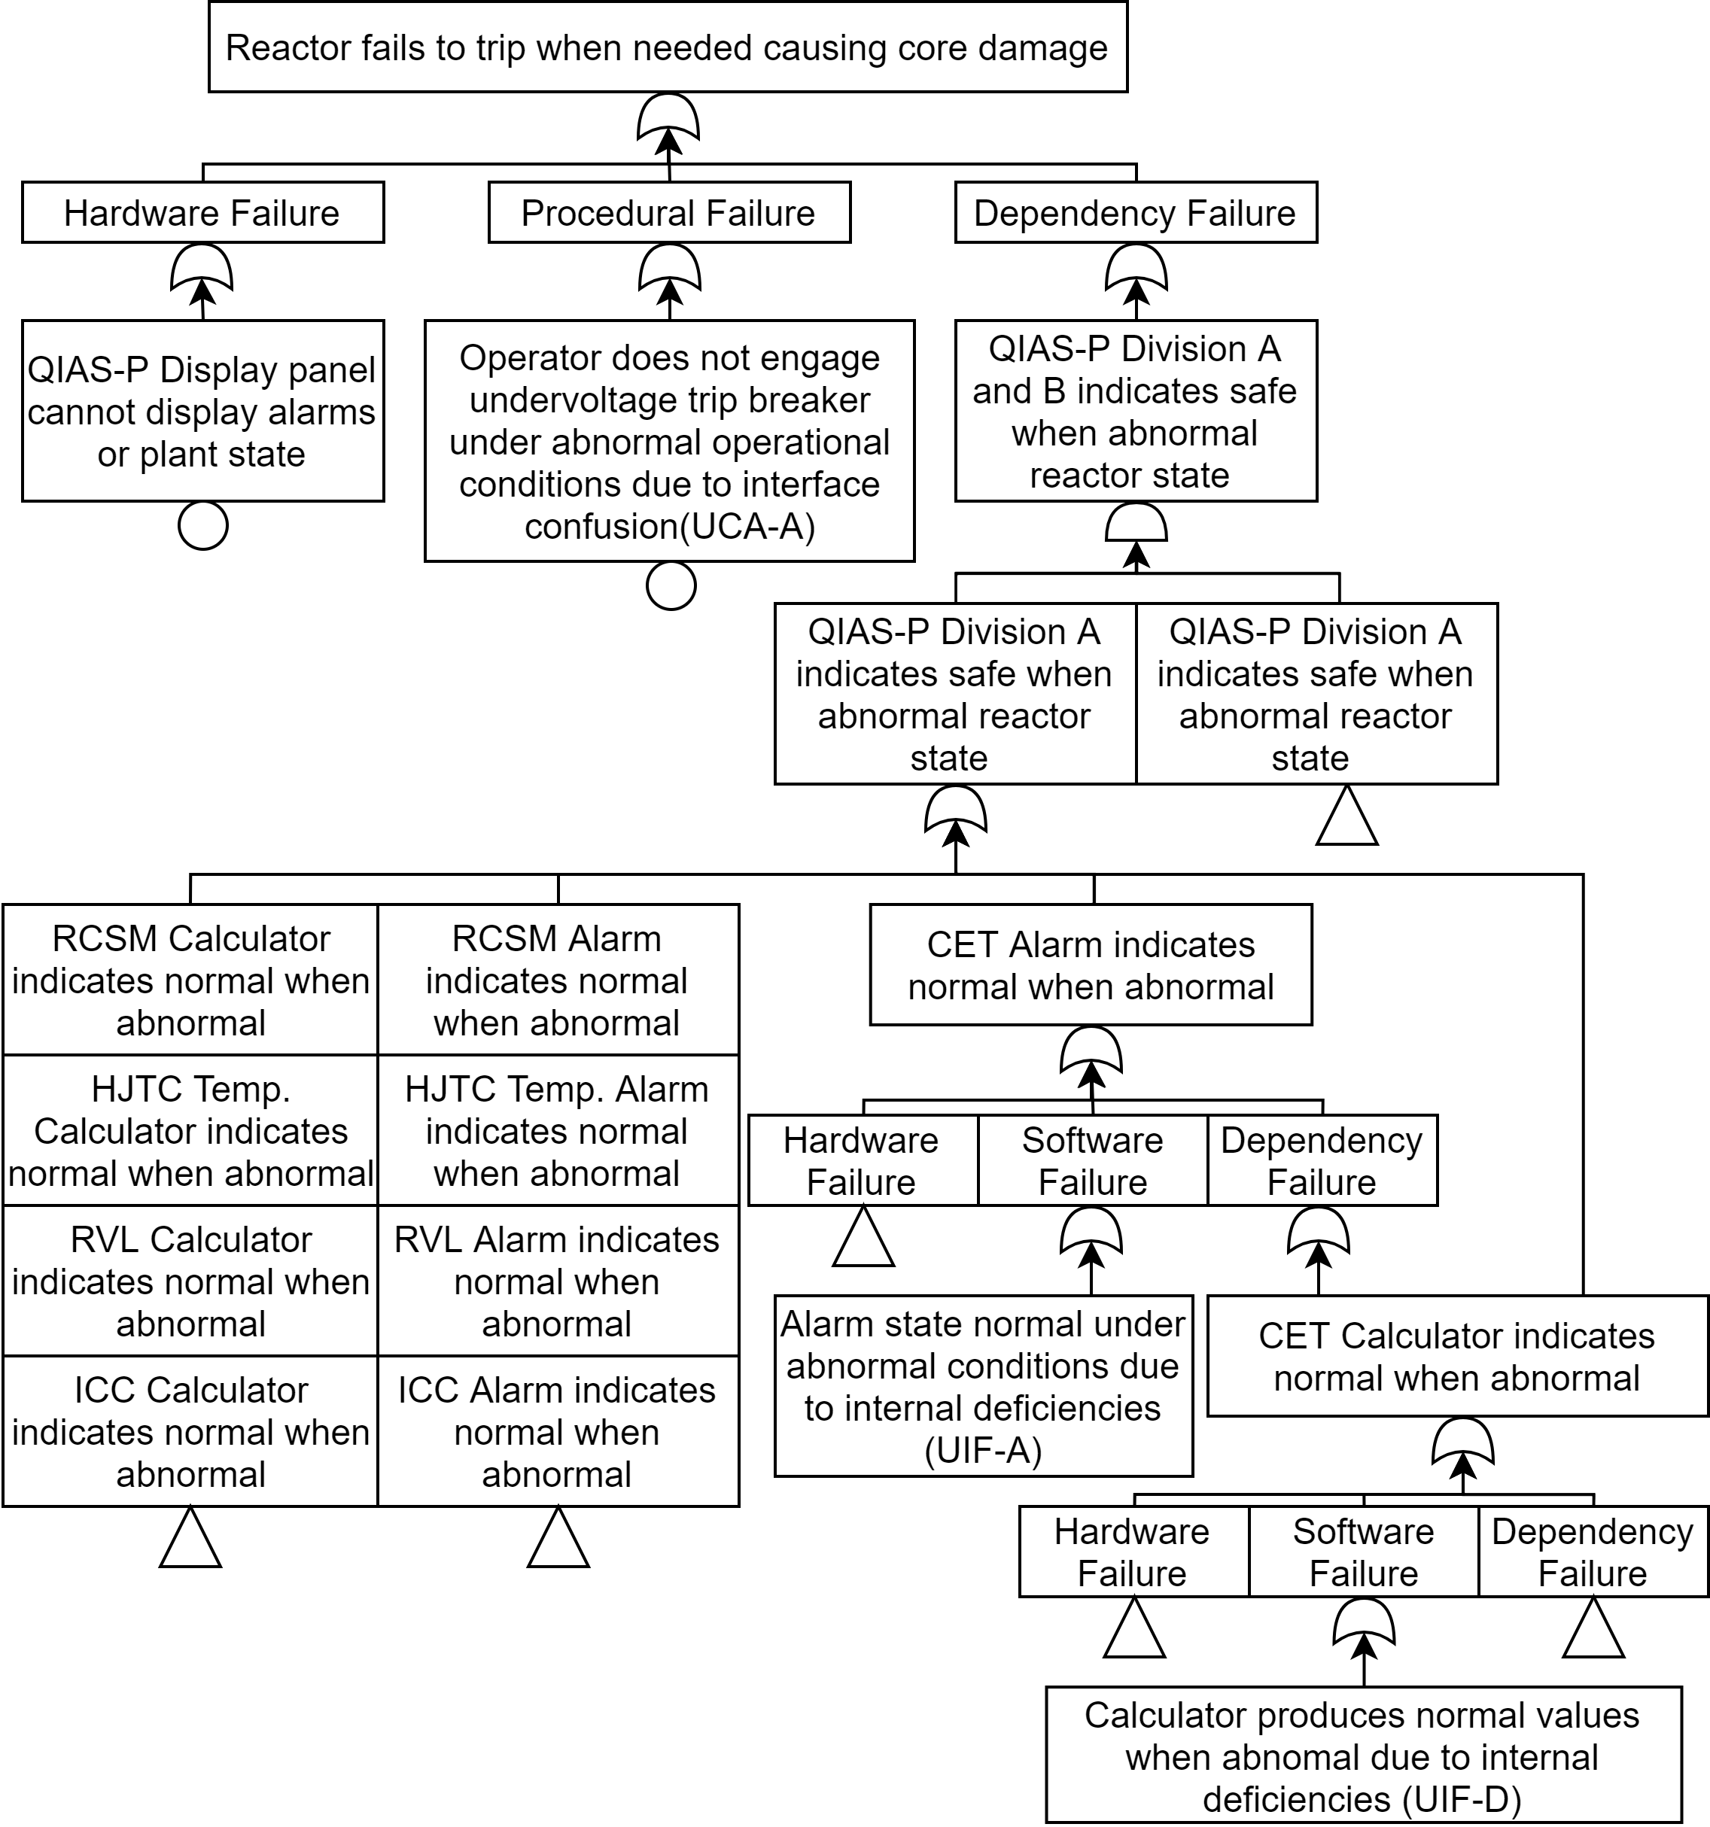
Single Software Failure Results
UCA; operator failing to follow procedure resulting in core damage
UIF; spurious alarm causes operator to unnecessary trip reactor. Software failure of CET alarm system
UIF; Abnormal heating condition not detected. Core damage occurs as operator is misinformed about true temperature
Abridged integrated fault tree of one redundant division of the HSI with UCA/UIF failures

Slide 15
Software CCFs of Advanced HSI system
# | Cut Set / Basic Event Description
1 | Division A&B HJTC calculators provide lower than real core temperature measurements under abnormal conditions (CCF due to UIF-D).
2 | Division A&B CET alarm does not trigger when coolant exit temperature exceeds acceptable margin (CCF due to UIF-A).
3 | Division A&B HJTC ADC provide lower than real digital core temperature conversion from analog signal (CCF due to UIF-D).
Issue Identification & Resolution
Lack of diversity among divisions in Advanced Redundant and Diverse HSI makes the system susceptible to software CCFs
Duplication of PLC function & software is one of the root causes
Train redundancy does NOT adequately protect against either hardware or software CCF

Slide 16
Conclusion & Discussion
 | Type A | Type B | Type C | Type D
Unsafe Control Action (UCA) | Control action not provided when required context. | Control action provided when not required causing hazard. | Control action is early, late, or out-of-order. | Control action is stopped too soon or applied too long.
Unsafe Information Flow (UIF) | Feedback is missing when required context. | Feedback is provided when not required causing hazard. | Feedback is early, late, out-of-sync, or out-of-order. | Feedback value is too low, too high, NaN, or Inf.
Introduced UIF for software failure traceability along the information feedback pathway
Provided guidance on FT construction to separate internal and external failure mechanisms for loss
Assessed advanced human system interface & identified single points of failure and common cause failures
Where does the software fail?
Which component(s) contribute most to risk?
How can we identify and trace these components?
Q&A
We are looking for industry & research partnerships for additional verification work!
Contact: Edward Chen echen2@ncsu.edu
Notes:
Benefit?
Future work to be done in thesis?

Slide 17
Acknowledgements
The research activities and achievements presented in this work were funded under the Risk Informed Systems Analysis (RISA) Pathway of the United States Department of Energy Light Water Reactor Sustainability Program.
This information was prepared as an account of work sponsored by an agency of the U.S. Government under DOE Contract No. DE-AC07-05ID14517. Neither the U.S. Government nor any agency thereof, nor any of their employees, makes any warranty, express or implied, or assumes any legal liability or responsibility for the accuracy, completeness, or usefulness of any information, apparatus, product, or process disclosed, or represents that its use would not infringe privately owned rights. References herein to any specific commercial product, process, or service by trade name, trademark, manufacturer, or otherwise, does not necessarily constitute or imply its endorsement, recommendation, or favoring by the U.S. Government or any agency thereof. The views and opinions of authors expressed herein do not necessarily state or reflect those of the U.S. Government or any agency thereof.

Slide 18
Conclusion & Discussion
FAQ:
Adding additional events to the fault tree, which already has 1000s will only further complicate assessment efforts. Why should we add UIFs?
UIFs are for decomposing select information systems that do not have control counterparts.
Decomposition is based on need and not requirement.
We aren’t experiencing component level failures (i.e., individual components aren’t failing, systems are). How does this work contribute?
If a controller system is failing and existing methods are insufficient, decomposing the system into its dependencies can expose vulnerabilities.
Where should you look? You look at the dependencies
UIFs sound a lot like failure mechanisms & fault trees only represent failure modes. Is there confusion here?
If your smoke alarm doesn’t go off when there is a fire (UIF-A) is that a failure mechanism or mode?
Failure mode = americium sensor broken; Failure mechanism = low batteries/no power
How can we quantify UIFs/UCAs in fault trees for risk assessment?
Thursday 10:30 – 12:00 PM (Wai’anae): Application of Orthogonal-Defect Classification for Software Reliability Analysis

Slide 19
References
[1] Nuclear Regulatory Commission, "Guidance for Evaluation of Defense in Depth and Diversity to Address Common-Cause Failure due to Latent Design Defects in Digital Safety Systems, BTP 7-19," Nuclear Regulatory Commission, Washington, 2021.
[2] N. G. Leveson and J. P. Thomas, "STPA Handbook," MIT Partnership for Systems Approaches to Safety and Security, Cambridge, 2018.
[3] Electric Power Research Institute, "Hazard Analysis Methods for Digital Instrumentation and Control Systems - Revision 1," Electric Power Research Institute, Washington, 2021.
[4] H. Bao, T. Shorthill and H. Zhang, "Hazard analysis for identifying common cause failures of digital safety systems using a redundancy-guided systems theoretic approach," Annals of Nuclear Energy, vol. 148, no. 1, p. 107686, 2020.
[5] T. Shorthill, H. Bao, H. Zhang and H. Ban, "A Redundancy-Guided Approach for the Hazard Analysis of Digital Instrumentation and Control Systems in Advanced Nuclear Power Plants," Nuclear Technology, vol. 208, no. 5, pp. 892-911, 2022.
[6] Korea Electric Power Corporation, Korea Hydro & Nuclear Power Co., LTD, "Chapter 7: Instrumentation and Controls. Rev 3," in APR1400 Design Control Document Tier 2, Washington, Nuclear Regulatory Commission, 2018.
[7] H. Bao, H. Zhang and K. Thomas, "An Integrated Risk Assessment Process for Digital Instrumentation and Control Upgrades of Nuclear Power Plants," Idaho National Laboratory, Idaho Falls, 2019.
[8] H. Bao, T. Shorthill and H. Zhang, "Redundancy-guided System-theoretic Hazard and Reliability Analysis of Safety-related Digital Instrumentation and Control Systems in Nuclear Power Plant," Idaho National Laboratory, Idaho, 2020.
[9] H. Bao, T. Shorthill, E. Chen and H. Zhang, "Quantitative Risk Analysis of High Safety-significant Safety-related Digital Instrumentation and Control Systems in Nuclear Power Plants using IRADIC Technology," Idaho National Laboratory, Idaho Falls, 2021.
[10] D. J. Lawson, "Failure Mode, Effect and Criticality Analysis," in Electronic Systems Effectivess and Life Cycle Costing, Berlin, Springer, 1983, pp. 55-74.
[11] A. D. Williams and A. J. Clark, "Using Systems Theoretic Perspectives for Risk-Informed Cyber Hazard Analysis in Nuclear Power Facilities," in 29th Annual INCOSE International Symposium, Orlando, 2019.
[12] The National Aeronautics and Space Administration, "Fault Tree Handbook with Aerospace Applications," The National Aeronautics and Space Administration Office of Safety and Mission Assurance, Washington, 2002.
[13] H. Bao, H. Zhang, T. Shorthill and S. Lawrence, "Quantitative Evaluation of Common Cause Failures in High Safety-significant Safety-related Digital Instrumentation and Control Systems in Nuclear Power Plants," 7 April 2022. [Online]. Available: https://arxiv.org/abs/2204.03717. [Accessed 2022].
[14] C. Elks, C. Deloglos, A. Jayakumar, A. Tantawy, R. Hite and S. Guatham, "Specification of a Bounded Exhaustive Testing Study for a Software-based Embedded Digital Device," Idaho National Laboratory, Idaho, 2018.
[15] G. D. Sirio, "ChibiOS/RT The Ultimate Guide," ChibiOS EmbeddedWare, 2020. [Online]. Available: https://www.chibios.org/dokuwiki/doku.php?id=chibios:documentation:books:rt:start. [Accessed 2022].
[16] E. Chen, H. Bao, H. Zhang, T. Shorthill and N. Dinh, "Systems-theoretic hazard analysis of digital human-system interface relevant to reactor trip," in 12th Nuclear Plant Instrumentation, Control and Human-Machine Interface Technologies, 2021.

