Slide 1
Overview of the Physical Security Pathway
Shawn St. Germain
Douglas M. Osborn, PhD
June 2022
Sandia National Laboratories is a multimission laboratory managed and operated by National Technology and Engineering Solutions of Sandia, LLC, a wholly owned subsidiary of Honeywell International Inc., for the U.S. Department of Energy’s National Nuclear Security Administration under contract DE-NA0003525. SAND2022-5526C
Notes:
Remember … amy attending will not be aware of the physical security work.
Meet NRC reequipment and be more cost effective.

Slide 2
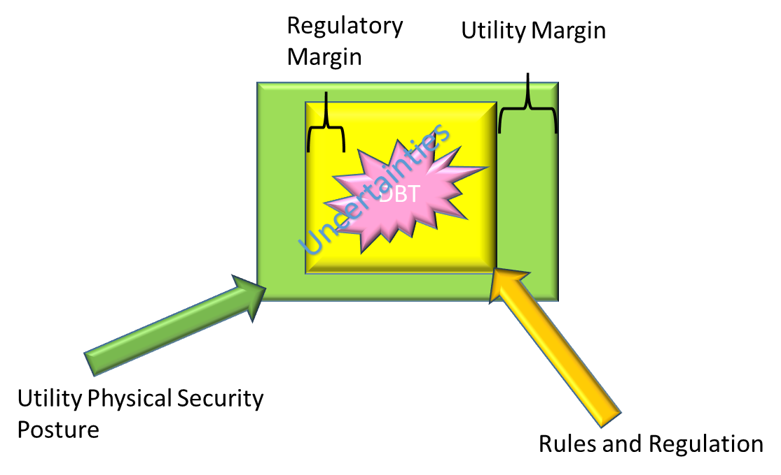
Overview of Physical Security Pathway
Physical Security research aims to create tools, technologies, and risk-informed physical security decisions and activities with the following objectives:
Develop mitigation strategies and enhance the technical basis necessary for stakeholders to reevaluate physical security postures while meeting regulatory requirements.
Analyze the existing physical security regime, current best practices, and compare/contrast insights with alternative methods which leverage advanced modeling and simulation, modern technologies, and novel techniques that address design basis threat and regulatory requirements
Short-term goal is to enable industry to operate nearer the staffing requirements of 10 CFR 73.55
Main research thrust areas:
Advanced Security Technologies
Risk-Informed Physical Security
Advanced Security Sensors & Delay
Notes:
Discuss ‘margin’ figure when highlighting objectives.
Advanced Security Technologies - Provide an economic and technical evaluation of remote weapon technology, development of the remote operated weapon system (ROWS) technical basis necessary to implement components within the system, and an implementation basis for installation of a remote weapons platform at a nuclear utility site that meets regulatory requirements for inclusion in their security posture, enabling a utility to optimize and enhance their security posture. The research is intended to support a cooperative private-public implementation of the technical basis at a candidate nuclear utility site with a candidate ROWS.
Risk-Informed Physical Security – Enhance, develop and demonstrate risk-informed technologies for physical security by integrating dynamic risk methods, physics-based modeling and simulation, operator actions, and FLEX equipment, which should extend the adversarial timeline for response force success. Explore the expansion of existing risk-informed methods for nuclear security. The risk tools will enable commercial utilities to incorporate increased realism in their force-on-force models, take credit for operator actions and FLEX equipment, and move towards greater use of quantitative measures of performance in security posture and the technical basis for physical security at nuclear power plants. The intent of this research is to use risk-informed methods and tools that enable utilities to optimize their physical security posture and demonstrate the updated physical security posture is as effective as before the change. Work with stakeholders to evaluate the risk related to unattended openings that potentially are person-passable for duct work and piping openings which is an identified gap in the technical basis for security pathways into a nuclear facility.
Advanced Security Sensors & Delay - Develop low cost, rapidly deployable detection and assessment technologies that could be applied to piping, walls, doors, water inlet/outlets, etc. for nuclear utility sites. An enabling technology that can be used to create the system is Technical Embroidery (aka, Stitch), an emerging technology that can be used to attach wire, fiber optics, and tubes to various substrate materials. The proposed work will explore advances in sensor technology, including available commercial-off-the-shelf (COTS) sensor, for use in security applications. Where technology has not been developed to support security needs, R&D will be performed to develop needed sensors.

Slide 3
Physical Security Risk-Related Research
Research Thrust Area
Advanced Security Sensors – Deliberate Motion Analytics
Advanced Security Sensors – Water Intakes
Risk Informed Security – Performance Based Data Collection Methodology
Risk Informed Security – Dynamic Risk Framework
Advanced Security Delay – Risk-Informed Adversary Timelines
Advanced Security Delay – Risk-Informed Approach for Unattended Openings
Risk Informed Security – Security Economics & Risk-Informed Management for Enterprise Security

Slide 4
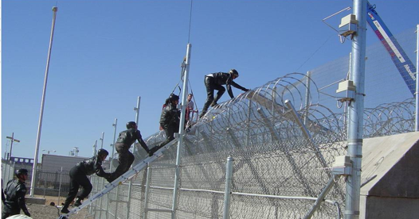
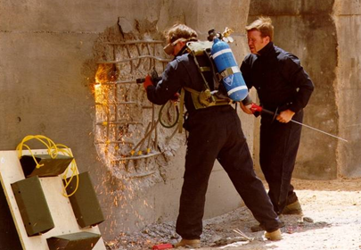
FY-22 Activities
    Stakeholder Engagement Meetings
      Path Analysis Workshop
      Explosive Engineering Workshop
    Advanced Security Technologies
      Remote Operated Weapons System (ROWS)
    Risk-Informed Physical Security
      Dynamic Risk-Informed Framework
      Performance Based Data Collection Methodology
    Advanced Security Sensors & Delay
      Deliberate Motion Analytics (DMA)
      Water Intakes
      Unattended Openings (UAOs)
      Vital Area Doors
Notes:
Brief mention of the technologies

Slide 5
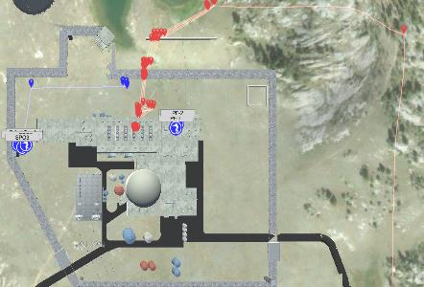
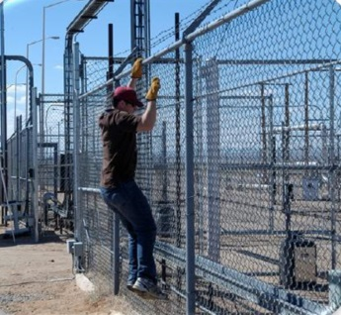
Recent Accomplishments
Completed first FY-22 stakeholder engagement meeting in February
Conducted preliminary Sentry-II ROWS modeling with collaborating utilities
Completed unattended opening testing
Completed discussion series for developing a risk-informed security methodology with pilot utility and PWROG
Ongoing human factors data collection during DOE marksman training evolutions
Completed Interim Access Delay Security System Desk Reference (SSDR)
Conducted first pilot study of DMA with collaborating utility
Notes:
Interm Access Delay SSDR – discuss the data declassification and improve realism of adversary pathways
Discuss how dynamic event tree analysis (figure on the left) is being applied to physical security
Completed discussion series for developing a risk-informed security methodology in March
STPA (System Theoretic Process Analysis)
RIMES (Risk-Informed Management for Enterprise Security)
MODA (Multi-Objective Decision Analysis)
Dynamic Event/Fault Tree Analysis
Applications of Bayesian statistics
Linked STPA with Static Event/Fault Tree Analysis
Dymatica (Dynamic Multi-scale Assessment Tool for Integrated Cognitive-behavioral Actions)

Slide 6
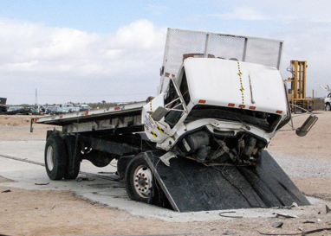
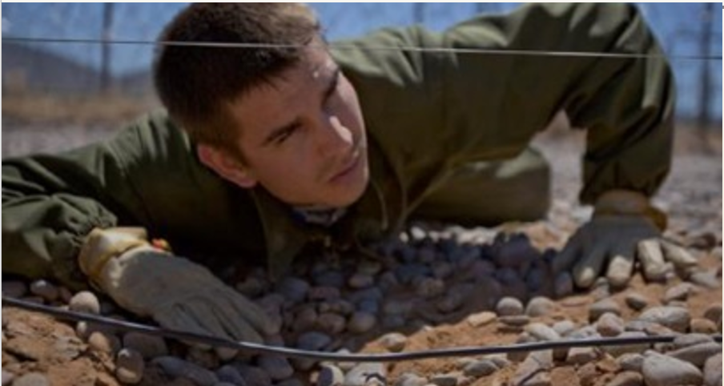
Industry Engagement & Roles
ROWS – Xcel Energy, Entergy, Constellation, and NRC
Unattended openings – NEI, Xcel Energy, Southern Nuclear Co. Stars Alliance, Dominion Energy, Entergy, NextEra, Exelon, and NRC
Deliberate Motion Analytics – American Electric Power and Entergy
Dynamic Risk-Informed Framework – Southern Nuclear, Arizona Public Service, PWROG, and RhinoCorps
SBIR – ARES Security Corp.
NEUP – Ohio State University

Slide 7
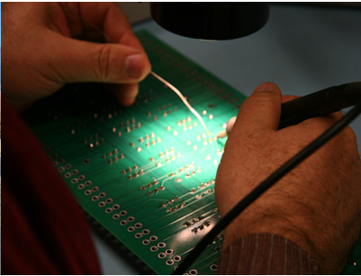
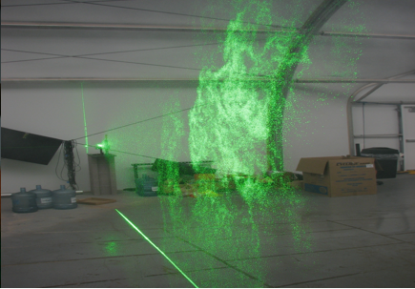
Impactful Out-Year Outcomes (within 3-years)
Provide a risk-informed technical basis for unattended openings (2D & 3D)
Access to updated performance based data sets and references from DOE Office of Security
  Interim Access Delay SSRD, and other SSDRs
Fleet-wide application of risk-informed access delay timelines for adversary and response force
Support deployment of ROWS to at least one candidate site
Pilot an integrated approach to dynamic force-on-force & reactor system response modeling
Pilot the integration of human factors data and modeling for adversary and protective force
Support deployment of advanced security sensor and delay technologies
  Sensor fusion
  Deliberate Motion Analytics
  Jam-proof wireless
  Vital area doors
Notes:
I will provide a little more detail on the ROWS and unattended opening efforts in the subsequent slides.

Slide 8
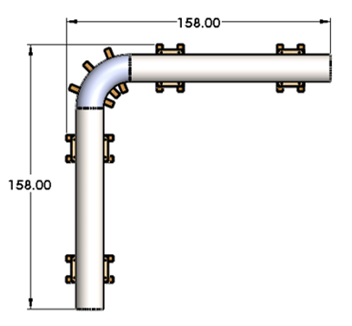
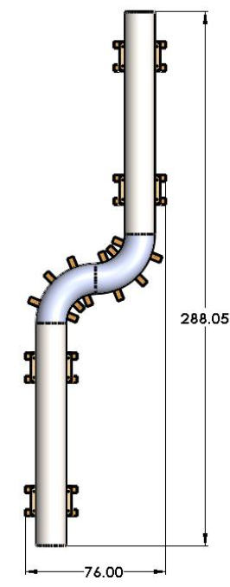
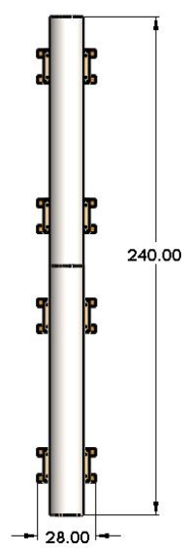
Risk Related Example - Unattended Openings
    Impact: Provide the technical basis to determine optimized protective strategies related to person-passible openings that intersect security boundaries during normal and maintenance operations. Reductions in patrols, monitoring, and compensatory measures could be reconsidered but will be site specific on a case-by-case basis.
    FY-22 efforts
    Conduct a risk-informed evaluation for 2D and 3D unattended openings based on past US Government policy
    Identify human factors associated with 2D and 3D openings
    Evaluate 2D UAO testing with 4-inch circle & rectangles and 36-inch circle
    Evaluate 3D UAO testing with 20-foot piping sections and pipe bends
    Evaluate success of passing through the opening (go/no-go), rate times, and limited data on exertion
Example of 3D UAO Testing Configurations

Slide 9
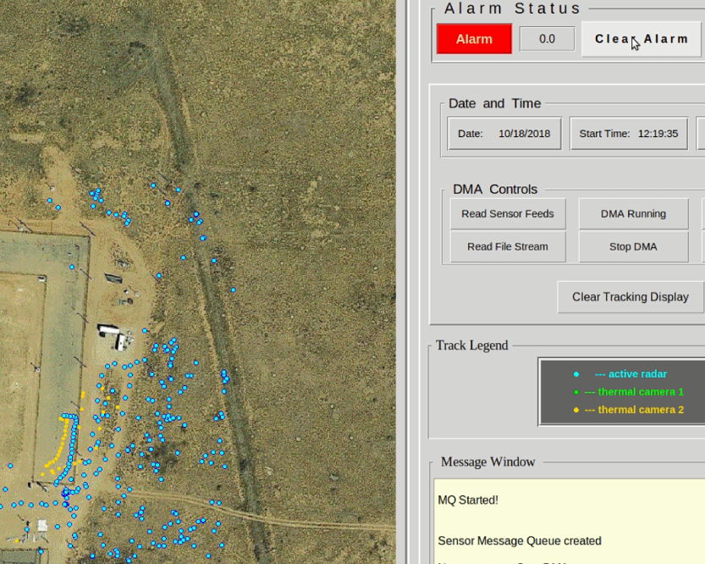
Risk Related Example - Deliberate Motion Analytics
Impact: Security sensor fusion linked with DMA can take input from multiple sensors of different types, analyze the data, and determine if an adversary is making an approach toward a facility. Sites using current commercial sensor technologies typically experience elevated nuisance alarm rates (NAR) not caused by an intruder. Maintaining a low NAR while being able to detect intruders has the potential to decrease the cost of security.
FY-22 efforts
Using DMA and sensor fusion, collect at least four weeks of continuous performance data at two nuclear power plant sites
Consider engineered terrain (perimeter intrusion detection system) and un-engineered terrain (owner controlled area).
Create an NPP-specific demonstration package containing sensor fusion
Active Radar (blue) and Thermal Camera (yellow) fused through DMA

Slide 10
Risk Related Example - Dynamic Risk-Informed Framework
Impact: A risk-informed physical security method integrating dynamic risk methods, physics-based modeling and simulation, operator actions, and FLEX equipment (as an example of safety equipment). This linked security-safety framework will extend the adversarial timeline for response force success. The tools will enable commercial utilities to incorporate increased realism in their force-on-force models, take credit for operator actions and FLEX equipment, and move toward greater use of quantitative measures of performance in security posture.
FY-22 Tasks:
Develop guidance in collaboration with stakeholders to support the use of the dynamic risk tools.
Integrate force-on-force simulation software platforms with thermal-hydraulic codes.
Document Physical Security human reliability needs.
Develop dynamic modeling tools to incorporate force-on-force and operator actions into static and dynamic risk assessment models; credit additional operator actions and FLEX within a site’s protective strategy.
Notes:
Don’t’ say ‘meltdown’ … just discuss ‘accident progression’

