Slide 1

Development of a new plant-specific, full-scope industrial-scale L1/L2 PSA-model with the application of the new RiskSpectrum® Model Builder Tool
Dr. Dusko Kancev
PSAM 16, June, `22

Slide 2
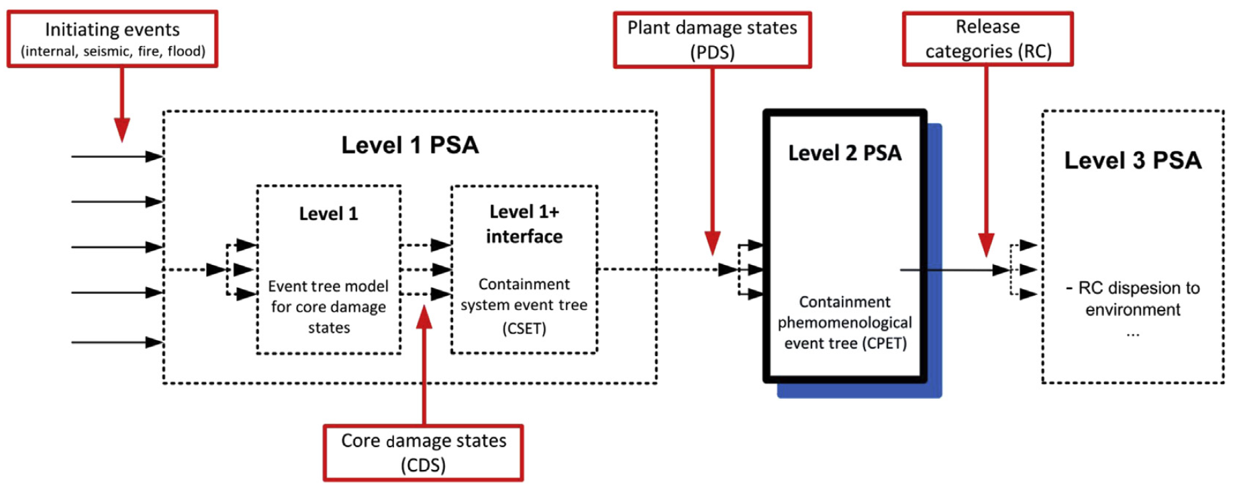
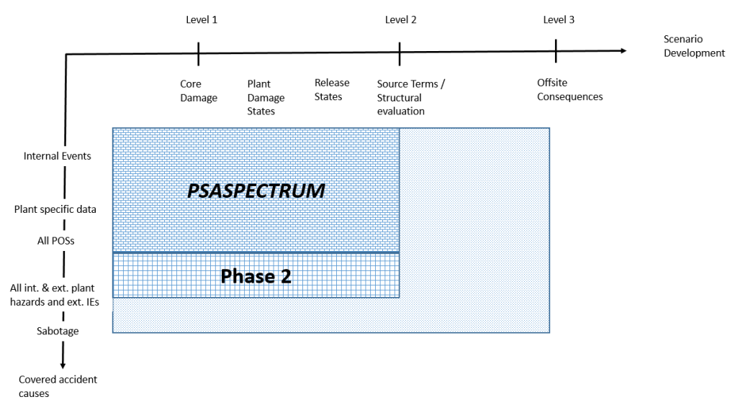
Introduction – PSASPECTRUM Project
Progression of the current KKG PSA model into the RiskSpectrum® software suite
Joint project between KKG (customer) & Framatome GmbH (main supplier)
All POSs, all IEs classes (internal & external), all hazards (internal & external), fully coupled (L1, L1+, L2) plant model
One of the highlights - application of the RiskSpectrum® Model Builder (RSMB) tool on the system level PSA modelling
Paper focus: summary of the system-level PSA modelling using the RSMB
P. Zvoncek,et al., “Development of a Fully-Coupled, All States, All Hazards Level 2 PSA at Leibstadt Nuclear Power Plant,” Nuclear Engineering and Technology, no. 49, pp. 426-433, 2017

Slide 3
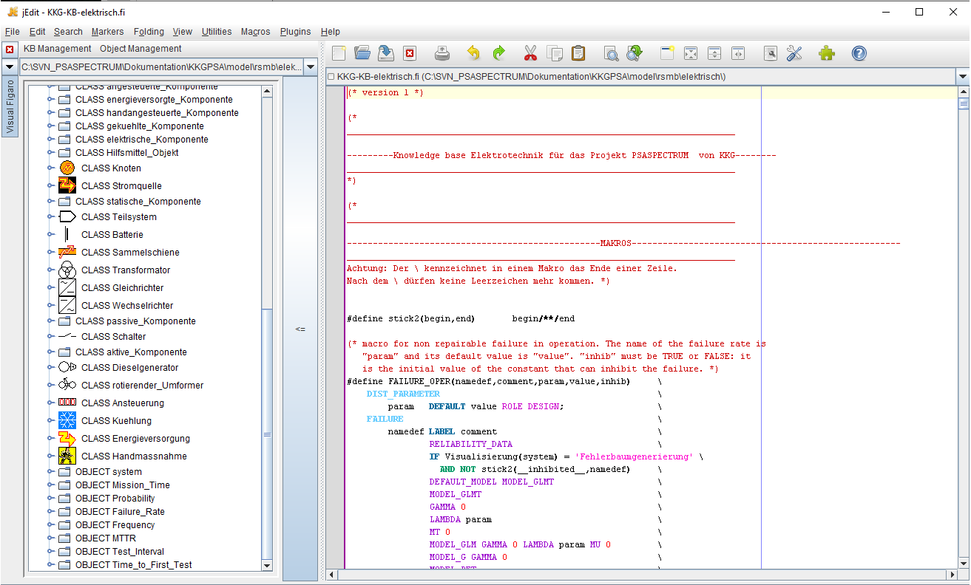
Modelling strategy – Creation of a Knowledge Base (KB)
First step - development of a plant-specific KB
A plant-specific KB encompasses the various components that are to be considered by the system modelling
2 KBs developed for the PSASPECTRUM: thermohydraulic systems & electrical systems
Each class is identified by a name and contains a series of characteristics which are common to the components it describes
This is coded with the Figaro-language in the jEdit environment ➔ Figaro-KB therefore contains a description model common to all the systems in the category
Each object in the system is created as an instance of a class in the KB

Slide 4
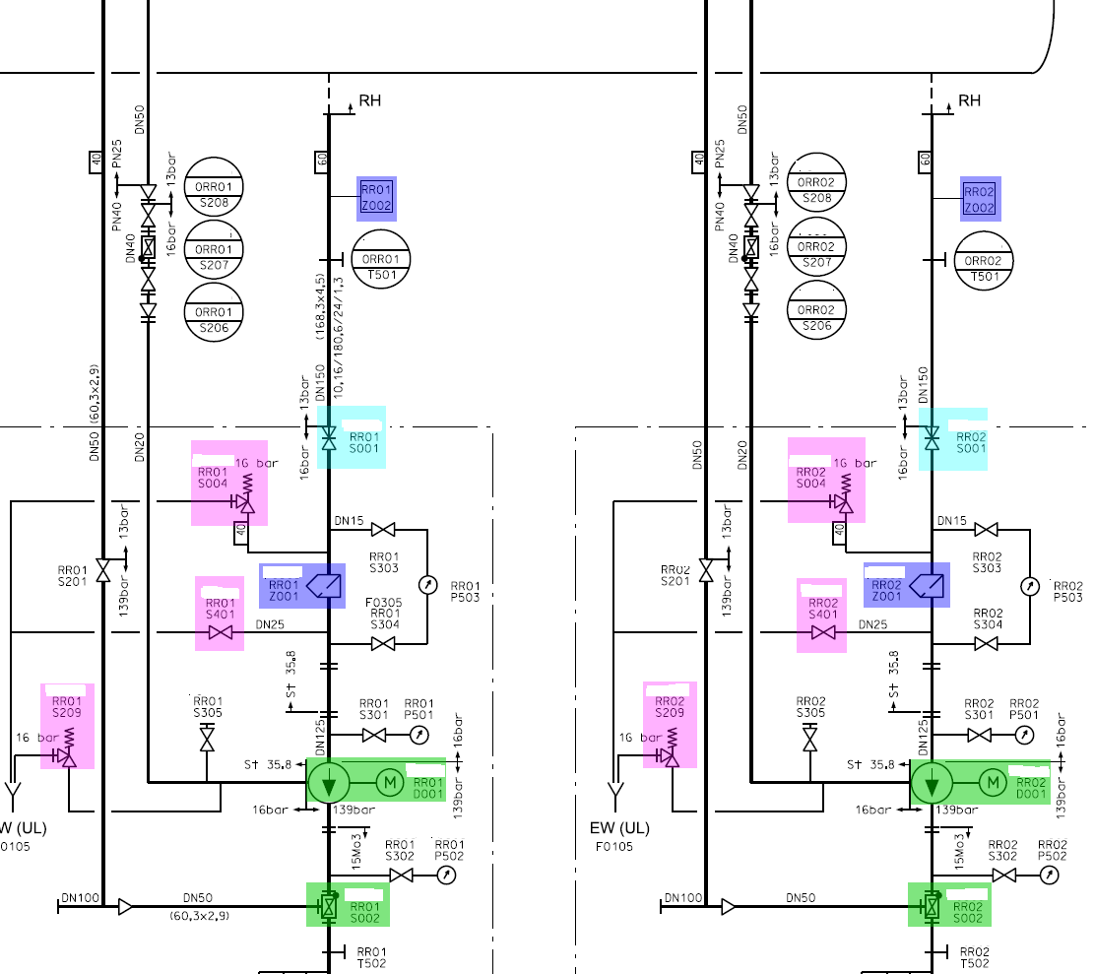
Modelling strategy – FMEA, identification and editing of PSA-relevant P&IDs
Each system`s P&ID is used as an input, i.e., pattern in the process of compilation of the corresponding RSMB-model
For each PSA-relevant system function, components in system P&ID are pre-edited using color coding
In parallel, the FMEA-DB is is being created for each analyzed system, which is also in alignment with the marked P&ID
FMEA-DB is designed as a comprehensive relational database using the Microsoft Access DB platform
The following information is stored within the FMEA-DB:
  component plant ID,
  component type & description,
  system affiliation / relevant system function,
  relevant failure mode for the given system function,
  relevance for the PSA,
  intra and inter-system dependencies,
  power supply and related I&C,
  cooling,
  allocation of the common cause component group (CCCG)

Slide 5
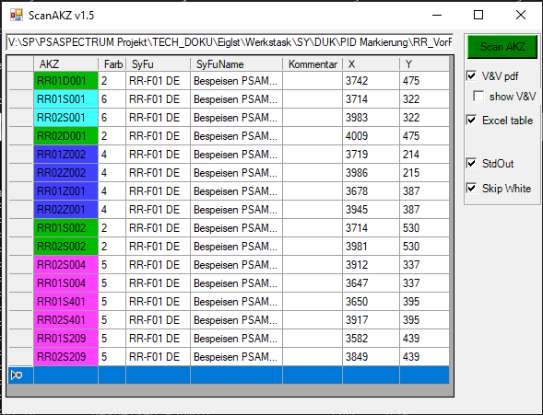
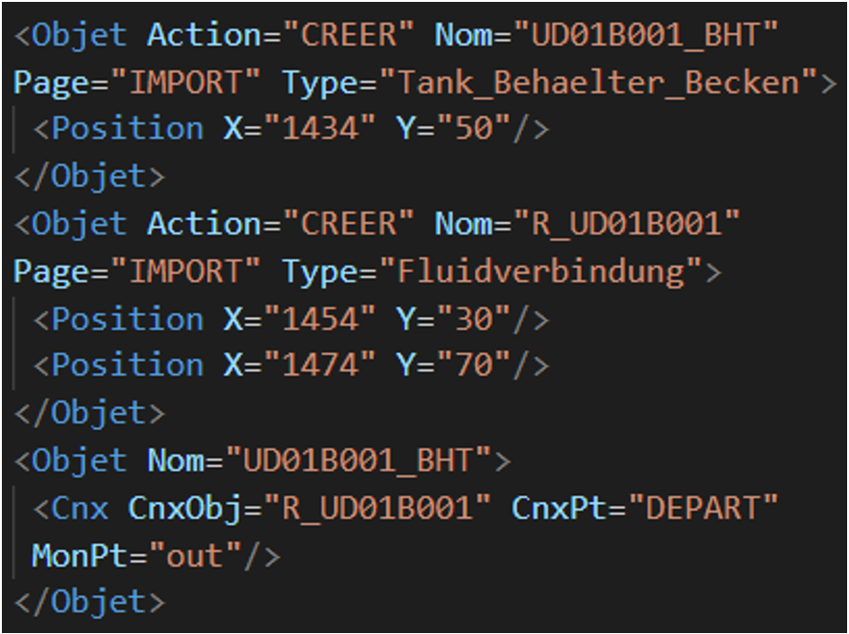
Modelling strategy – FMEA, identification and editing of PSA-relevant P&IDs
Framatome’s dedicated software tool ("ScanAKZ") enables the automatic import of the marked P&ID to the FMEA-DB
Using another dedicated script, ("KBMassImport"), also specially written by Framatome in frames of the PSASPECTRUM project ➔ KB input file is automatically created ➔ automatic mass import of the FMEA-DB for the given system into the RSMB

Slide 6
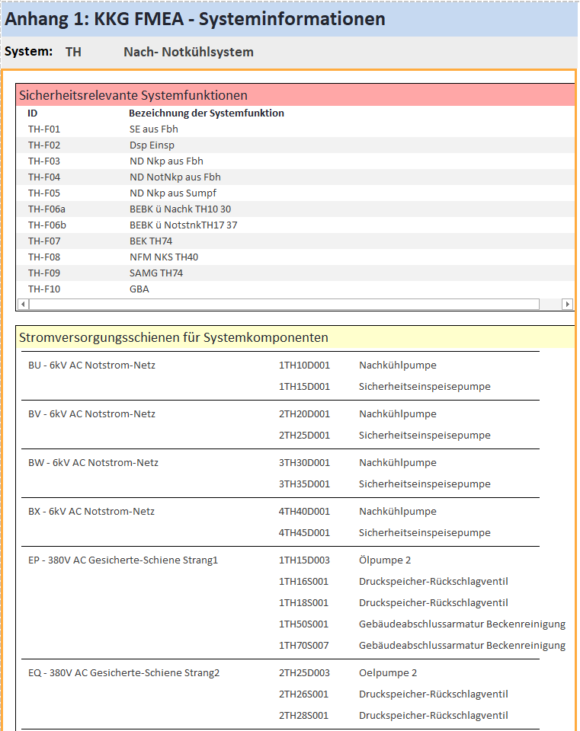
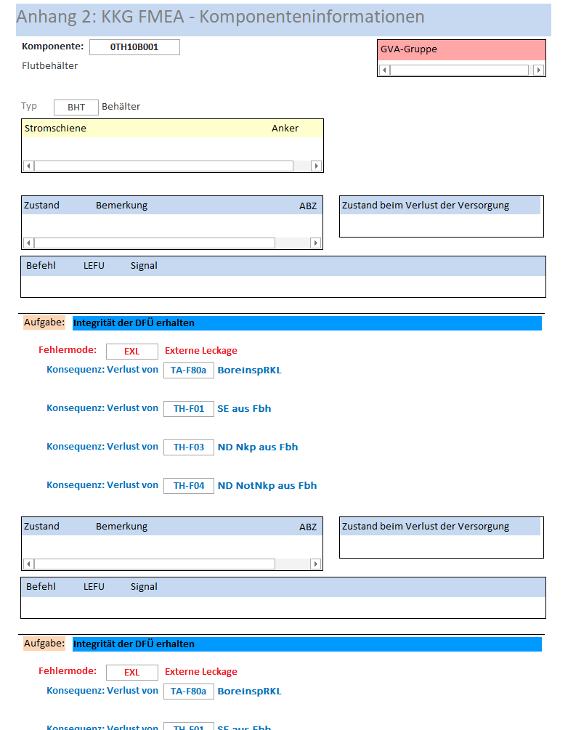
Modelling strategy – FMEA, identification and editing of PSA-relevant P&IDs
FMEA TH-System information
Component information

Slide 7
Modelling strategy – Creation of a RSMB Model
Example result of the automatic import using the tool "Mass Import" – VH System
"Mass Import" tool ➔ all the components marked in the P&ID are imported in the RSMB environment with all their FMEA-characteristics and at the same "geographic" position on the canvas as their coordinates in the source P&ID
A RSMB-study is created for each system; The subsystems are divided into "graphic macro components" (possible per system train, per system function or per subsystem)
In addition, the support systems (external system references) are collected separately in a graphical macro component

Slide 8
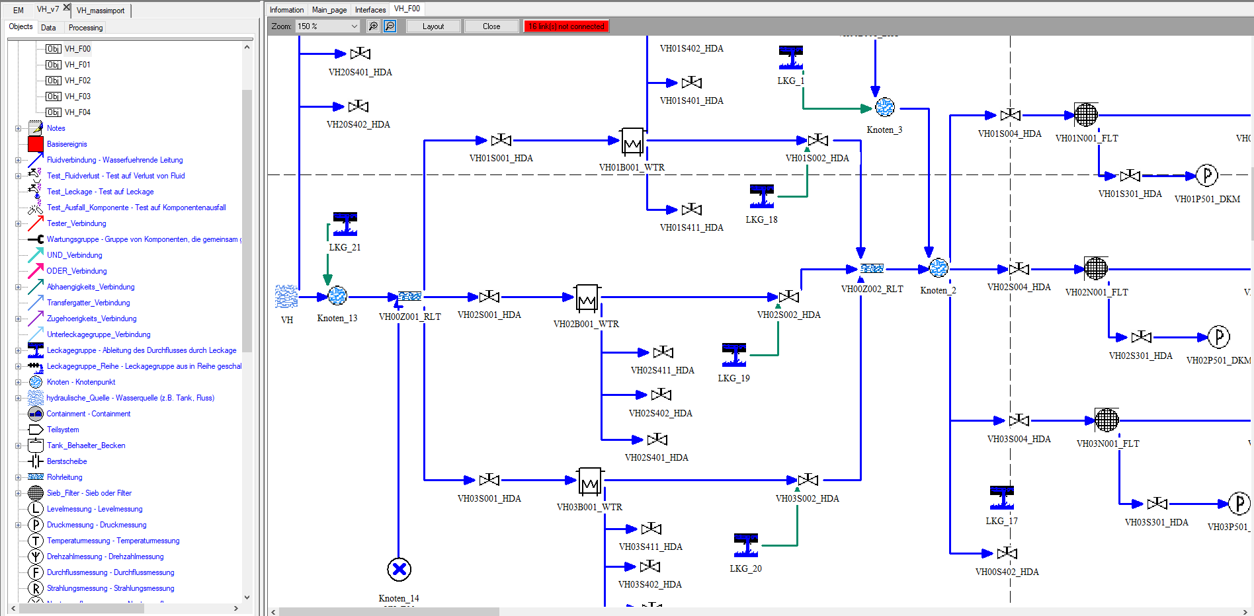
Modelling strategy – Creation of a RSMB Model
Part of the RSMB model of the VH System
So, basically the system drawing is created based on the available components and links within the KB on the left-hand side of the canvas panel

Slide 9
Modelling strategy – Creation of a RSMB Model
Characterization of components in terms of the initial state and mission state may be different depending on different system functions
RSMB allows for the definition of different system configurations within the same study:
  by defining various profiles (blue colour columns)
  or different variants within the same profile
Links can be added graphically or through interface
E.g. through interface for the power supply of the MDP VH01D001

Slide 10
Modelling strategy – Definition of the Undesired Event (UE)
After finalizing the RSMB model ➔ defining the UE ➔ will correspond to the TE in the exported FT within RiskSpectrum PSA
The UE practically tells the software what are the system failures for which one would like to generate a FT
Defined using the same FT logic (OR, AND, K/N-gates) as the FTs within RiskSpectrum PSA
The inputs to the UEs can be:
  System references: "test" of variables in the system structures, depicted through the "testers" (loss-of-fluid, leakage, loss-of-function) as graphical elements comprised within the KB,
  External references: links to a top FT outside the current RSMB system study,
  House events: applied as logical switches similarly as within the conventional FT creation methodology in RiskSpectrum PSA,
  Gates: logical operators to combine the above information (OR-, AND, K/N-gates)
  Manual rules - in case there is additional information to be added in the model (not already included within the KB for some reason)

Slide 11
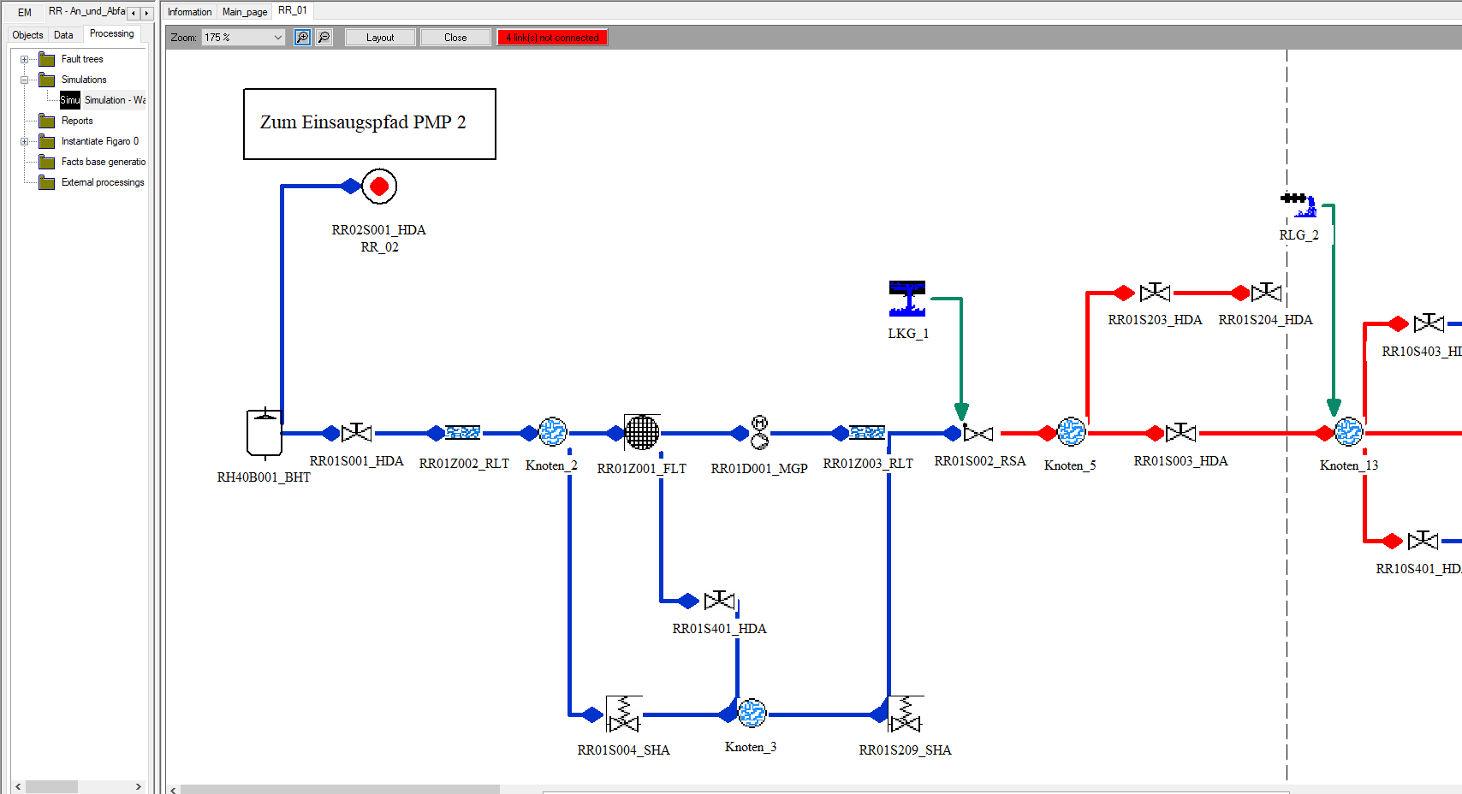
Modelling strategy – preparation and compilation of the FT
After the UEs are defined ➔ compilation of the corresponding FTs within the same RSMB study
The system configuration is defined from a profile (mandatory) and from variants (optional)
User selects required system profile, possibly apply variants via HE as a sub-configuration within the same profile or overload those variants into the selected profile (i.e., overriding the configuration`s setting with the one of the variant).
Another powerful feature of the RSMB tool is the possibility to visualize the configuration of interest
Exceptionally important and helpful property for the RSMB model debugging process
The bold blue lines present the undisturbed, uninterrupted inventory (e.g. water in this case of the depicted RR system)
The red lines represent the mode sections where this flow is being interrupted

Slide 12
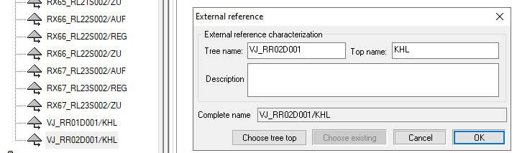
Modelling strategy – creation and analysis of the FT
Supporting interfaces (cooling and power supply) are included within the logical structure alongside the random probabilities of pump failure-to-run and failure-to-start
The cooling of the RR-pump is performed by another supporting interfacing system – the secured closed cooling water system VJ
➔ RSMB accommodates for the use of so-called external references for modelling interfacing systems
External references in RSMB are leaves used in the description of the undesirable events and the manual rules of the study
They refer to a gate of a fault tree in another study
In other words, the external references are references to pre-defined FT pages, within or external the current RSMB study
The external references are possible to be used as failure replacements
RSMB enables the user to replace failures with other failures or by external references specified by the user in the profile during the generation of a fault tree
The events of replacement are exploitable only in generation of tree such that the failures will be replaced in the FT generated by the event of chosen replacement
Notes:
In this specific case of the cooling of the RR-pump described above, the external reference VJ_RR02D001/KHL, presented as a FT leaf herein, will be replaced by a FT-subtree, modelling the concerned train of the VJ-system, once the RSMB fault tree is exported to the main RiskSpectrum PSA platform and linked with the other FTs on the PSA plant-level modelling.

Slide 13
Modelling strategy – FT export to RiskSpectrum PSA
Once the RSMB study is finalized and the FT generated within RSMB, one can proceed to export the trees to the RiskSpectrum PSA environment
One can choose which RSMB trees are to be exported to the RiskSpectrum PSA target project
Consistent naming of basic events, top gates and intermediate gates is ensured using naming rules
Notes:
Different import settings (Fig. 14) allow for different helpful options, such as: removing the existing FTs in the target project that are matching the pre-defined naming mask; (non)preserving of existing BEs, HEs, parameters and CCFs; (non)using the parameters defined in the RSMB study.

Slide 14
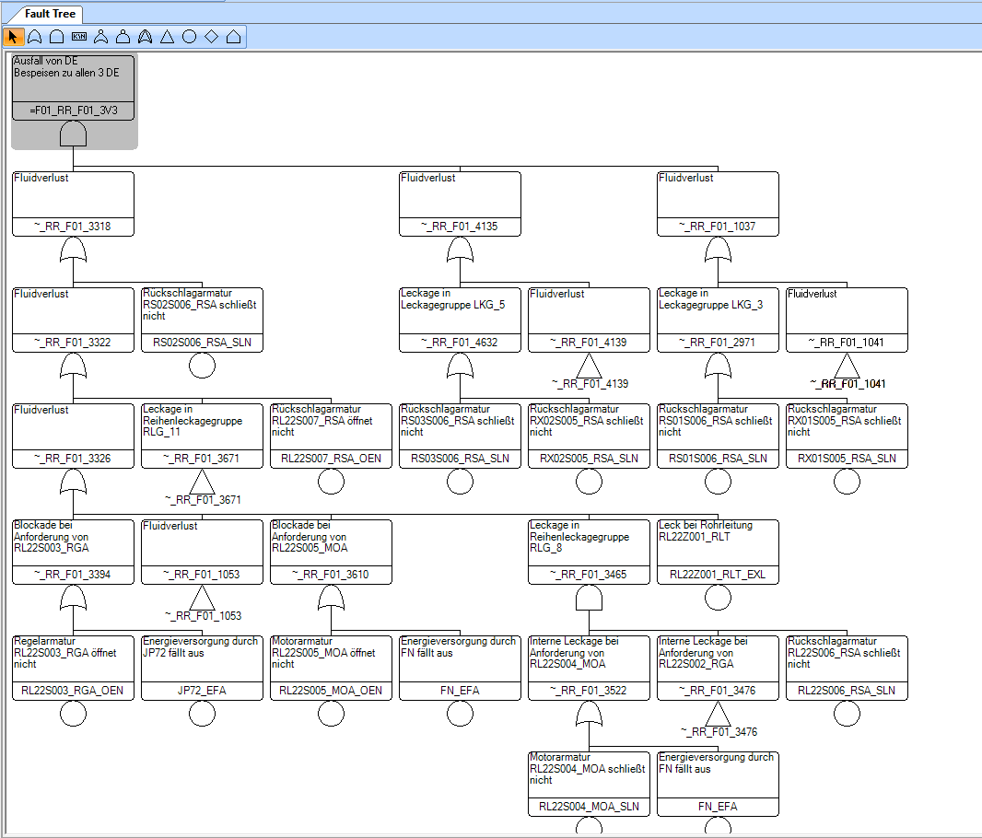
Modelling strategy – FT export to RiskSpectrum PSA
Fully-converted FT to RiskSpectrum PSA

Slide 15
Conclusions
A new system-level modelling strategy is presented, comprising the different steps:
  development of the KKG-specific KB in Figaro language
  system analyses and creation of FMEA database → Framatome’s dedicated software tool "ScanAKZ" enables the automatic import of the marked P&ID to the FMEA-DB
  compilation of simplified system P&IDs
  their import in the RSMB → Framatome’s dedicated software tool "KBMassImport" allows for a so-called automatic mass import of the FMEA-DB for the given system into the RSMB
  development of the RSMB system models ➔ end goal of creation of the corresponding FTs and their export to the plant-level PSA modelling
Three different systems are used within this paper as case studies – the ECCS (TH), the startup and shutdown FW system - RR, as well as conventional closed cooling water system VH as one of the important support systems
Advantages of using the RSMB tool in combination with the presented methodology:
  Automatic processing of pre-edited system P&IDs
  Clearly documented and traceable connection between the system P&IDs and the plant-level modelling in RiskSpectrum PSA can be established
  The simplified P&IDs allow easy manipulation of the FT model
  The routines for automated reading of the simplified P&IDs in the FMEA database as well as the automated import of the PSA-relevant components to RSMB highly increase the efficiency
  Higher grade of consistency in the PSA studies is ensured
  The modelling assumptions are systematic, traceable and easily verifiable
  Also, a higher grade of homogeneity among the system models is achieved
  In addition, once the PSA model is built by using the RSMB tool, then a rapid, efficient and systematic model maintenance and model update potential is ensured for the future.

Slide 16
Thank you for your attention !

Slide 17
Q & A

