Slide 1
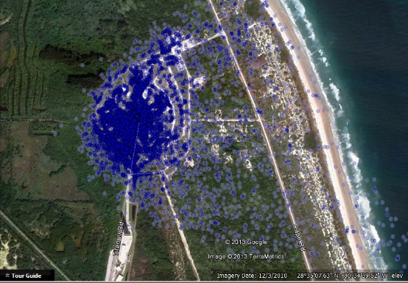
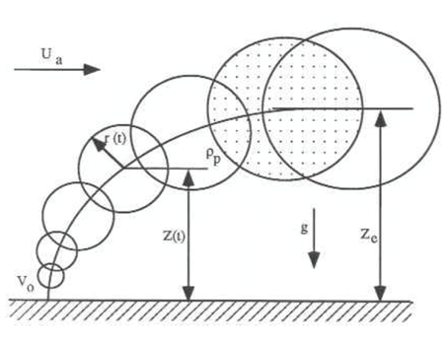
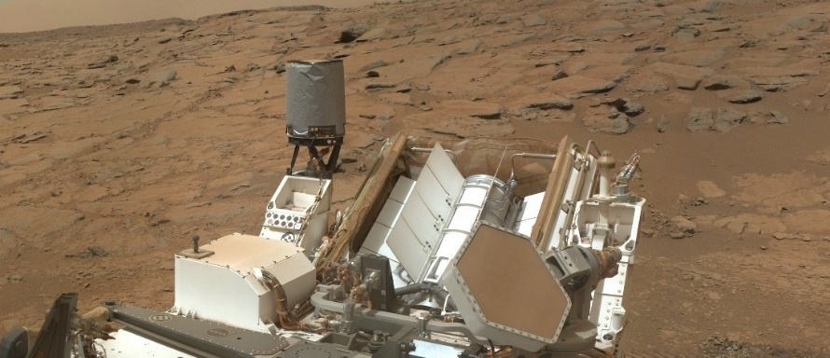
Summary of the Nuclear Risk Assessment 2019 Update for the Mars 2020 Mission Environmental Impact Statement
Dr. Daniel J. Clayton
Probabilistic Safety Assessment & Management
PSAM 16
June 26-July 1, 2022

Slide 2
Perseverance Rover on Mars
Multi-Mission Radioisotope Thermoelectric Generator
Image Courtesy NASA

Slide 3
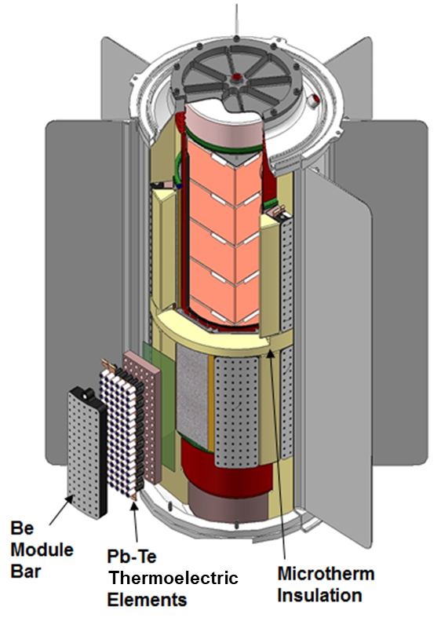
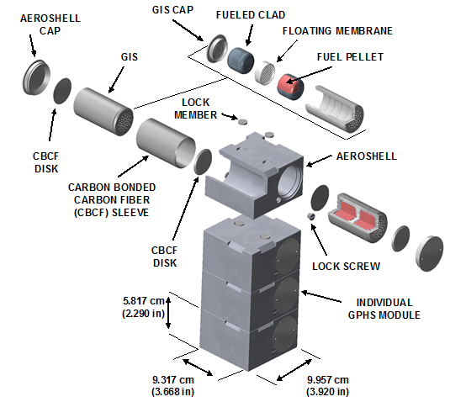
Multi-Mission Radioisotope Thermoelectric Generator (MMRTG)
Safety is built from the inside out and from the outside in.
Analysis must quantify this for decision makers.

Slide 4
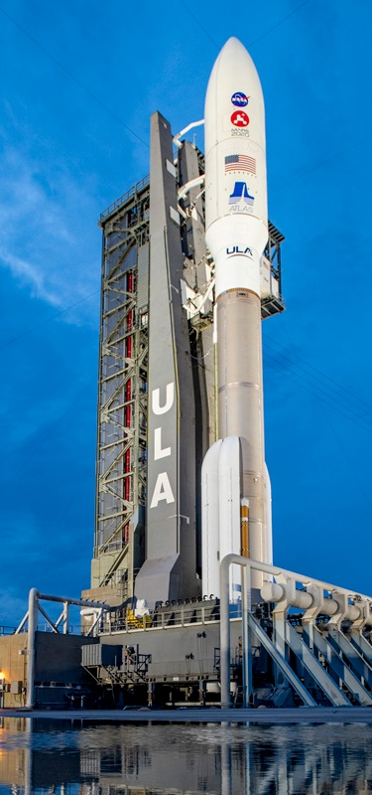
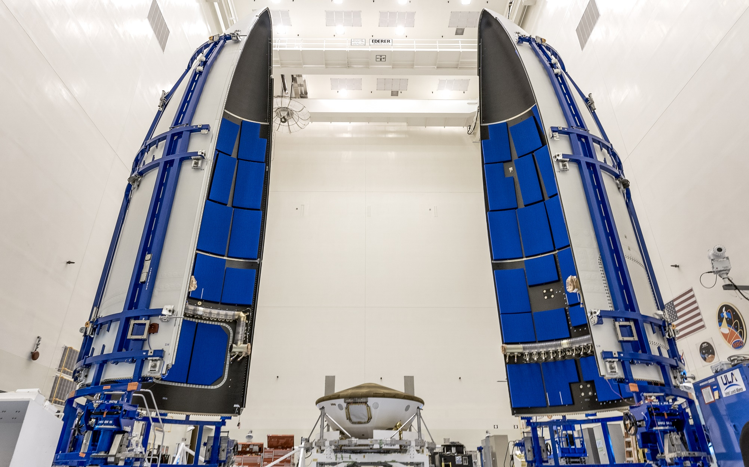
Space Nuclear System Sits on Top of a Very Powerful Launch Vehicle
Images Courtesy NASA

Slide 5
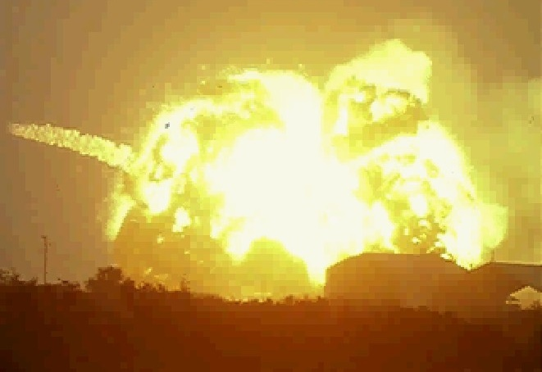
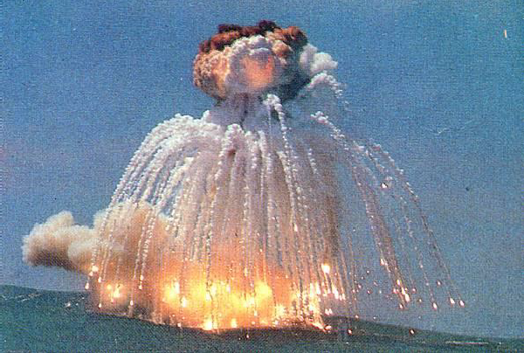
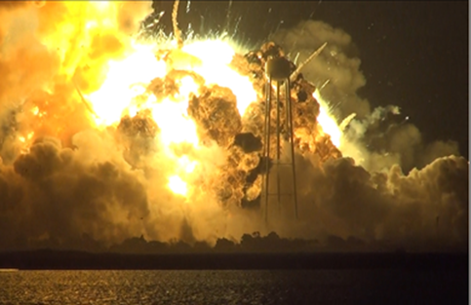
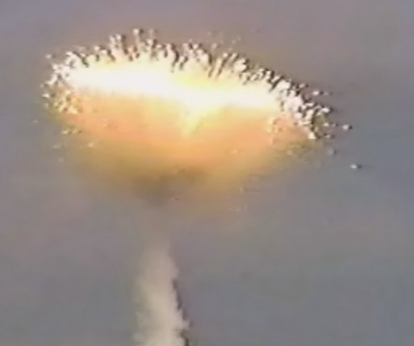
Launches Can Fail
Atlas Fallback-1965
Titan 34D-Apr 18, 1986
Antares-Oct 28, 2014
Delta 241-Jan 27, 1997

Slide 6
Space Nuclear Systems Launch Safety Approach
Identify main sources of risk, to allow for potential mitigating actions, to reduce the overall mission risk
Goal: Quantitative estimate of the risk that is defensible and credible
  Mean probability of an accident
  Mean probability of release of radioactive material
  Mass of material released (“source term”)
  Health effects (doses, latent cancer fatalities)
  Land, crop contamination
  All expressed as mean values, percentile values, and exceedance probability graphs
  Quantify uncertainty

Slide 7
Characterization of Risk
Probabilistic methods applied to generate specific probabilities of interest to define the risk picture for decision makers
$$P\left(C>c_{i}\right)=P\left(C>c_{i} | release\right) P\left(release | accident\right) P(accident)$$
  $$\text{Probability} \text{of} \text{a} \text{consequence} \text{greater} \text{than} \text{a} \text{certain} \text{threshold}$$
Probability of an accident occurring
Probability of a release given an accident
Probability of a consequence greater than a certain threshold given a release

Slide 8
Mission Phases
Phase 0 – Prelaunch, T < t₁, from installation of the system to just prior to start of engines at t₁
Phase 1 – Early Launch, t₁ ≤ T < t_{x}, start of engines to no potential for land impact in the launch area, t_{x}
Phase 2 – Late Launch, t_{x} ≤ T, end of Phase 1 to the launch vehicle reaching 30,480 m (100,000 ft), above which reentry heating could occur
Phase 3 – Suborbital Reentry, end of Phase 2 to just prior to orbit
Phase 4 – Orbital Reentry, end of Phase 3 to spacecraft separation
Phase 5 – Long-Term Reentry, end of Phase 4 to no chance of Earth reentry

Slide 9
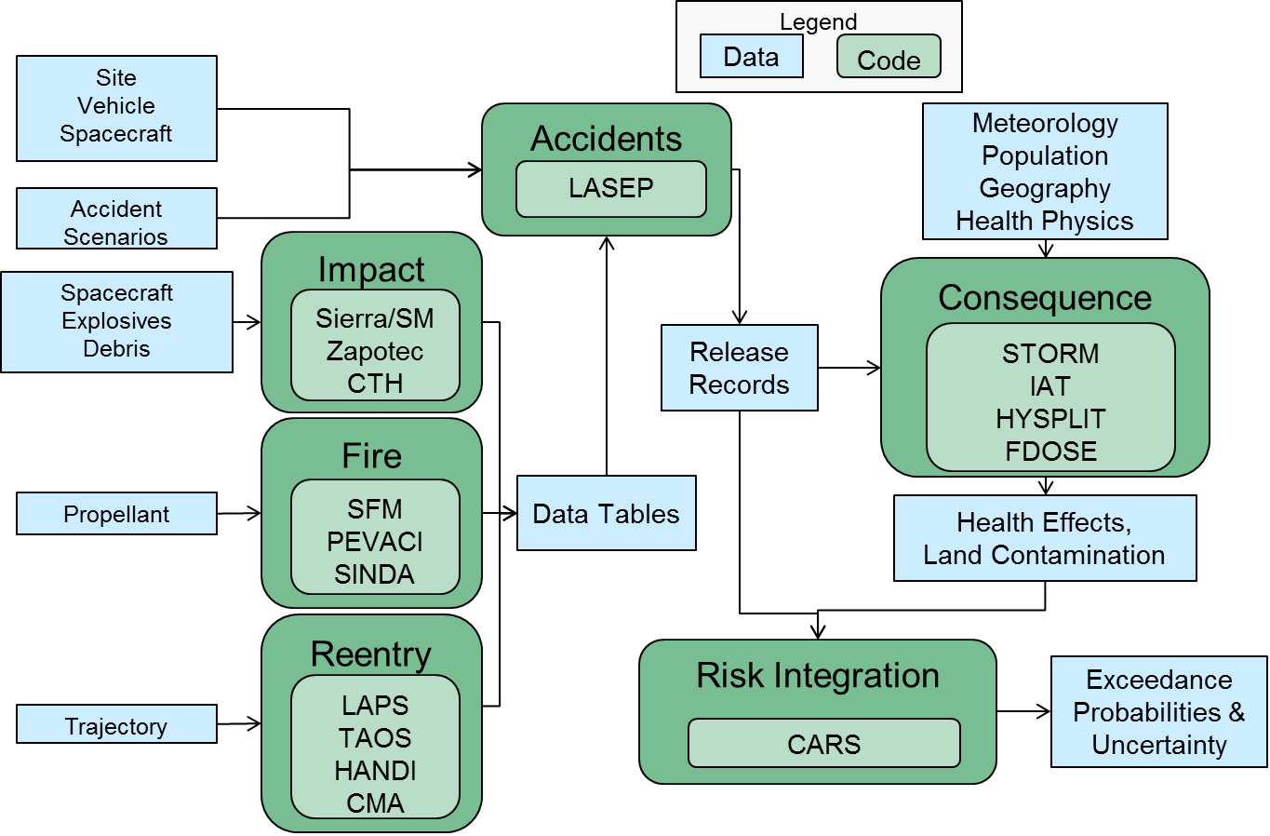
Launch Safety Code Suite

Slide 10
National Environment Policy Act Activities
January 2014 – Nuclear Risk Assessment (NRA) for the Mars 2020 mission
November 2014 – Final Environmental Impact Statement (FEIS)
January 2015 – Record of Decision (RoD) to proceed with mission
Investments made towards mission
  Mars 2020 rover and scientific payload design
  Mars landing site selection
  Selection of launch vehicle and launch period
  Power system fueling
  NASA/DOE safety testing & modeling updates
July 2019 – Mars 2020 Mission Final Safety Analysis Report
August 2019 –National Security Presidential Memorandum-20 (NSPM-20)
September 2019 – Nuclear Risk Assessment 2019 Update
January 2020 – Supplemental Environmental Impact Statement (SEIS)
July 2020 – Launch of Mars 2020 mission

Slide 11
National Security Presidential Memorandum-20
This Memorandum establishes an updated and risk-informed process for launching space nuclear systems by
  Structuring launch authorization for space nuclear systems to follow a tiered process based on system characteristics, level of potential risk, and national security considerations
  Establishing safety guidelines to assist mission planners and launch authorization authorities in ensuring launch safety across the full range of space nuclear systems.
  Directing that safety analyses incorporate past experience to maximize effectiveness and efficiency.
  Replacing the mission-specific ad hoc Interagency Nuclear Review Panel (INSRP) with a standing Interagency Nuclear Safety Review Board (INSRB).

Slide 12
Comparison with NSPM-20 Safety Guidelines
Results from the NRA 2019 Update show probabilities and uncertainty intervals at the NSPM-20 dose levels within safety guidelines

Slide 13
Accident Probability Comparison
Reduction due to updated launch vehicle information
  Selection of launch vehicle
  Additional launches of similar launch vehicles
  Fault tree development

Slide 14
Total Probability of Release Comparison
Increase due to model and input parameter updates
  Solid propellant fragmentation and trajectory
  Liquid and solid propellant fire environments
  Plutonia release model
  Potential debris impact area
  Blast model information
  Module and iridium cladding response to impact forces

Slide 15
Consequence Measure Comparison
Increase due to model updates and increased source terms
  Weather data
  Propellant plume rise with particle tracking in plumes
  Age-specific and organ-specific dose coefficients
  Organ-specific and exposure pathway-specific risk coefficients
  Region-specific crop information

Slide 16
Consequence Risk Comparison
Increase in consequence risks
  Decrease in accident probability
  Increase in release probability, source term, and consequence measures
  Uncertainty level of 25x specified in 2014 NRA
  Three consequence risks above factor of 25
  Three consequence risks below factor of 25

Slide 17
Summary
NRA addresses response of system to potential accident and abort conditions and provides the technical basis for radiological risks in SEIS
NRA updated based on specific investments and revised models and input parameters
Overall mission consequence risks increased
SEIS issued based on updated information
Well within safety guidelines in NSPM-20
Successful launch and landing on Mars (and still going strong)

