Slide 1
Diagnosis of Failure Modes from Bearing Data via Deep Learning Variational Autoencoder Method
Authors: Thais Lucas, Lavínia Araújo, Diego Aichele,
Márcio das Chagas Moura and Isis Lins

Slide 2
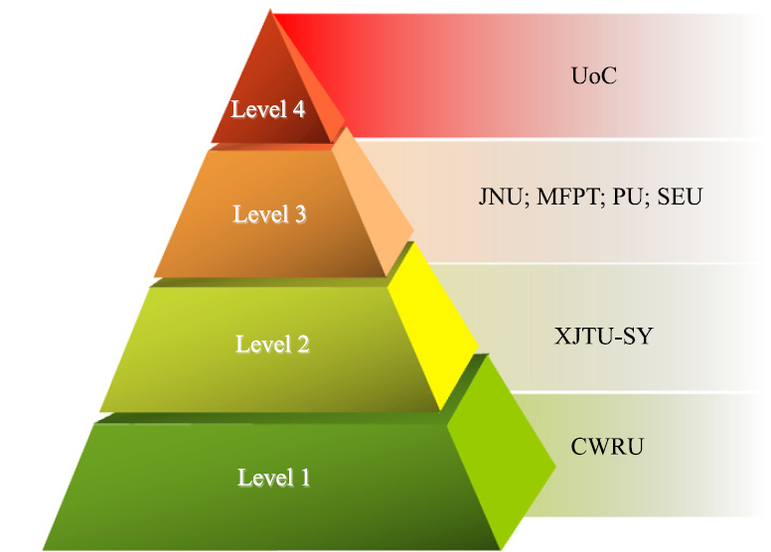
Introduction
Diagnosis methods:
Machine Learning approaches.
For unlabeled data:
Variational Autoencoder (VAE).
This paper aims to apply VAE for bearing failure mode diagnosis and compare it to the results of Zhao et al. (2020) for datasets with distinct levels of complexity
UoC
JNU; MFPT; PU; SEU
XJTU-SY
CWRU
The level of dataset difficulty (Zhao et al., 2020).
Source of bearing datasets
Notes:
Significant progress are seen in diagnosis methods including feature extraction using signal processing methods and defect classification adopting Machine Learning approaches.
For unlabelled data, an unsupervised learning could be achieved with a Variational Autoencoder (VAE). This task is more challenging because there is less information available in the dataset, making the learning more difficult. The difficulty of the seven datasets was ranked by Zhao et al. (2020) according to the accuracy exceeding 95% in each dataset, and based on that the pyramid was drawn.

Slide 3
The Datasets
CWRU Description
JNU Description
Mode Description
Health State at 600 rpm
Inner ring at 600 rpm
Outer ring at 600 rpm
Rolling Element at 600 rpm
Health State at 800 rpm
Inner ring at 800 rpm
Outer ring at 800 rpm
Rolling Element at 800 rpm
Health State at 1000 rpm
Inner ring at 1000 rpm
Outer ring at 1000 rpm
Rolling Element at 1000 rpm
Mode Description
Health State
Inner ring 1: 0.007 inch
Inner ring 2: 0.014 inch
Inner ring 3: 0.021 inch
Rolling Element 1: 0.007
Rolling Element 2: 0.014
Rolling Element 3: 0.021
Outer ring 1: 0.007 inch
Outer ring 2: 0.014 inch
Outer ring 3: 0.021 inch
Notes:
In the data, single-point faults were purposefully generated with fault diameters of 0.007, 0.014, and 0.021 inches on the rolling element, the inner ring, and the outer ring. The healthy state and the 9 faulty ones are shown in the table with its respective proportion in the dataset.
JNU datasets consisted of three bearing vibration datasets with different rotating speeds, and the data were collected at 50 kHz. The main difference from CWRU is that it considers 3 working conditions (600, 800 and 1000 rpm) and there is no distinction regarding failure extent. The healthy state and its 3 faulty ones for each working condition are shown in the table with its respective proportion in the dataset.
CWRU: same condition, different sizes
JNU: same size, diferente conditions
So, it is more difficult to identify failures in different conditions, than different sizes at same condition.

Slide 4
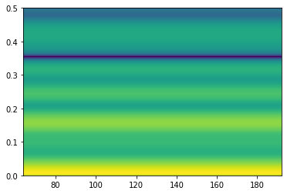
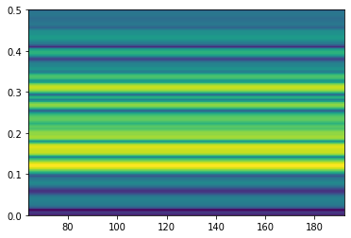
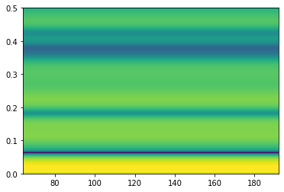
Input types
Pre-processing:
STFT
CWT
Slicing image
Notes:
The sizes of the images are the same as in Zhao et al. (2020) for comparison purposes.
Short-time Fourier Transform (STFT) is a Fourier-related transform applied to determine the sinusoidal frequency and phase content of local sections of a signal as it changes over time. This reveals the Fourier spectrum on each resulting segment. The chosen length of each sample is 33, resulting in 33 × 33 images.
The Hanning window is used and the window length is 64.
The Continuous Wavelet Transform (CWT) comes as a solution to the failures of the Fourier Transform because it uses variable scale windows to process the data in the time-frequency domain. The chosen length of each sample is 100, resulting in 100 × 100 images
the length of each sample xi is set to 100
Slicing image input consists of reshaping the non-processed data input into a 32 × 32 image.
Check spectrograms vs scalograms
Não entendi muito bem o slice
O que são os eixos?

Slide 5
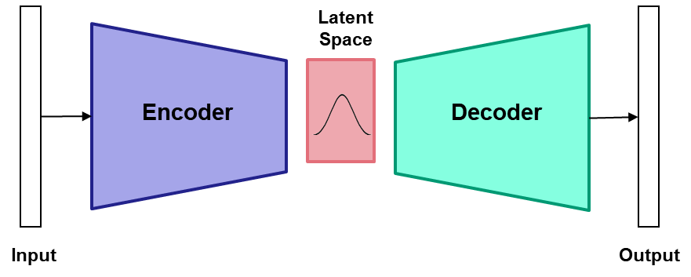
Variational Autoencoder (VAE)
Generative models that address the problem of finding an approximation to the posterior probability distribution p(z|x)
Combine neural networks, Bayesian variational inference and unsupervised learning
Latent Space:
z
Latent Space:
z
Encoder $q_{θ}(z|x)$
Decoder $p_{φ}(x|z)$
Data: x
Reconstruction:$\tilde{x}$
Reduces dimensionality
Reconstructs data
[1] Proposed by D. Kingma & M. Welling. “Auto-Encoding Variational Bayes”, arXiv:1312.6114v10], 2014

Slide 6
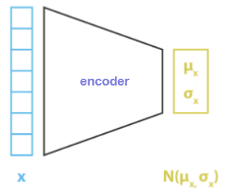
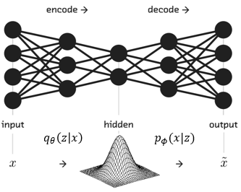
Encoder: q_{θ}(z|x)
It is chosen to be the family of multivariate isotropic Normal distributions
$$\left.q_{θ}\left(z | x\right)∼N(z|μ\left(x,φ_{1}\right), σ\left(x,φ_{2}\right)I\right)$$
[2] https://towardsdatascience.com/understanding-variational-autoencoders-vaes-f70510919f73
The hidden Gaussian
[3] https://towardsdatascience.com/what-the-heck-are-vae-gans-17b86023588a
Notes:
It is parametrized by a neural network with weights and biases θ : known as encoder or inference network
It takes a data point x as input and outputs a latent representation z
The lower-dimensional latent space is stochastic
The encoder’s NN outputs the parameters of q_{θ}(z|x)
Sample from q_{θ}(z|x) to get noisy values of the representations z
$μ$: neural network that takes as input the original data $x$ as well as weights and biases denoted by $φ_{1}$ and then outputs a vector of means for the latent variables
$σ$: neural network that takes the original data as input, it has a set of weights and biases denoted by $φ_{2}$, and outputs a vector of variances
Since the distribution $q(z|x)$ is forced to be isotropic, the vector of variances is multiplied by the identity matrix to form the covariance matrix
This serves a double purpose:
It allows each latent variable to have its own mean and variance, so it is a relatively flexible model
An isotropic Normal distribution in conjunction with the prior for p(z) as a standard Normal distribution makes the Kullback-Leibler divergence in the loss function to have a close and easy form to compute

Slide 7
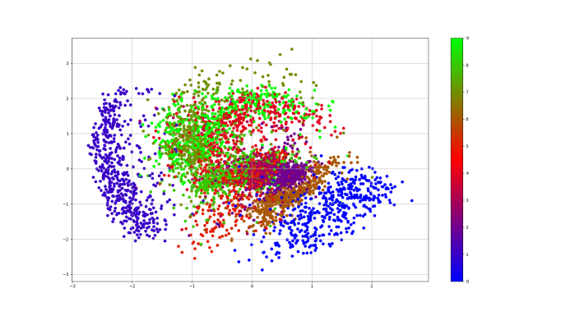
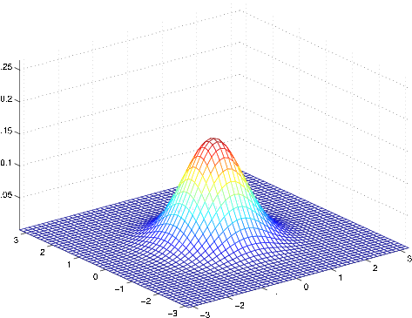
Latent Space
$$\left.p\left(z\right)∼N(z|0,I\right)$$
Prior distribution:
Posterior distribution of the latent variables $q_{θ}\left(z | x\right)$
[4] https://www.jobilize.com/course/section/the-gaussian-discriminant-analysis-model-by-openstax
[5] https://mohitjain.me/2018/10/26/variational-autoencoder/
Notes:
We can interpret z as “hidden” or “latent” variables that control what we can actually see
Note that:
If the encoder outputs representations z that are different than those from a standard Gaussian distribution, it receives a penalty in the loss
This regularization term encourages the encoder to produce representations z of inputs that are sufficiently diverse
Otherwise, the encoder could learn to cheat and give each data point a representation in a different region of Euclidean space
It would result in a poor representation of the underlying manifold(s)

Slide 8
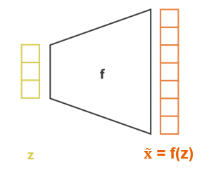
Decoder: p_{φ}(x|z)
It takes as input the representation z and outputs a reconstructed input x
The decoder network outputs the parameters of the probability distribution of the data p_{f}(x|z)
$f$: neural network that takes a set of latent variables z and a set$φ$ of weights and biases
p_{φ}(x|z) depends on the type of data
[6] https://towardsdatascience.com/understanding-variational-autoencoders-vaes-f70510919f73
Notes:
It is parametrized by a neural network with weights and biases f : it is the decoder or generative network

Slide 9
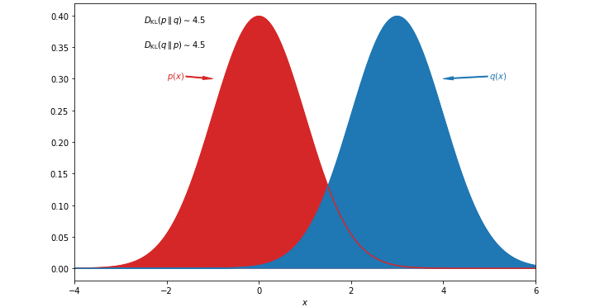
Training VAE
Our target is $p(z|x)$:
Bayes theorem gives us:
where $p\left(x\right)=\int{\left.p(x|z)p(z\right)dz}$ is the normalization factor.
We use variational inference to approximate the posterior $p(z|x)$ with a family of distributions $q_{θ}\left(z | x\right)$:
The distance or similitude between $p(z|x)$ and $q_{θ}\left(z | x\right)$ is measured by the Kullback-Leibler divergence (KL):
$$p\left(z | x\right)=\frac{\left.p(x,z\right)}{\left.p(x\right)}=\frac{\left.p(x|z)p(z\right)}{\left.p(x\right)}$$
$$KL(q|\left|p\right)= \int_{−∞}^{+∞}{p\left(x\right)\ln{\frac{\left.p(x\right)}{\left.q(x\right)}}dx}$$
$$θ_{}^{∗}=argmin_{θ}\left(KL\left(q_{θ}\left(z | x\right)||p(z|x)\right)\right)$$
[7] https://datumorphism.leima.is/wiki/machine-learning/basics/kl-divergence/
Notes:
We want $p(z|x)$:
In modelling some physical phenomenon, z represents coefficients that have real world interpretations
We can also compute $p\left(z | x\right)$ and then obtain $p(x)$ in a generative process
This integral requires exponential time to compute as it needs to be evaluated over all configurations of latent variables.
Variational parameter $θ$ indexes the family of distributions
For $q_{θ}\left(z | x\right)$given by a Gaussian: $θ=\left(μ_{x_{i}},σ_{x_{i}}\right)$
where $p$ and $q$ are two probability distributions defined over a continuous random variable $X$

Slide 10
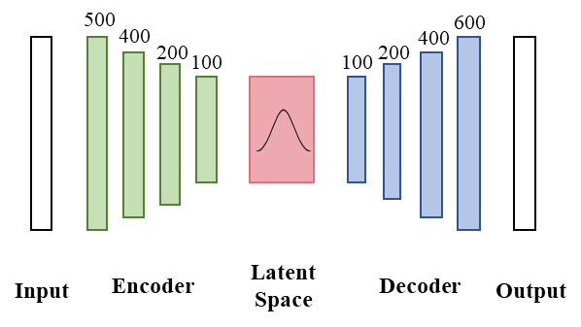
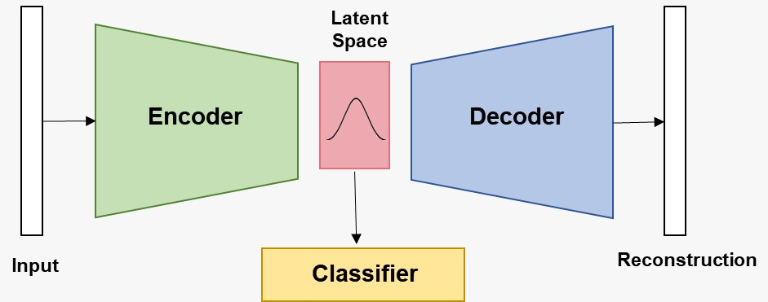
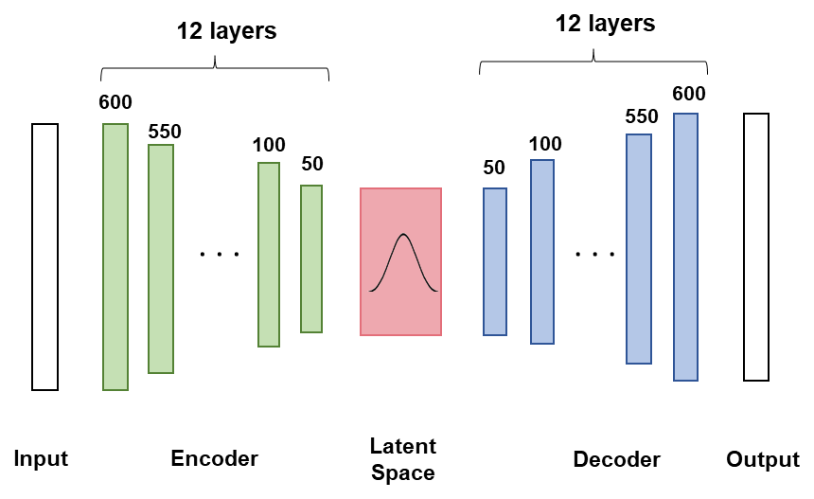
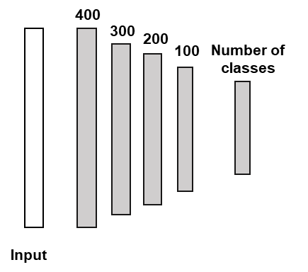
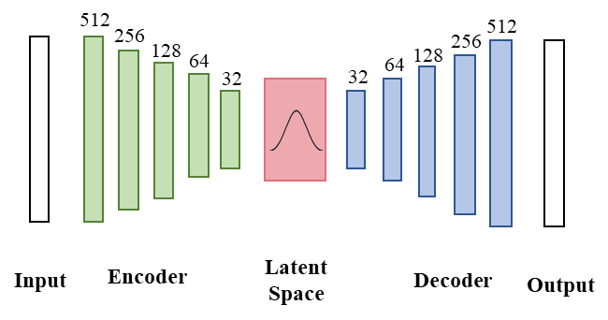
Methodology
Three different architectures for both datasets.
01
Repeat each experiment five times
02
Save mean and maximum values of:
overall accuracy;
last epoch accuracy.
Data preprocessing
03
Evaluation of metrics:
Last-Mean
Last-Max
Best-Mean
Best-Max
Notes:
The 3 architectures employed, each one containing distints number of neurons and of layers. The classifier is the same used for all the architectures.
The experiments were run with the proportions of 80% of samples as the training set and 20% of samples as the testing set which were randomly selected. To obtain reliable results and show the best overall accuracy that the model can achieve, we repeat each experiment five times. Four indicators are used to assess the performance of models, including the mean and maximum values of the overall accuracy obtained by the last epoch and the mean and maximum values of the maximal overall accuracy. For simplicity, they can be denoted as Last-Mean, Last-Max, Best-Mean, and Best-Max, respectively.
Qual a diferença entre as arquiteturas, essencialmente?
Arc 2 aumentou o numero de layers

Slide 11
CWRU Results
Architecture 1
Metric | STFT | CWT | Slice
Last-Mean | 0.9925 | 0.8127 | 0.3789
Last-Max | 0.9947 | 0.8199 | 0.3908
Best-Mean | 0.9966 | 0.8233 | 0.3968
Best-Max | 0.9989 | 0.8262 | 0.4057
Architecture 2
Metric | STFT | CWT | Slice
Last-Mean | 0.7821 | 0.5757 | 0.4509
Last-Max | 0.7934 | 0.5858 | 0.4792
Best-Mean | 0.809 | 0.5892 | 0.4792
Best-Max | 0.7966 | 0.5921 | 0.4641
Architecture 3
Metric | STFT | CWT | Slice
Last-Mean | 0.9218 | 0.1769 | 0.1802
Last-Max | 0.9297 | 0.1769 | 0.181
Best-Mean | 0.9282 | 0.1771 | 0.1857
Best-Max | 0.9361 | 0.1779 | 0.1863
CNN – Zhao et al. (2020)
Metric | STFT | CWT | Slice
Last-Mean | 0.9931 | 0.9885 | 0.8552
Last-Max | 1 | 0.9907 | 0.9387
Best-Mean | 0.9946 | 0.9935 | 0.9464
Best-Max | 1 | 0.994 | 0.9655
Notes:
For CWRU we can identify that the model with the best accuracy is STFT, followed by CWT, and finally Slice. In fact, the Slice model is expected to be the worst among the three, since the raw data is only transformed into images, without major transformations. Therefore, there is more noise in the diagnosis of failure modes. We can also make a comparison between the different architectures used in VAE. STFT and CWT had better results in architecture 1, i.e., increasing the layers of the MLP does not result in greater assertiveness of the model. While architecture 2 excelled, in terms of accuracy, in relation to Slice. Architecture 3 has better results compared to STFT in relation to Architecture 2, but Architecture 1 still emerges. Finally, we can perform a comparison between the results of our architectures with those obtained by Zhao et al. [4] using a CNN. Regarding CWT and Slice, the supervised method has better metrics. As for STFT, on the other hand, the results are quite close. It shows that, with this type of data pre-processing, the VAE performs as well as the CNN.
Generally, architecture 1 got the best results with the highest accuracy for stft
Supervised method still got the best results, but we need to evaluate the cost/trade-off to label the data
In red, the best results
Colocar mais cor
Pq colocou o resultado da CNN?
Por ser um método supervisionado com bons resultados. A intenção foi fazer um comparativo em relação ao VAE, para mostrar que com os dados categorizados o CNN é bom nos três cenários, mas no caso do método não supervisionado, apenas os dados tratados com STFT mostram-se bem acurados.
Além disso o método não supervisionado que o zhao testou não tratou imagens, apenas os sinais com FFT e time domain.
Qual a razão do CWT e do Slide serem tão piores?
Sobre o slice, uma explicação é que os dados brutos são apenas redimensionados para um espectograma, sem tratamentos significativos.
Já o CWT configura-se como uma imagem mais complexa. Nas arquiteturas ele gerou muito problema de overfitting também.

Slide 12
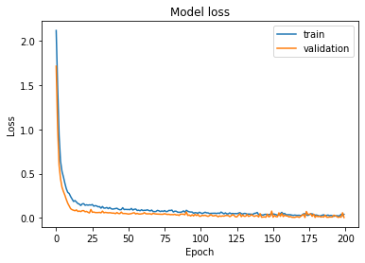
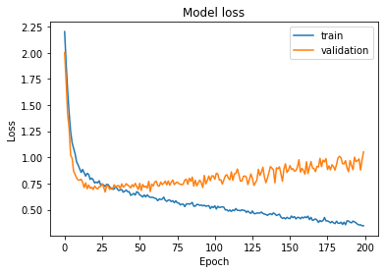
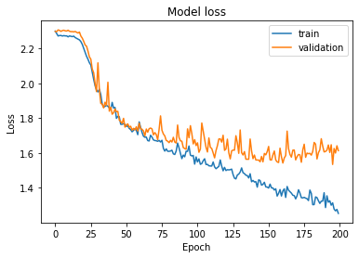
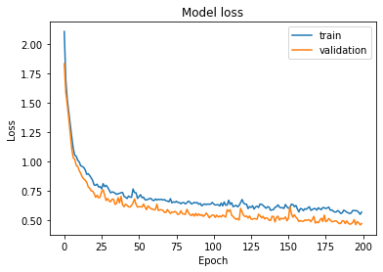
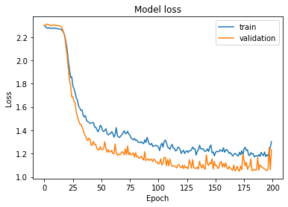
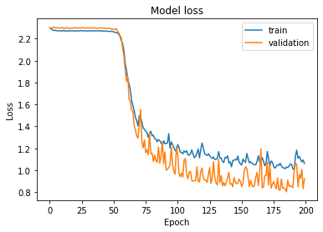
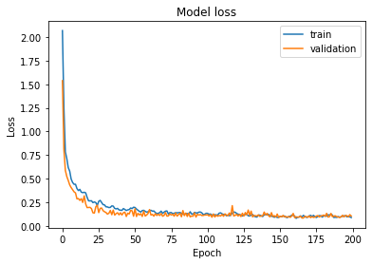
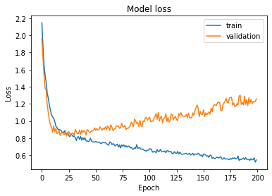
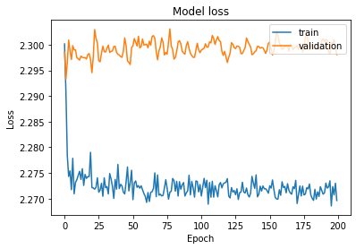
CWRU Results: Overfitting problems
CWT
CWT
STFT
CWT
STFT
STFT
Slice
Slice
Slice
Architecture 1
Architecture 1
Architecture 1
Architecture 2
Architecture 2
Architecture 3
Architecture 3
Notes:
Arquitetura 2 teve overfitting no cwt e arquitutura 3 no cwt e slice
Arquitetura 2 teve overfitting no cwt
O que devo destacar aqui?

Slide 13
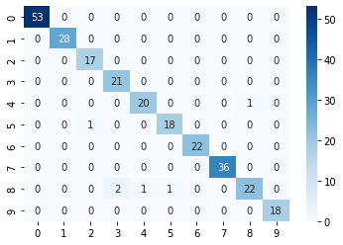
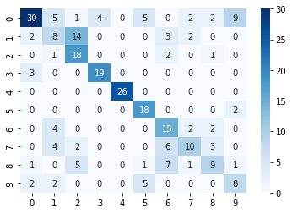
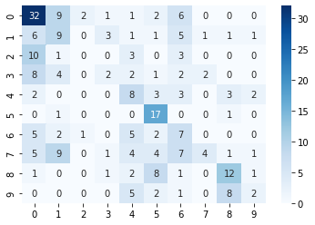
CWRU Results: Architecture 1
STFT
CWT
Slice
Notes:
O que devo destacar aqui?

Slide 14
JNU Results
Architecture 1
Metric | STFT | CWT | Slice
Last-Mean | 0.669 | 0.378 | 0.273
Last-Max | 0.667 | 0.375 | 0.267
Best-Mean | 0.669 | 0.372 | 0.259
Best-Max | 0.66 | 0.368 | 0.254
Architecture 2
Metric | STFT | CWT | Slice
Last-Mean | 0.596 | 0.166 | 0.171
Last-Max | 0.602 | 0.172 | 0.183
Best-Mean | 0.608 | 0.176 | 0.191
Best-Max | 0.611 | 0.18 | 0.194
Architecture 3
Metric | STFT | CWT | Slice
Last-Mean | 0.631 | 0.167 | 0.256
Last-Max | 0.647 | 0.176 | 0.262
Best-Mean | 0.640 | 0.177 | 0.272
Best-Max | 0.647 | 0.178 | 0.275
CNN – Zhao et al. [4]
Metric | STFT | CWT | Slice
Last-Mean | 0.437 | 0.697 | 0.429
Last-Max | 0.481 | 0.724 | 0.464
Best-Mean | 0.472 | 0.723 | 0.487
Best-Max | 0.517 | 0.755 | 0.496
Notes:
the same accuracy pattern present in the CWRU dataset results appears in the JNU, where the best results are found in the STFT pre-processed data, followed by CWT and Slice. But in this case, the accuracy is not as high as found in the CWRU data. In terms of architecture, the former was the one with the best results in terms of accuracy for all input types. Although the architecture 2 performed a bit better for the Slice data in comparison to the CWT, its results did not surpass the ones found in the first model. Similarly, architecture 3 performed better than architecture 2, but the first one is still better. Finally, we can compare our results with those of a supervised method (CNN). The results obtained by Zhao et al. [4] show that the use of CNN is preferable when pre-processing the data with CWT or Slice. However, our three architectures were more effective when preprocessing data in STFT.

Slide 15
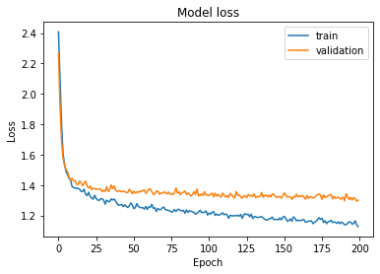
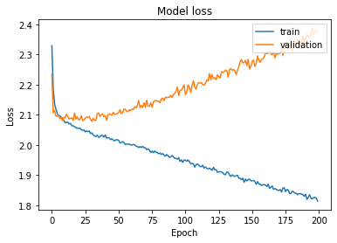
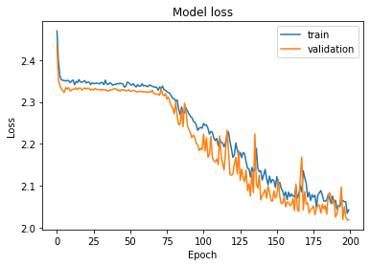
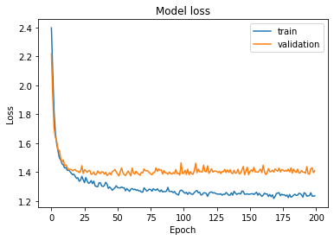
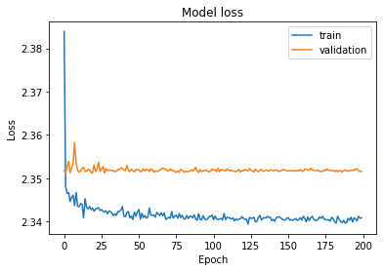
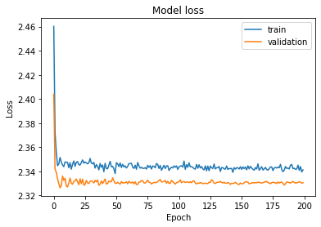
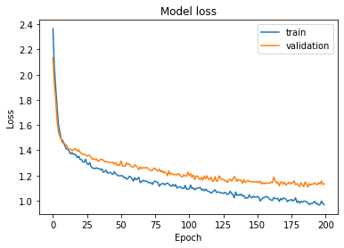
JNU Results: Overfitting problems
STFT
CWT
Slice
Architecture 1
Architecture 2
Architecture 3
Notes:
Arquitetura 2 teve overfitting no cwt e arquitutura 3 no cwt
O que devo destacar aqui?

Slide 16
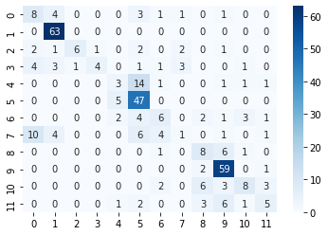
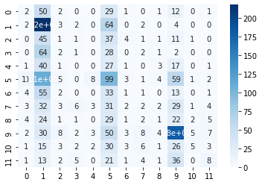
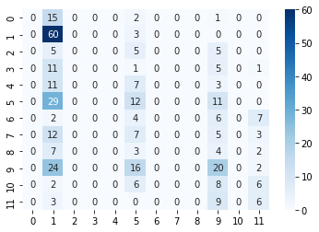
JNU Results: Architecture 1
STFT
CWT
Slice
Notes:
Comentários?

Slide 17
Conclusions
Architecture 1 and STFT had the best results.
The level of difficulty considerably influenced the performance
Compared to a supervised method, VAE shows better or similar results to CNN when using STFT
Future research: test other architectures, including ones considering CNN, and compare with other methods
Notes:
Por que a architecure 1 é a melhor?
Por que STFT é o melhor?

Slide 18
Thank you!
Do you have any questions?

