Slide 1

HIERARCHICAL BAYESIAN ESTIMATION OF FIRE GROWTH RATE FOR VARIOUS BUILDING USAGES BASED ON THE FIRE INCIDENTS REPORT
Yoshikazu Deguchi (NILIM)
Keisuke Himoto (NILIM)
Notes:
Aloha, I’m Yoshikazu Deguchi, from Ibaraki, Japan.
Today, I’d like to talk about an estimation of a factor called the fire growth rate, which is used in evacuation safety design in fires, using hierarchical Bayesian estimation based on the fire incidents report.
Now, let’s look at the next slide.

Slide 2
Aims of this study
To estimate the distribution of Fire Growth Rate (FGR) using fire statistics for a wide range of room uses.
In previous studies, distribution of FGR of typical room uses (offices, residences, restaurants, merchandise stores) were estimated.
Office
Deguchi, Y. et.al, “Statistical Estimation of the Distribution of Fire Growth Factor -Study on Risk Based Evacuation Safety Design Method-”, Fire Safety Science, 2011
Notes:
Aims of this study is to estimate the distribution of Fire Growth Rate (hear after FGR) using fire statistics for a wide range of room uses.
Actually, previous studies have estimated the distribution of FGR of typical room uses: offices, residences, restaurants and merchandise stores.

Slide 3
Aims of this study
To estimate the distribution of Fire Growth Rate (FGR) using fire statistics for a wide range of room uses.
In previous studies, distribution of FGR of typical room uses (offices, residences, restaurants, merchandise stores) were estimated.
sufficient data
CHALLENGE
How to estimate the distribution of FGR which could not be estimated due to insufficient data in the previous study.
SOLUTION
Using Hierarchical Bayesian Estimation
Notes:
These four room uses could be estimated because sufficient data was available.
The challenge of this study is to estimate the distribution of FGR which could not be estimated due to insufficient data by use of Hierarchical Bayesian estimation.
Now, let me explain to you about FGR.

Slide 4
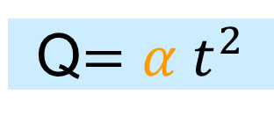
What is the Fire Growth Rate (FGR,α) ?
FGR is a factor of fire spreadability
Q$=α t^{2}$
Smoldering
Growth
Fully developed fire
Decay
Flashover
Heat Release Rate Q (kW)
Ignition
Time t
FGR is one of the most important factors for fire safety design
Notes:
First of all, I’d like to talk about “what is the FGR”.
This is a conceptual diagram of building fire progression.
The x-axis is time and the y-axis is the heat release rate.
FGR is a factor that expresses the degree of fire growth during the growth period.
Generally, in the field of building fire engineering, heat release rate Q is expressed as a quadratic function of time, and the coefficient is defined as FGR.
You can see how FGR is an important factor in fire safety design.
Next, I will describe the fire statistics used for the estimation.

Slide 5
About Fire statistical data
National Fire Statistics
All fire incidents which occur are reported to fire stations in Japan and are recorded by the National Fire Defense Agency
Screening conditions (following previous study)
Time period: FY1995-2018
Fire classification: Building fires
Explosions: No explosive fires
Burnt floor area: At least 1 m²
First-aid firefighting: None
Time from start of water spraying to extinguishment: 60 min or less
Time from fire occurrence to start of water spraying: 20 min or less
Locations of fire occurrence: 41 uses
Data with estimated FGR of 1 kW/s² or over were excluded
28,702 incidents were extracted
Notes:
I used the Japanese National Fire Statistics.
In the statistics, all fire incidents which occur are reported to fire stations in Japan, and recorded by the National Fire Defense Agency.
And we screened the data using the criteria shown here and finally 28,702 incidents were extracted.
Next, let me talk a little about the Japanese Building Code.

Slide 6
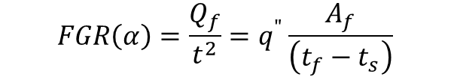

Method of Handling of the Fire Statistics
E
E≒F
F
A
f
D
Image of real fire behavior
Burnt Area A_{f} (m²)
assumed fire behavior
A≒C
A
C
B
t
s
t
estimated
ignition
time
first call
time
f
under
controlled
time
completely
extinguished
time
ignition
time
start of water
spraying time
t
Time (min.)
$$FGR\left(α\right)=\frac{Q_{f}}{t^{2}}=q^{"}\frac{A_{f}}{\left(t_{f}−t_{s}\right)}$$
$$q^{"}=q_{s}^{"}×A_{fuel}=130×0.54{\left(\frac{q_{l}}{16}\right)}^{1/3}$$
Notes:
This figure illustrated the method of handling the fire statistics data to calculate the FGR.
The dashed line(A-D-F) shows the image of growth of burnt area Af in actual fire and the red line shows the image of approximated fire growth curve.
We need the information of the time A and D, and burnet area at the time of D to calculate FGR.
However only the symbol ★ data can be obtained from the fire statistics.
So, the fire ignition time (C) was estimated by the fire department. Although a certain degree of error may be involved between the true values (A), we trust the accuracy of the professional estimate by the fire department.
That is, time (A)is considered to be approximately the same as time (C).
And the start of water spraying time (B) must be almost accurate.
While, we cannot obtain the burnt area at that time (D).
Alternately, we replace the time (B) with that of the final burnt area (F). Assuming that the fire spread was negligible after the start of water spraying because we focus the early fire stage, so that the burnt area at the start of water spraying (E) is not greatly different from the burnt area at the time of extinguishment (F).

Slide 7
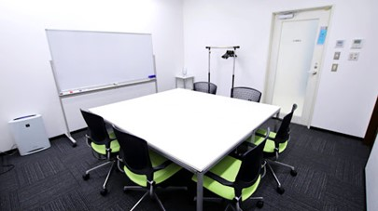
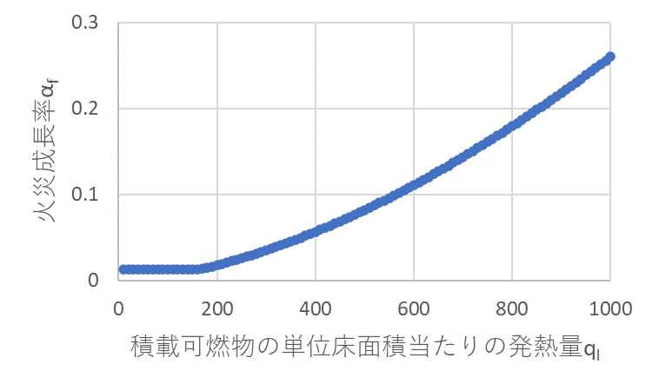
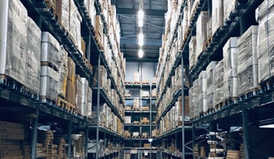
Definition of FGR in the Japanese Building Code
In the Japanese building code, FGR is calculated using the heat of combustible per unit floor area (q_{l}), that is set for each of the 22 types of room uses
Conference room
（q_{l}=160MJ/m²）
Fire Growth Rate α (kW/s²)
Heat of combustible per unit floor area (q_{l})
Storage
（q_{l}=2,000MJ/m²）
Notes:
In the Japanese building code, FGR is calculated using the heat of combustible per unit floor area (q_{l}), that is set for each of the 22 types of room uses.
For example, the ql of the conference room is set as 160 (MJ/m2), and from this formula FGR for the conference room can be calculated as 0.0125.

Slide 8
Statistical Data Classified for Each Room Use
id | Types of room use | q_{l} (MJ/m²) | Number of Data
1 | Habitable room in a dwelling | 720 | 18,002
⋮ | ⋮ | ⋮ | ⋮
4 | Conference room or room similar thereto | 160 | 91
⋮ | ⋮ | ⋮ | ⋮
6 | Exhibition room in a museum or art gallery or other similar thereto | 80 | 6
⋮ | ⋮ | ⋮ | ⋮
19 | Storage or other room used to store goods | 2000 | 4,315
sufficient data
insufficient data
Total 28,702
Notes:
This is a table that breaks down the fire statistics data into 22 types of room uses.
As you can see, there is wide divergence in the number of incidents involving the rooms shown in this slide.
For example, “Habitable room” has the largest number of incidents, while “Exhibition room” has only 6 incidents.
Now, let’s move on to “the Decision of probability distribution model”.

Slide 9
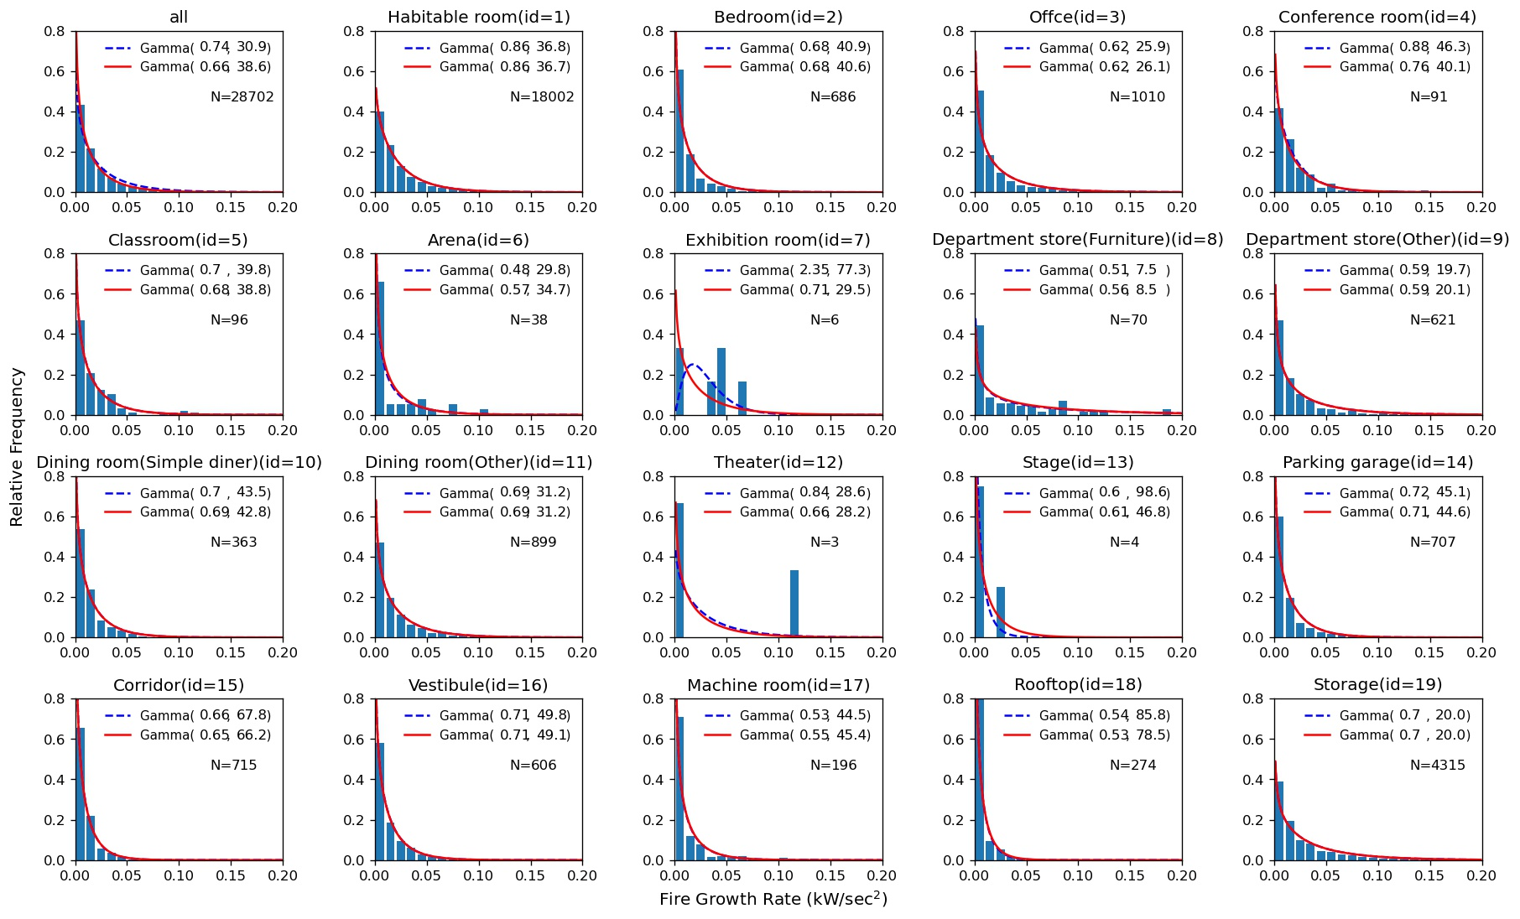
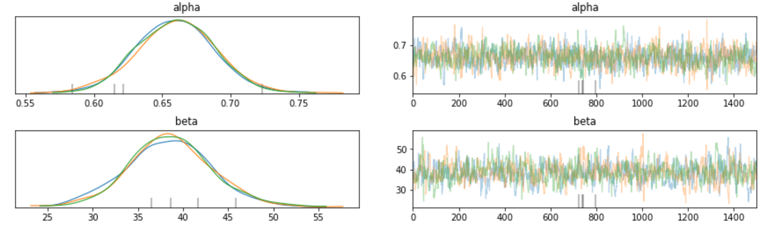
Decision of probability distribution model
Gamma distribution had the best degree of conformity
Relative Frequency
a : shape parameter
b : scale parameter
Fire Growth Rate (kW/s²)
Estimate two parameters, a and b, by MCMC
※MCMC（Markov Chain Monte Carlo methods）
Notes:
This figure shows the relative frequency distribution of all data on FGR.
We applied typical probability distribution such as gamma distribution, Rayleigh distribution and lognormal distribution.
As a result, the gamma distribution was used for the distribution of FGR in this study because it was found to be the most suitable.
As you know, the gamma distribution is expressed by this formula, and it has two parameters, a shape parameter “a” and a scale parameter “b”.
We estimated these two parameters by use of MCMC.
Next, let me explain “the calculation algorism”.

Slide 10
Calculation Algorithm
Pystan was used in the calculation algorithm of the (Hierarchical) Bayesian method.
5,000 trials of MCMC, (of which 500 trials were burn-in)
3 repetitions (total 15,000 trials, 1,500 burn-in)
Non-information prior distribution was used as the prior distribution
Notes:
Pystan was used in the calculation algorithm of Bayesian method and Hierarchical Bayesian method.
There were 5000 trials of MCMC, of which 500 trials were discarded as burn-in. And this was repeated three times.
Non-information prior distribution was used as the prior distribution.
Now, let’s move onto the next slide.

Slide 11
Results of the estimation
Notes:
This figure shows the estimated results of the distribution of FGR for each room uses.
The bars are histograms.
And the blue dotted line represents estimated distribution by the Bayesian method.
On the other hand, the red line represents estimated distribution by the Hierarchical Bayesian method.
The smaller and more biased the number of data, such as “the Exhibition room” , the larger the difference between the two methods.

Slide 12
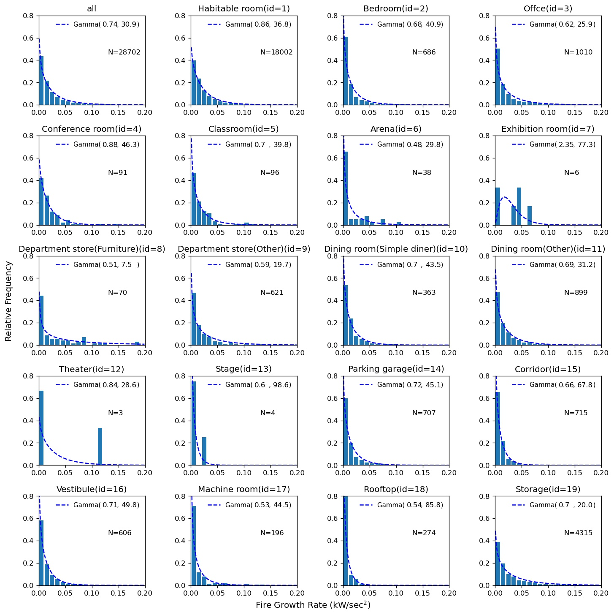
Estimation by Bayesian method
Parameter
a_
Habitable room
b_
Habitable room
a_i
b_i
a_
Exhibition room
b_
Exhibition room
・・・
・・・
Data
d_{H1}, d_{H2}・・・,d_{HN}
d_{i1}, d_{i2}・・・,d_{iN}
d_{E1}, d_{E2}・・・,d_{EN}
sufficient data
insufficient data
Distribution pattern differs from those for other room uses
GOOD
BAD
Notes:
This figure shows a graphical model of the Bayesian method.
Room uses with sufficient data, for example “the Habitable room”, is no problem, but room uses with insufficient data, such as “the Exhibition room”, cannot be estimated well.
We can see that the estimated distribution pattern differs from those of other room uses and difficult to predict.

Slide 13
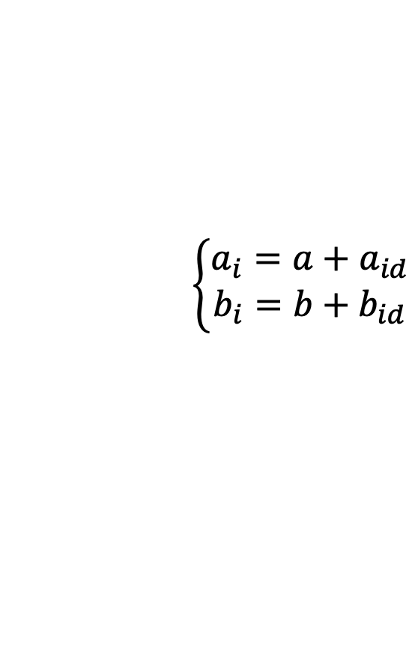
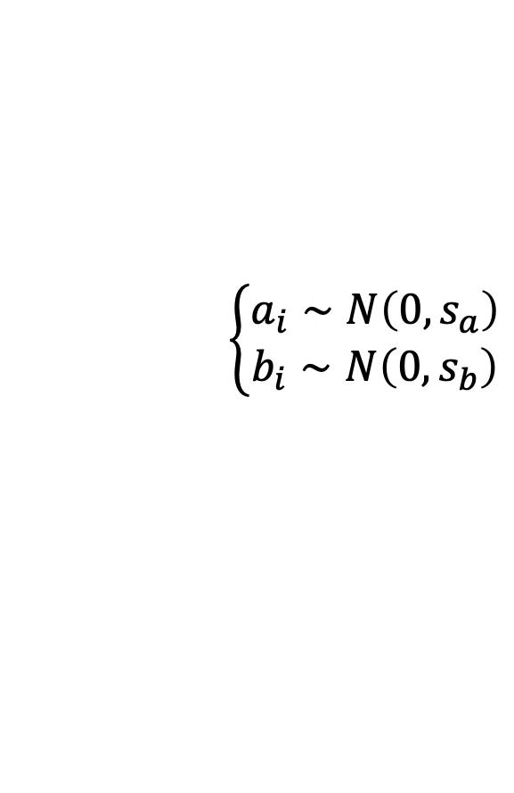
Estimation by Hierarchical Bayesian method
Parameter
S_a
a
b
S_b
a_
Habitable room
b_
Habitable room
a_i
b_i
a_
Exhibition room
b_
Exhibition room
・・・
・・・
Data
d_{H1}, d_{H2}・・・,d_{HN}
d_{i1}, d_{i2}・・・,d_{iN}
d_{E1}, d_{E2}・・・,d_{EN}
Group differences
$$\left\{\begin{matrix}a_{i}=a+a_{id} \\ b_{i}=b+b_{id}\end{matrix}\right.$$
$$\left\{\begin{matrix}a_{i}∼N\left(0,s_{a}\right) \\ b_{i}∼N\left(0,s_{b}\right)\end{matrix}\right.$$
Parameters a,b of all data
Notes:
On the other hand, this is a graphical model of the Hierarchical Bayesian method.
As shown in these Equations, this method assumes that the parameters ai, bi of room uses i are the parameters a, b of all data plus the group differences aid, bid.
And then, even for scarce data, stable estimations can be made using overall trends.

Slide 14
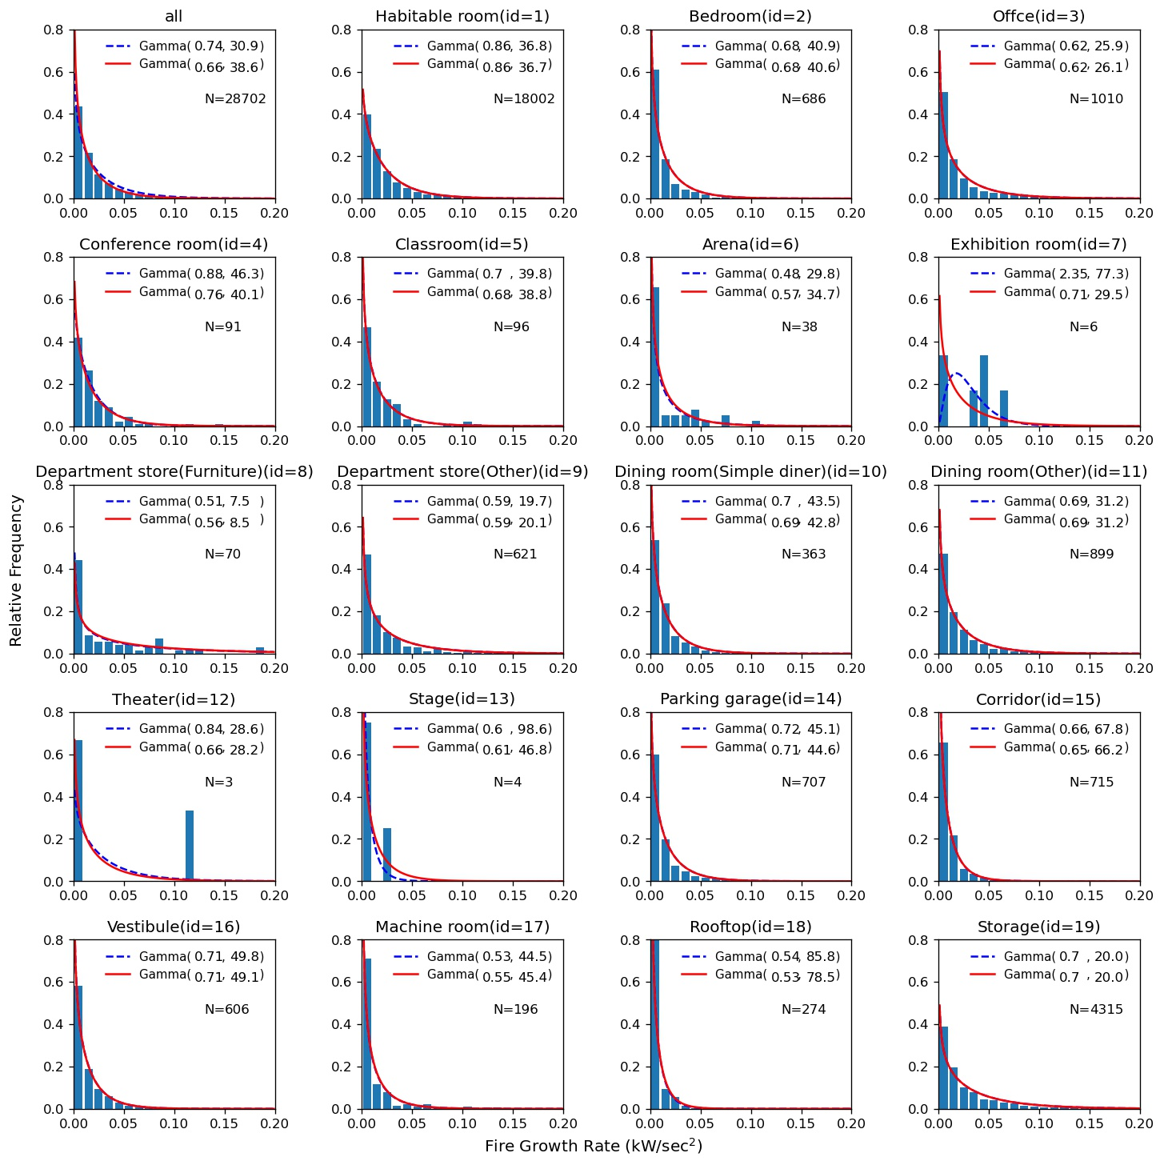
Estimation by Hierarchical Bayesian method
Parameter
S_a
a
b
S_b
a_
Habitable room
b_
Habitable room
a_i
b_i
a_
Exhibition room
b_
Exhibition room
・・・
・・・
Data
d_{H1}, d_{H2}・・・,d_{HN}
d_{i1}, d_{i2}・・・,d_{iN}
d_{E1}, d_{E2}・・・,d_{EN}
sufficient data
insufficient data
Good grasp of the overall
GOOD
GOOD
Notes:
Look at these figures of estimated distributions.
In the case of “the Habitable room”, there is only a small difference with the result of the Bayesian method.
While, in the case of “the Exhibition room”, even with insufficient data, we have a good grasp of the overall trend and are able to estimate the distribution well.
Finally, let’s talk about “Comparison with FGR set in the Japanese Building Code”.

Slide 15
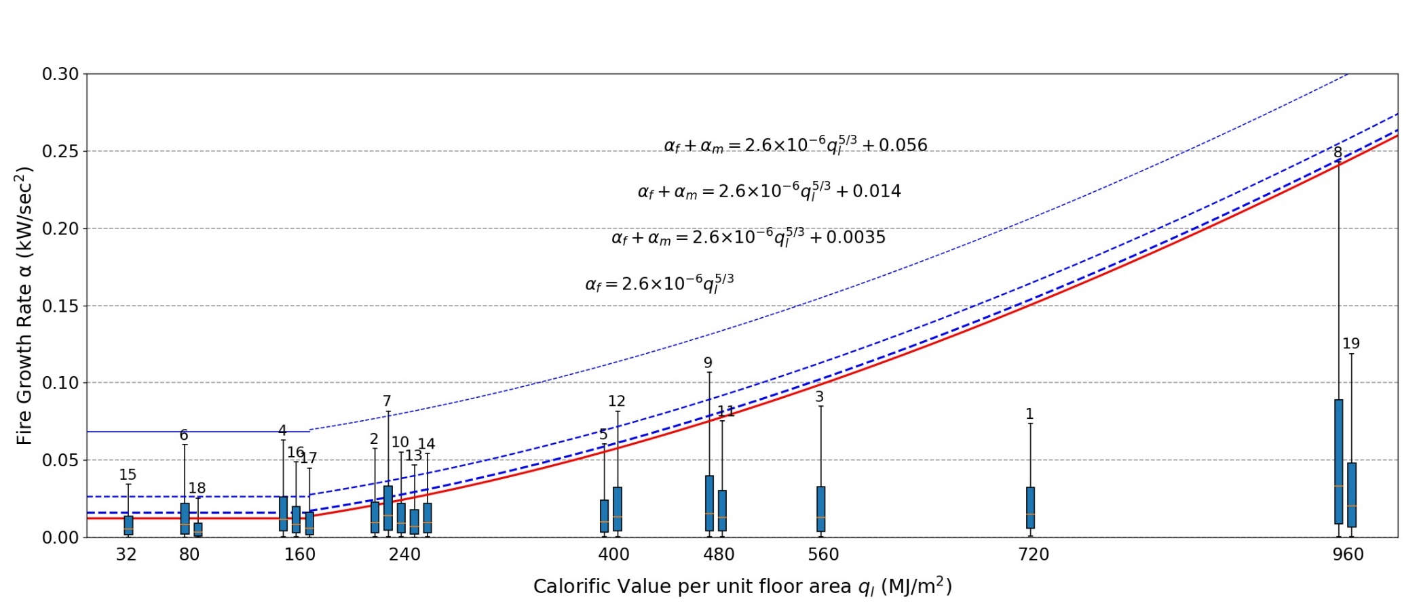
Comparison with FGR set in the Japanese Building Code
FGR of interior finish
flame-retardant materials
quasi-non-combustible materials
non-combustible materials
Conference room
Exhibition room
Office
Habitable room
Storage
Notes:
This figure shows the estimated results of the distribution of FGR of all room uses in the Hierarchical Bayesian method.
The x-axis is ql and the y-axis is FGR.
The red line in the figure represents FGR set in the Japanese building code.
And the three blue dotted lines are FGR which include interior finish burning.
Blue box plots are estimated results of FGR for each of 22(19) types of room uses.

Slide 16
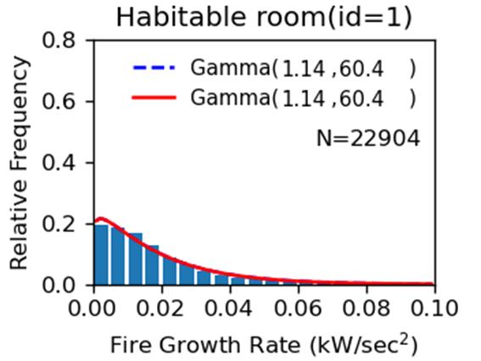
Box plot
95%
75%
50%
5%
50%
95%
25%
75%
25%
5%
Notes:
This diagram shows the box plots in this study.
Please note that it differs from regular box plots, as the percentile values are 5, 25, 50, 75 and 95%.
Let’s go back and look at the previous slide.

Slide 17
Comparison with FGR set in the Japanese Building Code
flame-retardant materials
quasi-non-combustible materials
non-combustible materials
Conference room
Exhibition room
Office
Habitable room
Storage
The estimated results by use of Hierarchical Bayesian method has been successful
Notes:
We can not specify the interior finish of fire rooms from the fire report, here we will consider an example of assuming that quasi-non-combustible materials are used as interior materials.
FGR of Japanese building code for all room uses had a larger value than the estimated 75 percentile value.
However, in many uses it was smaller than the estimated 95 percentile value.
Therefore, our estimations have shown that the estimated results by use of the Hierarchical Bayesian method has been successful.
In conclusion,

Slide 18
Conclusion
Hierarchical Bayesian estimation could be used to estimate the distribution of FGR even in room uses with insufficient data.
Compared to the estimated distribution of FGR, it was found that the FGR set in the Japanese building code assumed a fire equivalent to the 75 percentile of actual fires.
The distributions of FGR by room uses obtained in this study are useful data that can be used in fire safety design not only in Japan but also worldwide.
Notes:
Hierarchical Bayesian estimation could be used to estimate the distribution of FGR even in room uses with insufficient data.
Compared to the estimated distribution of FGR, it was found that the FGR set in the Japanese building code assumed a fire equivalent to the 75 percentile of actual fires.
The distributions of FGR by room uses obtained in this study are useful data that can be used in fire safety design not only in Japan but also worldwide.
This concludes my presentation today.
I’d like to thank you all for your participation.
Does anyone have any questions?

Slide 19

Mahalo !

