Slide 1
Institut für Maschinenelemente
Forschungsbereich Zuverlässigkeitstechnik
Risk-based Reliability Demonstration Test Planning for Decision Making under Uncertainty
Probabilistic Safety Assessment and Management Conference (PSAM 16)
Dr.-Ing. Martin Dazer

Slide 2
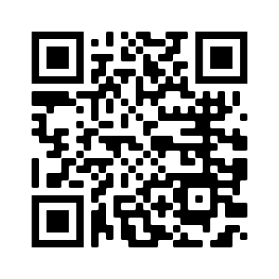
Institute of Machine Components
Reliability Department
Dr.-Ing. Martin Dazer
e-mail
dazer@ima.uni-stuttgart.de
phone +49 (0) 711 685-
66164
www.
www.
ima.uni-stuttgart.de
reltest-solutions.com
„Find us on LinkedIn“
Pfaffenwaldring 9
70569 Stuttgart
Germany

