Slide 1
Benchmark on External Events Hazard Frequency and Magnitude Statistical Modelling
Dr. Curtis Smith (Idaho National Laboratory)
June 2022

Slide 2
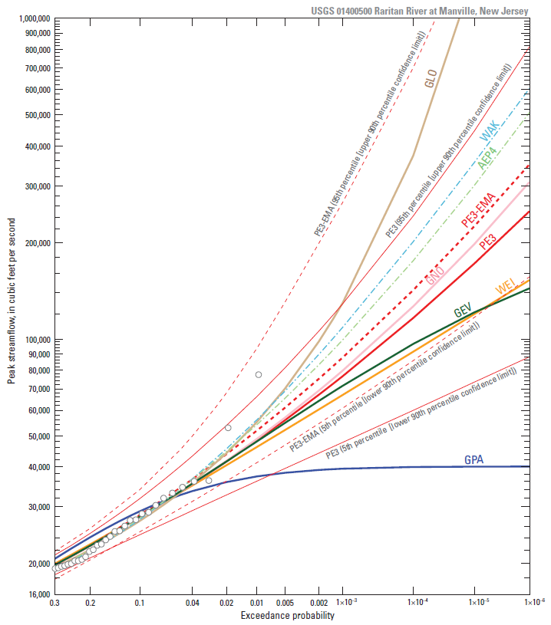
Motivation
How to deal with this?

Slide 3
Background
Working Group on External Hazards (WGEV) from OECD/NEA took on this challenge
Hazard initiating event (IE) is starting point for the risk models
  IE both contributes to risk quantification results and provides the boundary conditions for the hazard scenarios
Current practice has shown a variety of technical approaches, models, and limitations in validation of external events IE
Benchmark intended to capture commendable practices in formulating and assessing quantification of external event IEs when using statistical models
Open to a variety of technical communities
  Academia, government agencies, industry, research institutes, and Technical and Scientific Support Organizations

Slide 4
WGEV Administration
WGEV Chair: Min Kyu Kim (KAERI, South Korea)
WGEV Bureau: John A. Nakoski – Vice Chair (NRC, USA), ShiZhong Lei (CNSC, Canada), Dana Havlin Novakova (SONS, Czechia), Vincent Rebour (IRSN, France), Gernot Thuma (GRS, Germany), Stef Carelsen (ANVS – Netherlands)
WGEV Participants from:
  Belgium (BelV), Bulgaria (Kozloduy NPP), Canada (CNSC, OPG), Czech Republic (SONS), Finland (STUK), France (IRSN, EdF), Germany (GRS), Japan (NRA), Netherlands (ANVS), Poland (PPA), Romania (Cernavoda NPP), Spain (CSN), South Korea (KAERI), Sweden (SSM), Switzerland (ENSI), United States (NRC, DOE, EPRI)
  International Atomic Energy Agency, and World Metrological Organization
Established in 2014

Slide 5
Example Completed Activities for WGEV
NEA/SEN/SIN/WGEV(2015)1 – Technical Note on Severe Weather with Concurrent Flooding and High Winds
NEA/CSNI/R(2017)13 – Proceedings for the Workshop on Severe Weather and Storm Surge
NEA/CSNI/R(2018)7 – Examination of Approaches for Screening External Hazards
NEA/SEN/SIN/WGEV(2018)1 – Topical Report on Riverine Flooding
NEA/SEN/SIN/WGEV(2018)13 – Proceedings for the Workshop on Riverine Flooding
NEA/CSNI/R(2020)9 – Concepts and Definitions for Protective Measures in Response to External Flooding Hazards

Slide 6
Benchmark on External Events Hazard Frequency and Magnitude Statistical Modelling (1/3)
Objective
The objective of this benchmark study was to facilitate an exercise on statistical modelling in order to better understand the quantitative technical analysis steps and processes used for assessing hazard frequency and magnitude for external events risk assessment.
The global objective of the benchmark study launched by the OECD, is to focus on an initiating event induced by an external hazard. The statistical modelling of a hazard frequency and magnitude is of a particular interest in this benchmark.

Slide 7
Benchmark on External Events Hazard Frequency and Magnitude Statistical Modelling (2/3)
Scope
The scope of the benchmark study included hypothetical data describing the external hazard comes from synthetic models for two cases :
  Case 1 : a fully-revealed open case where both the synthetic data and the synthetic model producing the data is provided ;
  Case 2 : a blinded-test case where only the synthetic data is provided.

Slide 8
Benchmark on External Events Hazard Frequency and Magnitude Statistical Modelling (3/3)
Participants were asked to describe the assumptions made to create the hazard frequency/magnitude model(s), the qualitative and quantitative results of the model(s), the process used to assess the adequacy of the model(s), and the results of the model adequacy assessment.
Phenomenological-based evaluation and modelling was not considered since only “observational-type” data (derived from a synthetic model) is provided, resulting in statistical-types of models to be considered.
Participants:
  EdF, Finnish Meteorological Institute, INL (two groups), IRSN, KAERI, Romney Duffey

Slide 9
Process
The benchmark exercise process
  Benchmark proposal
  Benchmark specification
  Benchmark draft results and insights technical note
  Benchmark final results and insights technical note
  Prepare final CSNI Technical Report

Slide 10
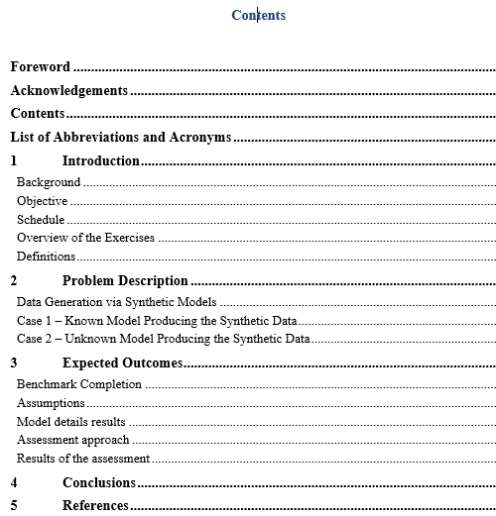
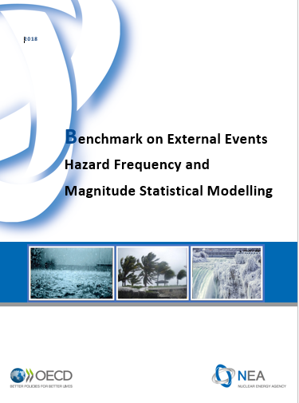
Benchmark specification report

Slide 11
What is next?
The report has been finalized and edited
It will soon be published by OECD/NEA and be made public

