Slide 1

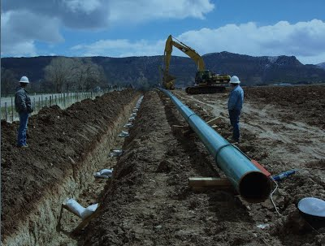
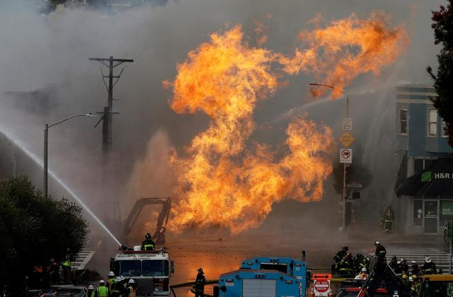
Construction and Verification of a Bayesian Network for Third-Party Excavation Risk Assessment (BaNTERA)
Colin Schell, Andres Ruiz-Tagle, Austin Lewis, Dr. Katrina Groth, GTI: Ernest Lever
Center for Risk and Reliability, Mechanical Engineering / Reliability Engineering
University of Maryland
This information, data or work presented herein was funded in part by the U.S. Department of Transportation Pipeline and Hazardous Materials Safety Administration’s Pipeline Safety Research and Development Program, under Award Number 693JK32110002POTA. The views and conclusions contained in this document are those of the authors and should not be interpreted as representing the official policies, either expressed or implied, of the Pipeline and Hazardous Materials Safety Administration, the Department of Transportation, or the U.S. Government.

Slide 2
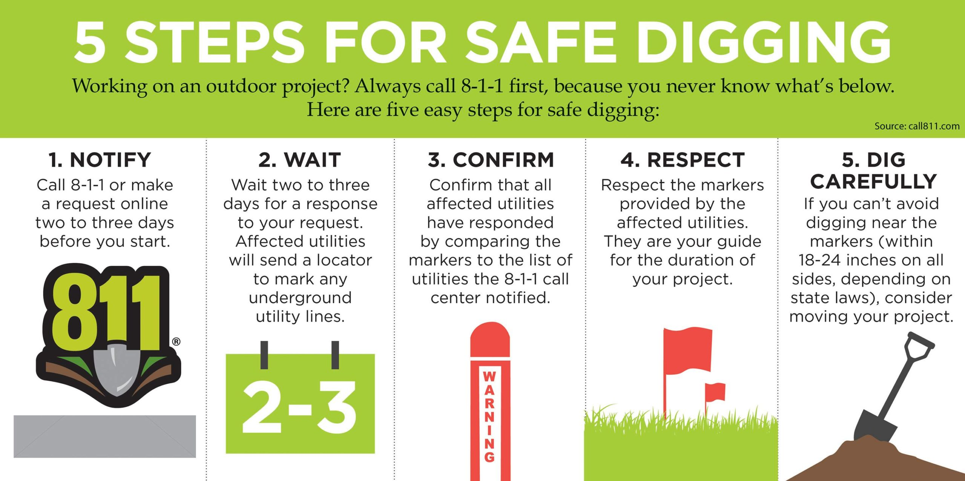
What is third-party pipeline damage?
Third-party damage (TPD) to pipelines refers to damage caused by excavators that are not related to the pipeline company.
Excavators are encouraged to follow the process shown below in order to protect against TPD.

Slide 3
Third-party damage to natural gas pipelines remains a significant threat
Between 2016 and 2021, third-party damage was responsible for an estimated 21.45% of all damages to U.S. gas transmission and distribution lines.
These incidents resulted in $140M USD in property damage.
Current third-party damage models do not capture a sufficiently comprehensive set of up-to-date root cause factors to model an modern excavation process.

Slide 4
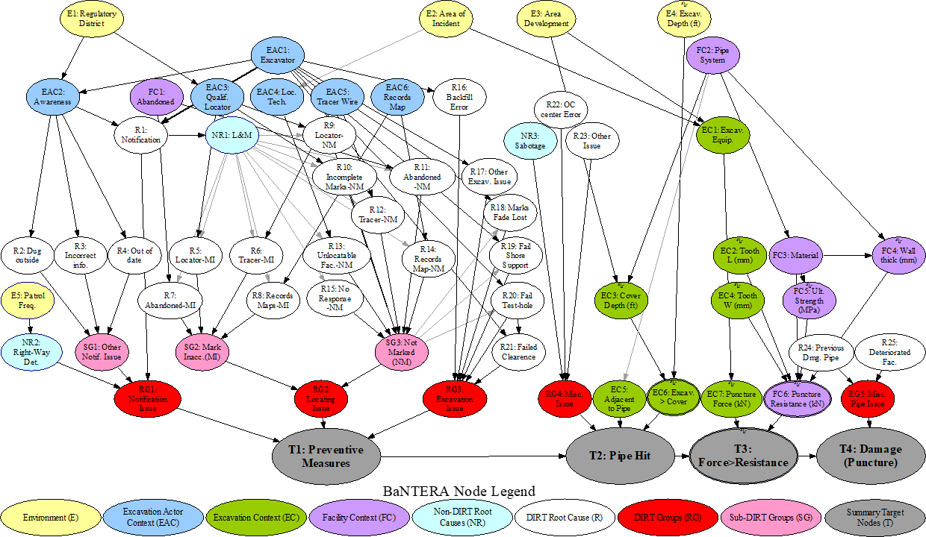
What is BaNTERA?
A probabilistic graphical model that represents a general excavation process and a comprehensive set of risk influencing factors.
A holistic decision support tool for third-party damage.
  Includes the best-available industry data.
  Flexible, adaptive model – can “learn” as we gather data, knowledge.
  Built as a Bayesian network (BN) enabling in-depth causal reasoning.
Useable for quantifying risk – and identifying how to reduce it.
Notes:
MVC software architecture -- multiple user views can be built on same underlying models
Transformed “v0” (FY13 Matlab implementation) of QRA algorithm into “v1” (a useable tool for industry, per C&S/QRA workshop)

Slide 5
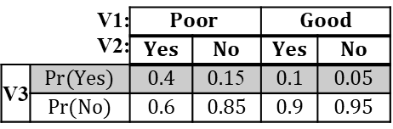

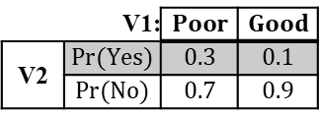
Bayesian Networks (BNs) are a model & reasoning tool
BNs are:
  A model documenting relevant variables and their conditional dependencies (causal).
    Expressed as nodes, arcs & conditional probabilities.
  A tool for performing probabilistic reasoning under uncertainty.
V1 | $$Pr(Poor)$$ | $$0.05$$
 | $$Pr(Good)$$ | $$0.95$$
Variable 1
Variable 2
V1: |  | $$Poor$$ | $$Good$$
V2 | $$Pr(Yes)$$ | $$0.3$$ | $$0.1$$
 | $$Pr(No)$$ | $$0.7$$ | $$0.9$$
Variable 3
V1: V2: |  | $$Poor$$ |  | $$Good$$
 |  | $$Yes$$ | $$No$$ | $$Yes$$ | $$No$$
V3 | $$Pr(Yes)$$ | $$0.4$$ | $0.1$5 | $$0.1$$ | $$0.05$$
 | $$Pr(No)$$ | $$0.6$$ | $$0.85$$ | $$0.9$$ | $$0.95$$
$Pr\left(V3 ∩V1∩V2\right)$ = $Pr\left(V3 | V1,V2\right)∗Pr\left(V2 | V1\right)∗Pr\left(V1\right)$

Slide 6
The benefits of a BN extend beyond other ML/AI techniques
Causal Insight: Beyond “just” risk assessment – understand cause/effect, perform “what-if” analyses, identify & prioritize ways to prevent, mitigate risk.
Completeness: Includes all variables, not just those with “enough” data.
Credibility: Models built with information & data from multiple sources, experts.
Understandability: Explicitly represents all variables and relationships deemed relevant to the problem space.
A BN can incorporate the data from the science & engineering, the experts, and the statistics.

Slide 7
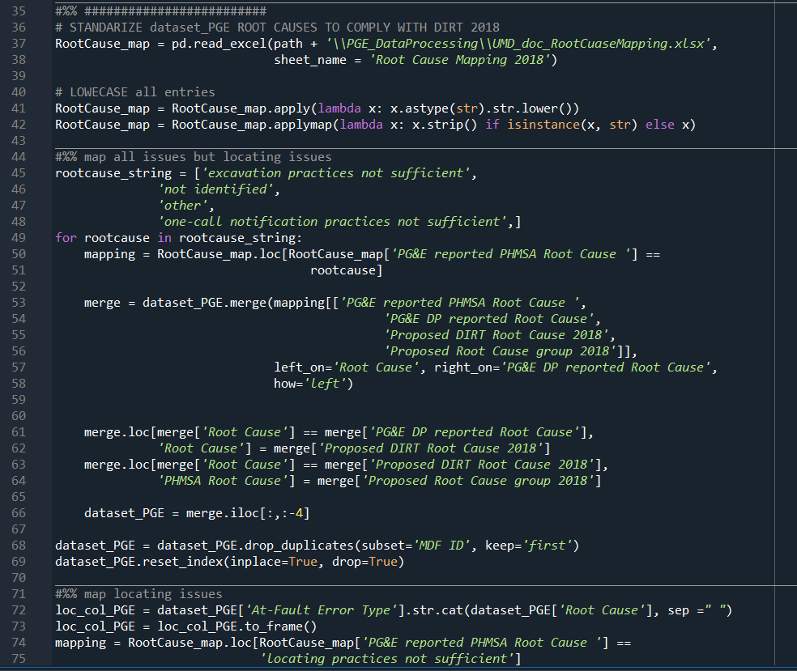
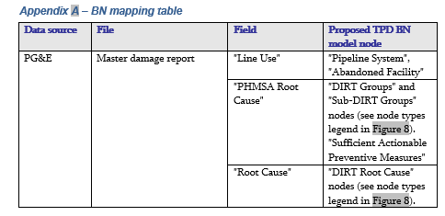

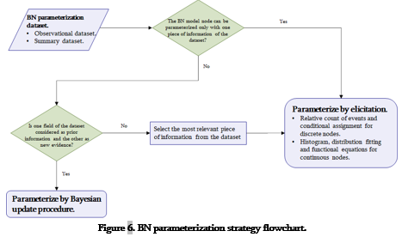
BaNTERA development process
Define relevant variables & model dependencies
Output: Model structure (graph), variable list
Method: Synthesize previous models, peer-reviewed literature rev, engineering expertise
Develop data map and processing method
Output: Mapping between data sources and BN nodes; data into consistent format
Method: Mapping, Python, data analysis tools
w/data quality checks
Partner
BN model parameterization
Output: Probability tables for each node
Method: Elicitation, parameterization, and Bayesian techniques
Demonstrate use of BN for safety and integrity management
Output: Case studies showing how users calculate risk, identify risk contributors, diagnose causes, and ask “what-if” for decision-making
Method: Causal reasoning, Bayesian inference, probabilistic queries
Was notification awareness a cause?
The pipe was hit

Slide 8
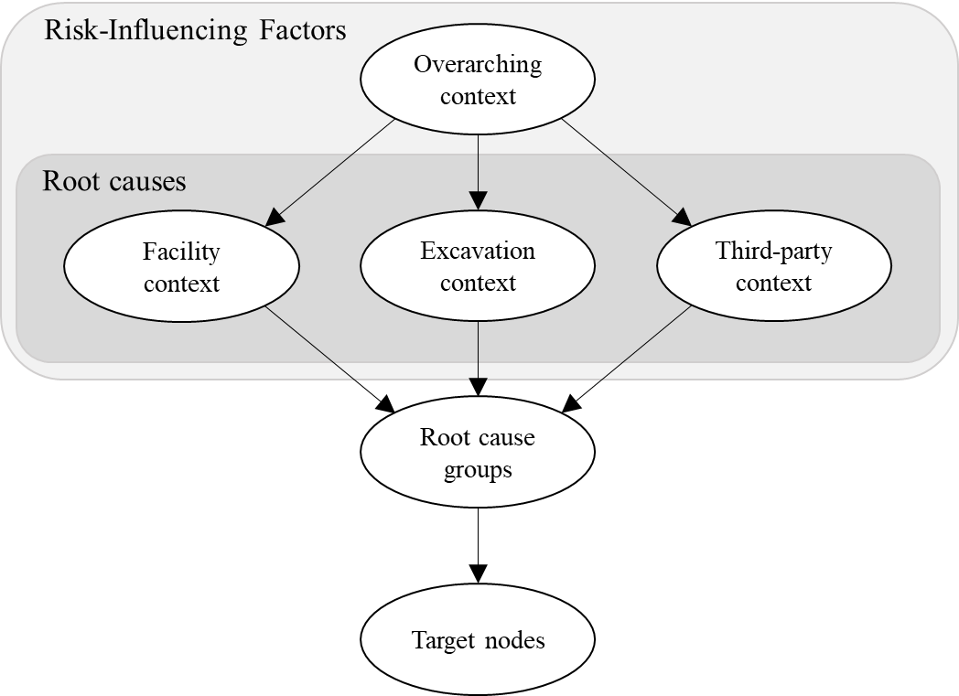
A taxonomy of a third-party excavation was developed to inform BaNTERA’s structure
Risk-influencing factors were defined based on the context of a typical excavation.
Root cause definitions from the CGA DIRT were adopted due to their wide-spread use and high granularity.
Target nodes capture relationships among pipeline damage root causes.

Slide 9
BaNTERA model structure
Node legend
Yellow – Background
Blue – Third party context
Green – Excavation context
Purple – Facility context
Gray – Summary target
White – DIRT Root cause
Light blue – Non-DIRT Root Cause
Pink – Root cause sub-group
Red – Root cause group
BaNTERA consists of 62 nodes, 101 arcs, thousands of data cells

Slide 10
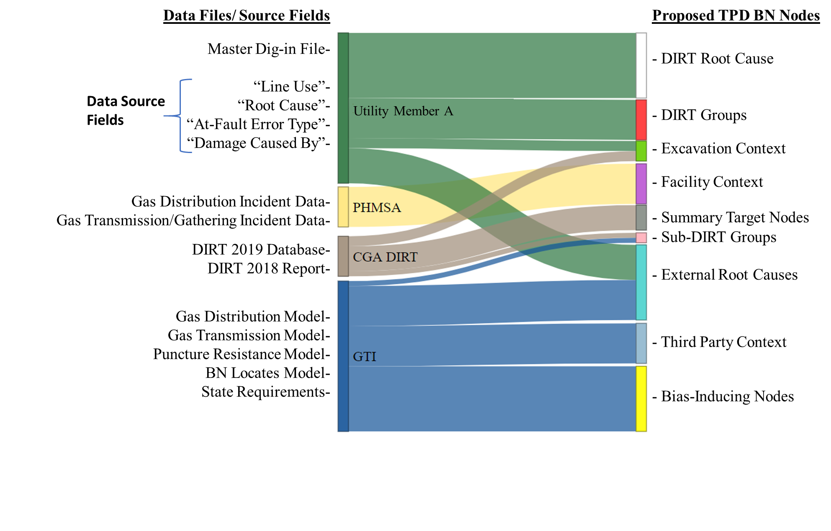
BaNTERA was built from a wealth of data and information

Slide 11
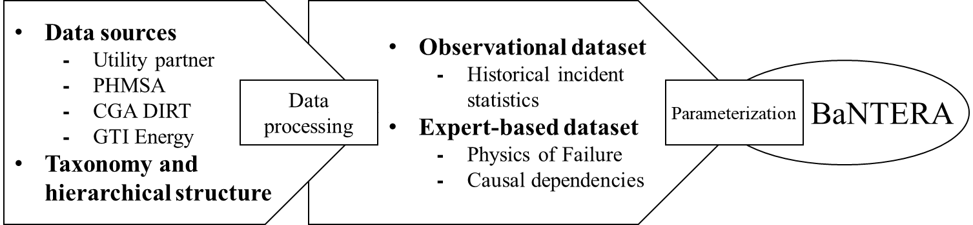
Quantifying BaNTERA required the integration of several unique data sources
Data processing: Data were processed into a format consistent with BaNTERA’s network structure.
Parameterization: BaNTERA was then parameterized using elicitation methods and Bayesian updating.

Slide 12
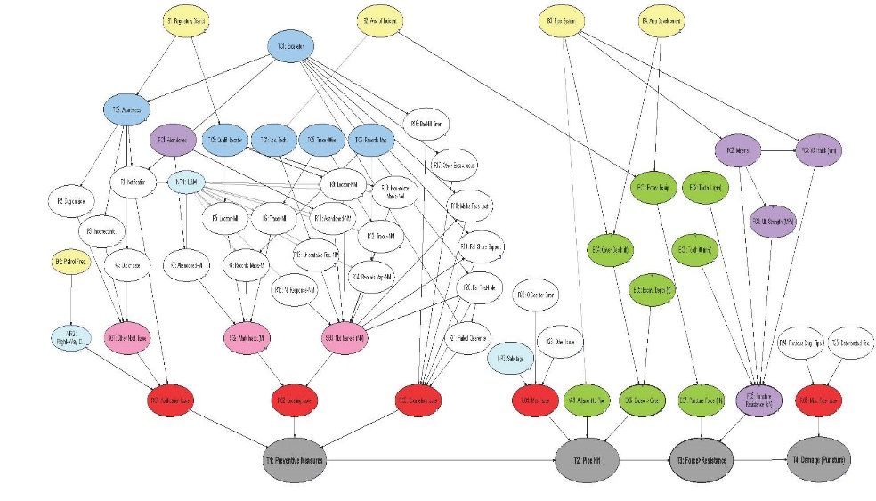
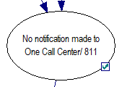

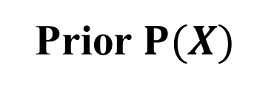
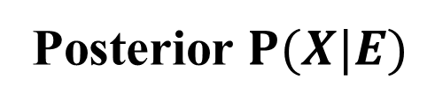
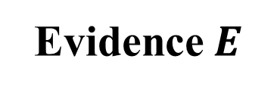
How to use BaNTERA: Bayesian Reasoning
Prior $P(X)$
+
Evidence $E$
=
Posterior $P(X|E)$
Notification made to One Call Center/ 811
= Yes
= Yes
The prior represents BaNTERA in its default state: all node states in the network are displayed with their default probability distributions.
The evidence represents the node states that the analyst is observing: this is how the analyst alters the network.
The posterior represents BaNTERA updated with evidence: the analyst can assess how introducing evidence changed the probabilities of other variables in the model.

Slide 13
BaNTERA is capable of performing three types of probabilistic inference
Notification Issue
Locating Issue
Helps decision makers gain insight into how risky a one-call ticket is before it occurs.
Predictive
(Forward inference)
Pipe Hit
Notification Issue
Locating Issue
Diagnostic
(Backward inference)
Helps decision makers better understand the causes of damage and enact more effective policies as a result.
Pipe Hit
Notification Issue
Locating Issue
Explanatory
(Intercausal inference)
Pipe Hit
Notes:
Inference (Belief Updating, Evidence Propagation) in the network is the process of computing the probability distribution over the variables (in the network), given the evidence.
Types of reasoning:
Causal (top to bottom; from root nodes, forward)
Evidential (bottom up; backwards)
Intercausal (both, simultaneously, via conditional relationships)
Causal: Diseases cause symptoms. Learn what symptoms I should expect from a diseases
Evidential: Infer disease from symptoms. What do I have, give my symptoms?
Intercausal: Given my symptoms and my disease, what can I infer about other possible diseases?
Causal: “Given this amount of time, how likely is an error?”
Evidential: “Given an error, what are the likely states of time?”
Intercausal: “Given this amount of time, and error, what are the likely states of stress?”

Slide 14
BaNTERA’s capabilities have been showcased in past deliverables
Demonstration Videos
Video 1: Introduction to BaNTERA | Explains the basics of BaNTERA
Video 2: Predictive Reasoning with BaNTERA | Uses BaNTERA to calculate the probability of puncture for a known One Call ticket
Video 3: Diagnostic and Explanatory Reasoning with BaNTERA | Uses BaNTERA to diagnose root causes of a pipe hit
Papers
Journal Paper: BaNTERA: A Bayesian Network for Third-Party Excavation Risk Assessment | A. Ruiz-Tagle, A. D. Lewis, C. A. Schell, E. Lever, and K. M. Groth, “BaNTERA: A Bayesian Network for Third-Party Excavation Risk Assessment,” Reliability Engineering & System Safety, vol. 223, p. 108507, 2022, https://doi.org/10.1016/j.ress.2022.108507
Conference Paper: Construction and Verification of a Bayesian Network for Third-Party Excavation Risk Assessment (BaNTERA) | A. Ruiz-Tagle, A. D. Lewis, C. A. Schell, and K. M. Groth, “Construction and Verification of a Bayesian Network for Third-Party Excavation Risk Assessment (BaNTERA),” PSAM2022: Probabilistic Safety Assessment and Management, Honolulu, O’ahu, Hawaii, USA
All papers and demonstration videos are available by request.

Slide 15
Verification results
BaNTERA’s predictive performance is sensitive to its parameterization and data processing strategies.
As such, its predictions were verified in two different ways:
  Consulting with GTI Energy and the utility partner to compare BaNTERA’s predictions with industry knowledge.
  Comparing predicted damage rates to data source damage rates.
 | Damage rate per 1,000 notified excavations
Utility partner incident data (average for 2017-2020) | 1.41
GTI Energy (average for 2016-2018) | 1.62
BaNTERA | 1.53

Slide 16
Next steps
Adding detail to network nodes that are currently broad in scope.
Improving the availability of success-space excavation data (data concerning excavations that did not result in an incident).
Adding other TPD damage types to BaNTERA.
  Currently, only puncture damage is included, but TPD can also result in dents and/or gouges.
  Dent and/or gouge data is more difficult to collect given that it does not result in an immediate gas release.

Slide 17
Future work
BaNTERA Projects
BaNTERA is being deployed into the industry for use in third-party excavation risk assessment.
As more information becomes available, the model will be updated.
New SyRRA Projects
The SyRRA lab is now working on modeling pipeline risks stemming from mechanical and natural hazard loading conditions using strain-based methods.

Slide 18
Summary and conclusions
The BaNTERA model is a holistic, rigorous tool for third-party excavation risk assessment built on modern data sources, expert judgement, and insight from previous models.
BaNTERA’s verification results indicate that the model is a promising foundation for future work.
  The model is being adopted for industry use.
  The model will be updated given new information.
Expanding the capabilities of BaNTERA may in turn improve third-party excavation management and provide more effective policies aimed at improving pipeline safety.

Slide 19
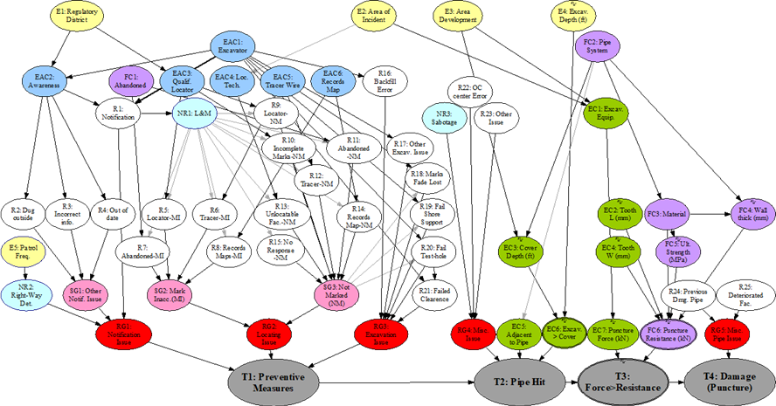
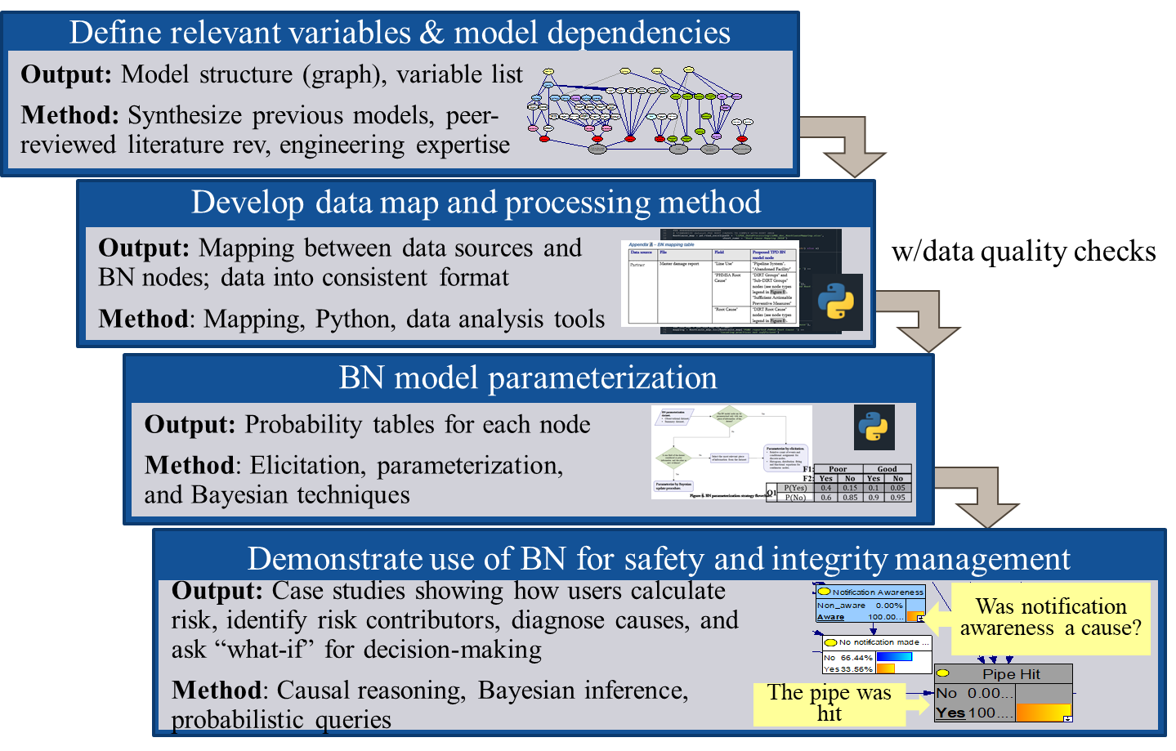
Thank you!
Colin Schell
Ph.D. Student, Reliability Engineering
cschell@umd.edu
Dr. Katrina Groth
Assistant Professor, Mechanical Engineering
kgroth@umd.edu
Andres Ruiz-Tagle
Ph.D. Student, Reliability Engineering
aruiztag@umd.edu
Austin Lewis
Ph.D., Reliability Engineering
adlewis@umd.edu
SyRRA Lab http://syrra.umd.edu
Center for Risk and Reliability http://crr.umd.edu
This information, data or work presented herein was funded in part by the U.S. Department of Transportation Pipeline and Hazardous Materials Safety Administration’s Pipeline Safety Research and Development Program, under Award Number 693JK32110002POTA. The views and conclusions contained in this document are those of the authors and should not be interpreted as representing the official policies, either expressed or implied, of the Pipeline and Hazardous Materials Safety Administration, the Department of Transportation, or the U.S. Government.
19

Slide 20
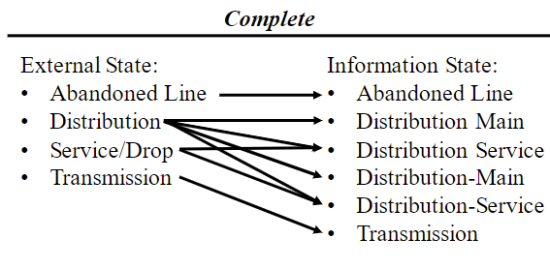
BaNTERA's supporting datasets are of a sufficient quality for model deployment
BaNTERA data quality was assessed using the semiotic data quality framework.
Key data fields were chosen for quality analysis based on their relevance to BaNTERA and cross-referenced against industry knowledge.
This analysis revealed only minor quality concerns that should not have any meaningful impact on model use.
Quality Criteria | Unique Entries with Quality Issues
Complete | 0 unaccounted external states
Non-redundant | 2/6 information states
Meaningful | 1/6 information states
Unambiguous | 2/6 information states
Correct | 0/6 information states
Complete cross-referencing
Tabulated scores for each quality criteria
Price, R., & Shanks, G. (2016). A Semiotic Information Quality Framework: Development and Comparative Analysis. Enacting Research Methods in Information Systems, 219–250. https://doi.org/10.1007/978-3-319-29272-4_7

