Slide 1
Human Performance in Operation of Small Modular Reactors
Research for a better future
Digital Systems Sector
PSAM 16
June 2022
Claire Blackett, Maren H. Rø Eitrheim, Rob McDonald, Marten Bloch

Slide 2
Introduction
SMR designs represent a significant departure from conventional nuclear power plant designs.
We expect to see higher levels of automation, and even autonomous operations for some microreactor designs, but we expect that there will be requirements for human operators to oversee plant operations.
The highly competitive nature of the SMR market means that there is little publicly available literature about the planned conduct of operations for different SMR designs.
The literature that is available helps to shed some light on potential human factors topics of interest.

Slide 3
Human factors aspects of SMRs: A new concept of operations
Conventional design NPP
Example SMR design NPP
RO
BOP
SRO
RO
CRS
SRO
STA

Slide 4
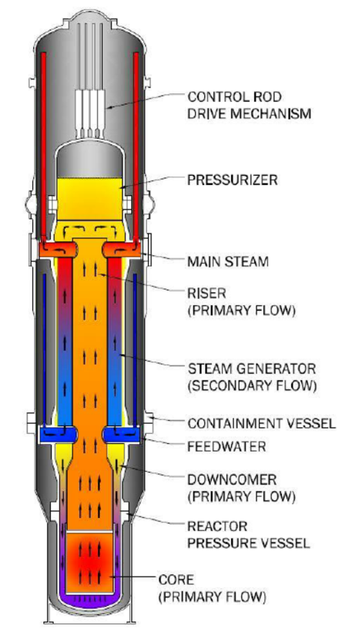
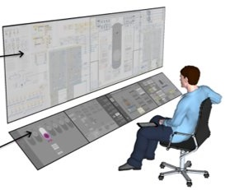
Human factors aspects of SMRs: The changing role of the operator
Many SMR designs indicate increased use of passive safety systems for reactivity control, as well as higher levels of system and process automation.
This means there is less (if any) requirement for human operators to actively manage reactivity or maintain a safe plant state.
Operator roles are likely to change to one of monitoring and checking, rather than actively intervening in plant operation and management.
Some functions may still be shared between the operators and the passive / automated systems, in which case it will be vital to understand human-automation interaction and collaboration.
Image from: neutronbytes.com

Slide 5
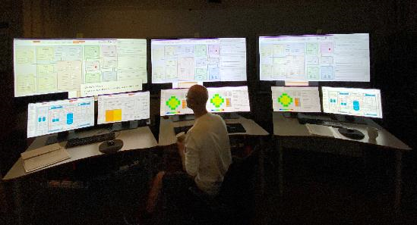
Human factors aspects of SMRs: Variability in SMR deployment
1
2
3
4
SMR design allows for more flexible and variable deployment including to different sectors, e.g.:
Load following
District heating
Seawater desalination
Hydrogen production
How will different units or groups of units be monitored and controlled? Will there be separate control rooms depending on which SMRs are deployed for which purposes? Or one control room but separate teams of operators?
SMRs also allow for scalability, meaning that additional units can be added to the original plant over time, as energy demands increase. It’s likely that later units will have incorporated design changes as a result of operating experience.
V2.0
H₂
V1.0
V1.0

Slide 6
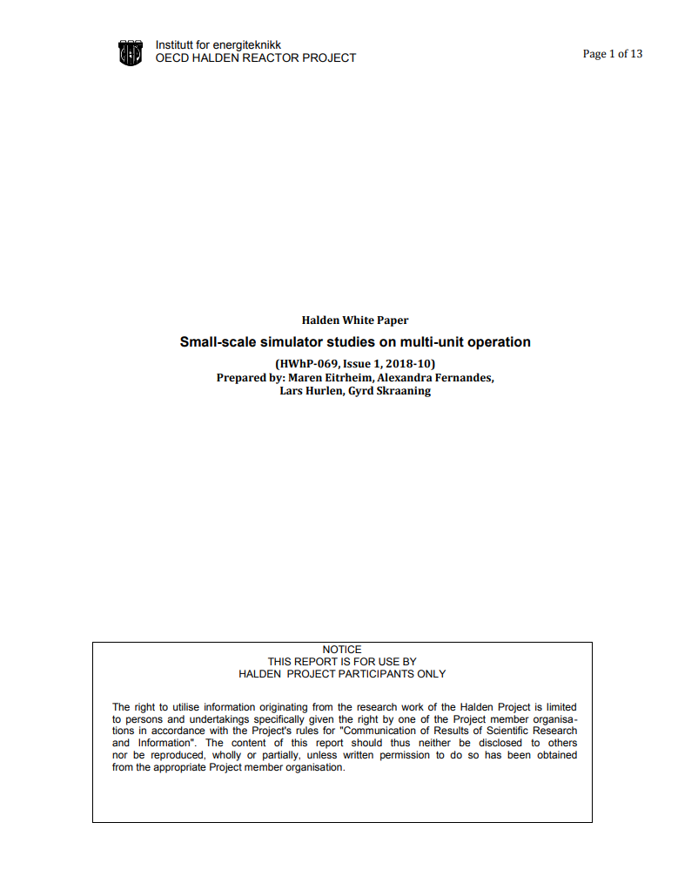
Halden Project research on SMRs: White paper on SMR simulator studies (2018)
“Small scale simulator studies on multi-unit operation”
Purpose was to outline some human factors challenges and research questions such as:
Operator vigilance in highly automated plants.
The effects of distractions and interruptions in a multi-unit control room environment.
The cognitive effects of multi-tasking when monitoring and controlling multiple units.
The workload dichotomy of underload as a result of long periods of monitoring where operators are more prone to boredom and errors, to overload as a result of responding to simultaneous failures on multiple units.
The effects on human performance of task switching between units and between passive monitoring to active control.

Slide 7
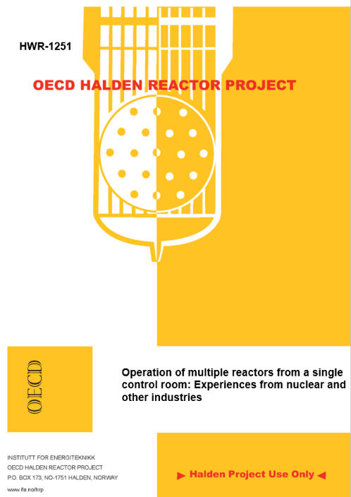
Halden Project research on SMRs: Technical report on cross industry learning (2019)
“Operation of multiple reactors from a single control room: Experiences from nuclear and other industries”
Included a review of range of control room layout designs and crew compositions for multi-unit operation within nuclear, hydropower, air traffic control and petroleum industries.
Identified that the centralized, multi-unit control room concept is gaining in popularity, and many of these industries forecast that operations will become highly automated in the future, with less human intervention.
Such concepts may reduce workload, but will introduce new operator demands for supervising and understanding automation.
Also considered ways in which multi-unit control room concepts differ in design from single-unit and the potential risk implications for one operator/team of operators monitoring two or more units in parallel.

Slide 8
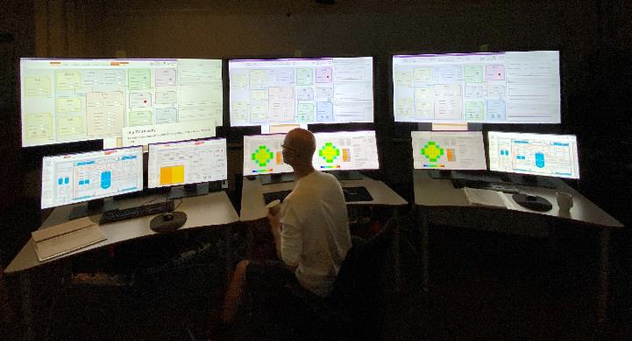
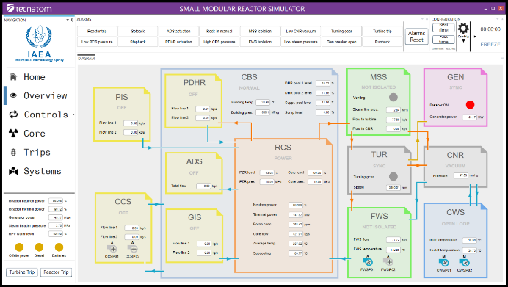
Halden Project research on SMRs: Installation of a basic principle simulator (2019)
Developed by Tecnatom for the International Atomic Energy Agency (IAEA) for educational purposes to demonstrate basic principles of iPWR operations.
Design is largely based on the Idaho National Engineering and Environmental Laboratory’s Multi-Application Small Light Water Reactor (MASLWR), which is the basis for the NuScale design.
Design features include passive safety systems that include an Automatic Depressurization System, Pressurized Injection System, Gravity Injection System, and a natural circulation Passive Decay Heat Removal system.
The graphical user interfaces are simplified, and the integrated alarm system was visual only.
Three instances of the iPWR simulator were installed in the FutureLab in Halden.

Slide 9
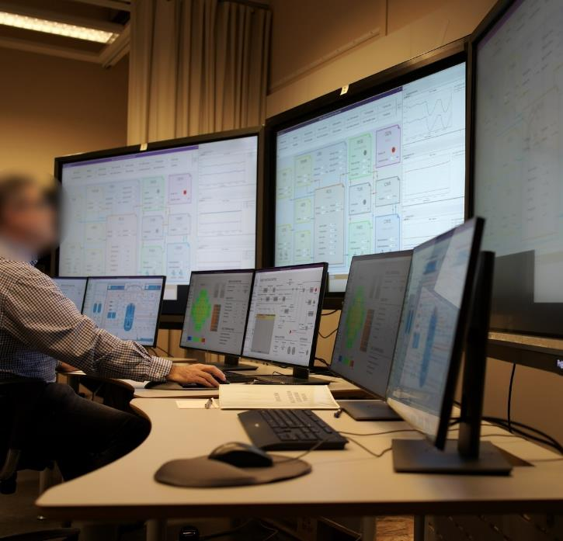
Halden Project research on SMRs: First SMR simulator study (2019)
Naturalistic study with the purpose of investigating operator monitoring strategies and prioritization of taskwork across multiple units.
1 operator, 3 independent reactor units, 4 scenarios of increasing complexity, leading to parallel multi-unit disturbances.
Findings:
Both participants were able to handle the 3 units even in challenging scenarios with multiple disruptions.
We did not observe unit confusion, but maybe did not sufficiently create the right conditions for this.
Workload increased when participants performed tasks on multiple reactors, but did not seem to exceed cognitive capacity or impede task completion.
Notes:
Enabled a better understanding of SMR operation, prioritization of future research questions, requirements for participant training in future experiments, and test environment requirements for conducting more complex human performance studies.

Slide 10
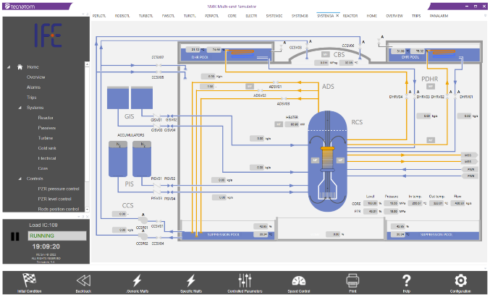
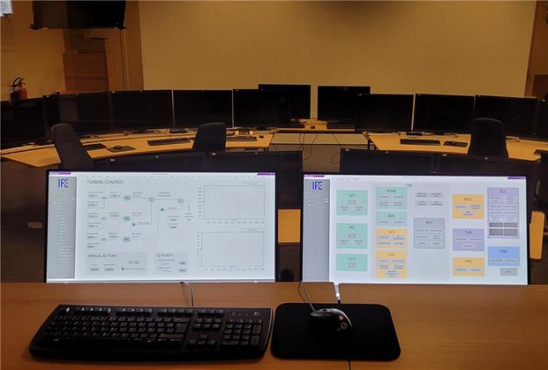
A new simulator is needed
The 2019 first study enabled a better understanding of SMR operation principles, prioritization of future research questions, requirements for participant training in future experiments, and test environment requirements for conducting more complex human performance studies.
The study identified topics for future exploration, including:
monitoring strategies when overlooking several reactors at a time;
means to support monitoring of reactors in different operating modes;
detection of multi-unit failures; and
team organization to support planned, parallel operations and safe prioritizations of tasks.
Confirmed that the IAEA iPWR simulator is not sufficient for experimental studies on more complex topics – it was not developed for these purposes.
New full-scope SMR simulator currently under installation in HAMMLAB.

Slide 11
Future research questions for experimental study
Based on the 2019 first study, and experience from other Halden experiments, we have identified the following key research questions:
What are the impacts of expected staffing strategies (e.g., a 3-person crew for a 12-unit plant) on operating monitoring strategies across multiple units?
What are reliable monitoring strategies for operators overlooking several reactors at the same time, that can minimise the risk of unit confusion?
What are effective means for detecting single-unit and multi-unit failures?
How can adaptive human problem-solving capabilities be utilized while ensuring safe prioritizations of tasks in multi-unit environments?
To what extent will proposed control room layouts, user interfaces and staffing plans support operators’ ability to maintain attention/stay alert, and/or how could these have a detrimental impact on human performance?

Slide 12
Conclusions
Some SMR design characteristics indicate that operation and control of SMRs is likely to change significantly from conventional nuclear power plants.
We initiated a research activity in 2018 in the Halden Project to identify and being exploring human performance challenges related to SMR multi-unit operations.
A first study in a basic-principle iPWR simulator helped to identify and prioritise key research questions.
The installation of a full-scope multi-unit SMR simulator in 2022 will facilitate investigation of more complex scenarios & research questions into the future.

Slide 13
Thank you!
Dr. Claire Blackett
Senior Research Scientist claire.blackettife.no

