Slide 1
The Challenge of Assessing Human Performance and Human Reliability for First-of-a-Kind Technologies
Research for a better future
Digital Systems Sector
PSAM 16
June 2022
Claire Blackett, Maren H. Rø Eitrheim, Andreas Bye

Slide 2
Introduction: What is a Small Modular Reactor?
There is growing interest worldwide in the potential of advanced reactor technologies such as Small Modular Reactors (SMRs) as a more competitive, more efficient and greener way to meet future energy needs.
SMRs represent a significant departure from the design of current generation nuclear power plants (NPP) and can be considered First-of-a-Kind (FOAK) technology.
SMRs are scalable plants with a power output below 300 MWe per module.
Can be broadly classified into four major groups, based on reactor coolant type:
Water-cooled
Gas-cooled
Liquid metal-cooled
Molten salt-cooled
In 2020, the IAEA identified that there are over 70 SMR designs in development worldwide
Image from: bibalex.org

Slide 3
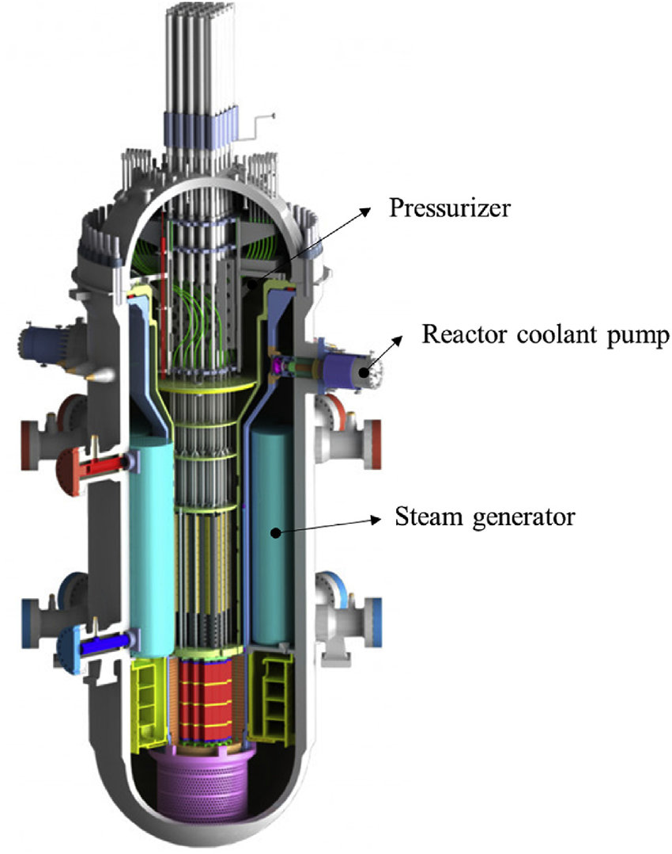
Design features of a typical SMR
Smaller reactor cores and an integral design mean that the footprint for SMRs is significantly smaller than for a conventional NPP.
The modular design means that major components (modules) can be fabricated and assembled in a factory, and shipped to site for installation, fueling and commissioning.
Passive safety systems take advantage of natural forces such as gravity, differential pressure or natural heat convection to maintain cooling and shutdown in an abnormal event.
Scalability means that additional SMR units can be installed onsite over time if the energy demand increases.
Flexible deployment means that SMRs can be used for baseload energy generation, load following with other power sources (e.g. renewables), seawater desalination, hydrogen production, etc.
Image from: Ahn et al. (2020)

Slide 4
SMRs as FOAK technology
A first-of-a-kind (FOAK) plant refers to:
“the first commercial plant of a particular design where prior operational experiences and lessons learned will play a part, but ultimately the majority of experience is to be gained during operation of this specific plant design”
- Boldin & Sabharwall (2014)
The key design characteristics of SMRs are a somewhat radical departure from conventional NPPs:
Reduced control room staffing levels per unit
Increased use of passive safety systems
Multi-unit approach & flexible deployment
We expect to see a significant change in the role of the control room operator, from that of active management and control of the plant, to that of supervision of passive and automation functions, with occasional intervention in abnormal situations.
This will likely result in the need for a new conduct of operations (COO) for SMR NPPs.

Slide 5
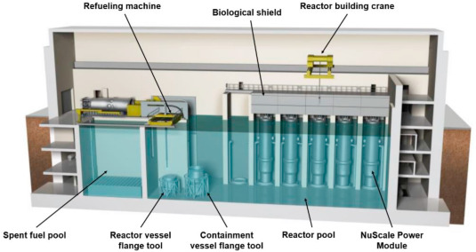
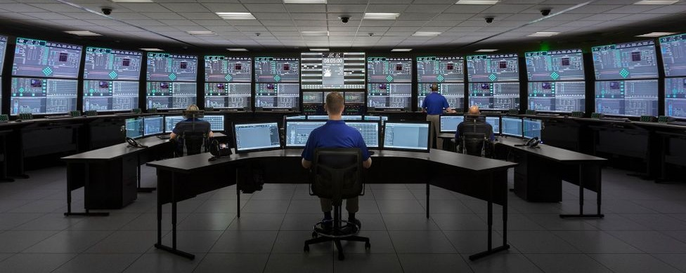
A new staffing model
Image from: Fakhraei et al. (2021)
We can assume that most SMR plants will adopt a multi-unit approach, monitored and managed from a single control room; this will require a new staffing model.
NuScale example:
Plant design of up to 12 SMR units
Single, centralised control room
Minimum shift of 3 reactor operators - 2 Senior Reactor Operators (SRO) and 1 Reactor Operator (RO)
One of the SRO positions would combine the functions of a Shift Technical Advisor (STA) and Shift Manager/Control Room Supervisor)
NuScale is not necessarily a benchmark, but this may set a precedent for other SMR staffing models.
Image from: nuscalepower.com

Slide 6
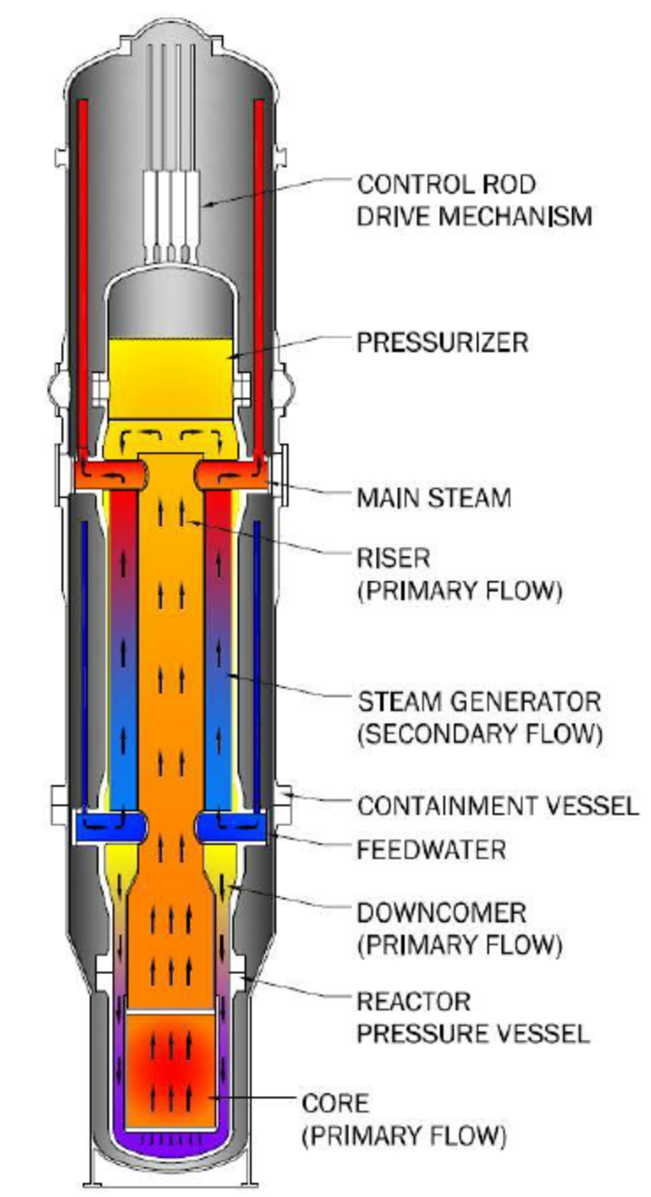
Passive safety systems & automation
We expect to see higher utilization of passive safety systems in SMRs, as well as higher levels of task automation, compared to conventional NPPs.
Passive safety systems rely on natural phenomena, such as gravity, differential pressure or natural heat convection (shown right) to maintain cooling and shutdown in an abnormal event.
“With a passive safety system, a microreactor design would not require significant human or automation intervention to maintain a safe state. Thus, human and/or automated tasks may serve as a secondary safety check rather than a primary function to operate the reactor.”
Fleming et al., 2020
The combination of passive safety & automation will shift the role of the operator from active management to passive monitoring.
Image from: neutronbytes.com

Slide 7
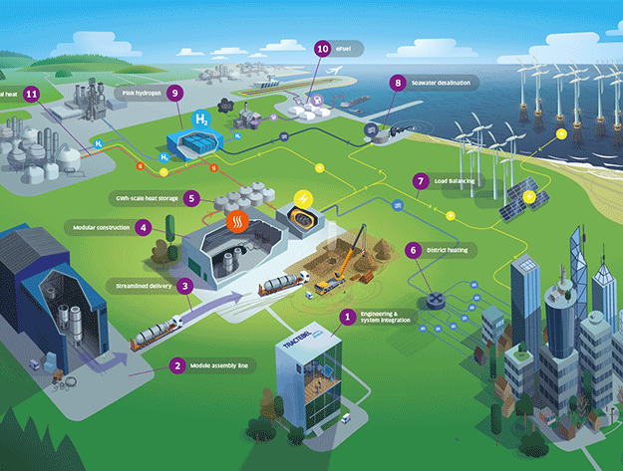
Scalability & flexibility
We expect that SMR NPPs may start with fewer units but add more over time to increase the total power output from the NPP.
Possible that subsequent SMR units will have incorporated design changes as a result of operating experience.
We expect to see more flexible deployment of SMRs beyond baseload electricity production, which may change how the SMR should be monitored and controlled.
It’s feasible that future plants could include a combination of design maturity levels, and even a combination of functions within a single plant, maybe managed from a single control room.
Image from: tractebel-engie.com

Slide 8
How will a new COO affect human performance?
How will operators distribute & prioritise tasks in a multi-unit control room?
How will operators share responsibilities & communicate under the new staffing model?
How can you maintain sufficient “human-in-the-loop” awareness with higher levels of passive safety systems and automation?
How can you maintain operator familiarity and competence for different unit designs, remote units and/or different functionalities?
How will these aspects differ from normal operations to single unit disturbances to multi-unit disturbances?

Slide 9
Human Performance & Human Reliability Assessments for SMRs
The challenge for FOAK designs:
“it may be
argued that only data collected from the actual context in which a task is performed should be used to
predict future failures in that situation. This is because human performance is extremely dependent upon
task conditions”
- Energy Institute (2012)
Human Reliability Analysis (HRA) is a well-established tool in the nuclear industry to evaluate the human contribution to safety and risk.
Even with more passive safety & higher automation, human operators will still be responsible for overseeing operations, so HRA (in some form) will be needed.
HRA depends on human performance data for credible assessment of error probabilities.
Human performance data is often collected from operating experience (OPEX), but this is not possible for FOAK designs.

Slide 10
Contextual data is essential for HRA
All HRA methods include a systematic evaluation of human performance shaping factors (PSFs) to better understand how human operators can contribute to (and prevent / mitigate) the overall risk of an adverse event, under different operating conditions and in different circumstances.
Nominal human error probabilities (NHEPs) are defined in HRA methods for generic task types relevant to nuclear power plant operation.
NHEPs are then adjusted based on contextual information about where, when and how specific operator tasks are performed, to more realistically estimate the overall human error probability for a specific task at a specific plant.
Extremely difficult (impossible?) to do for FOAK plants, yet HRA is still needed as part of the design engineering and regulatory licensing processes.
Figure adapted from: Kirwan (1994)

Slide 11
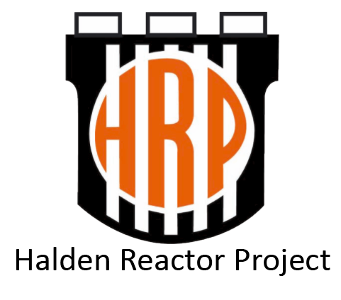
Simulators can provide important contextual data
Possible to observe and measure where, when and how specific operator tasks are performed in different scenarios and under different operating conditions.
The OECD Halden Reactor Project / Halden Human Technology Organisation (HTO) project uses simulation to provide qualitative and quantitative human performance data in support of nuclear safety, design and engineering.

Slide 12
About the OECD NEA Halden Reactor / HTO Project
Established in Halden, Norway in 1958; renewed every 3 years since then.
The longest-running nuclear research project in the world.
Two research programs:
Fuels & Materials
Man – Technology – Organisation
Funded by over 100 organisations in 20 countries worldwide.
The Halden reactor was permanently closed in 2018 after 60 years of service.
The HRP F&M program finishes in 2023.
The HRP MTO program became the Human Technology Program in 2021, and continues today, supported by 20 organisations in 12 countries.

Slide 13
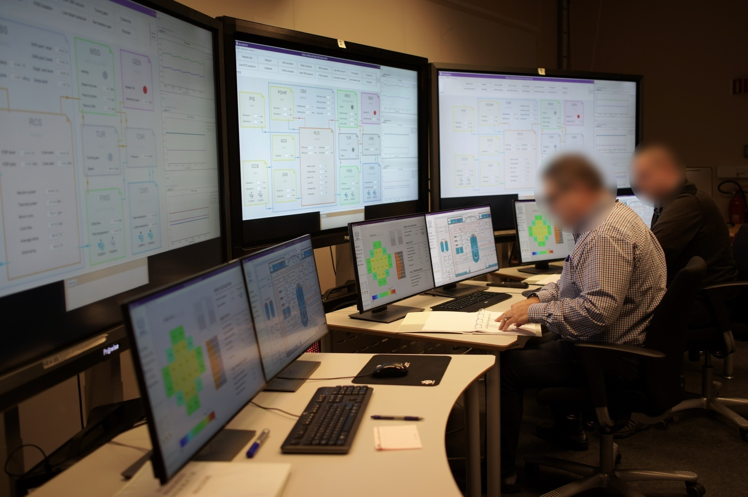
SMR research in the HRP/Halden HTO Project
A research activity titled “Operation of Multiple SMRs” was initiated in 2018, with an initial focus on cross-industry learning from multi-unit operation (CANDU reactors; hydropower; aviation; petroleum)
In 2019, a basic principle iPWR control room simulator was installed in the Halden HTO labs.
A first simulator study was carried out in late 2019 with the goal to explore how one operator would monitor multiple (3) reactors at the same time, during four scenarios of increasing complexity.
We are currently installing a full-scope iPWR control room simulator, capable of simulating up to 12 units operating in parallel and enabling experimental data collection for more complex and challenging scenarios.
Notes:
Four scenarios were designed to be gradually more complex with parallel tasks and disturbances occurring in three reactors.
Although they had limited familiarity with the iPWR process, the participants were able to control the three reactors even in challenging scenarios.
The results of the study indicated that workload increased but did not seem to impede task completion.
The explorative study enabled a better understanding of prioritized topics for future research, requirements for participant training and simulator capabilities in future studies.

Slide 14
Other relevant human performance data from the OECD NEA Halden HTO project – reduced staffing
HAMMLAB experiments on reduced staffing in 2000 – reduced staffing from a crew of 4 to a crew of 3 operators in a conventional plant setup and then a crew of 2 operators in an advanced plant setup.
Findings showed that 2-operator crews performed better than the 4-operator crews in the advanced plant, indicating that advanced plant features such as passive safety systems, automation and more compact, integrated control room designs may better accommodate flexible and possibly smaller crew configurations with new operator roles.
HAMMLAB experiments on alternative staffing strategies and new operator roles in 2009 – tested whether a 3-operator crew could simultaneously control two nuclear processes.
Findings showed that the crews’ situation awareness was higher when controlling simultaneous processes, indicating that operators may prioritize situation awareness in such situations, at the expense of other tasks
Findings also showed that the increased workload may have prompted participants to utilize dedicated tools for monitoring automation activities that were introduced in the study.

Slide 15
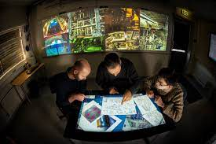
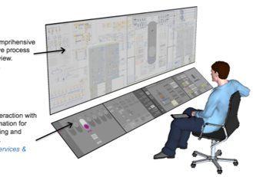
Other relevant human performance data from the OECD NEA Halden HTO project – automation
Studies on automation have been performed since the mid-1990s, including topics such as:
Levels of automation
Operator trust in automation
Automation transparency
Out-of-the-loop unfamiliarity
Automation malfunction / failure
The Halden FutureLab was established to prototype plausible conceptual control room designs for operation of highly automated plants, with the goal of further understanding how operators might realistically work in such environments.
Automation research continues in the current HTO program, with a renewed focus on simulation studies in highly-automated control room setups, such as SMRs.

Slide 16
Utilizing experimental data for HRA
In conventional plants, OPEX from reference plants of similar design can be used to inform predictive HRA.
FOAK designs do not have reference plants and so the level of uncertainty in the HRA can be very high.
The expected changes in COO for SMR plants means that there is even higher uncertainty about whether new error modes could be introduced, and how multi-unit operation could affect human performance and safety.
Simulator studies exploring and measuring human performance can help analysts to make more informed decisions and judgements about potential new/different error modes and how operators tend to respond in different situations and circumstances.
Figure adapted from: Kirwan (1994)

Slide 17
Challenges with using simulator data for FOAK
There may be questions about the ecological validity, or generalizability of the simulator data.
Are results from conventional plant simulators generalizable to FOAK designs?
Are the similar task dimensions and factors between the conventional plant and the FOAK design that help with generalizability?
Halden studies are performed using licensed operators working in realistic operating scenarios in a high-fidelity environment, thus ensuring high ecological validity and generalizability to other settings.
Design characteristics of different types of multi-unit SMR plants may make generalizability more difficult for analysts, especially for some performance factors such as the impact of scalability on workload.
Image from: nuscalepower.com

Slide 18
Advantages with using simulator data for FOAK
Ability to explore safety-critical situations in an environment that is safe, controllable and observable.
E.g., manipulation of task complexity to study the how the crew manages the situation as a team and the impact on the operator’s performance.
Very difficult to do in an operational setting due to the potential risk of unintended consequences on plant operation and safety.
Experimental settings allow for tighter control over variables that can affect performance to determine which specific factor(s) affect performance, and by how much.

Slide 19
Conclusions
SMR designs are expected to result in a significant change to control room operations, due to features such as increased use of passive safety systems and higher levels of automation.
Rather than reducing the need for human reliability analysis, we argue that a new understanding of human performance and its effect on reliability and safety will be needed.
There are high levels of uncertainty about human performance and human reliability for SMRs as these are FOAK designs, and there are few/no reference plants from which relevant OPEX can be collected.
Simulator studies, such as those performed by the Halden Project, can provide invaluable information about potential new failure modes related to multi-unit operation, high levels of automation, changes to staffing models, increased use of passive safety systems, etc.
Current Halden Project research activities on SMR operation and human-automation collaboration are of particular interest, as these will utilize a new full-scope iPWR simulator installed in the Halden HTO research laboratories in Norway.

Slide 20
Thank you!
Dr. Claire Blackett
Senior Research Scientist claire.blackettife.no

