Slide 1
Capturing Epistemic Uncertainties in the Power Spectral Density for Limited Data Sets
Marco Behrendt¹, Matthias G.R. Faes²,
Marcos A. Valdebenito³, Michael Beer^{1,4,5}
¹Institute for Risk and Reliability, Leibniz Universität Hannover, Germany
²Chair for Reliable Engineering, Technische Universität Dortmund, Germany
³Faculty of Engineering and Sciences, Universidad Adolfo Ibáñez,
Viña del Mar, Chile
⁴Institute for Risk and Uncertainty, University of Liverpool, United Kingdom
⁵International Joint Research Center for Engineering Reliability an Stochastic
Mechanics, Tongji University, Shanghai, China
PSAM 16 2022
Probabilistic Safety Assessment and
Management Conference
26 June – 1 July 2022
Honolulu, Hawaii

Slide 2
Motivation
Buildings and structures are subject to environmental processes
High-rise buildings
Bridges
Offshore-platforms
Hazards by environmental processes
Earthquakes
Wind loads
Sea waves
Reliability of existing structures
Design safe structures
Dynamic behaviour
Time analyses and simulations

Slide 3
Environmental processes
Environmental processes can be considered as stochastic processes
Power spectral density (PSD) function is widely adopted in modelling of stochastic processes
Interested in the influence of environmental processes to systems
Apply data to a model with system excitation/response process

Slide 4
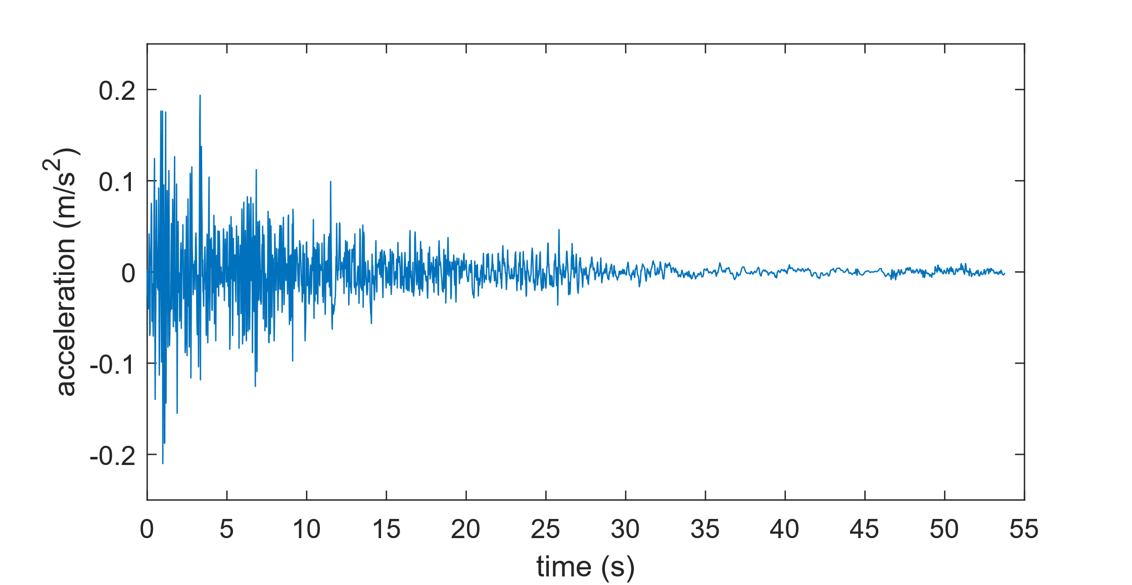
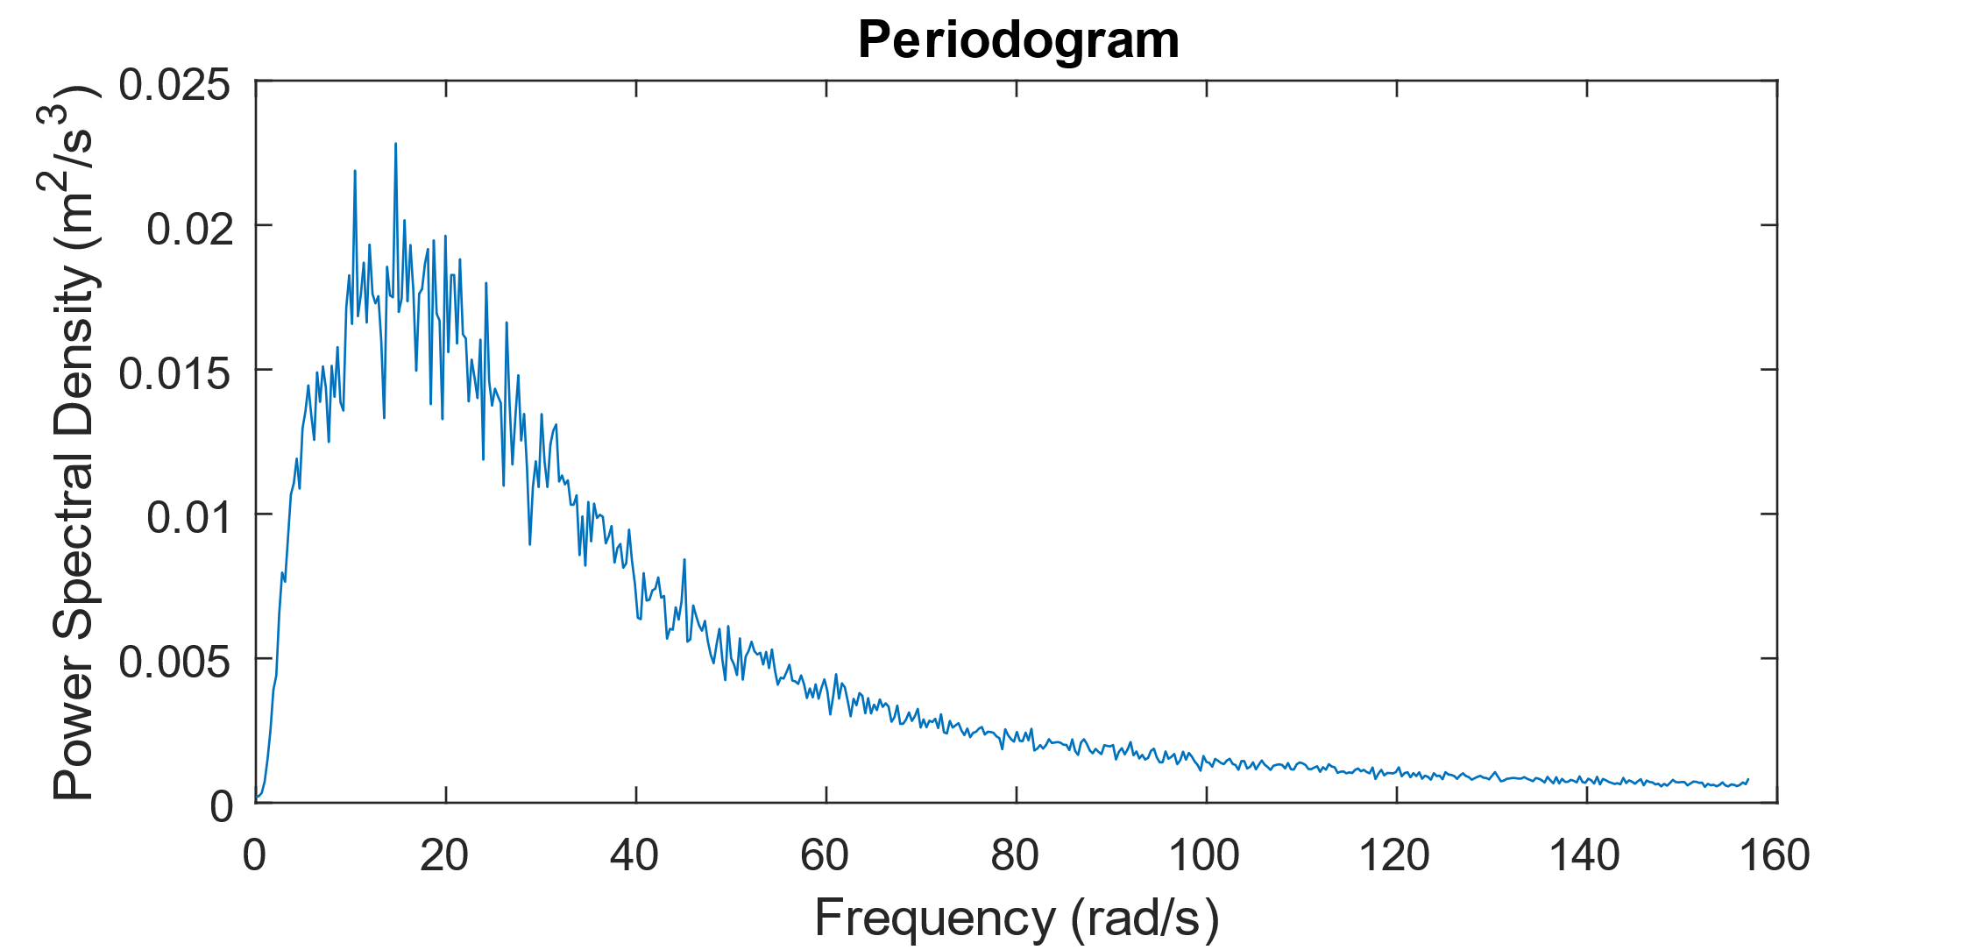
Power spectral density estimation
Transformation from time domain to frequency domain
Distribution of power into frequency components
$${\hat{S}}_{X}\left(ω_{k}\right)=\frac{Δt^{2}}{T}{\left|\sum_{t=0}^{T−1}{x_{t}e^{−\frac{i2πkt}{T}}}\right|}^{2}$$
$T$ number of data points
$Δt$ sampling time increment
$t$ data point index
$k$ integer frequency for $ω_{k}={2πk}/T$

Slide 5
Uncertainties in real data records
Real data records underlie uncertainties
Uncertainties must be quantified
To ensure reliable simulation results
There is a need to represent the data in a manner suitable for application to systems
A different form of the PSD function is derived from similar PSD functions

Slide 6
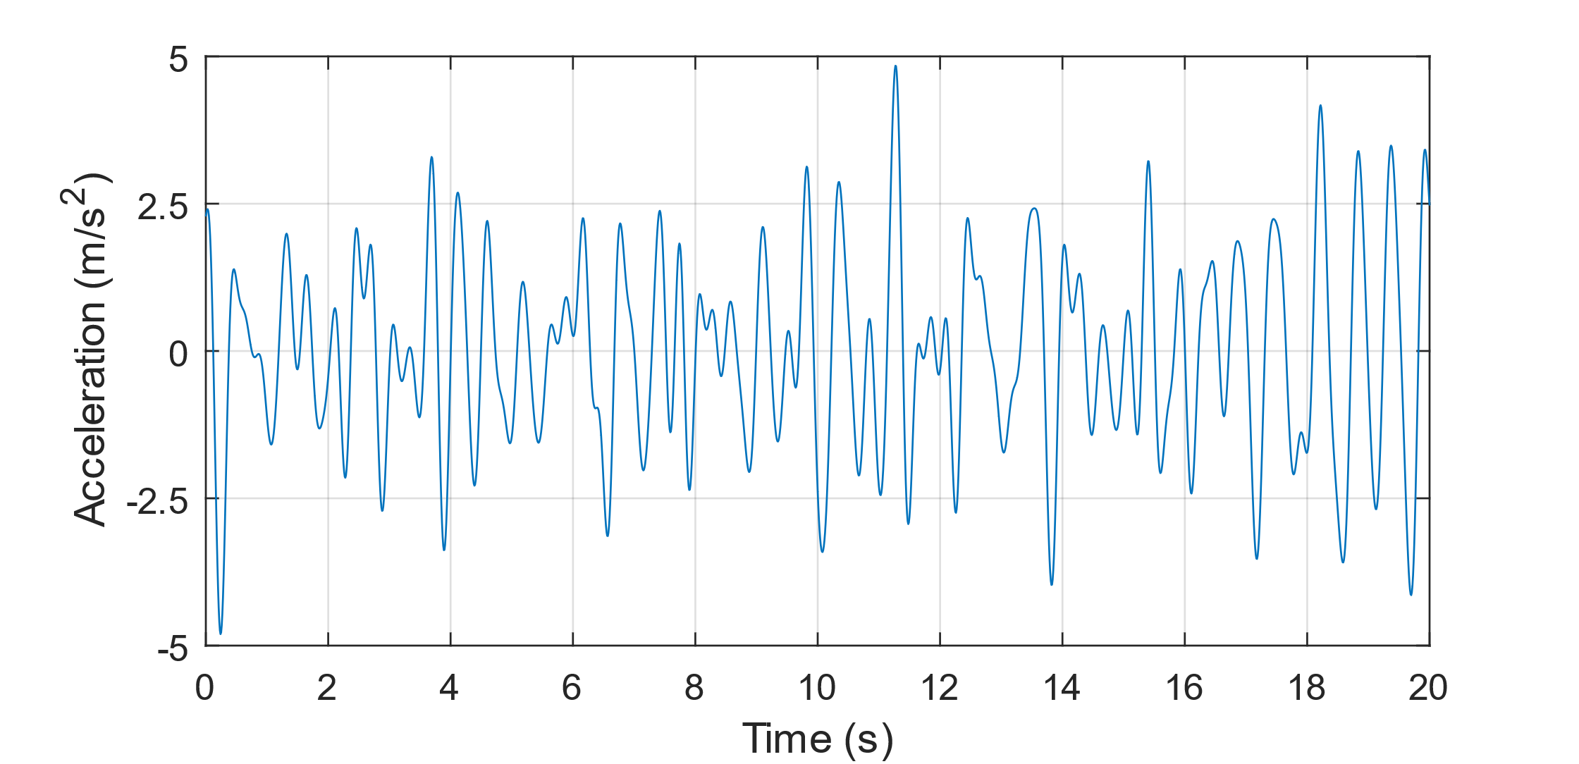
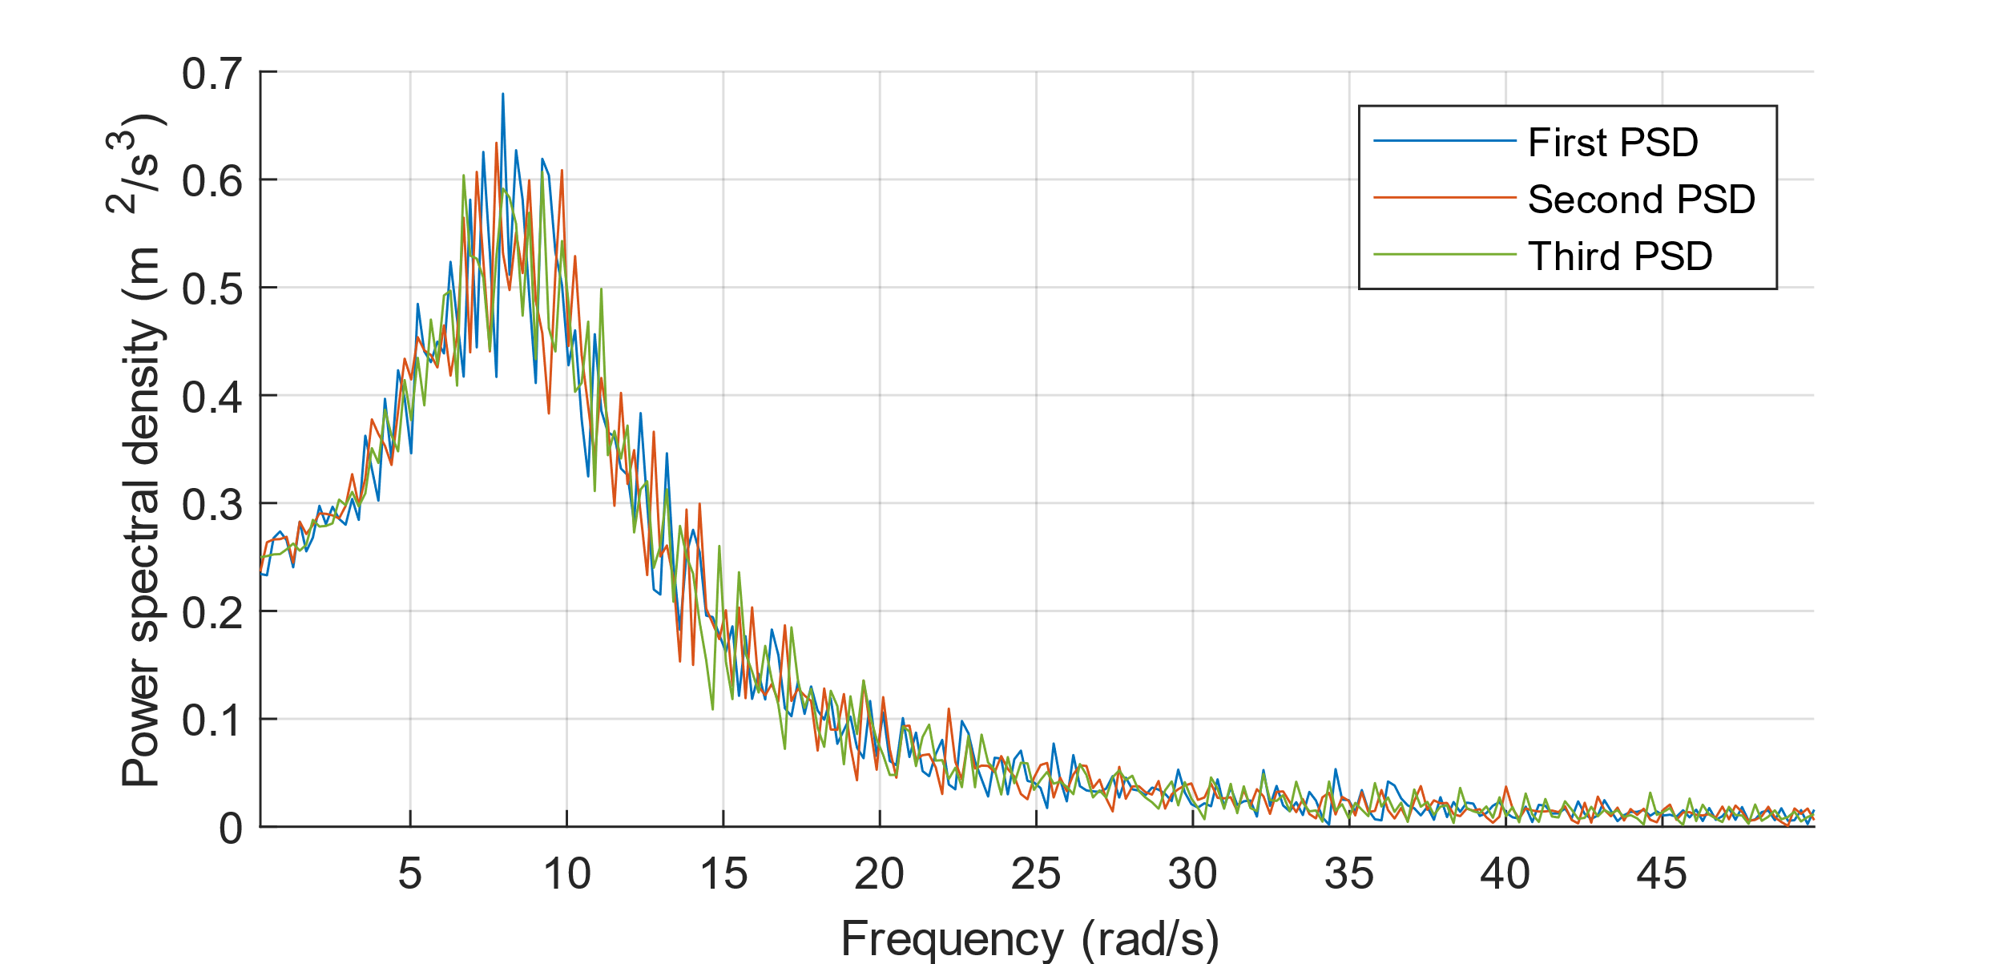
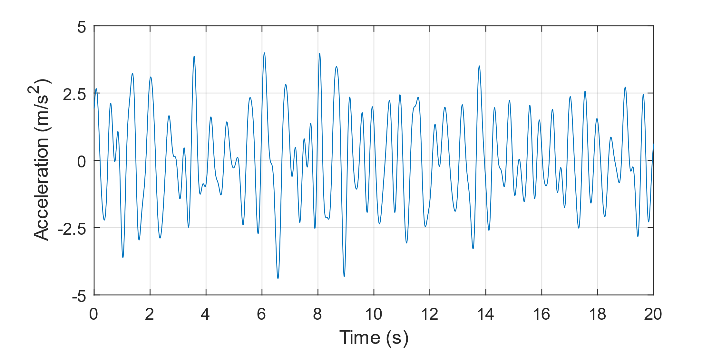
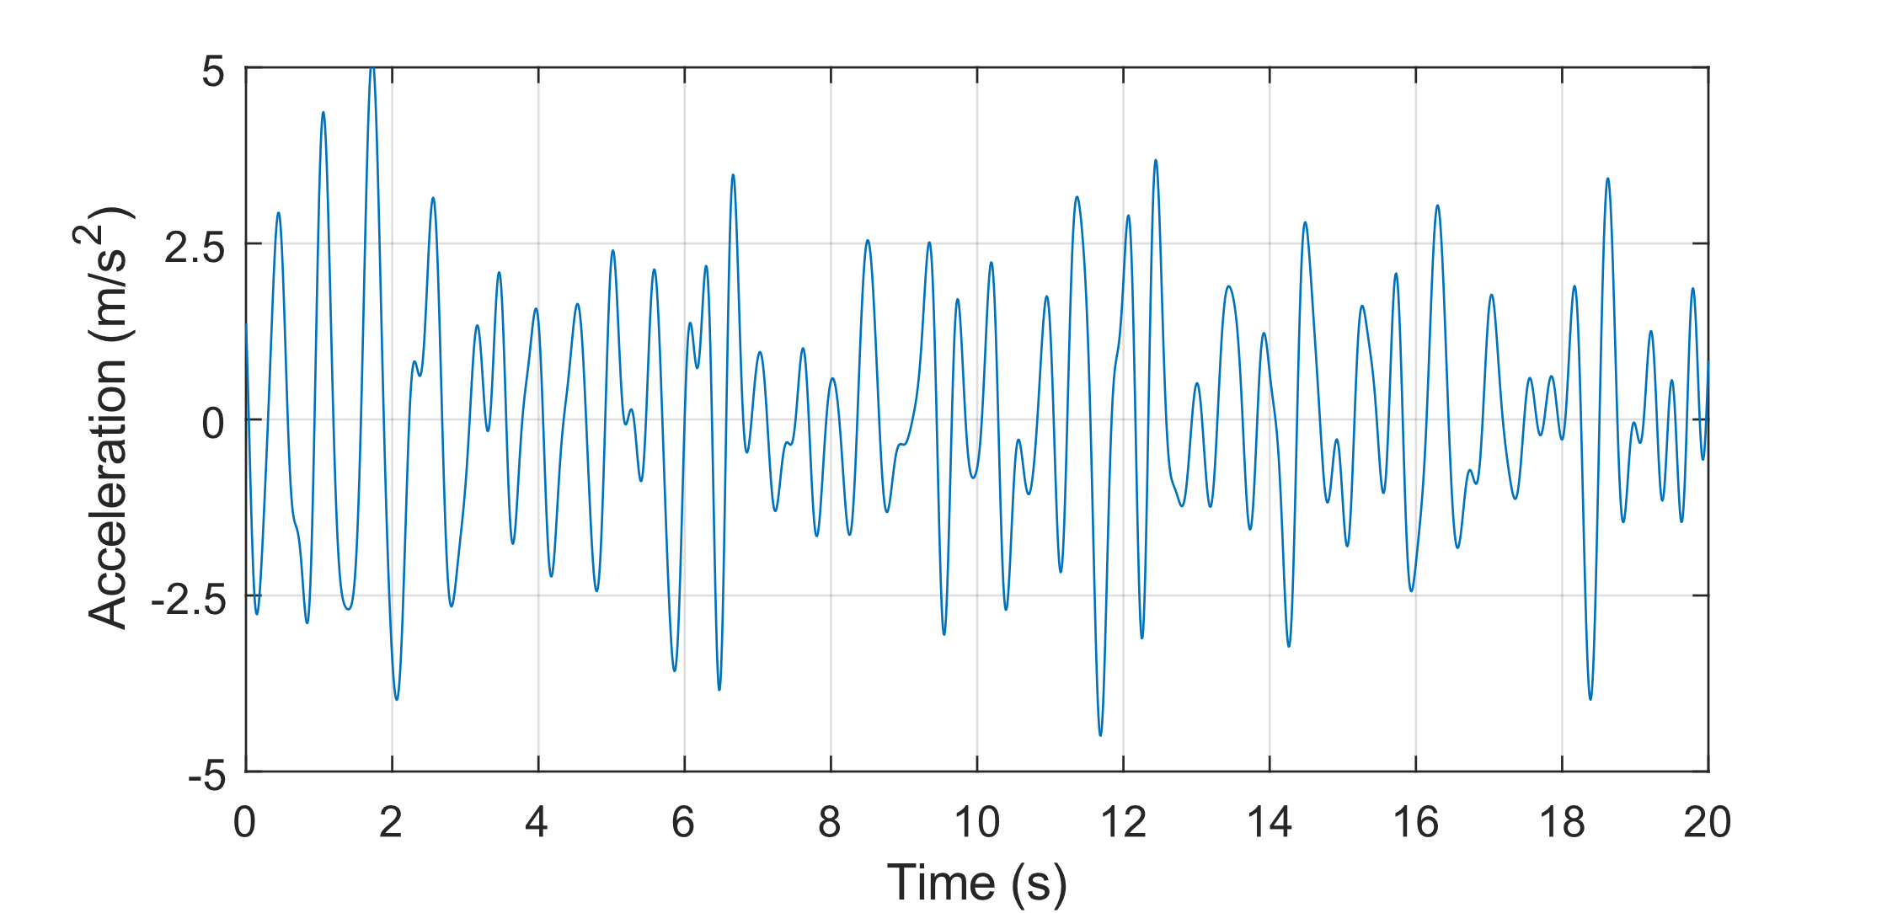
Ensemble
PSD estimation

Slide 7
Imprecise power spectrum
Identification of the basis power spectrum of the ensemble
Fitting an RBF network to the basis power spectrum
Adding/subtracting an interval parameter to/from each basis function to obtain a first approximation of the bounds
Optimisation of the interval parameter with minimum of constrained non-linear multi-variable function to obtain reliable bounds depending on the ensemble minimum and maximum

Slide 8
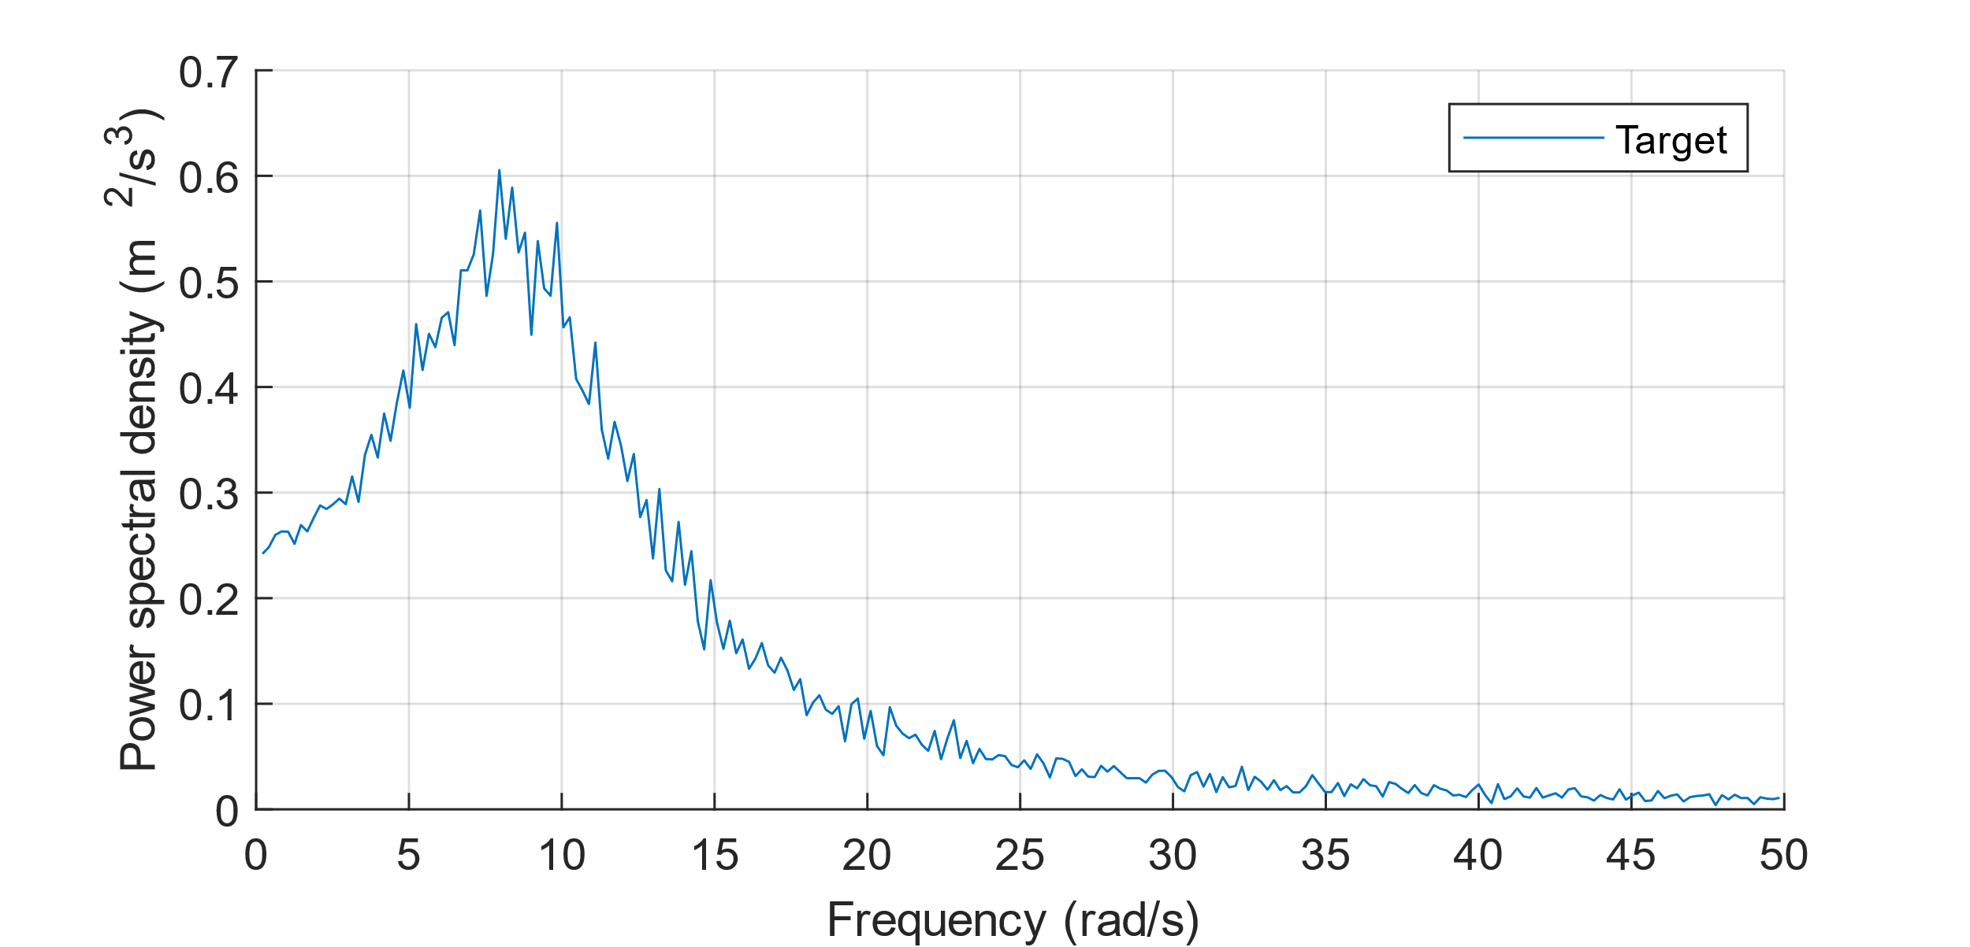
Basis power spectrum
$S_{basis}=\frac{1}{2}\left(S_{max}+S_{min}\right)$
→ midpoint spectrum $≠$ mean spectrum

Slide 9
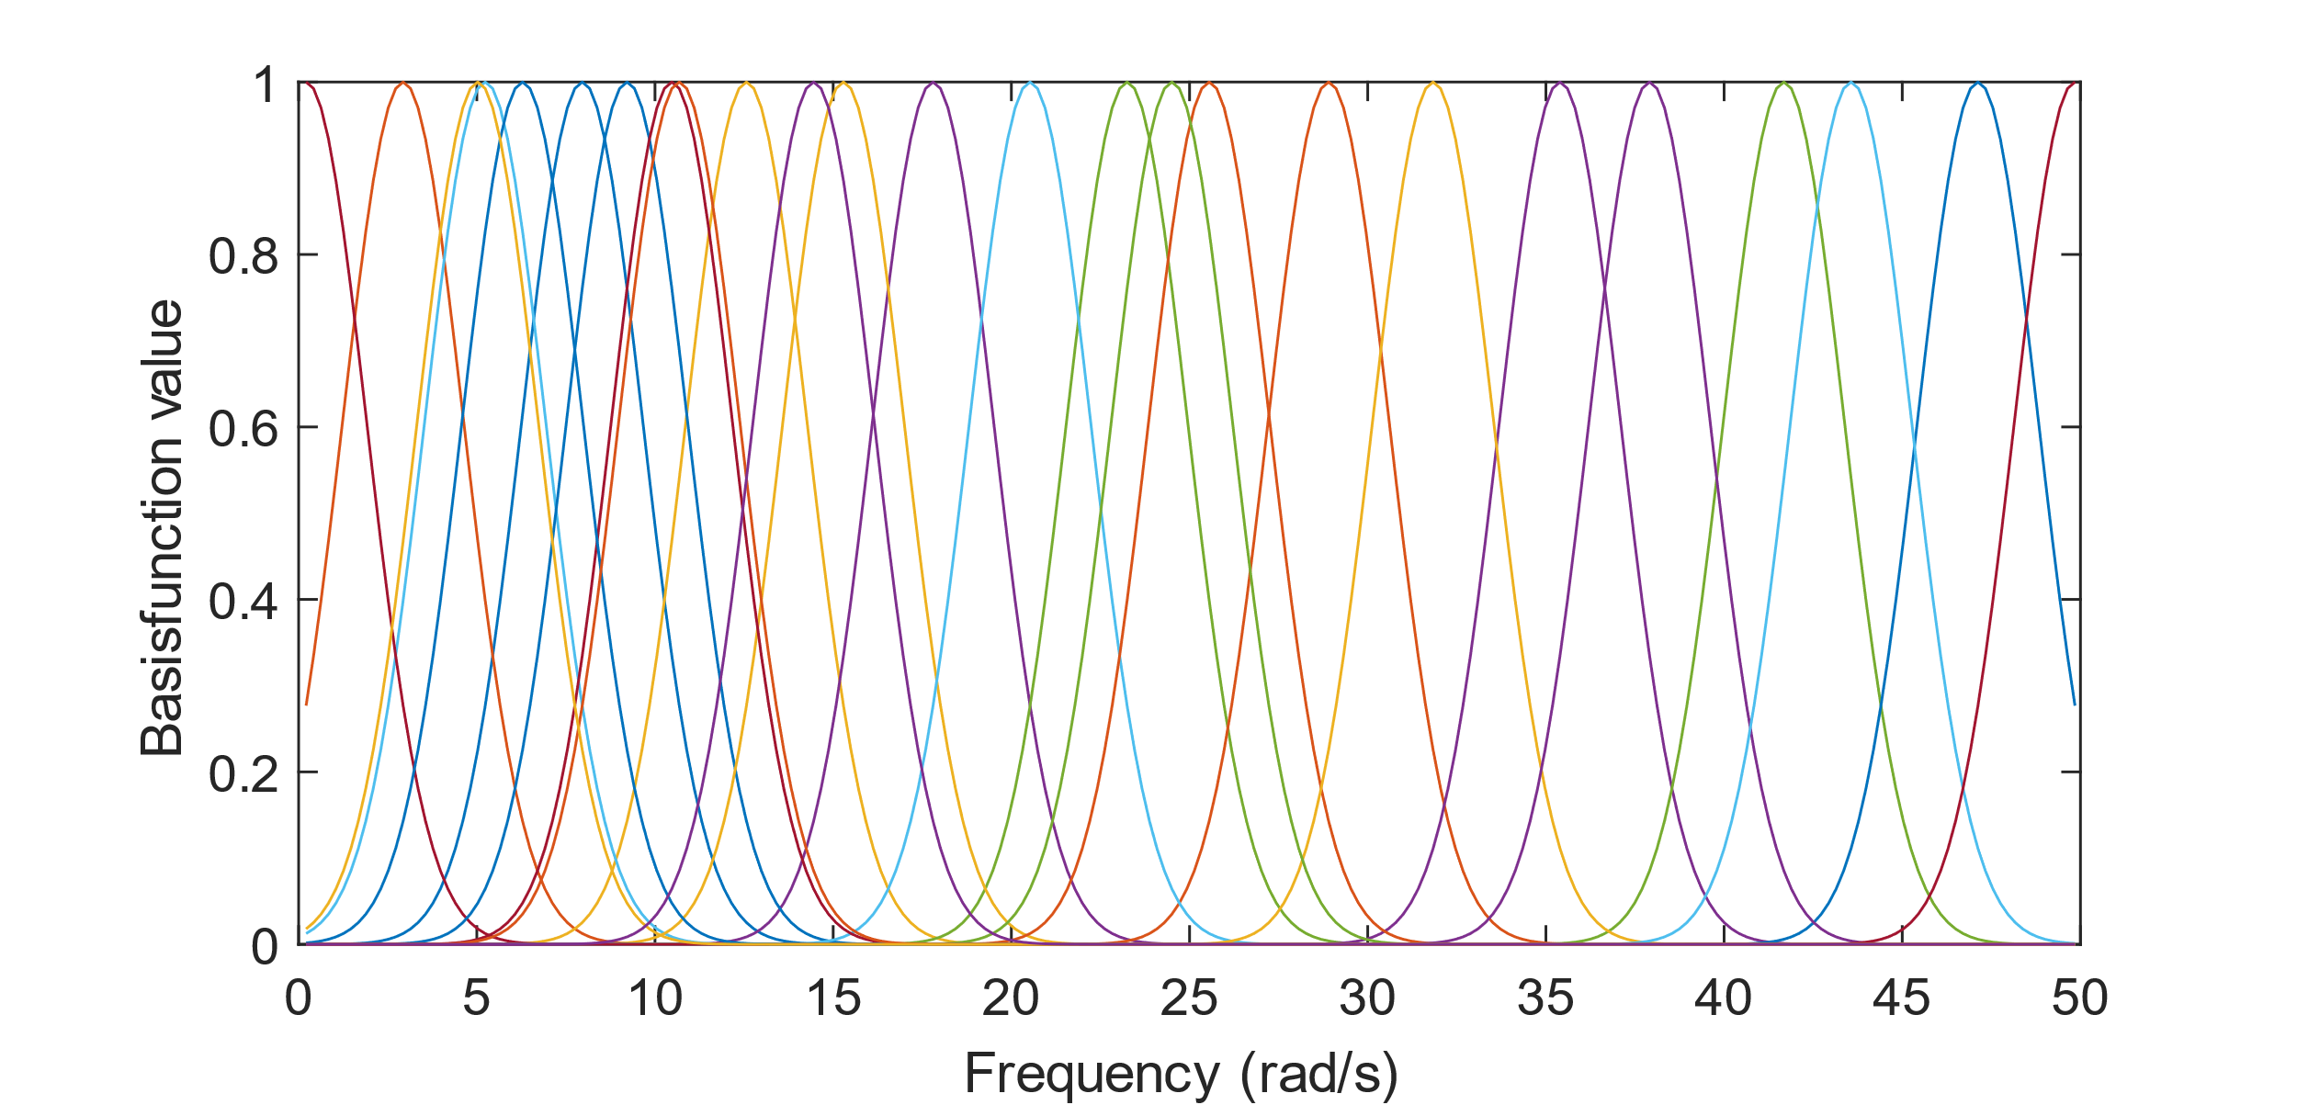
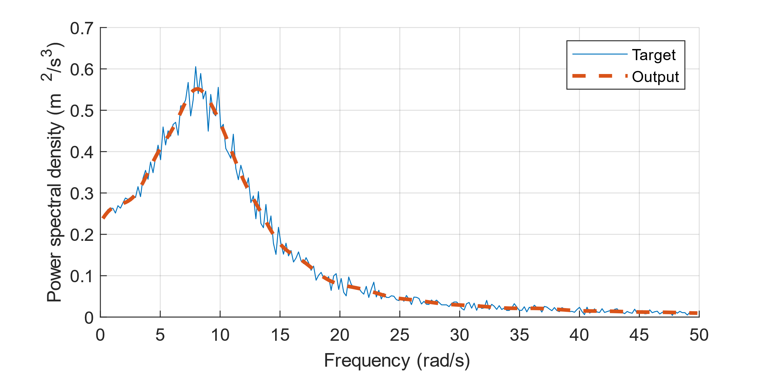
Fitting an RBF network
RBF network Radial basis functions
$y=\sum_{i=1}^{m}{w_{i}}φ_{i}\left(ω\right)+b_{0}$ $φ_{i}\left(x\right)=e^{−{\left(\left\|x−c_{i} \right\|⋅b_{φ_{i}}\right)}^{2}}$

Slide 10
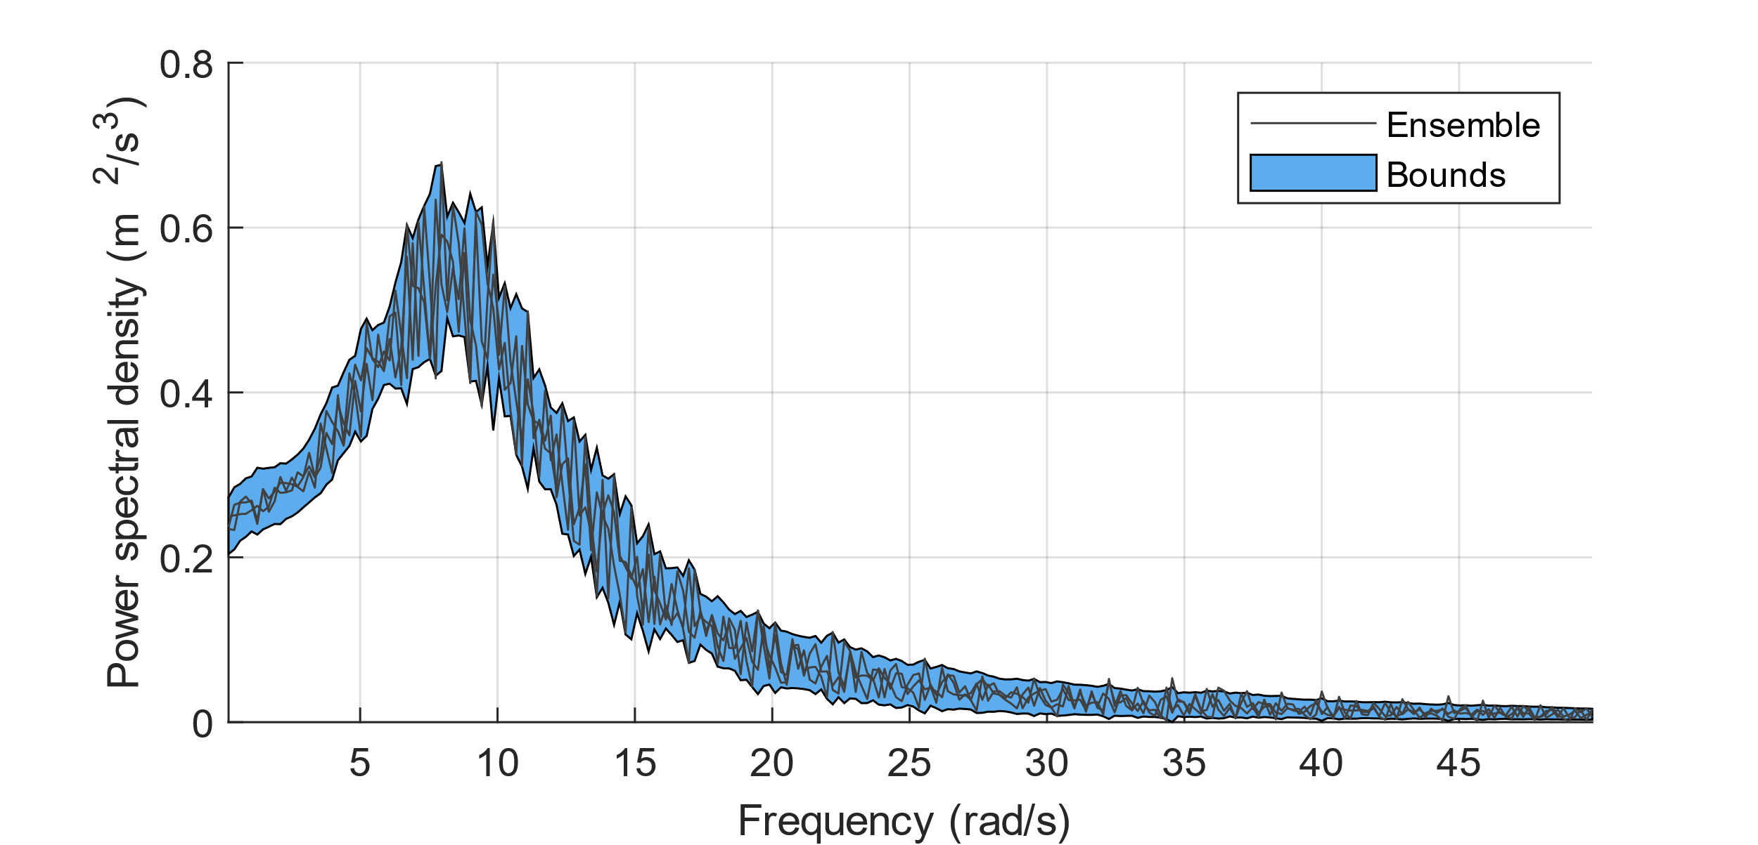
Optimisation of the bounds
$$\overline{S_{opt}}\left(ω;δ\right)=\sum_{i=1}^{m}{w_{i}}\left(φ_{i}\left(ω\right)+δ_{ω}\right)+b_{0}$$
$$\underline{S_{opt}}\left(ω;δ\right)=\sum_{i=1}^{m}{w_{i}}\left(φ_{i}\left(ω\right)−δ_{ω}\right)+b_{0}$$
$$\min{ \left|\overline{S_{opt}}\left(ω;δ\right)−\underline{S_{opt}}\left(ω;δ\right)\right|}$$
$$s.t. \overline{S_{opt}}\left(ω;δ\right)≥S_{max}\left(ω\right)$$
$$\underline{S_{opt}}\left(ω;δ\right)≤S_{min}(ω)$$
$$\underline{S_{opt}}\left(ω;δ\right)≥0$$

Slide 11
Sampling from the imprecise PSD
Determine reliability of structures by Monte Carlo simulation
Sampling uniformly distributed PSDs to generate time signals
Spectral representation method is utilised
$$\left|\sum_{n=0}^{N_{ω}−1}{S_{basis}\left(ω_{n}\right)−}\sum_{n=0}^{N_{ω}−1}{S_{sample}\left(ω_{n}\right)}\right|≤Δ_{tol}$$
Tolerance factor ensures same energy content of sampled PSD
No unrealistic PSD sampled (such as the upper bound) → does not reflect the stochastic process

Slide 12
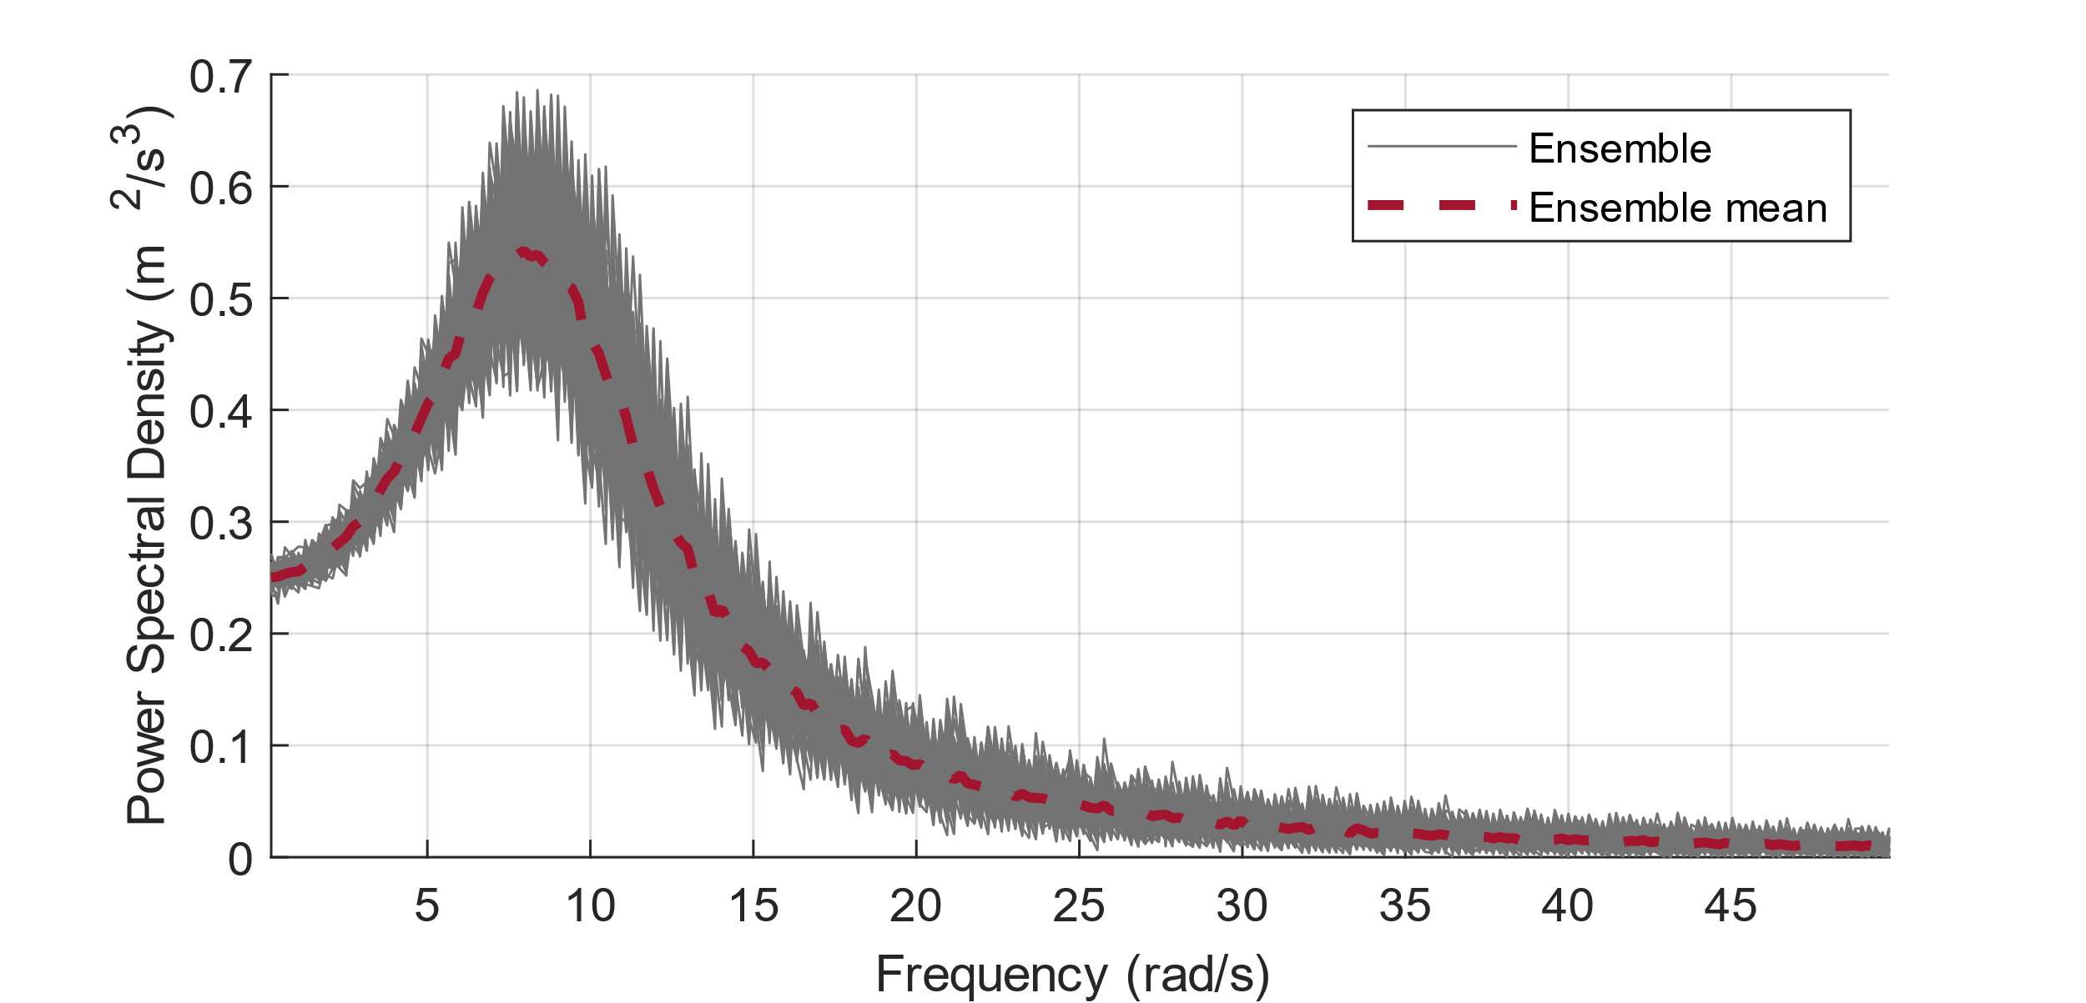
Numerical examples
Single-degree-of-freedom model: $m\ddot{x}\left(t\right)+c\dot{x}\left(t\right)+kx\left(t\right)=F(t)$
For comparison: Mean value of an ensemble consisting of 100 PSDs
Example 1)
$m=50$ kg
$c=5$ Ns/m
$k=4441.3$ N/m
$$ω_{0}=\sqrt{k/m}≈3π$$
Example 2)
$m=50$ kg
$c=3$ Ns/m
$k=12337$ N/m
$$ω_{0}=\sqrt{k/m}≈5π$$

Slide 13
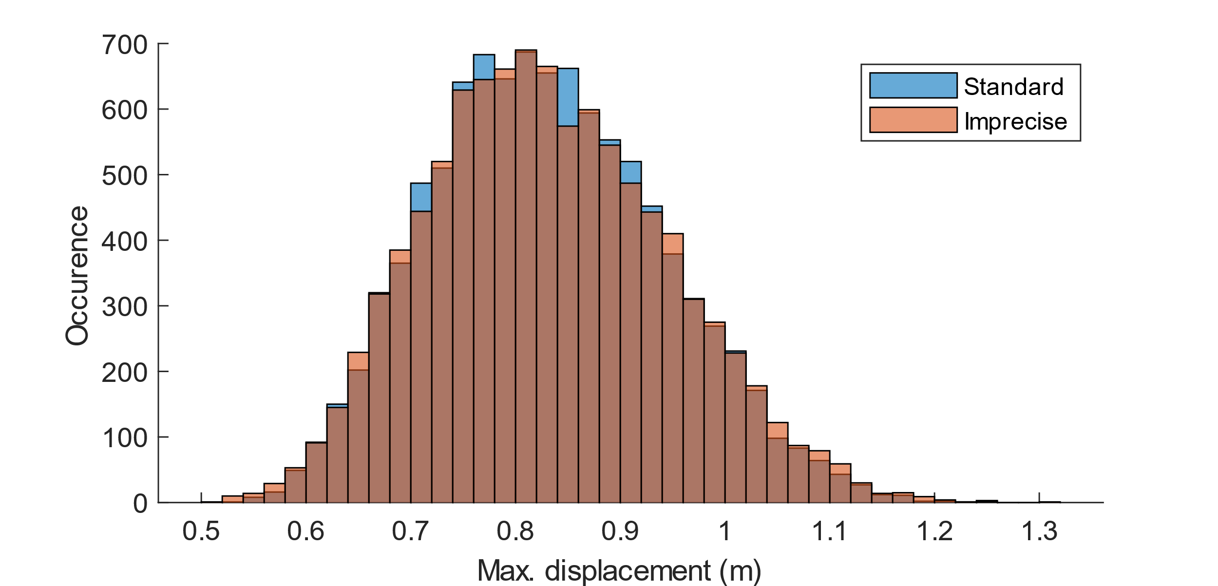
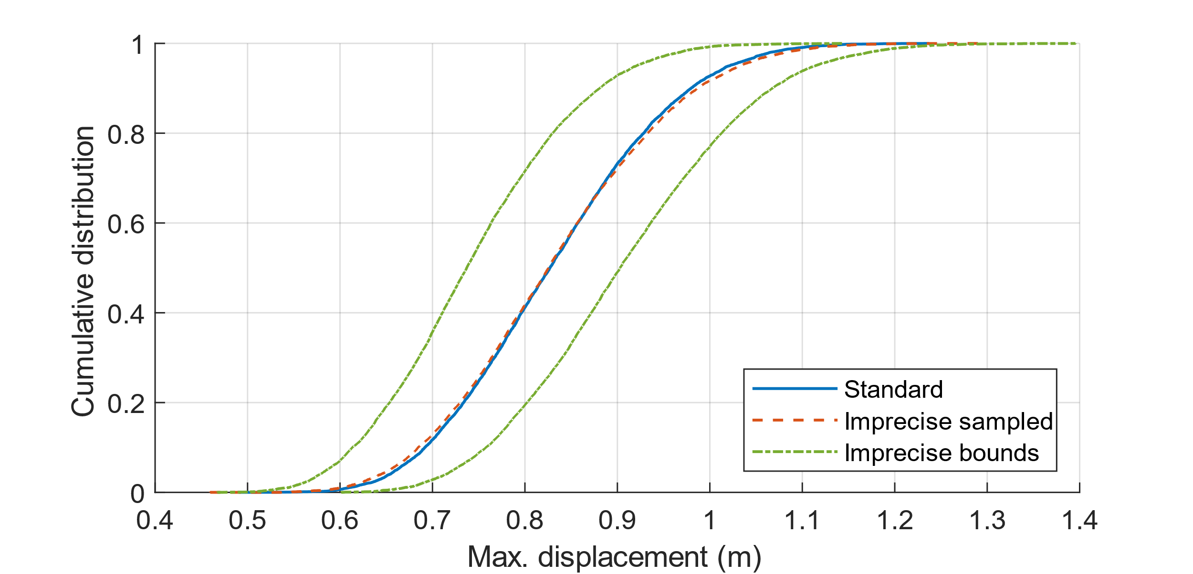
Example 1

Slide 14
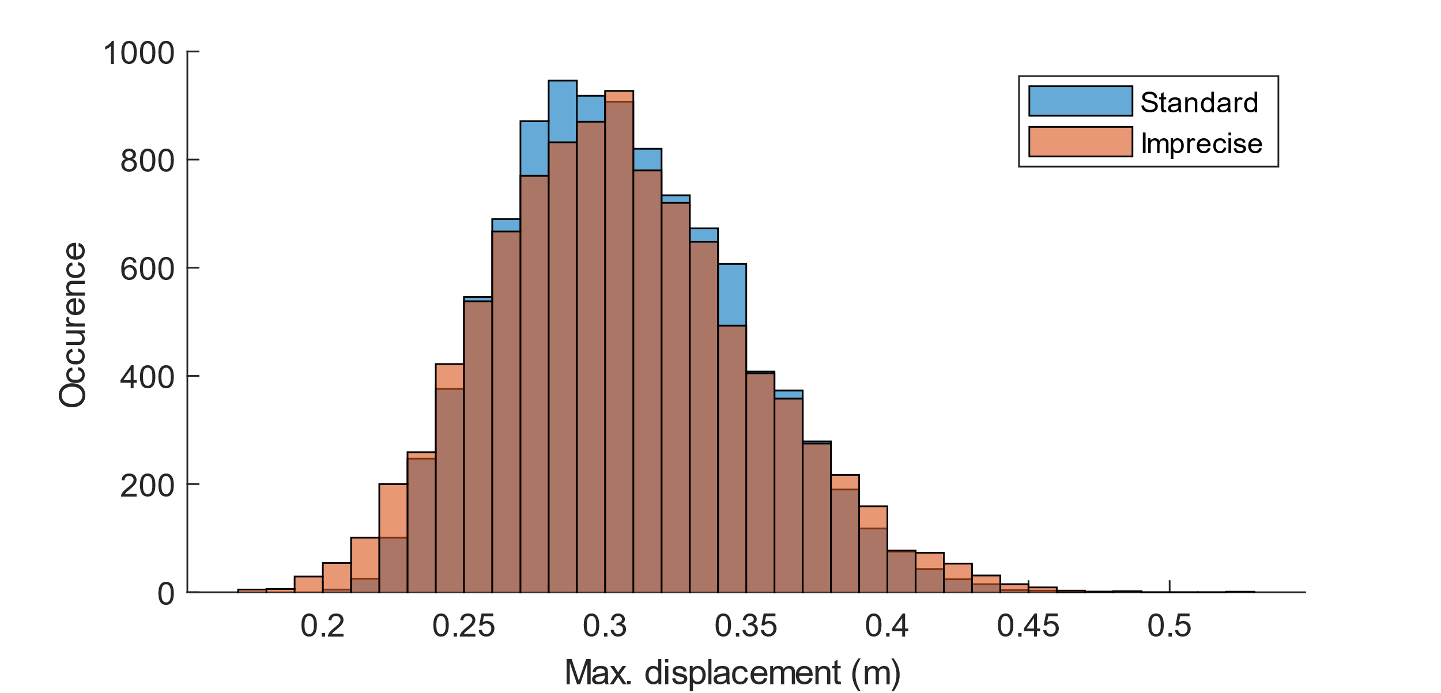
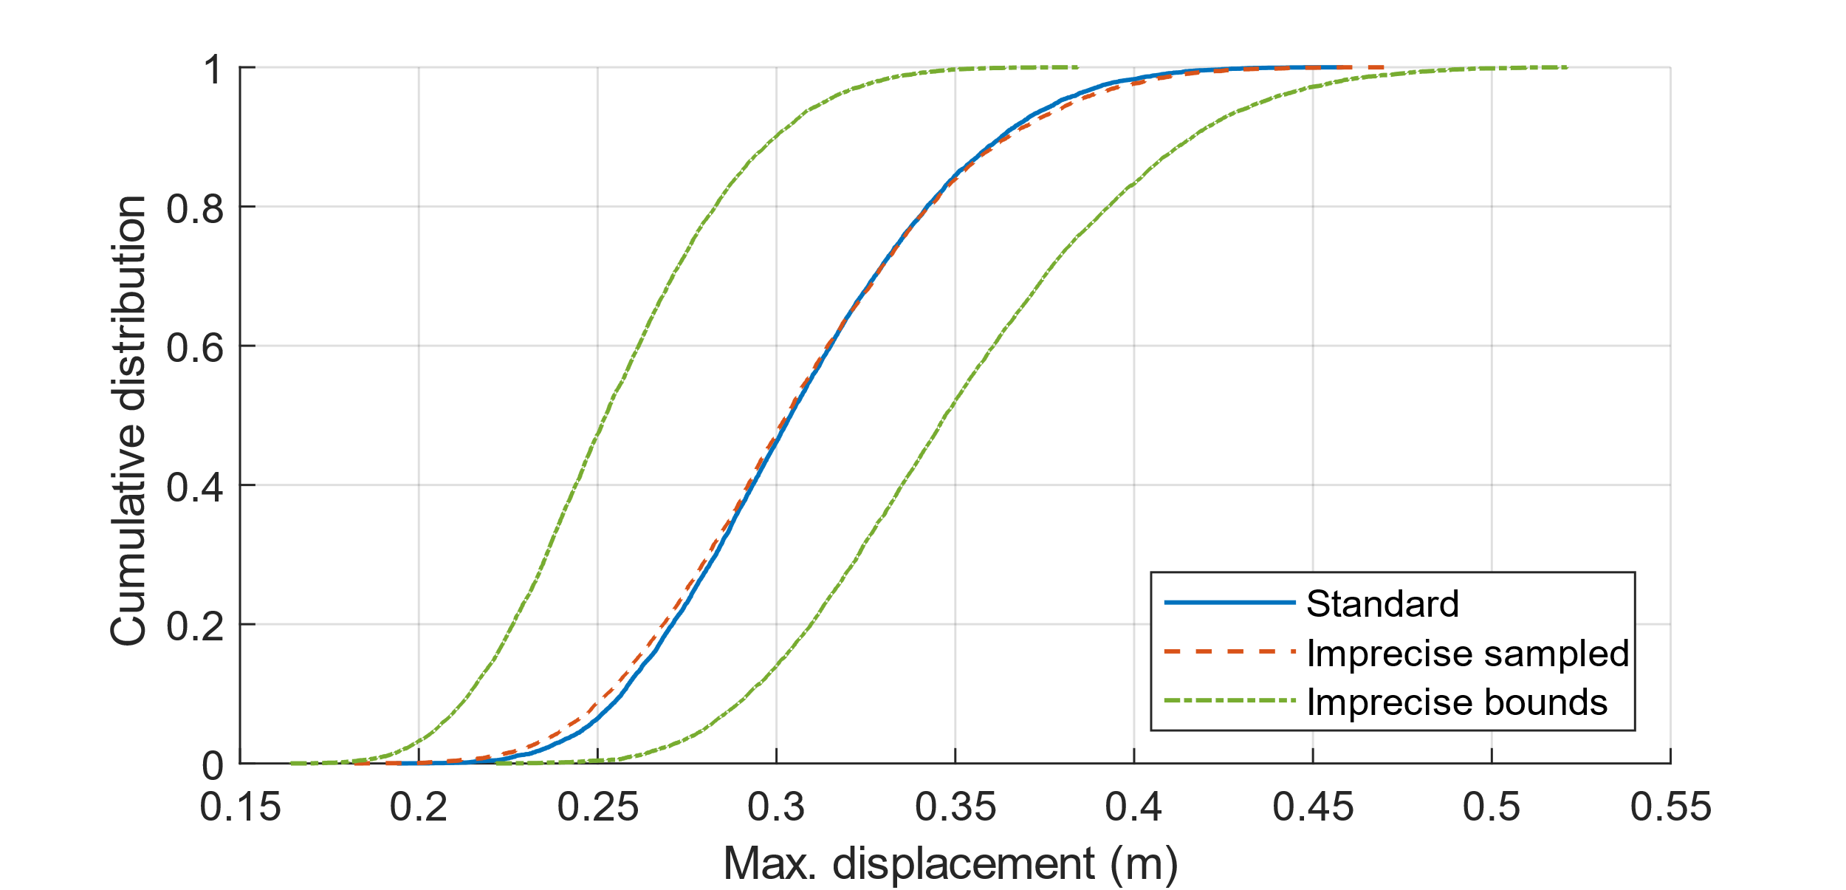
Example 2

Slide 15
Conclusion
Novel representation of the power spectral density function
Set of discrete-valued power spectra is transformed to an interval-valued power spectrum
Specifically useful for a limited amount of data is available
Not possible to obtain reliable statistical information
Intervals instead of discrete values for each frequency
Range of possible values identified by optimisation
Does not rely on any distribution of the data within the bounds
Enables the quantification of uncertainties

