Slide 1
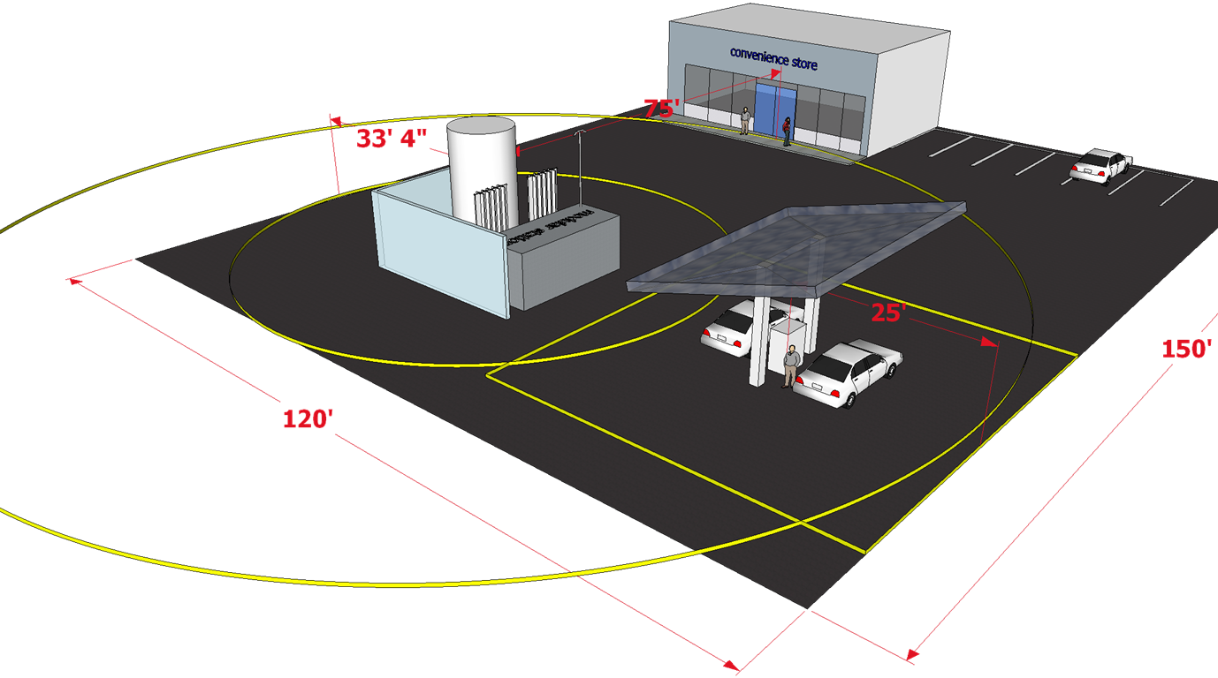
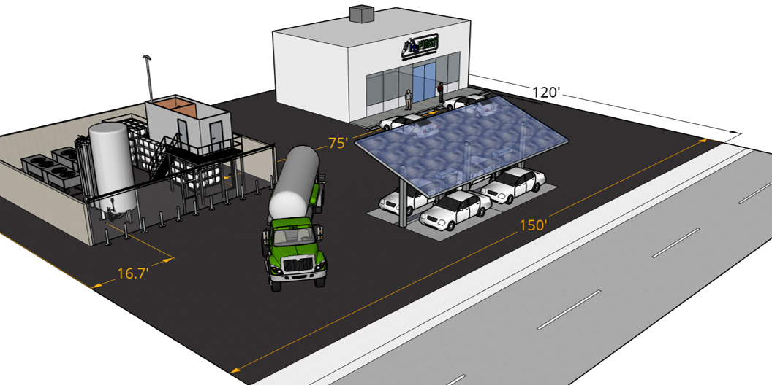
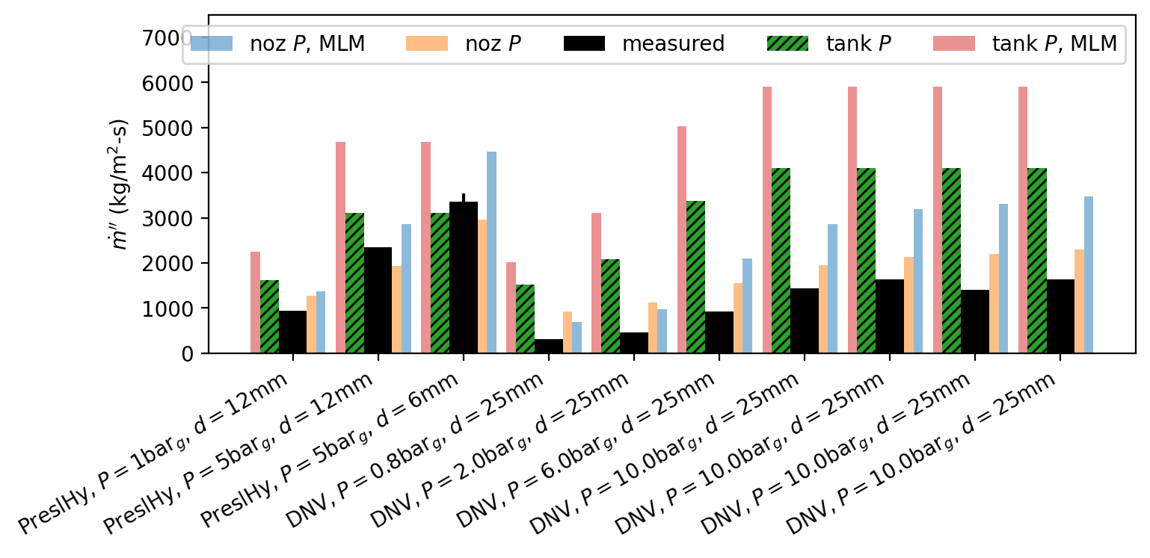
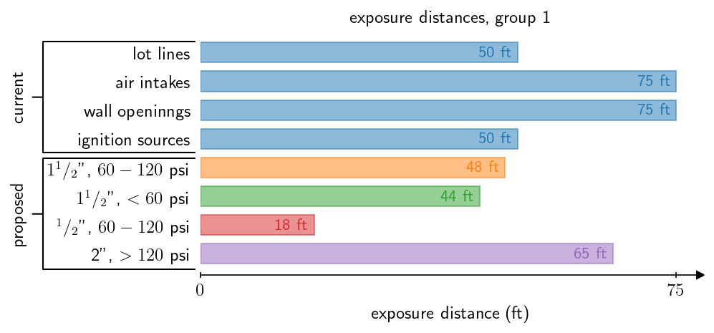
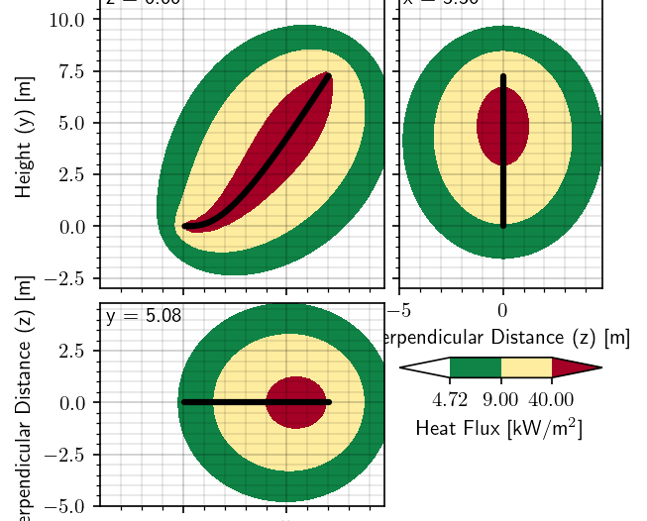
Quantitative Risk Assessment Sensitivity Study as the Basis for Risk-Informed Consequence-Based Setback Distance Requirements for Liquid Hydrogen Storage Systems
Brian D. Ehrhart, Benjamin B. Schroeder,
Ethan S. Hecht
Probabilistic Safety Assessment and Management (PSAM) 16
Honolulu, HI, USA
June 26 - July 1, 2022
SAND2022-8323 C

Slide 2
Background
Currently, NFPA 2 (Hydrogen Technologies Code) has prescriptive requirements for setback distances from bulk liquid hydrogen outdoor storage
  Some distances vary with total stored quantity of liquid hydrogen, but not all
  No known documented basis for the distances used
Past work on gaseous hydrogen setback distances resulted in revised requirements
  Distances vary with storage pressure and size of interconnecting pipe, rather than stored quantity
  Informed by quantitative risk assessment on representative hydrogen system and leak frequency analysis
Some concerns with using previous approach on liquid hydrogen system
  Lack of extensive operating data, especially for liquid hydrogen
  Leak size may be non-conservative
  Overpressure consequences not considered
NFPA 2, Hydrogen Technologies Code, 2011 Edition. National Fire Protection Association, Quincey, MA.
NFPA 2, Hydrogen Technologies Code, 2020 Edition. National Fire Protection Association, Quincey, MA.
LaChance, et al. Analysis to support development of risk-informed separation distances for hydrogen codes and standards. Sandia National Laboratories, SAND2009-0874

Slide 3
Goal and Approach
Goal:
To use risk-informed methods to justify a hydrogen release leak size that allows for calculation of consequence-based separation distances that vary with pressure and pipe size
Approach
Estimate risk-based separation distances for representative system
Calculate equivalent hole size for consequence-based distances
Select conservative hole size and use to calculate table values

Slide 4
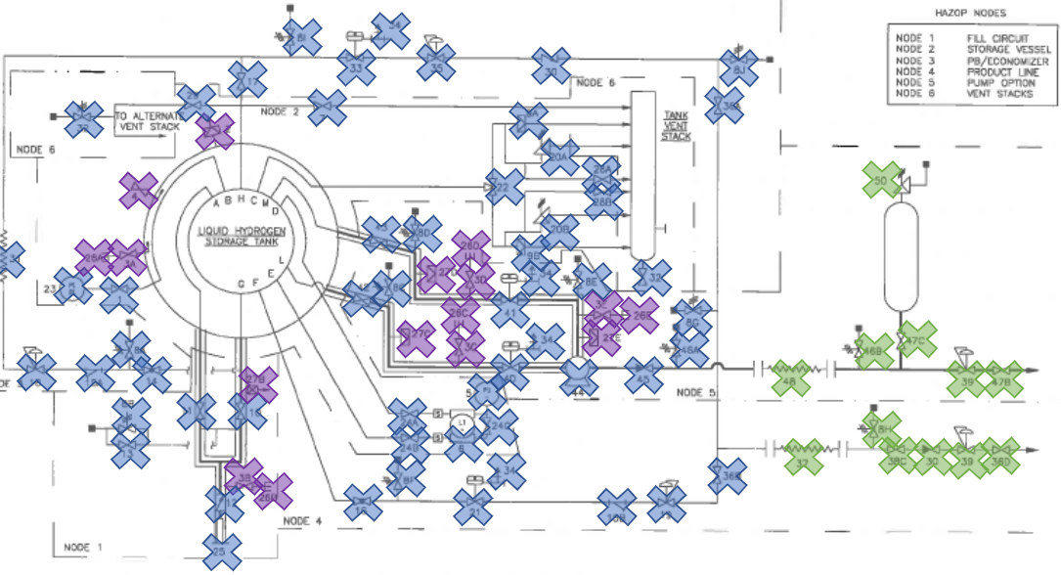
Representative Liquid Hydrogen System
Informative process schematic from
CGA P-28 (2014) Standard used as base representative system
  Included liquid hydrogen-wetted components only
Storage system only
  Not industrial process plant
  Not refueling station
Number of components varied in sensitivity study (details to follow)
Component | Count
Pump | 1
Pipe (m) | 10
Vessel | 1
Filter | 2
Valve | 44
Flange | 8
Instrument | 3

Slide 5

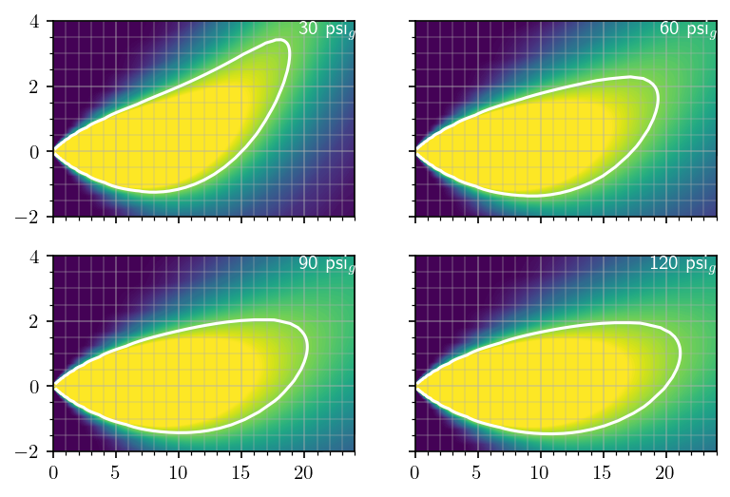
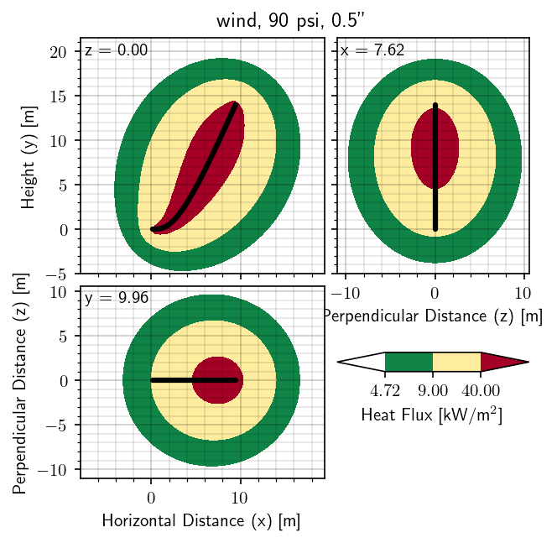
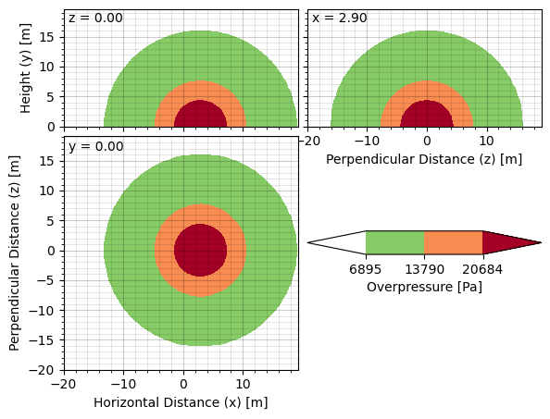
HyRAM+ Physics/Consequence Models
Unignited Concentration
  1-D streamline model with buoyancy
  Hazard for ignition source in flammable region
Jet Flame
  1-D multi-point radiation model
  Heat flux hazard
Unconfined Overpressure
  Uses unignited plume model
  Different overpressure models: TNT, BST, Bauwens/Dorofeev
  Overpressure hazard
Brian D. Ehrhart and Ethan S. Hecht. Hydrogen Plus Other Alternative Fuels Risk Assessment Models (HyRAM+) Version 4.1 Technical Reference Manual. SAND2022-5649, April 2022.
https://hyram.sandia.gov

Slide 6
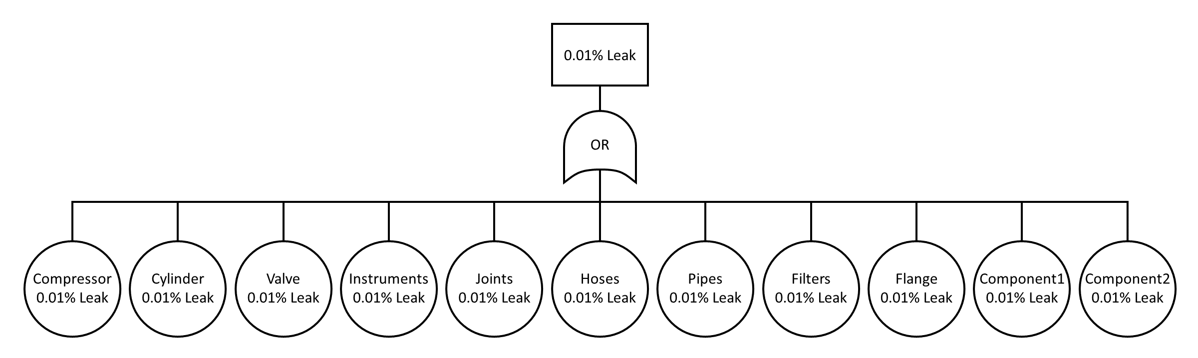
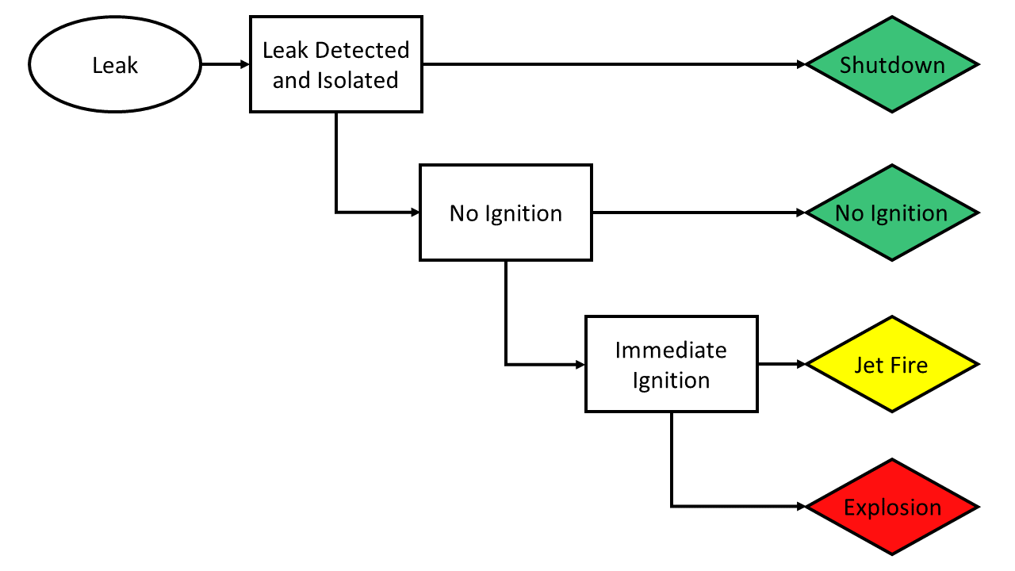
HyRAM+ Quantitative Risk Assessment Models
Fault tree estimates system annual leak frequencies from per-component estimates
  High uncertainty in leak frequencies due to inherent variability and lack of data
5 order of magnitude leak sizes: 0.01%, 0.1%, 1%, 10%, 100% of flow area
Event tree estimates probability of 4 possible outcomes
Harm calculated based on thermal effects (jet fire) or overpressure effects (explosion) at fixed location
Probits used to estimate likelihood of fatality based on estimated harm
Brian D. Ehrhart and Ethan S. Hecht. Hydrogen Plus Other Alternative Fuels Risk Assessment Models (HyRAM+) Version 4.1 Technical Reference Manual. SAND2022-5649, April 2022.
https://hyram.sandia.gov

Slide 7
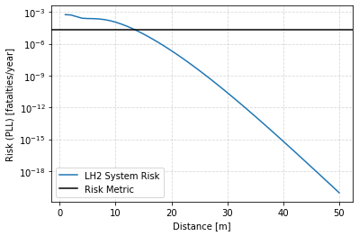
Risk-Based Distance Estimation
Risk from system can be quantified at specific distances away from a leak point
Point at which the risk falls below a given metric (criterion) yield a risk-based distance
  Analogous to individual risk contours
  Risk falls due to distance from thermal and overpressure hazards
  2 x 10-5 fatalities/year used as criterion, based on gasoline refueling stations
Purely risk-based distance not always best for prescriptive requirements
  Highly sensitive (next slide)
  Difficult to explain to code committees or authorities having jurisdiction (AHJs)
LaChance, et al. Analysis to support development of risk-informed separation distances for hydrogen codes and standards. Sandia National Laboratories, SAND2009-0874

Slide 8
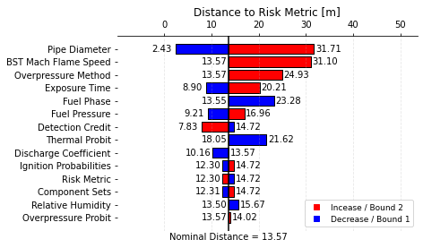
Risk Assessment Sensitivity
Varied many of the QRA inputs:
System-specific
  Pipe diameter
  Fuel phase
  Fuel pressure
  Number of components
Consequence-specific
  Overpressure method
  BST Mach flame speed
  Discharge coefficient
  Relative humidity
Risk-specific
  Thermal exposure time
  Detection credit
  Ignition probabilities
  Thermal probit
  Overpressure probit
  Risk metric

Slide 9
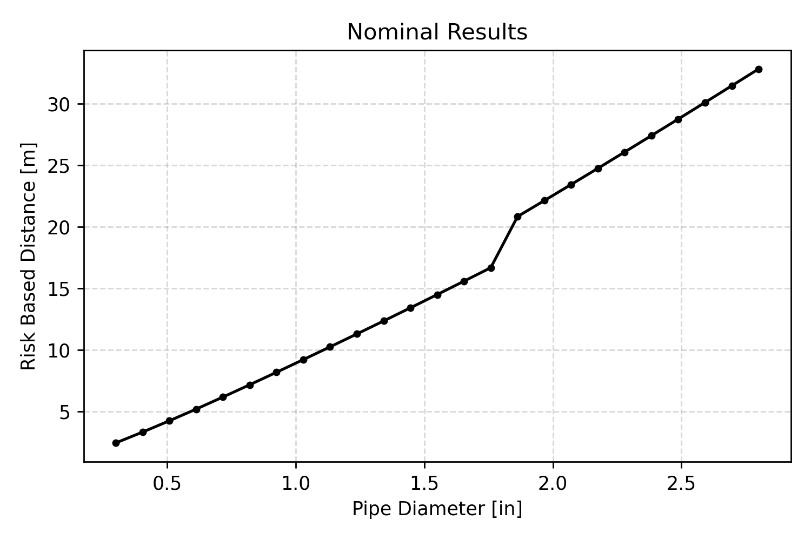
Risk-Based Distance for Variable Pipe Size
Pipe diameter is one of the most sensitive parameters for risk-based distance
  Pipe size relatively easy for AHJ review as a basis for prescriptive requirements
Calculate a risk-based distance for set of inputs, varying only the pipe size

Slide 10
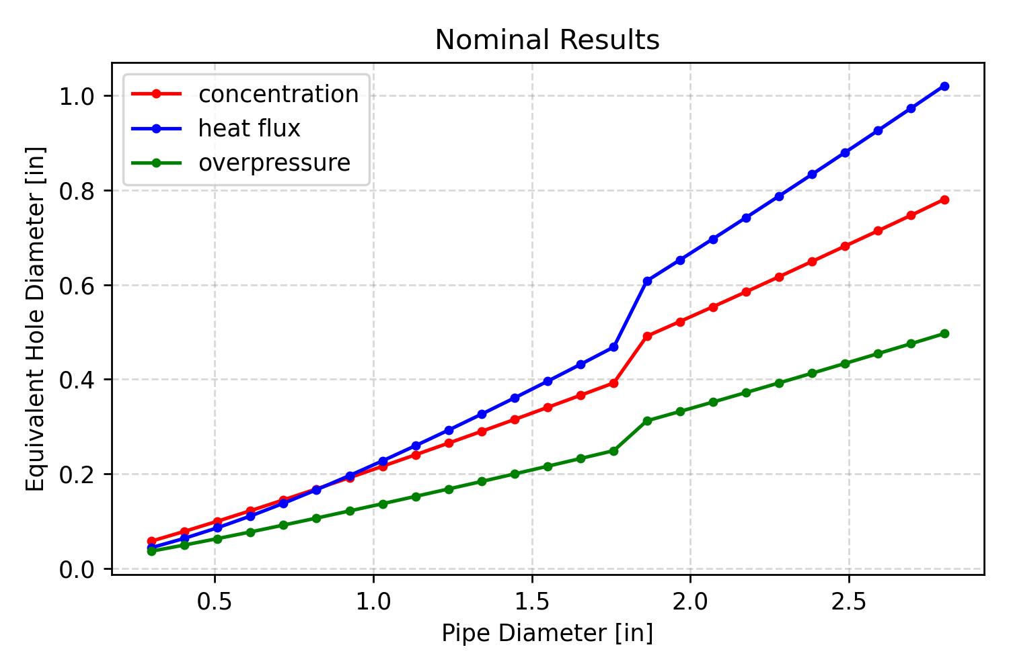
Equivalent Hole Size Estimation
Equivalent hole size can then be estimated using on risk-based distance
  For each risk-based distance value:
  Calculate leak hole size that would give same consequence-based distance
  Based on physical hazard criteria
    Unignited concentration: 8% by volume
    Heat flux: 4.7 kW/m2
    Peak overpressure: 6.9 kPa (1 psi)

Slide 11
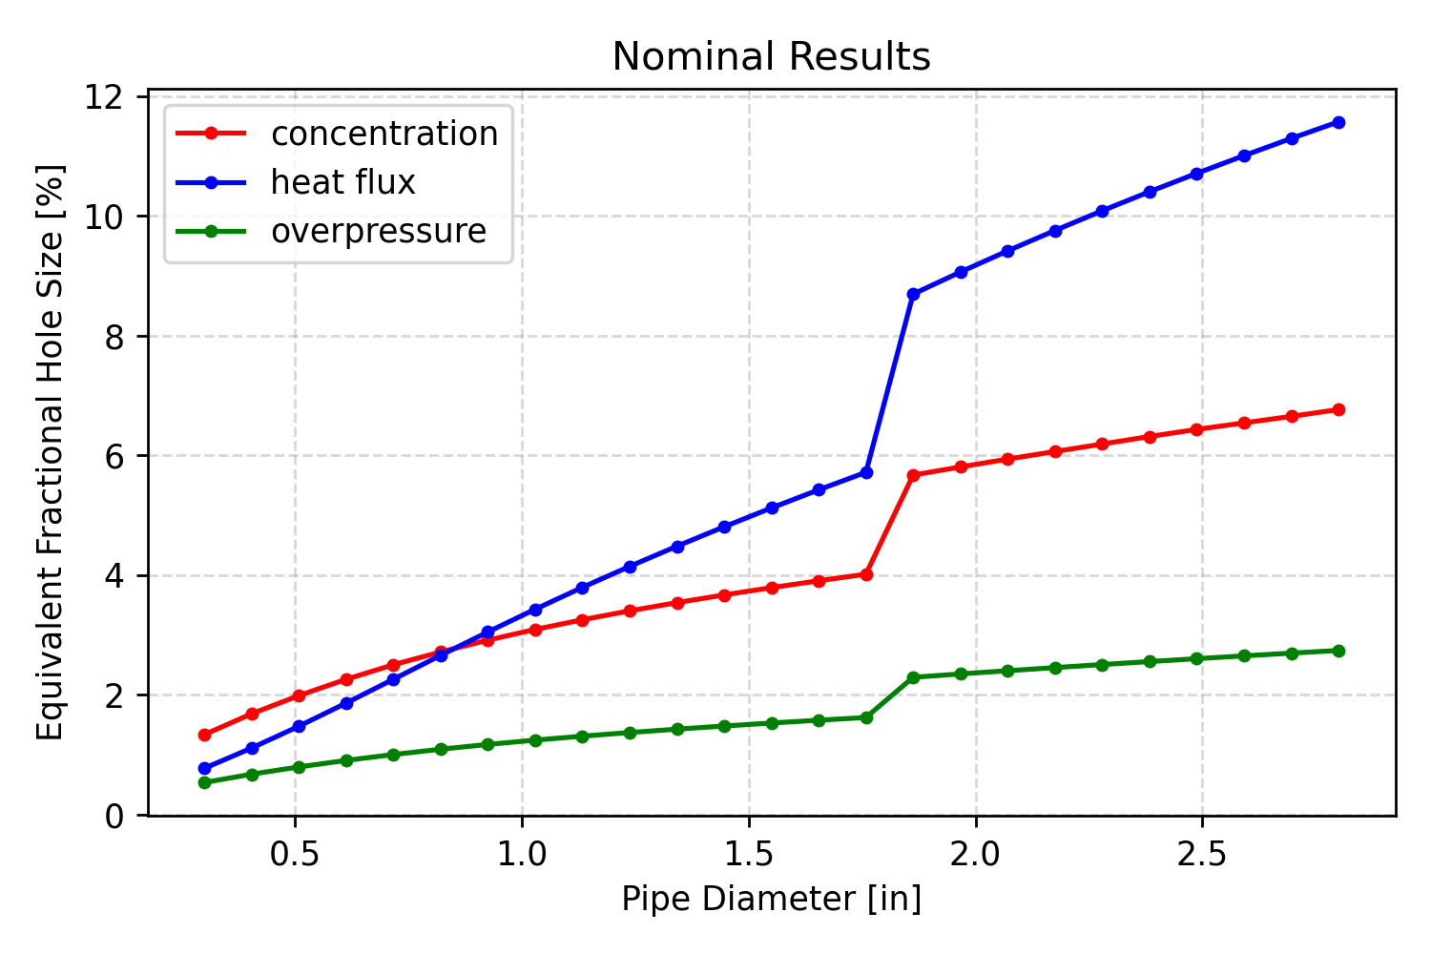
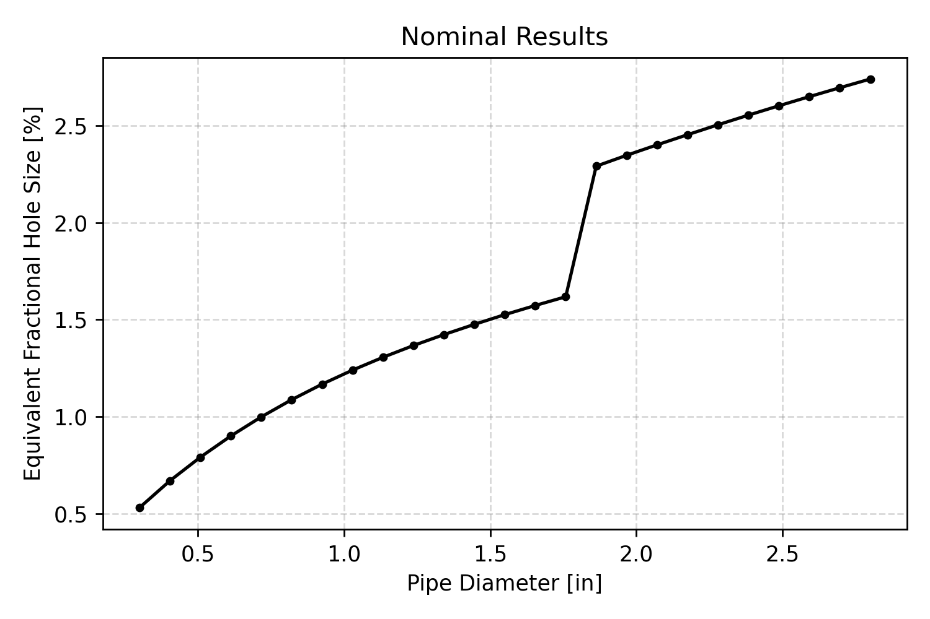
Equivalent Hole Size for Variable Pipe Size
For each equivalent hole size, calculate fractional hole size based on pipe flow area
For each pipe size, select smallest fractional hole size
  This would be the “driving” hazard for a given setback distance

Slide 12
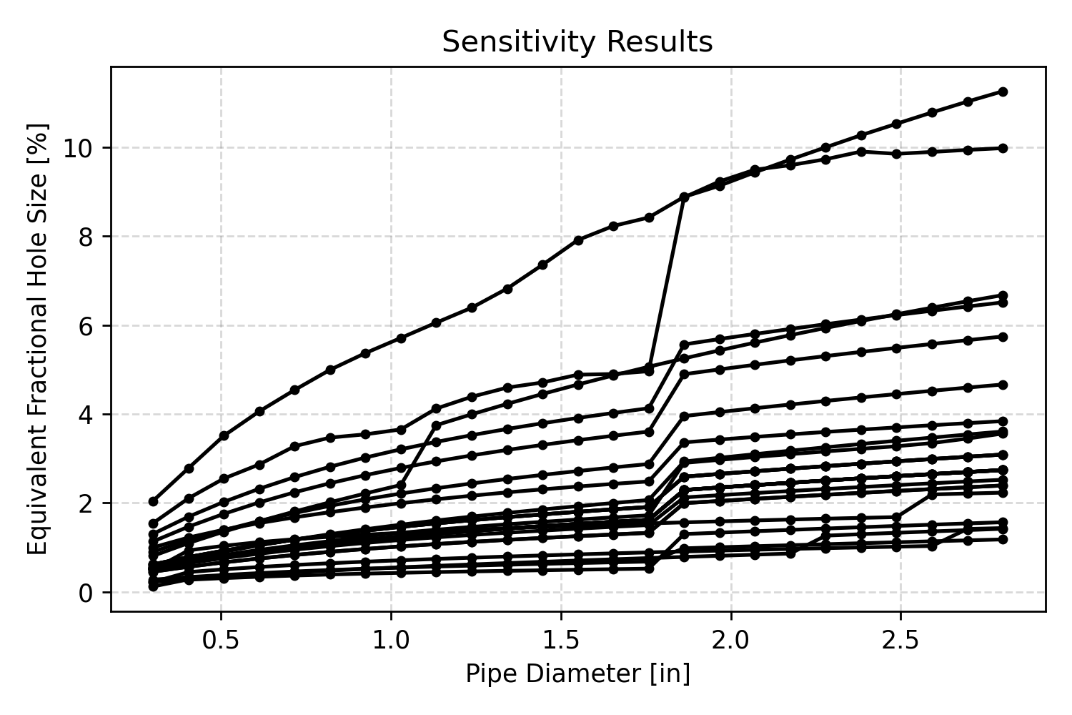
Equivalent Hole Size Sensitivity
The equivalent fractional hole size can then be repeated for each item of the sensitivity case study
  Results in 26 individual lines, each of which vary with pipe diameter
Almost all cases cluster below 5-10% equivalent fractional hole size

Slide 13
Overly-Conservative Cases: Sub-Cooled Liquid and Detonation
3 cases exceed 5-10% equivalent fractional hole size at largest pipe diameter:
Sub-cooled liquid source
  HyRAM+ consequence models assume a release directly to atmosphere
  Neglects piping effects (e.g., flow losses and heat transfer) that would heat up cryogenic hydrogen (≈20 K)
  Experiments that were intentionally trying to release liquid hydrogen could only get a two-phase mixture, not even a saturated liquid
Detonation-based overpressure methods
  BST method with Mach flame speed of 5.2 too high for non-premixed jet
  Bauwens/Dorofeev model assumes detonation of fraction of flammable mass, but model has limited validation data
  These methods tend to overpredict experimental measurements based on delayed ignition of unconfined hydrogen
K. Lyons, S. Coldrick, and G. Atkinson. Summary of experiment series E3.5 (rainout) results. Technical report, PRESLHy deliverable number D3.6, 2020.
C. Huescar Medina, A. Halford, and J. Stene. Liquid hydrogen safety data report: Outdoor leakage studies. Technical report, DNV-GL. Report 853182, Rev. 2, 2008.
S. Jallais, E. Vyazmina, D. Miller, and J. K. Thomas, “Hydrogen jet vapor cloud explosion: A model for predicting blast size and application to risk assessment,” Process Safety Progress, vol. 37, no. 3, pp. 397–410, 2018.
C. R. L. Bauwens and S. B. Dorofeev, “Modeling detonation limits for arbitrary non-uniform concentration distributions in fuel–air mixtures,” Combustion and Flame, vol. 221, pp. 338–345, 2020.
Notes:
Bauwens method also confounded by separate overpressure probit

Slide 14
Overly-Conservative Cases: Exposure Time and Thermal Probit
2 cases exceed 5% equivalent fractional hole size at largest diameter:
Thermal exposure time: 60 seconds (double nominal)
  Multiple sources recommend 30 second response time to move away from flame
  Weakly-radiating hydrogen flame can decrease harm over distance quickly
Tsao and Perry thermal probit
  Includes infrared effects in addition to ultraviolet
    Hydrogen flames radiate weakly, meaning infrared radiation likely to be low
  Does not account for protection from clothing
TNO Green Book, Methods for the Determination of Possible Damage. CPR 16E. Published by the Director-General of Labour, Netherlands, 1992.
Phani K. Raj. A review of the criteria for people exposure to radiant heat flux from fires. Journal of Hazardous Materials, 159:61–71, 2008.
Jeffrey LaChance, Andrei Tchouvelev, and Angunn Engebø. Development of uniform harm criteria for use in quantitative risk analysis of the hydrogen infrastructure. International Journal of Hydrogen Energy, 36(3): 2381–2388, February 2011.

Slide 15
Selection of 5% Fractional Leak Area
Sensitivity results are mostly below 10% fractional leak area
  Only 2 of 26 cases exceed 10% at largest pipe inner diameters (~3 inch):
    Overpressure models with detonation (BST Mach 5.2 and Bauwens/Dorofeev)
  Only 3 of 26 additional cases exceed 5% at largest pipe inner diameters:
    Sub cooled liquid source, exposure time doubled (60s), Tsao and Perry thermal probit (includes infrared effects)
  21 of 26 cases are below 5% fractional hole size for all inputs and pipe diameters considered
Possibilities considered:
  Use 10% hole size as conservative hole size (too conservative)
  Use 5% hole size (generally conservative)
  Use ~3% hole size (mid-range, may not be sufficiently conservative)

Slide 16
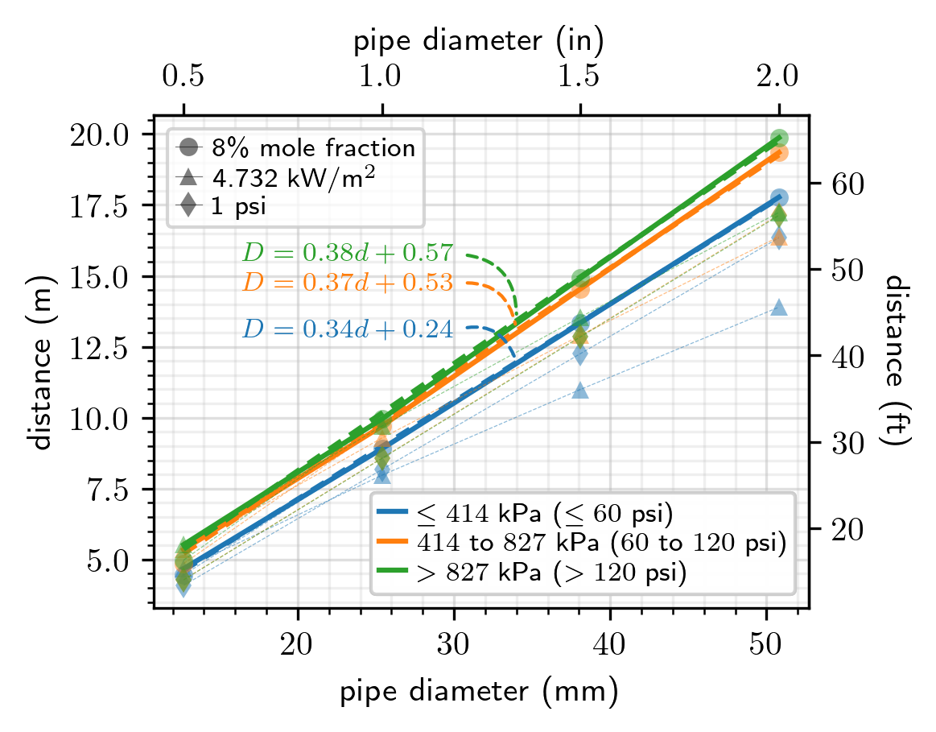
Use of Fractional Hole Size for Setback Distance Calculation
5% fractional hole size used as source
Pressure and pipe size were varied
  This affected release flow rate
  Thus varied distance to hazard
For each exposure group (types of exposure), furthest distance was selected
Resulted in distances that vary with pressure and pipe size

Slide 17
Conclusions
Risk-based distances can be highly sensitive to system parameters and modeling assumptions
Sensitivity study of risk-based distances showed amount of variability, and leads to conservative but not unrealistic choice in leak size
Fractional leak size can allow “credit” for differences in pipe size and fuel pressure
Risk-informed justification for consequence-based setback distances can utilize useful aspects of consequence-based distances while still incorporating trends from risk assessment

Slide 18
Potential Future Work
Use same methodology to revisit gaseous hydrogen requirements
Include cryogenic pooling scenarios
Improved validation from upcoming experiments
Better characterize hydrogen-specific overpressure
Use similar methodology to assess liquid transfer points

Slide 19
Thank you!
Questions?
bdehrha@sandia.gov

Slide 20
Back Up Slides

Slide 21
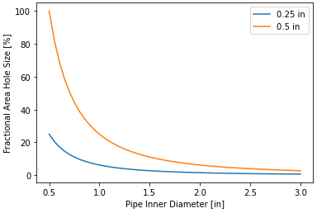
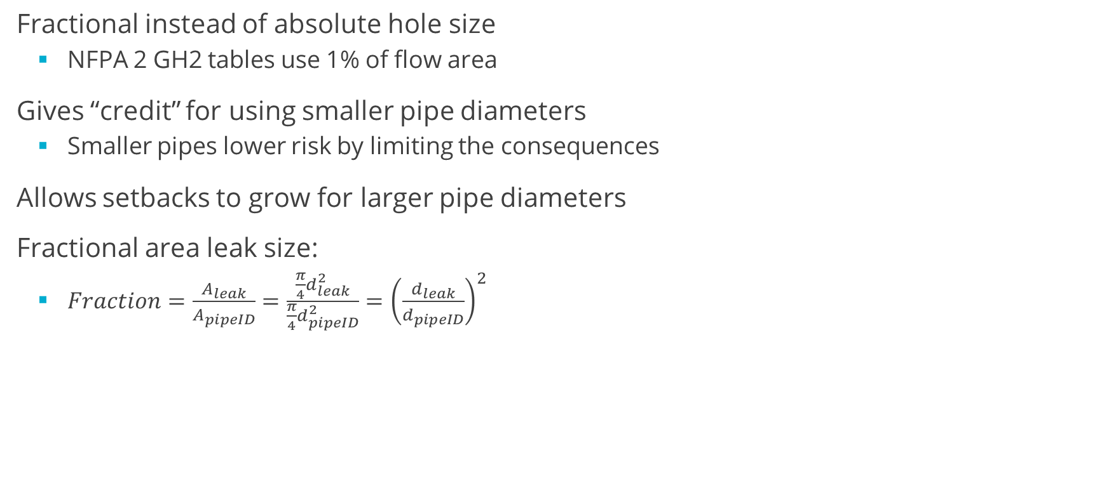
Fractional Hole Size
Fractional instead of absolute hole size
  NFPA 2 GH2 tables use 1% of flow area
Gives “credit” for using smaller pipe diameters
  Smaller pipes lower risk by limiting the consequences
Allows setbacks to grow for larger pipe diameters
Fractional area leak size:
  $Fraction=\frac{A_{leak}}{A_{pipeID}}=\frac{\frac{π}{4}d_{leak}^{2}}{\frac{π}{4}d_{pipeID}^{2}}={\left(\frac{d_{leak}}{d_{pipeID}}\right)}^{2}$

Slide 22
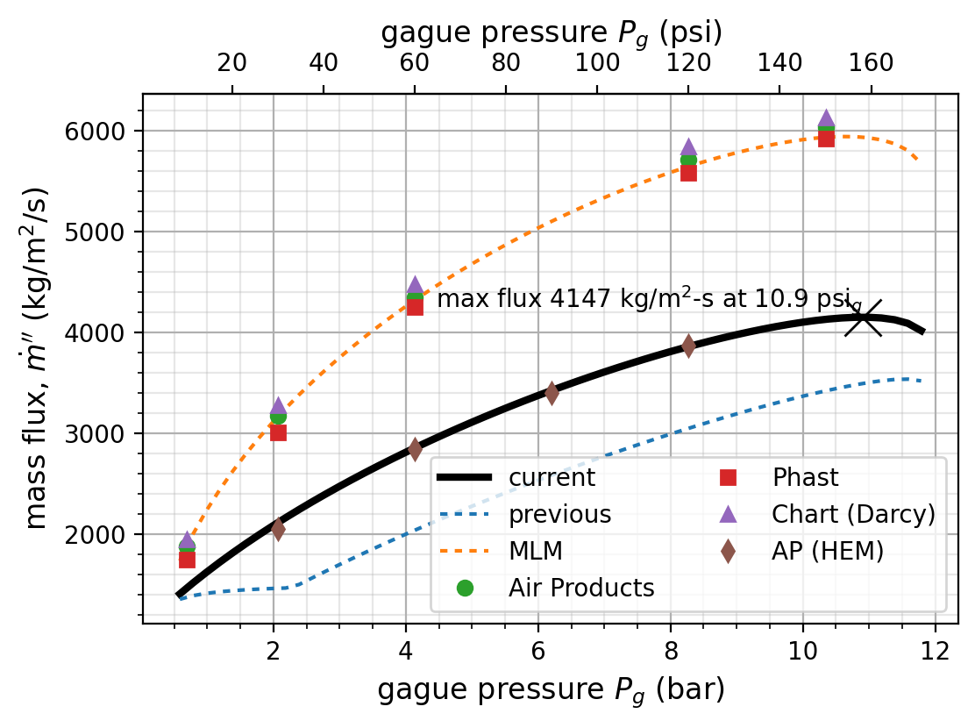
Mass Flow Rate–Comparison and Justification
Calculations use homogenous equilibrium model (with search for maximum mass flux)
Experiments attempting to get maximum liquid don’t see flows approaching MLM

Slide 23
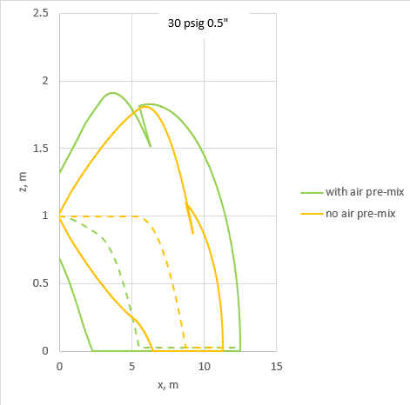
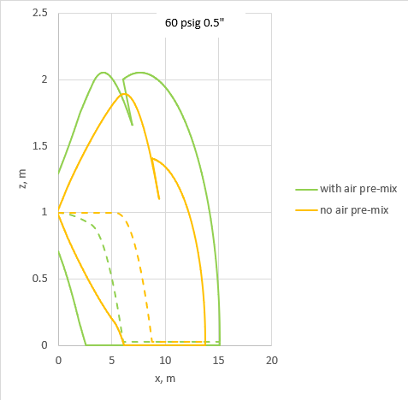
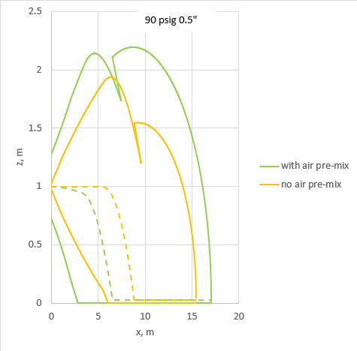

HyRAM+ vs. AP VentJet dispersion: 0.5” hole
HyRAM+
AP VentJet
VentJet is affected by ground while HyRAM+ does not account for this
HyRAM+ distances are slightly longer (more conservative) than VentJet
Distances calculated along streamline rather than just x-distance adding additional conservativism

Slide 24
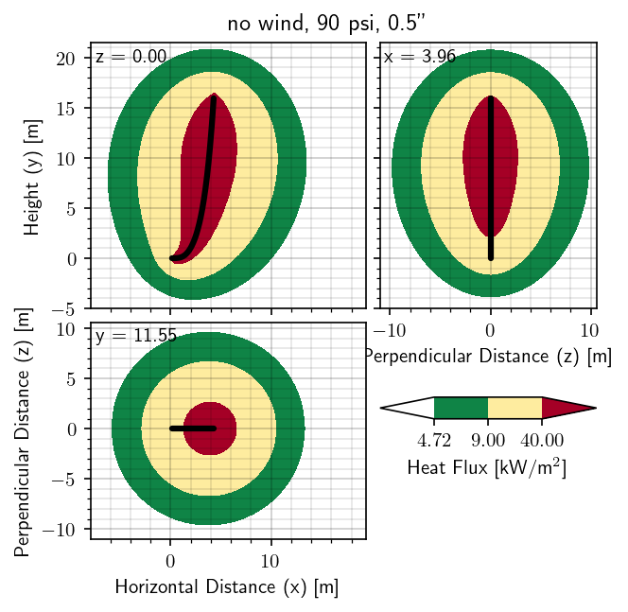
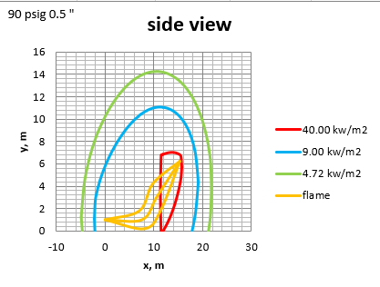
HyRAM+ vs AP flame: 90 psi, 0.5” hole
HyRAM+
AP VentJet
High density of LH2 results in low momentum release rates
HyRAM+ modified to include the effect of wind; results in similar distances to AP flame
Largest projected heat fluxes onto the ground are used as exposure distances

Slide 25
Model Justification: Unconfined Overpressure
Work by Jallais et al. (2018) suggested use of modified TNO ME or BST method for calculating overpressure from delayed ignition of hydrogen jet
  Source energy of blast wave is calculated from flammable mass from 10-75% (not 4-75%)
  Blast wave curve (blast intensity) is tied to mass flow rate of leak; deflagration (not detonation)
  Compared models to experimental data and high-fidelity models
This approach was implemented using HyRAM+ and compared to AP JetEx model
  Similar results obtained
Overpressures compared to DNV-GL release data
  Peak overpressures overpredicted by 3-10 times (conservative)
HyRAM+
0.5” hole, 90 psi
1 psi, 2 psi, 3 psi

Slide 26
Criteria Justification: Unignited Concentration
Exposures to consider:
  Air intakes
  Sewer inlets
  People (fireball)
NFPA 2 GH2 uses 8% by volume
  Based on ability to sustain ignition
  Rather than 4% by volume lower flammability limit
NFPA 59A uses LFL (50% of LFL depending on model used)
  Also considers higher concentrations for oxygen displacement
Will use 8% by volume unignited concentration for Group 1 exposures

Slide 27
Criteria Justification: Jet Flame Heat Flux
Exposure types to consider:
  People
  Cars
  Buildings
  Combustibles
NFPA 2 GH2 currently uses:
  Group 1: 4.732 kW/m² (based on IFC 2003 exposure for employee for 3 minutes)
    Previously was 1.577 kW/m² (based on IFC 2003 exposure at property line); now same as Group 2
  Group 2: 4.732 kW/m² (based on IFC 2003 exposure for employee for 3 minutes)
  Group 3: 20 kW/m² for combustibles, 25.237 kW/m² for noncombustibles (IFC 2003)
Visible flame length is currently used for NFPA 2 GH2 Group 3
NFPA 59A Table 19.8.4.2.1
  9 kW/m2: fatality of person outdoors without PPE
  5 kW/m2: irreversible harm to person outdoors without PPE
  25 kW/m2: harm/fatality to person inside building with combustible exterior
  30 kW/m2: harm/fatality to person inside building with noncombustible exterior
LaChance et al. (2011):
  1.6 kW/m2: No harm for long exposures
  4-5 kW/m2: Pain for 20s exposure; first degree burn
  9.5 kW/m2: Second degree burn after 20s
  12.5-15 kW/m2: First degree burn after 10s; 1% lethality in 1min
  25 kW/m2: Significant injury in 10s; 100% lethality in 1min
  35-37.5 kW/m2: 1% lethality in 10s
Will use:
4.732 kW/m² for Group 1,
9 kW/m² for Group 2, and
20 kW/m² for Group 3

Slide 28
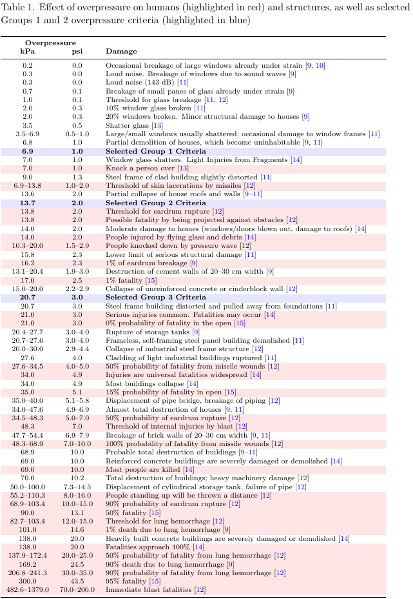
Criteria Justification:
Peak Overpressure
Exposures to consider:
  People
  Cars
  Buildings
Hecht and Ehrhart, ICHS 2021
  Group 1: 0.7 psi
  Group 2: 2.3 psi
  Group 3: 10.2 psi
NFPA 59A Table 19.8.4.3.1
  3 psi fatality to person outdoors
  1 psi irreversible harm to person outdoors
  1 psi limit for buildings
Will use:
  1 psi for Group 1 exposures,
  2 psi for Group 2 exposures,
  3 psi for Group 3 exposures

Slide 29
Typical Inner Diameter
Table 8.3.2.3.1.6(a) Minimum Distance from Outdoor Bulk Liquefied Hydrogen [LH2] Systems to Exposures, up to 75000 gallons— Typical Inner Diameter (1.5 in [38.1 mm])

Slide 30
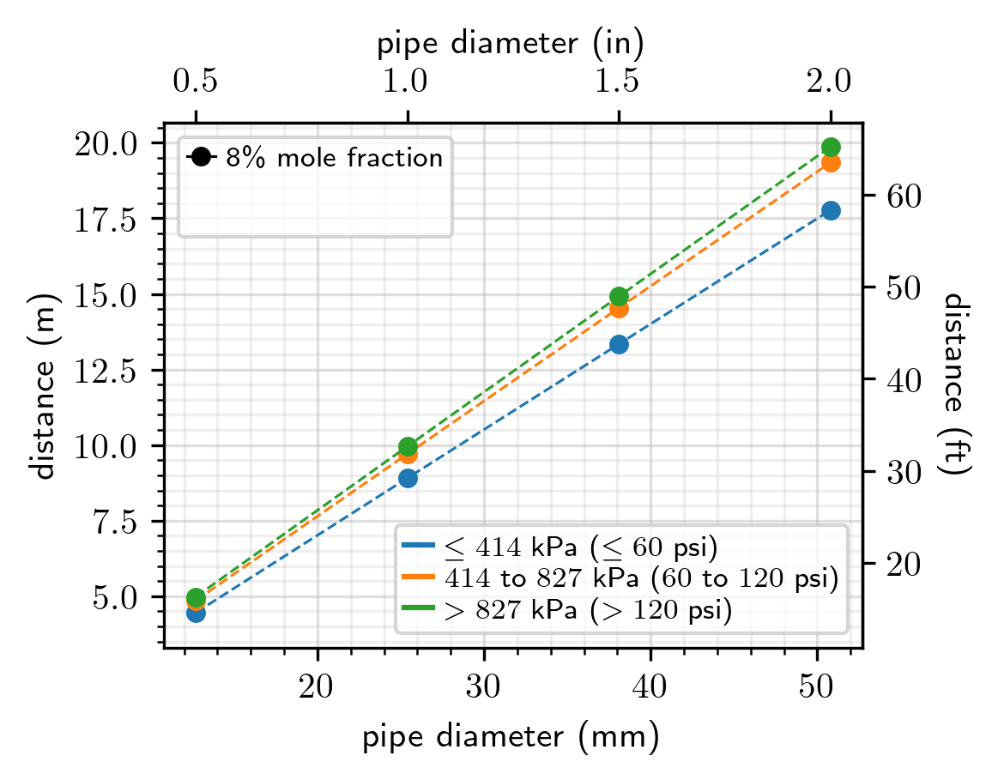
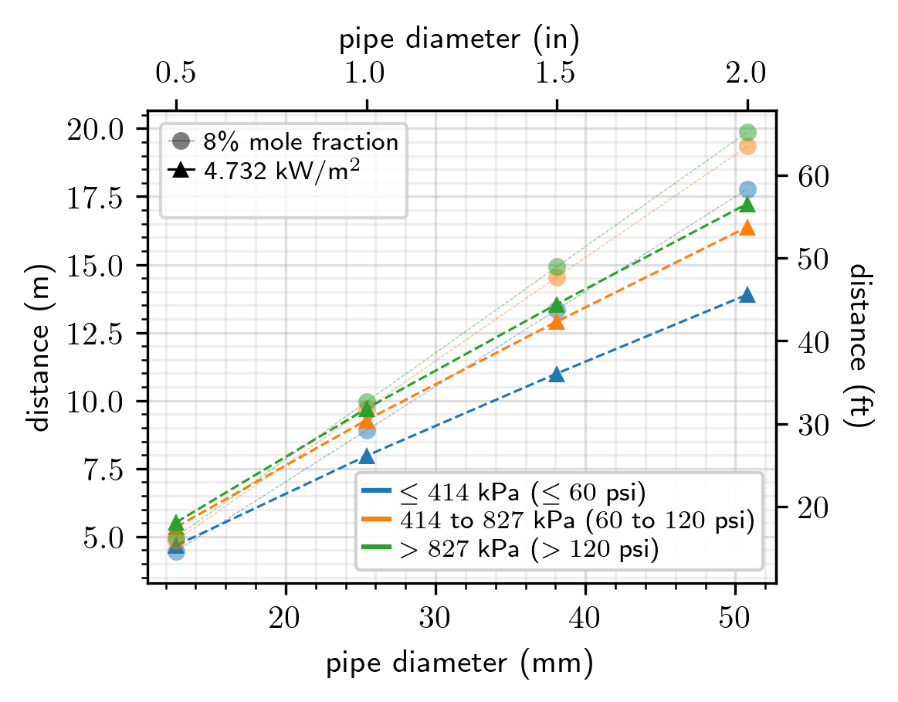
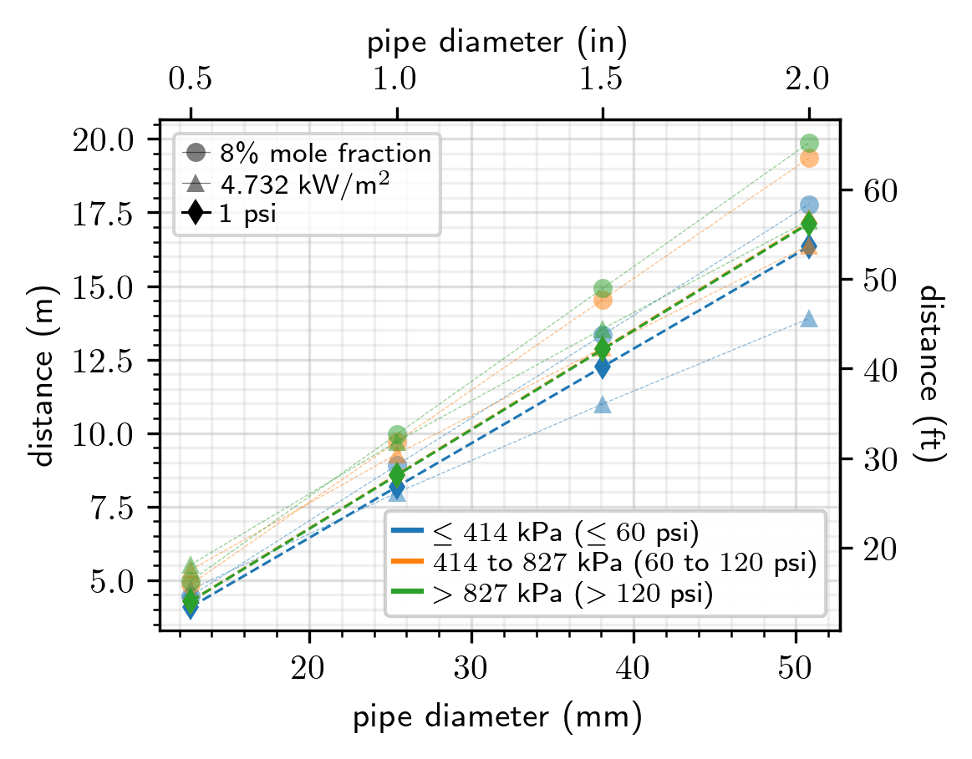
Group 1
  Lot lines
  Air intakes
  Operable openings in buildings
  Ignition sources such as open flames/welding
Protects against:
Flammable concentration
Damage from heat flux
Damage from overpressure
General public

Slide 31
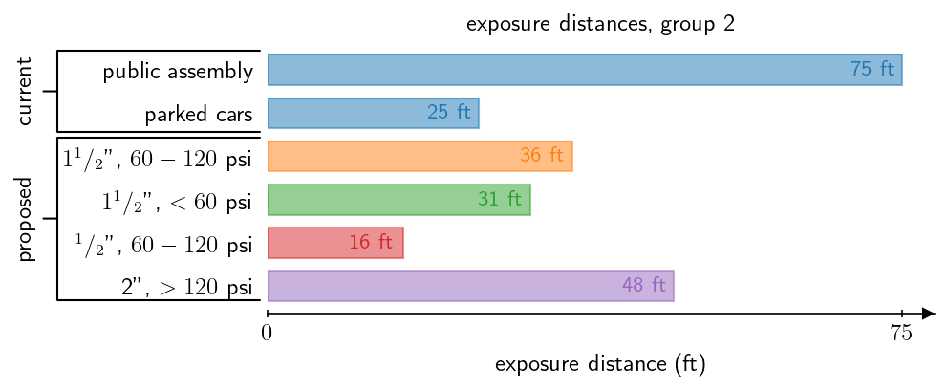
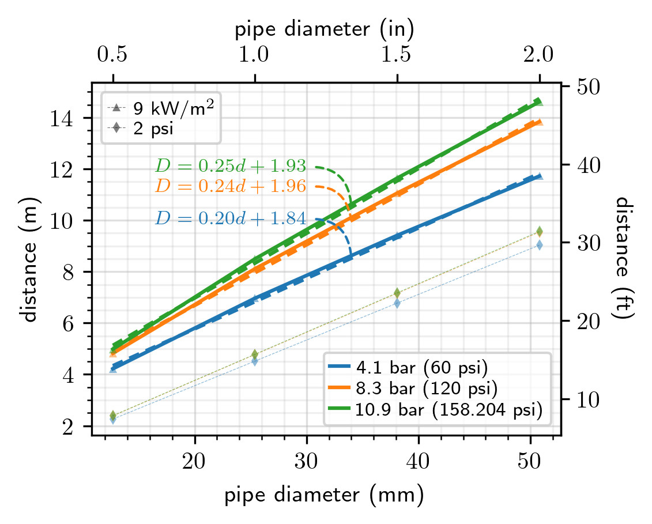
Group 2
  Exposed persons other than those servicing the system
  Parked cars
  Buildings of combustible construction
  Hazardous materials storage systems above ground or fill/vent openings for below ground storage systems
  Ordinary combustibles, including fast-burning solids such as ordinary lumber, excelsior, paper, or combustible waste and vegetation other than that found in maintained landscaped areas
Protects against:
Fire spread to ordinary combustibles
Significant damage to buildings
Harm to people informed of risk (people at the fueling station)

Slide 32
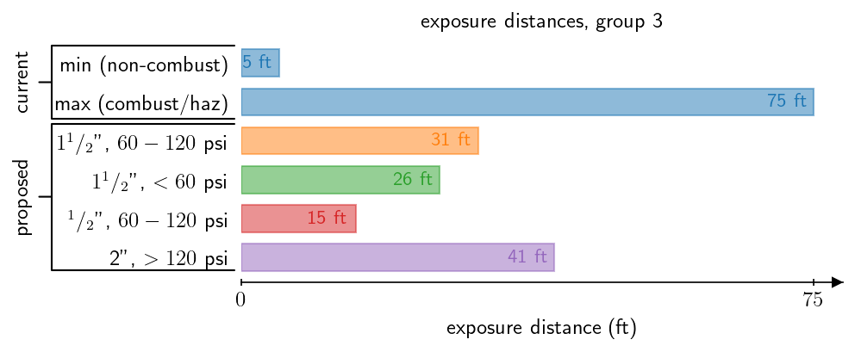
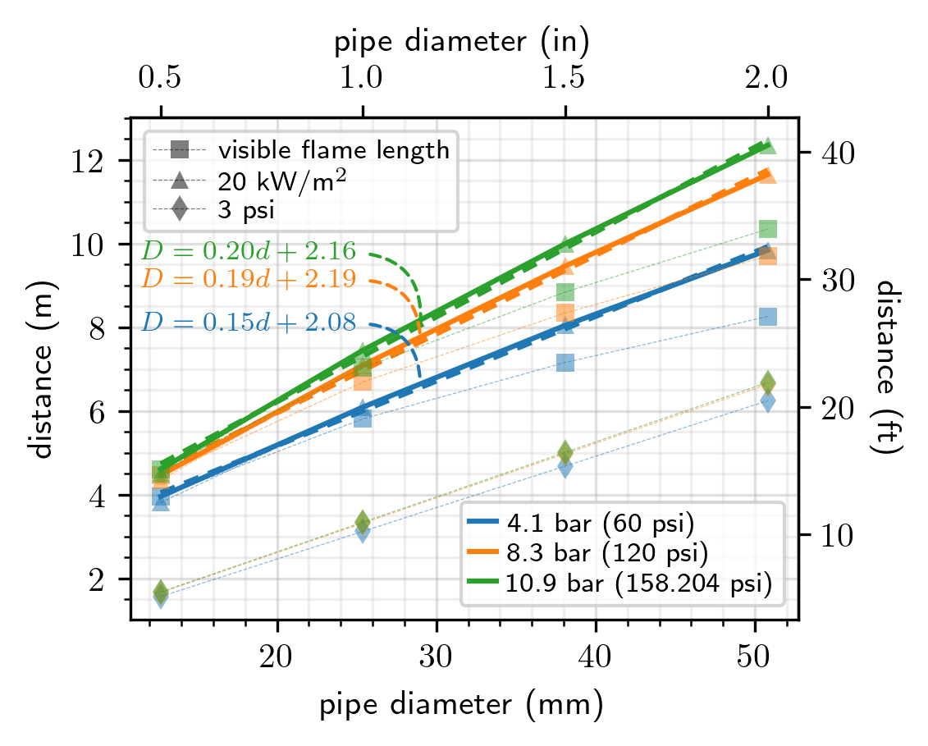
Group 3
  Buildings of Non-combustible non-fire-rated construction
  Flammable gas storage systems above or below ground
  Heavy timber, coal, or other slow-burning combustible solids
  Unopenable openings in buildings and structures
  Encroachment by overhead utilities (horizontal distance from the vertical plane below the nearest overhead electrical wire of building service
  Piping containing other hazardous materials
  Flammable gas metering and regulating stations such as natural gas or propane
Protects against:
Escalation of event (fire spread)

Slide 33
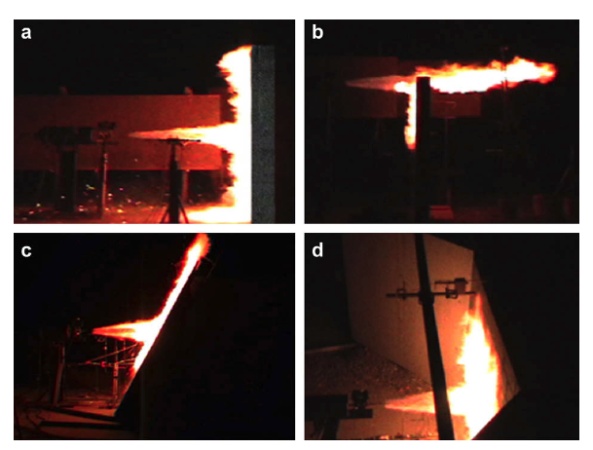
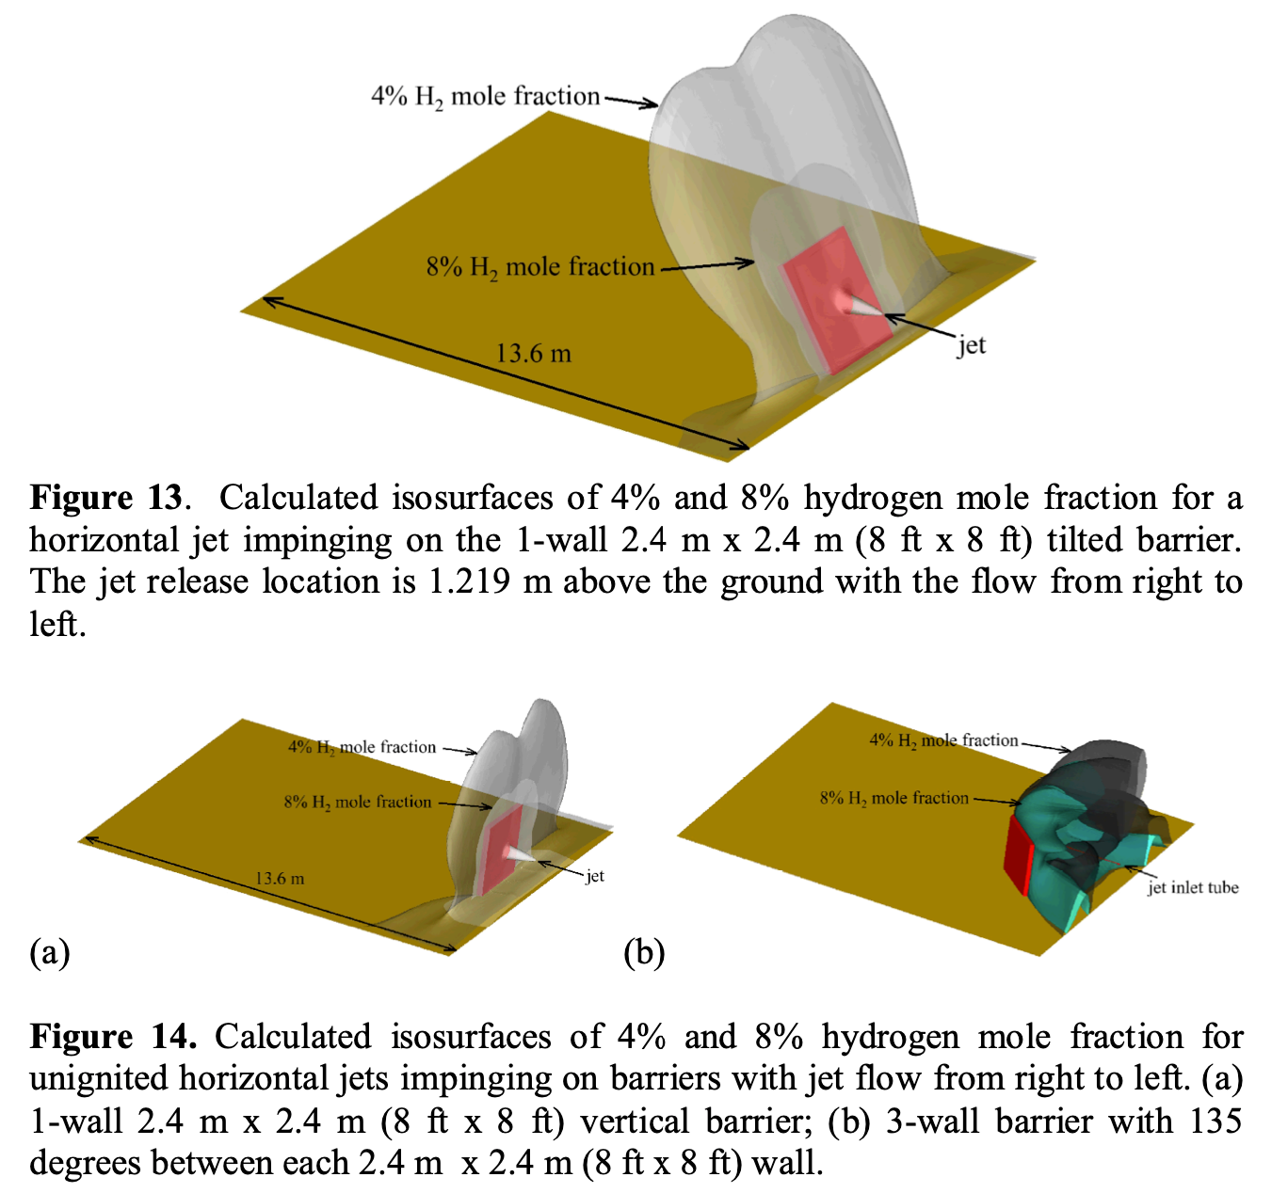
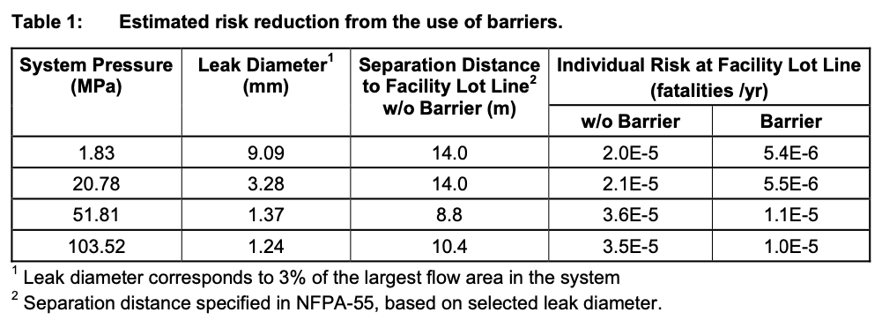
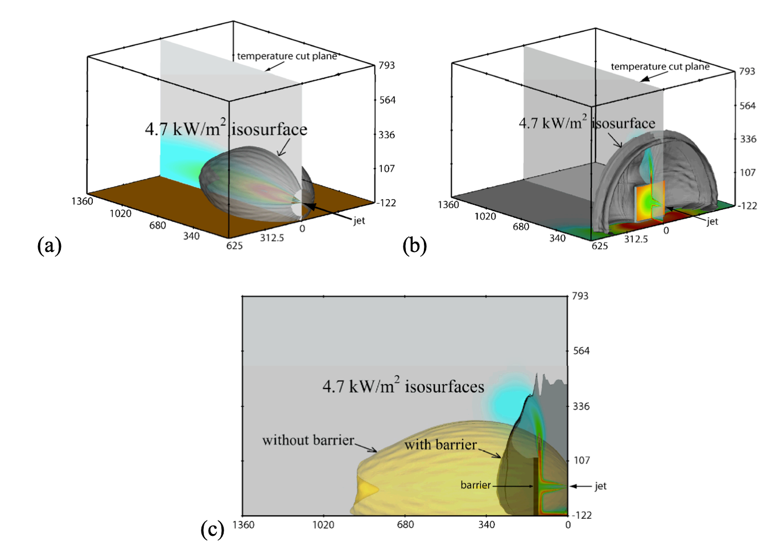
Reduction Justification: Walls
Schefer 2009: Ignited experiments
  Significant reductions in overpressure and heat flux behind the barrier
  No entrainment down the back of the wall
Houf 2008: Modeling for unignited gas clouds
  No entrainment down the back of the wall
Individual risk calculations (not consequence-based) informed distance reductions
  “Results demonstrated up to a 66% reduction in separation distance, but revisions of gaseous table in NFPA 2-2011 used conservative 50% reduction” from DOE Program Record
From LaChance 2010

Slide 34
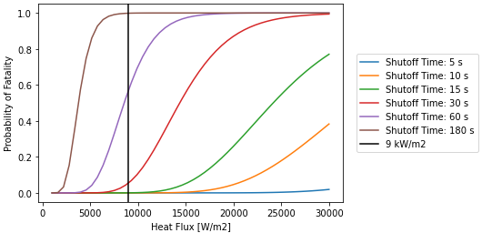
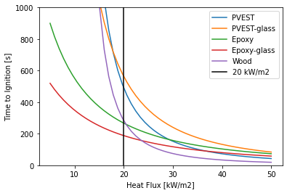
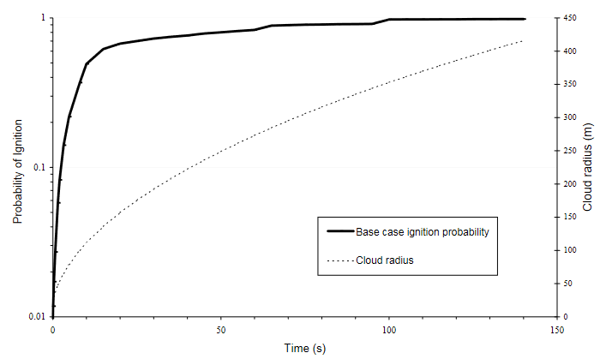
Reduction Justification: Shutdown
Justification for heat flux to humans:
  NFPA 2 gives a heat flux criteria of 4.7 kW/m² based on exposure to employee for maximum of 3 minutes (Group 1 and 2 exposures)
  15 seconds at 8 kW/m² instead drops probability of fatality from ~80% to ~0%
Justification for heat flux to buildings/combustibles:
  Many sources (e.g., SFPE Handbook) give time to ignition at different heat flux values for different materials
  Group 3 (buildings/combustibles) exposures could be reduced to zero if automatic shutoff can be proven to activate before the time to ignition (3min) at the heat flux criteria chosen (20 kW/m²)
Harder to mathematically calculate reductions for unignited concentration or unconfined overpressure
Therefore, automatic retention valves will not give explicit distance-reduction, but will be required at public (refueling) facilities to reduce risk
Daycock and Rew, UK HSE Report 226, 2004

Slide 35
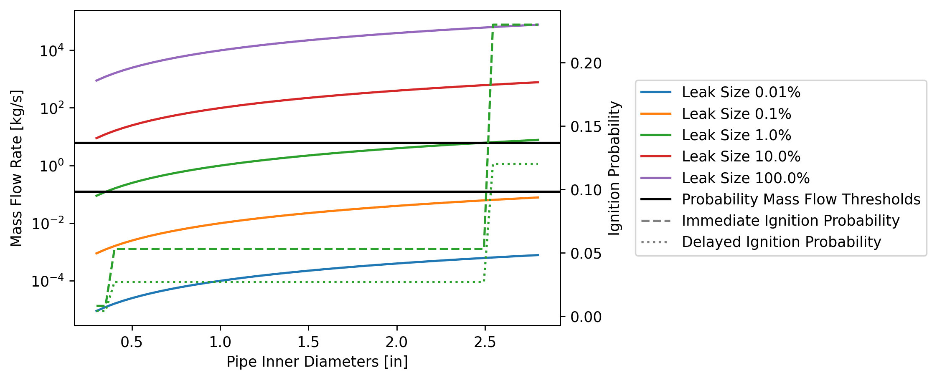
Risk discontinuities from ignition probabilities
Current ignition probabilities based on mass flow rate
  Probability step-changes at specific mass flow rate thresholds
One of the leak sizes passes through two thresholds
  Causes step-changes in risk
Need for better characterization of ignition probability

