Slide 1
A Dynamic, Integrated Approach to Vital Area Identification
Presented by:
Brian Cohn
Presented at The 16th Probabilistic Safety Assessment & Management Conference
SAND2022-8717 C

Slide 2
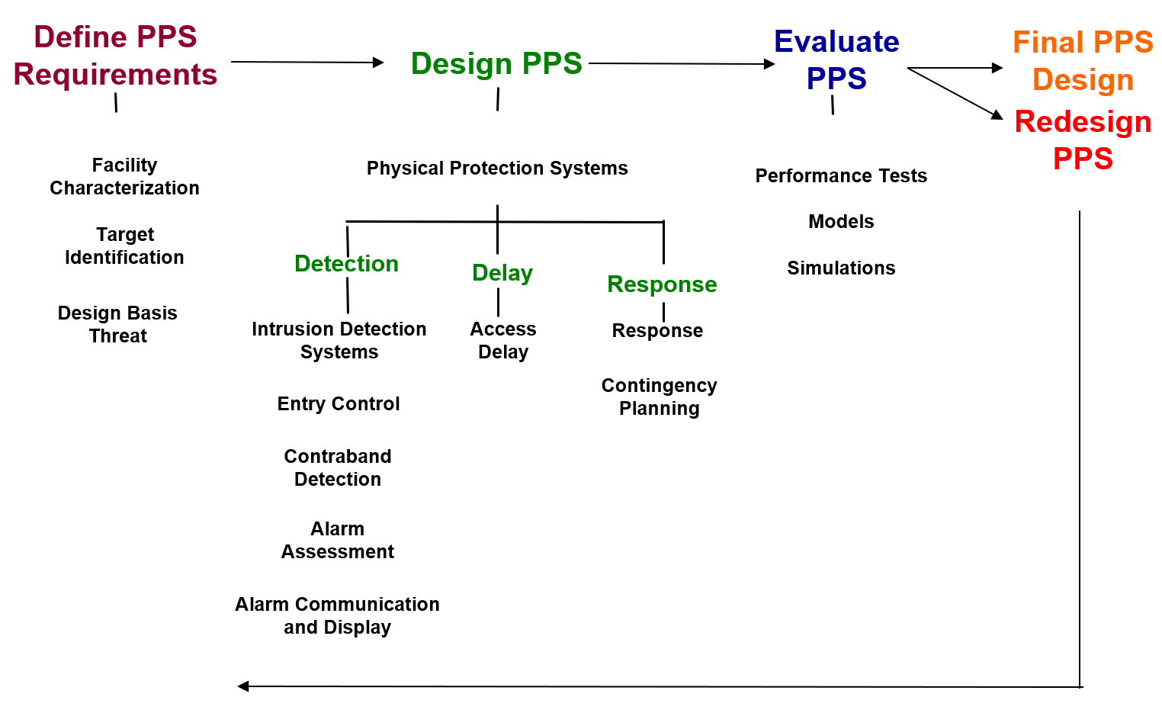
Introduction
The Design Evaluation Process Outline (DEPO) methodology is widely used for developing physical protection systems (PPSs)
Vital Area Identification (VAI) plays a key role in implementing the DEPO and other PPS design processes

Slide 3
VAI Overview
VAI serves at the foundation for nuclear security analysis
Based on static fault tree/event tree (FT/ET) analysis to determine vital equipment to protect with the physical protection system
Vital areas are based on preventing severe core damage from adversary sabotage
Challenges with the VAI structure
FTs are largely sourced from safety analysis with inbuilt safety assumptions that can be difficult to reevaluate
VAI implies the instant onset of severe core damage following adversary sabotage of vital equipment
For some scenarios, vital areas are only sabotage targets for a limited period of time
Little communication between safety and security risks

Slide 4
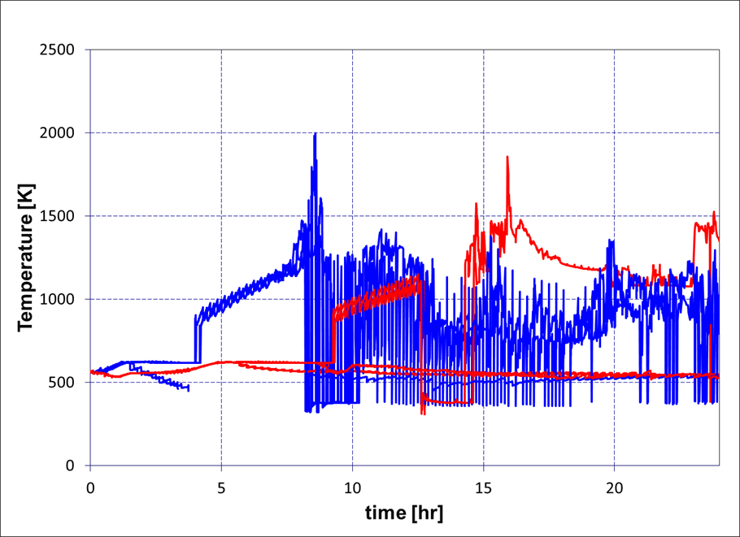
Previous Work
Integrated dynamic safety-security (2S) analysis of a hypothetical LWR
Connected MELCOR reactor response analysis to security modeling
Modeled successful sabotage of a complete target set
Case study found strong dynamic elements
Level of damage from sabotage
Success of mitigation and recovery actions
Minimal environmental releases

Slide 5
Dynamic Approach to Vital Area Identification
Intent is to use 2S analysis to inform vital areas
Identify adversary sabotage activities with associated timing
Use timings to determine consequences to the reactor
Based on Systems Theoretic Process Analysis (STPA) and Dynamic Probabilistic Risk Assessment
STPA is effective at systematically identifying systems of concern
Poor at prioritizing between systems
DPRA is effective at determining consequences of scenarios
Poor at identifying scenarios of concern
Combined STPA and DPRA analysis can be more than the sum of its parts

Slide 6
Proposed Dynamic VAI Approach
Initial Facility Design
Design Basis Threat
SSC Targets
Credible Adversary Scenarios
Dynamic Linked Safety-Security
(Force-on-Force & Severe Accident)
Modeling
SME/PRA/STPA for Target Sets
Dynamic Security
(e.g. PathTrace) Modeling
STPA Insecure Actions
Time-Dependent Vital Areas
Identified Conservatisms within Static Analysis
Safety Mitigations of Security Events
Areas to Reduce Conservatism
Security Economic Model
Final PPS for Facility Design
Re-evaluate PPS

Slide 7
Phase 1
Purpose of this phase is to generate a comprehensive list of security-relevant systems
Analysis is not concerned at this stage with the relationships between systems
List of relevant systems can be obtained from:
SME judgment
PRA
STPA
Can include passive safety systems and digital controls

Slide 8
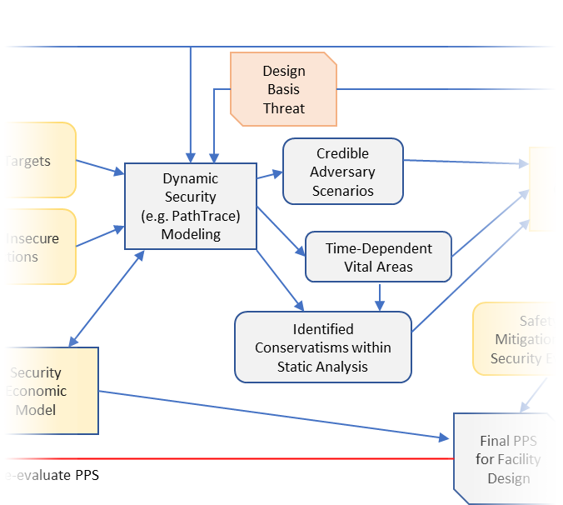
Phase 2
Purpose of this phase is to generate conservative adversary attack timelines
Dynamic security modeling used to understand the impact of sabotage
PathTrace or other timeline model constructed
Sabotage timings generated for each permutation of targets
Timing information is sent to reactor response model to determine consequences of sabotage
Output is a list of credible adversary scenarios
Reactor response strategies not considered in this phase

Slide 9
Phase 3
Purpose of this phase is to determine the physical protection system’s effectiveness against the credible adversary scenarios
Credible scenarios are entered into a force-on-force code
Reactor response model receives information on damage to safety systems and determines appropriate responses
Operator and response force activities can take the state of the plant into consideration
Models mitigating actions
Analysis can extend beyond core damage to radionuclide release
Similar to the previously described 2S analysis

Slide 10
Proposed Case Study
A case study integrating all three phases has been proposed for analysis
Uses the hypothetical Lone Pine Nuclear Power Plant
Previously modeled during 2S analysis
Analysis is limited in scope to modeling the auxiliary feedwater (AFW) system
Rest of the plant will be modeled, but only consider availability of AFW
Is intended to combine all three phases of the dynamic VAI approach
Considers the success of the reactor despite sabotage to vital equipment

Slide 11
Conclusions
Existing VAI methodologies rely on conservatism to ensure the protection of NPPs
Limitations of static VAI present challenges for advanced reactors
Reliance on passive safety systems
Use of digital control systems
Potential for adversaries to achieve some sabotage of systems
Proposed a dynamic VAI methodology
STPA to systematically identify critical components
DPRA to determine dynamic effects of adversary sabotage to components
Case study may be able to determine the effectiveness of the proposed methodology

Slide 12
Questions?

