Slide 1
Numerical Investigation of Flame Propagation for Explosion Risk Modeling Development
Ashley Coates¹, Scott Lawrence¹, Donovan Mathias¹, Brian Cantwell²
¹NASA Ames Research Center
²Stanford University, Aeronautics and Astronautics
PSAM 16 Conference
June 26 – July 1, 2022

Slide 2
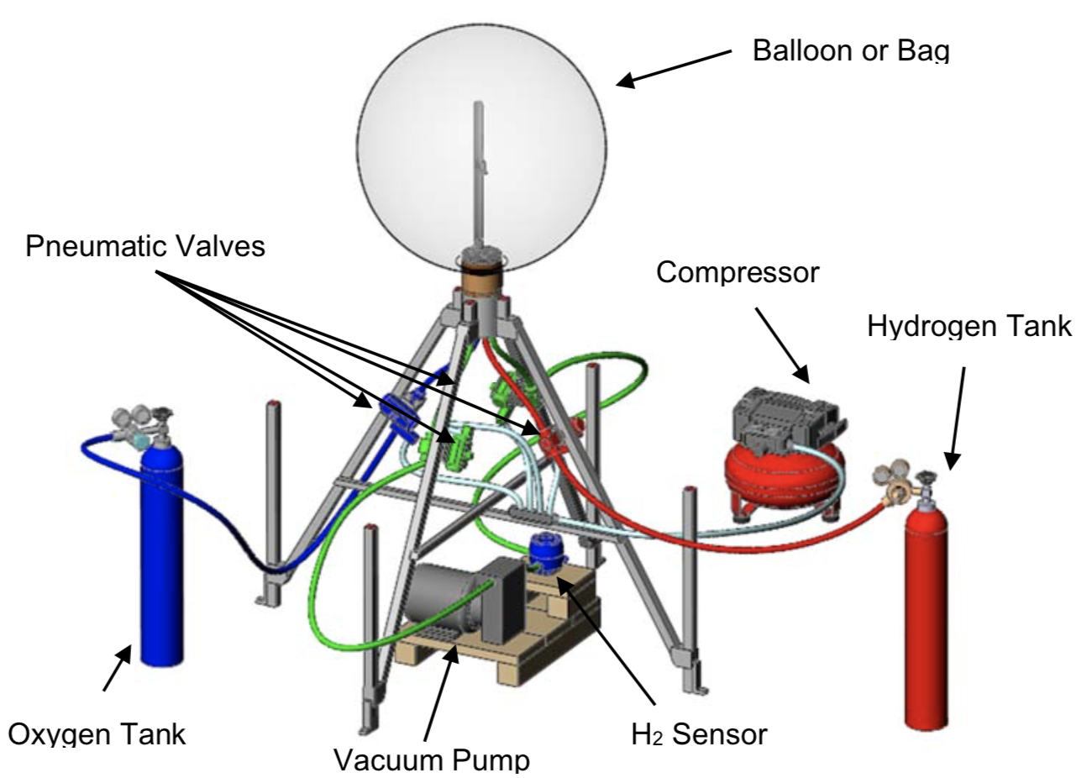
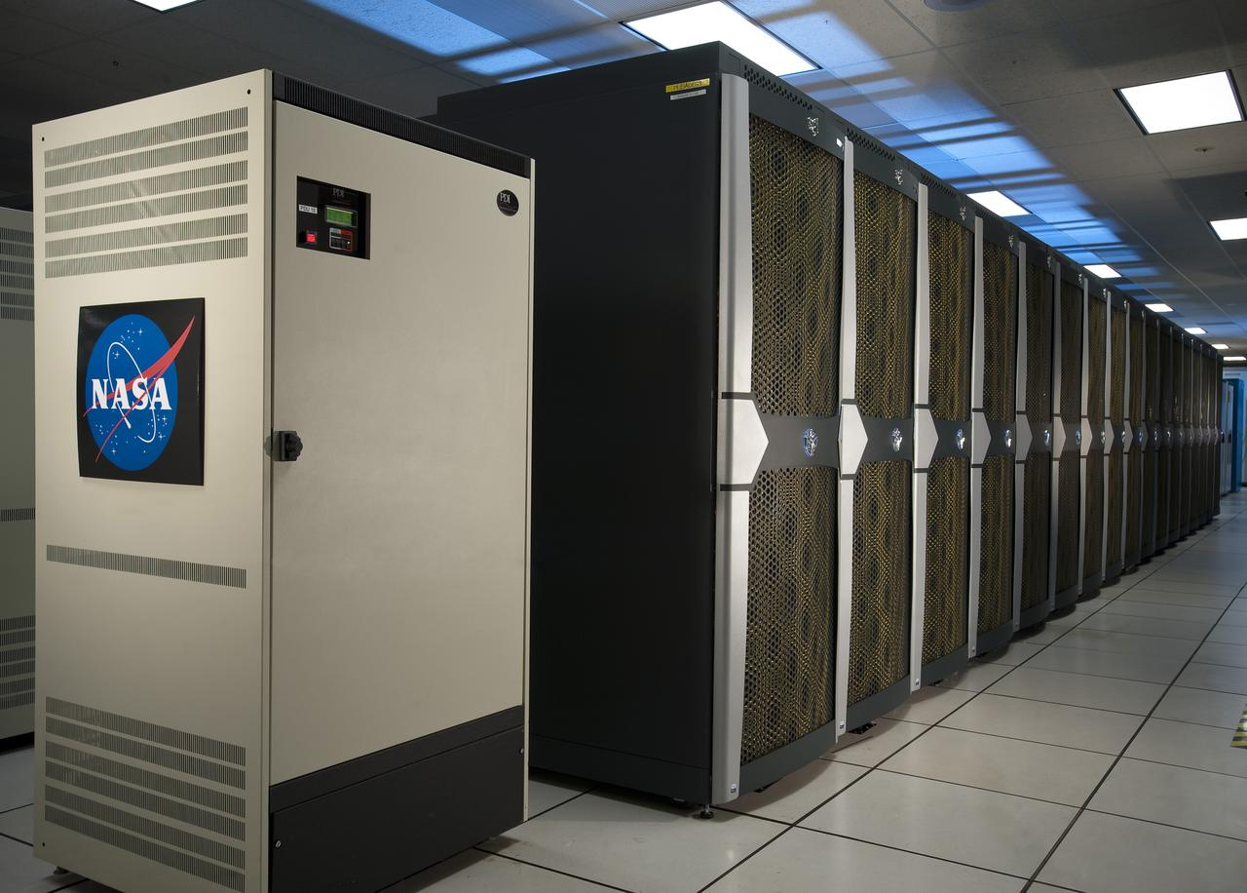
Motivation
Identify risk-driving failure mechanisms and help to evaluate overall design safety using probabilistic failure propagation and abort risk models
Gain understanding through high-fidelity simulations about the complex physics of flame propagation, debris strikes, overpressure, and other factors that could occur after an uncontained launch failure
Experiments
Engineering-level Blast Model
CFD Simulations

Slide 3
Motivation
Many things can interfere with or change how the flame is propagating
Underlying flow conditions
Confinement
Multiple ignition points
Obstacles
Potential setup features considered in this work
Initial Pressure
Initial Velocity Distribution

Slide 4
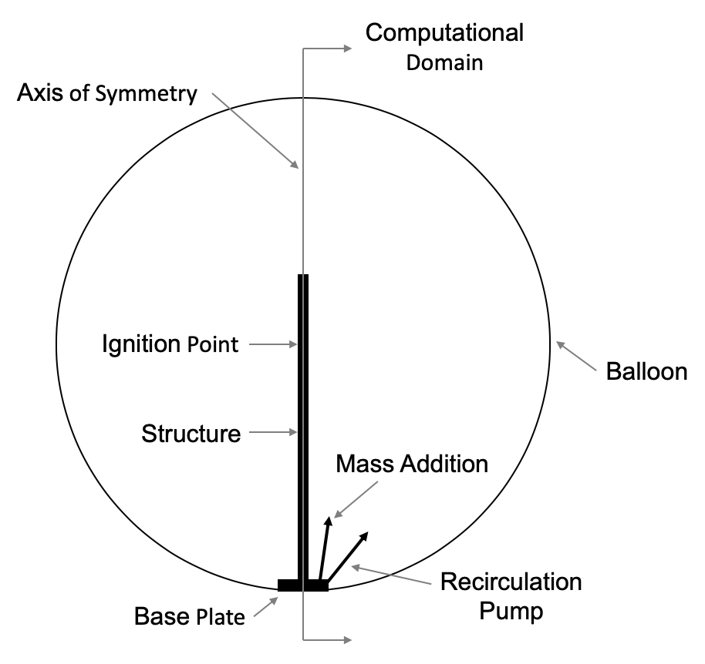
Problem Setup
Geometry representative of the Hydrogen Unconfined Combustion Test Apparatus (HUCTA) experiments conducted at MSFC
Experimental Setup
Computational Setup

Slide 5
Problem Setup
Loci-Chem CFD Code
Density-based, finite volume, unstructured solver
2nd order accuracy time and space
Navier-Stokes in three dimensions
Viscous, turbulent, chemically reacting flows
Models
Built-in database for transport and diffusion models
Menter’s Baseline turbulence model
7-species, 8-reaction H₂-O₂ chemistry model
Mesh
Unstructured
Grid spacing of 0.254 mm, order of laminar flame thickness
Spacing very small in comparison to overall domain, use multiple meshes
Assume axisymmetric, 2D mesh
Arrhenius Form k=AT^{B}exp(-C/T)
Portion of mesh highlighting concentric regions

Slide 6
Results and Discussion

Slide 7
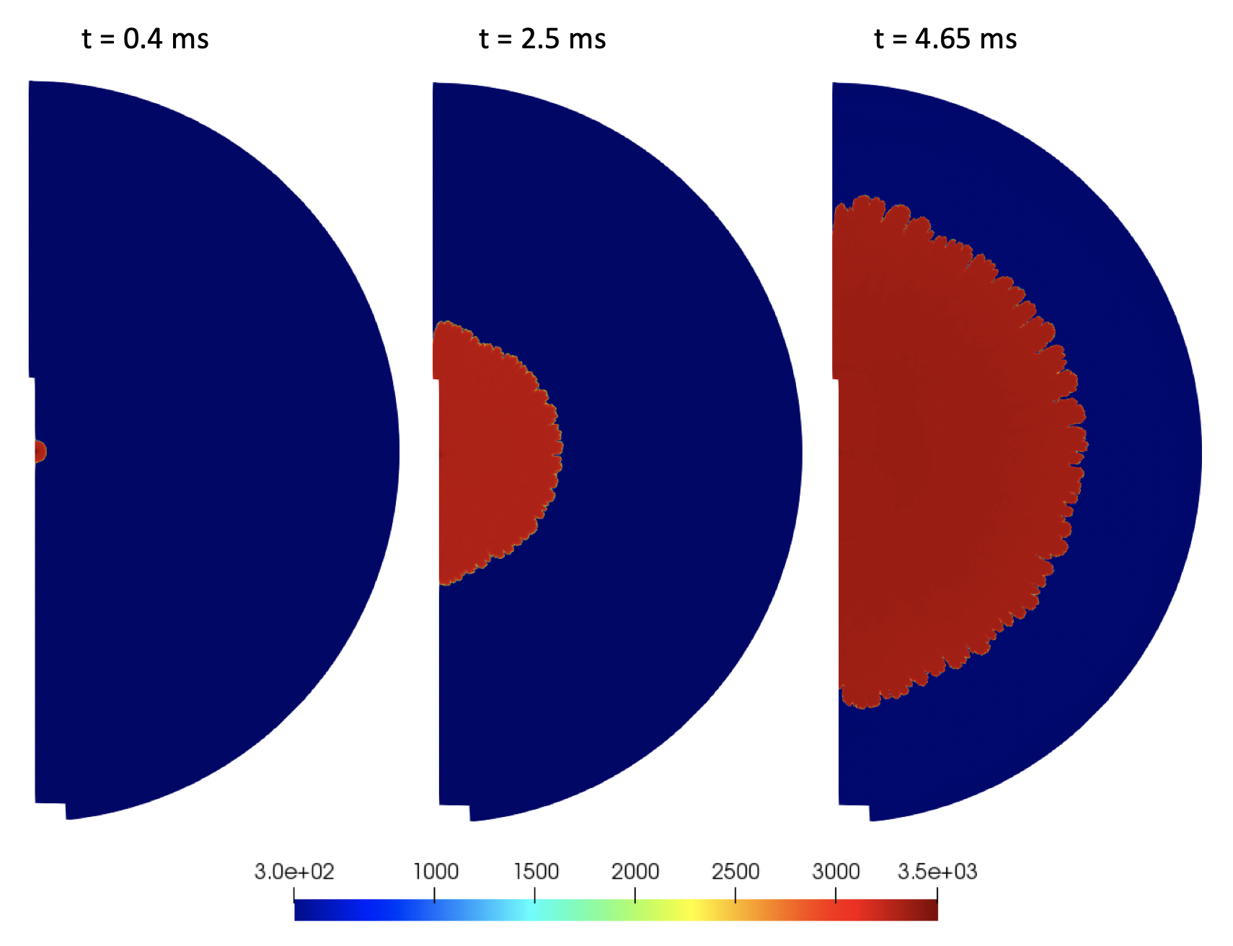
Quiescent Initial Pressure Variation
Stoichiometric
Hydrogen-Oxygen
Quiescent
P_{initial} = 125 kPa
Temperature Contours [K]

Slide 8
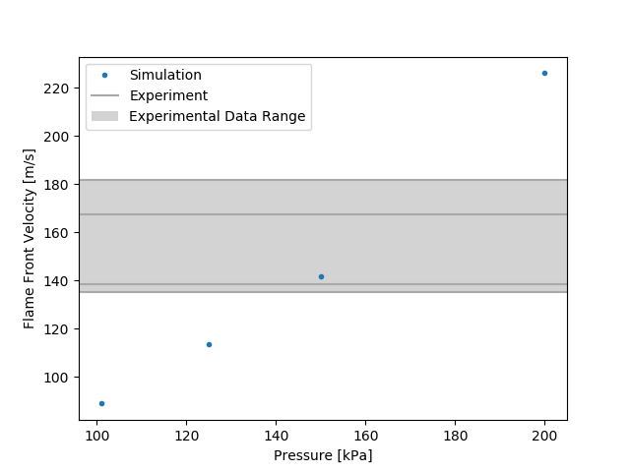
Compare to Experiment
Pressure varied in simulations, but at constant temperature, so density varied
Experimental data range determined from cases with approximately stoichiometric mixtures
More than 40% above ambient to reach experimental data range with quiescent simulation – not practical
x
Pressure not the driving factor for increased flame speed in experiment

Slide 9
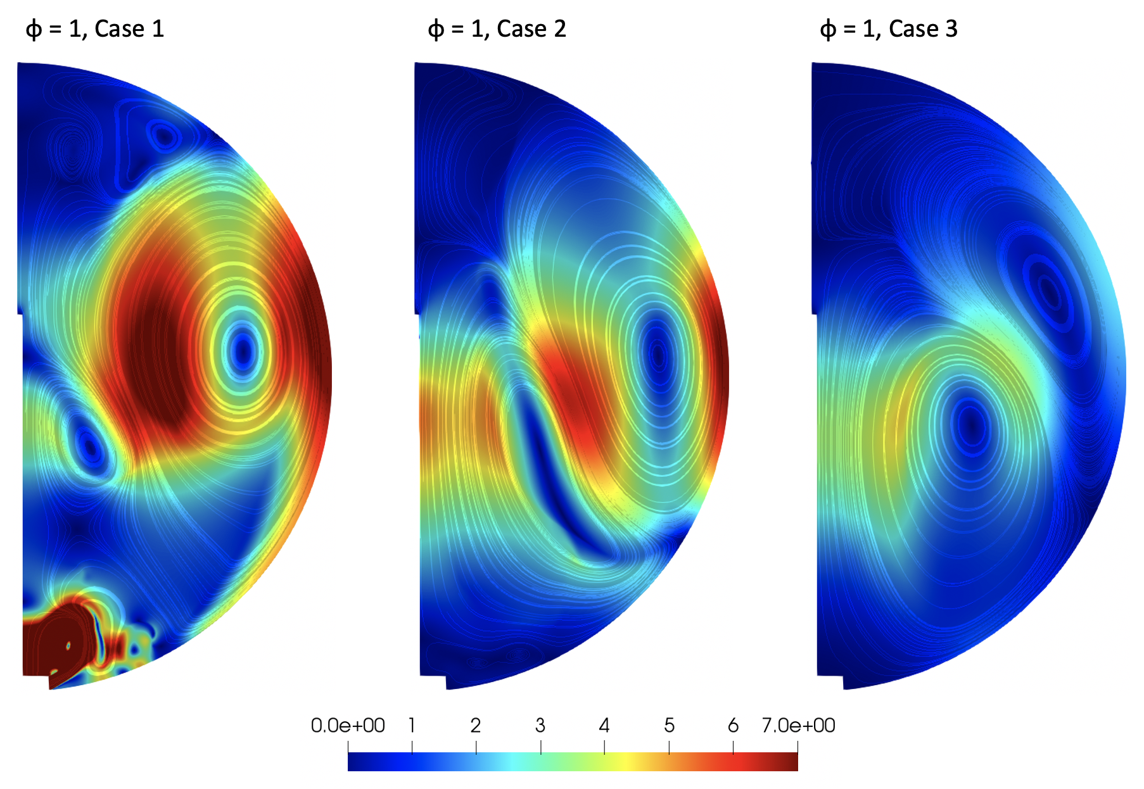
Initial Velocity Variation
Characterize potential effects an initial velocity distribution could have on the flame speed
Capture filling and recirculation processes observed in experiments
Case 1
Case 2
Case 3
Case 1: Shortest delay time, Highest initial velocity magnitude
Case 2: Middle delay time, Middle initial velocity magnitude
Case 3: Longest delay time, Lowest initial velocity magnitude
Velocity magnitude contours [m/s] of the three initial velocity distributions considered

Slide 10
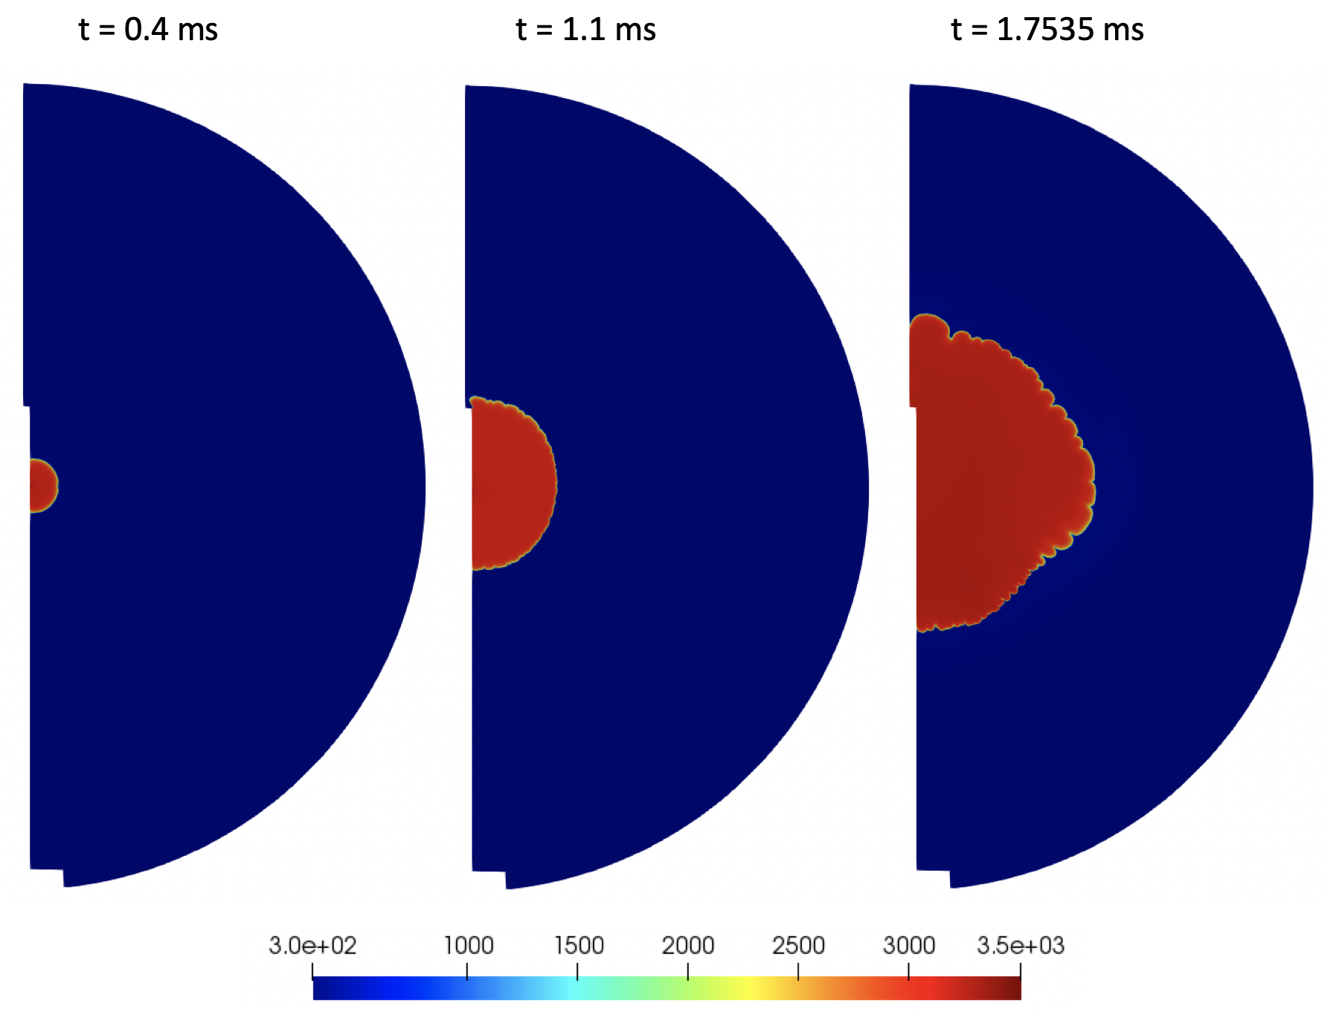
Initial Velocity Variation
Stoichiometric
Hydrogen-Oxygen
Middle Velocity Distribution, Case 2
Temperature Contours [K]

Slide 11
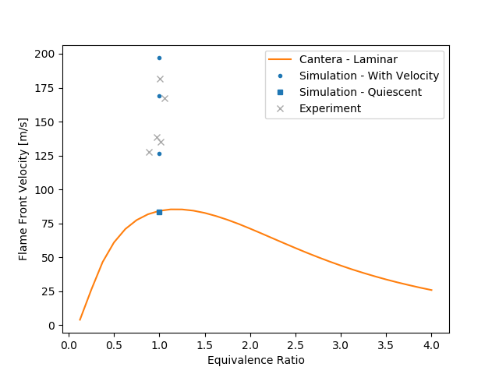
Compare to Experiment
Reminder: Simulations did not model experiments exactly since experimental fill and recirculation process parameters were not reported and likely important
Presence and character of a non-uniform velocity field at ignition can significantly affect flame propagation behavior

Slide 12
Engineering Model
Current engineering-level blast risk model used in support of NASA’s Space Launch System (SLS) program is analogous to the vapor cloud explosion model by Baker, Strehlow, and Tang
Solves one-dimensional Euler equations
Based on user-specified relative flame speed and level of heat addition, computed for multiple user-specified flame speeds to address uncertainties
Flame is tracked to the edge of a vapor cloud where a blast wave is initiated and propagated outward
Blast parameters are captured as a function of distance from the flame center

Slide 13
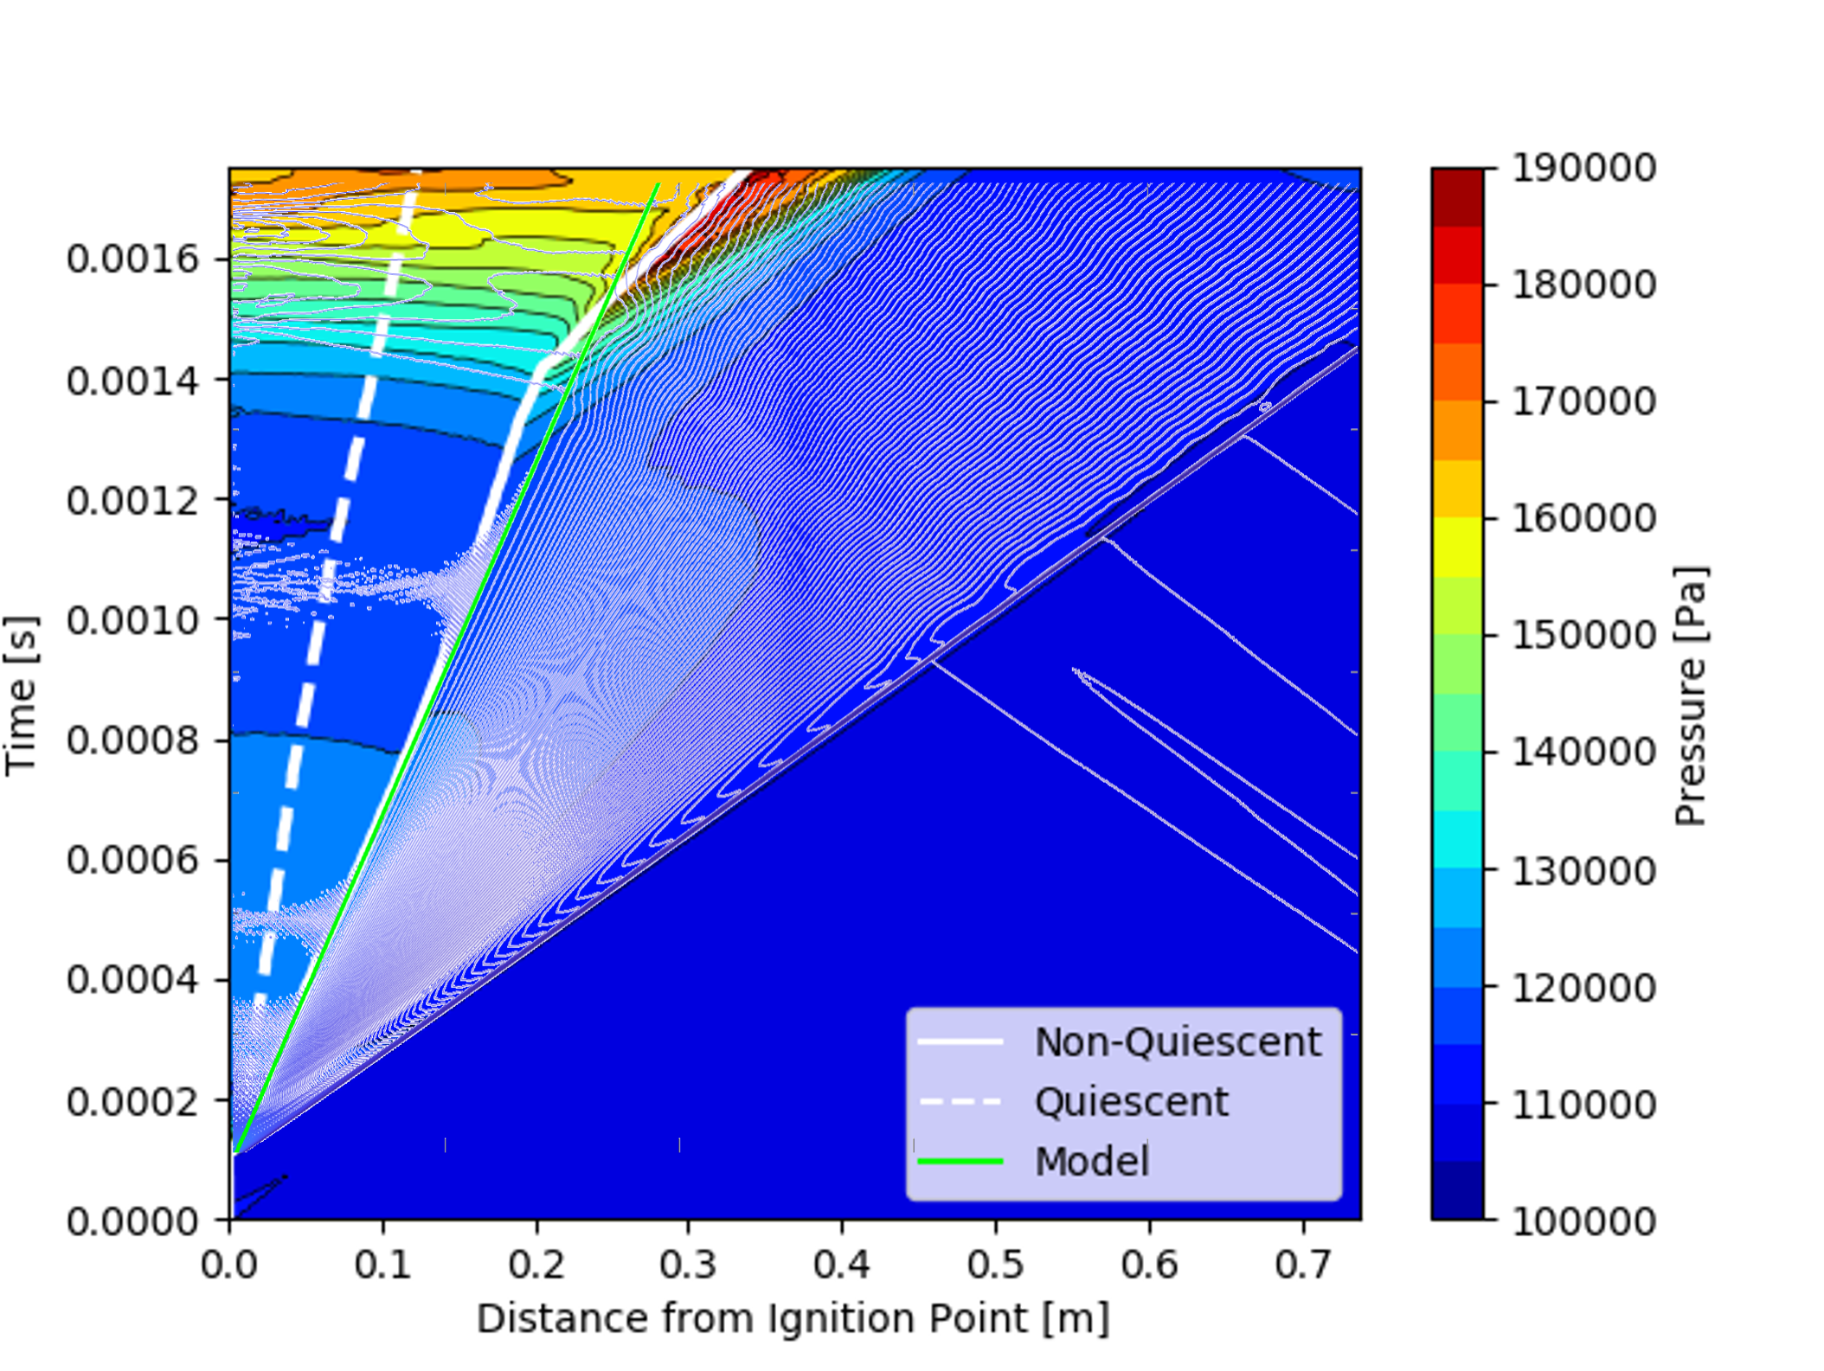
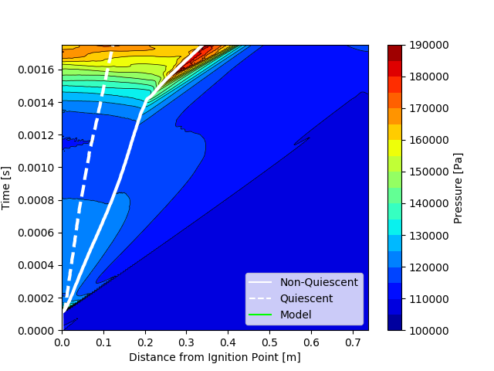
Compare to Engineering Model
Pressure appears to be well resolved by the engineering model if the flame speed is known
Focus for furthering model capabilities should be placed on determining appropriate flame speeds

Slide 14
Closing Remarks

Slide 15
Conclusions and Future Work
Numerical simulations were computed for a variety of conditions and results were compared to experimental data and engineering model results. The gained understanding about influential parameters will lead to more informed flame speed numbers for risk assessments.
Conclusions
Setup procedures for both numerical and experimental studies can significantly affect flame speeds results – report information carefully
Flame speed is sensitive to initial conditions, particularly to interactions with underlying velocity flow features
Engineering model is well-suited to capture blast waves if the flame speed is known throughout propagation
CFD was useful for understanding and determining influential parameters
Future Work
Consider 3D effects
Determine how well flame speed needs to be captured to get good pressure results
Disseminate findings on local flame acceleration study

Slide 16
References
[1] E. Richardson, T. Skinner, J. Blackwood, M. Hays, M. Bangham, and A. Jackson. “An experimental study of unconfined hydrogen/oxygen and hydrogen/air explosions”, 46th Joint Army- Navy-NASA-Air Force (JANNAF) Combustion Conference, (2014).
[2] Supercomputer Picture, https://images.nasa.gov/details-ARC-2008-ACD08-0272-002
[3] E. Luke and T. George. “Loci: A rule-based framework for parallel multidisciplinary simulation synthesis”, Journal of Functional Programming, 15, pp. 477–502, (2005).
[4] E. Luke. “On robust and accurate arbitrary polytope CFD solvers (invited)”, 18th AIAA Computational Fluid Dynamics Conference, (2007).
[5] E.A. Luke, X. Tong, J. Wu, P. Cinnella, and R. Chamberlain. “CHEM 3.3: A Finite-Rate Viscous Chemistry Solver - The User Guide”, (2014).
[6] Pointwise, Inc., https://www.pointwise.com/.
[7] Cantera, https://cantera.org.
[8] S.L. Lawrence and D.L. Mathias. “Blast overpressure modeling enhancements for application to risk-informed design of human space flight launch abort systems”, Reliability and Maintainability Symposium (RAMS), (2008).
[9] M.J. Tang and Q.A. Baker. “A new set of blast curves from vapor cloud explosion”, Process Safety Progress, 18, pp. 235–240, (1999).
Additional references in full paper

Slide 17
Questions?
Thank You

