Slide 1

Modeling of Recovery Efficiency of Sampling Devices used in Planetary Protection Bioburden Estimation
Presented by: Mike DiNicola and Arman Seuylemezian

Slide 2

Problem Statement
Generate an experimentally derived recovery efficiency value for swabs and wipes to be used for planetary protection bioburden accounting purposes.
  Generate a statistical framework for the analysis and interpretation of sampling efficiency experimental data.
  Apply statistical framework to experimental data.
  Identify consistencies across multiple variables
    Inoculation amount (linearity)
    Different organism (specificity)
  Develop approach for applying recovery efficiency values to Bayesian statistical framework
Questions
  Is recovery efficiency sensitive to inoculation level?
  Is recovery efficiency sensitive to different species?
  Is it ok to extrapolate with spore count data?
    E.g. can recovery efficiency experiments be considered valid for surfaces with low bio-density?
This presentation directly addresses these first two questions using a model of recovery efficiency.
The modeling allows for extrapolation as long as modeling assumptions still hold.

Slide 3
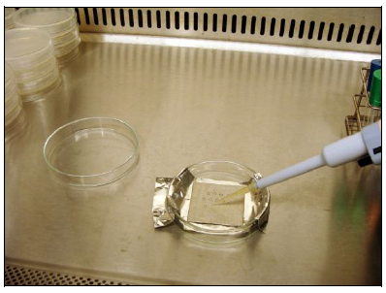
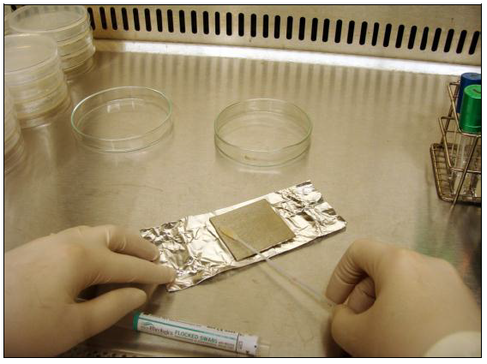
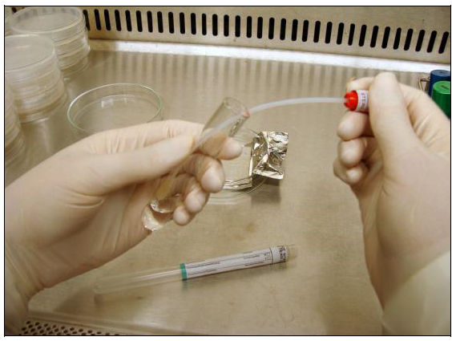
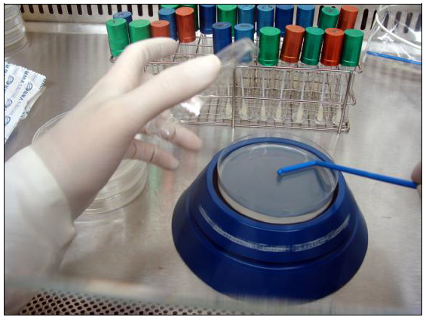
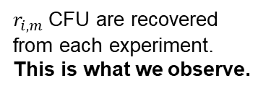
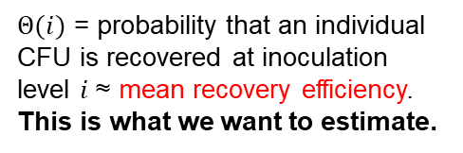
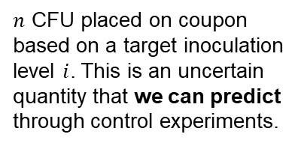
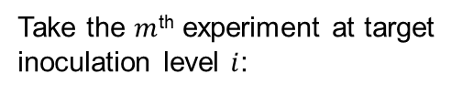
Process being modeled
Take the $m$^{th} experiment at target inoculation level $i$:
Acquire sample: swab or wipe surface
Extract spores, plate and observe CFU at 72 hours
Actual experiments performed
Seed Coupons
Sample storage and deliver to lab
Inoculating coupons with CFU
These are the two main processes being modeled here.
NSA CFU recovery
$r_{i,m}$CFU are recovered from each experiment. This is what we observe.
$n$ CFU placed on coupon based on a target inoculation level $i$. This is an uncertain quantity that we can predict through control experiments.
$Θ(i)$ = probability that an individual CFU is recovered at inoculation level $i$ ≈ mean recovery efficiency.
This is what we want to estimate.

Slide 4
Potential Models
Seeding Model
Recovery Model
Conditional on how much was seeded; Theta follows a Beta distribution
Consistent with current practice, but lacks realism and does not capture all uncertainties
v0
Recovery Model w/categorical variable
Theta modeled with a Beta distribution, with parameters themselves following a distribution based on inoculation level or species
Allows us to capture non-trivial dispersions in data that may not be captured by simpler models
Increase in scope, complexity and ability to tackle questions we would like to answer.
v1
Recovery Model w/linear trend
Theta modeled with a Beta distribution, with parameters themselves following a distribution that allows for a linear trend with inoculation level or species
Allows assessment of trends between inoculation level and recovery, interpolation
v2
Seeding & Recovery Model w/linear trend
Theta modeled with a Beta distribution, with parameters themselves following a distribution that allows for a linear trend with inoculation level or species
Seeding and Recovery brought together for added realism and uncertainty quantification
v3

Slide 5
Model Assumptions
The mathematical model treats individual microorganism recovery as independent from one another and have the same probability of being seeded and recovered from a coupon
Why? Because this is how the experiment was designed that generates the data we observe
Independence
  Stock solution is sonicated (19-27 kHz for 2 minutes) prior to seeding the coupon, avoiding clumping or attaching to other materials
Uniformity:
  Uniformity of inoculant: Stock solution prepared with and coupons seeded with the same species according to the same protocols
  Uniformity of materials: Coupons of the same material type, size and from the same manufacturer; each type of swab and wipe tested are from the same manufacturer
  Uniformity of processes: Same recovery procedure applied to all replicates of a given experiment (NSA or ESA assay processes); avoids outside contamination
  Avoidance of non-uniformities: Reagents tested for sterility according to manufacturer’s recommendations; avoids outside contamination
From the above, we can deduce the Poisson model for seeding and Binomial model for recovery
Models are derived from the experimental design and tested through model validation

Slide 6
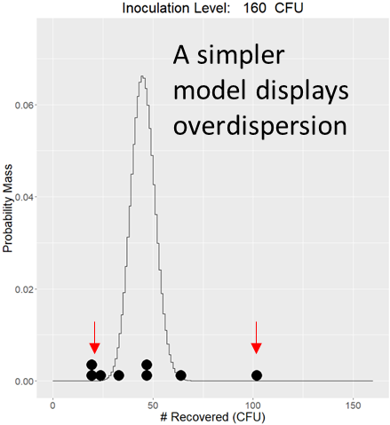
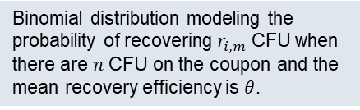
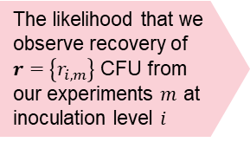
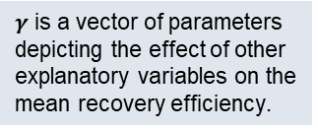
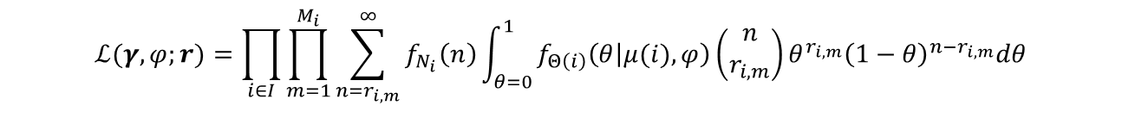
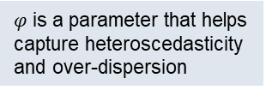

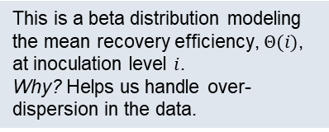
Model Formulation (v3)
This is a beta distribution modeling the mean recovery efficiency, $Θ(i)$, at inoculation level $i$.
Why? Helps us handle over-dispersion in the data.
Binomial distribution modeling the probability of recovering $r_{i,m}$ CFU when there are $n$ CFU on the coupon and the mean recovery efficiency is $θ$.
$φ$ is a parameter that helps capture heteroscedasticity and over-dispersion
The likelihood that we observe recovery of $r=$ $\left\{r_{i,m}\right\}$ CFU from our experiments $m$ at inoculation level $i$
$$ℒ(γ,φ;r)=\prod_{i∈I}{\prod_{m=1}^{M_{i}}{\sum_{n=r_{i,m}}^{∞}{f_{N_{i}}\left(n\right)\int_{θ=0}^{1}{f_{Θ\left(i\right)}\left(θ | μ(i),φ\right)\left(\begin{aligned}n \\ r_{i,m}\end{aligned}\right)θ^{r_{i,m}}{\left(1−θ\right)}^{n−r_{i,m}}dθ}}}}$$
Beta-binomial distribution
$γ$ is a vector of parameters depicting the effect of other explanatory variables on the mean recovery efficiency.
Seeding model: Posterior predictive distribution derived from control experiments and the Poisson seeding model
Why the sum? Because the number seeded onto the coupon is an uncertain quantity affecting our experimental observations.
$μ\left(i\right)=\frac{1}{1+e^{−\left(γ_{0}+{iγ}_{1}\right)}}$ is the mean probability of individual microorganism recovery as function of inoculation level and parameters $γ$.
Why? The functional form of $μ(i)$ is known as the logit transformation and has ties with the Boltzmann distribution in physics. It will allow also us to assess trends of recovery efficiency with inoculation level and species.

Slide 7
Recovery Efficiency Results: Swabs
Nylon flocked swab processed with the ESA Standard is the preferred method by the model
Puritan cotton swabs processed with the NASA Standard were preferred next by the model (second and third place)
Both Copan swabs performed significantly worse per the model’s criteria
A decision-theoretic metric that compares how well the assay method compares with an ideal method that has perfect recovery efficiency for purposes of estimating bioburden
3
#2
#3
#1
DiNicola, M., Seuylemezian, A., et al. “Modeling of Recovery Efficiency of Sampling Devices used in Planetary Protection Bioburden Estimation”, PSAM16 Conference Paper, June 2022.

Slide 8
Recovery Efficiency Results: Swabs
A noticeable drop in the mean recovery efficiency occurs with ESA facility nylon-flocked swab experiments when using the NASA (C) instead of ESA (D) standard assay.
This result is of borderline statistical significance at the 5% level.
Fewer replicates performed for (C) leads to higher variability in the mean recovery efficiency results.
Making the number of replicates consistent with (D) would allow this difference to be better quantified.
3
DiNicola, M., Seuylemezian, A., et al. “Modeling of Recovery Efficiency of Sampling Devices used in Planetary Protection Bioburden Estimation”, PSAM16 Conference Paper, June 2022.

Slide 9
Recovery Efficiency Results: Swabs
For Puritan cotton swabs, there is a borderline statistically significant difference (at the 5% level) between its mean recovery efficiency when tested at a NASA (A) versus ESA (B) facility.
Further experiments controlling for processing technique and testing facility would be needed in order to better understand the mechanism causing this difference.
3
DiNicola, M., Seuylemezian, A., et al. “Modeling of Recovery Efficiency of Sampling Devices used in Planetary Protection Bioburden Estimation”, PSAM16 Conference Paper, June 2022.

Slide 10
Recovery Efficiency Cost Function Comparison
TX3211 wipe has the lowest cost and is therefore the wipe method preferred by the modelling.
Despite having much higher variability in its mean recovery efficiency than the TX3224 wipe, the TX3211 wipe has ~2 times the recovery efficiency on average, driving down its expected cost in this comparison.
4
#1
DiNicola, M., Seuylemezian, A., et al. “Modeling of Recovery Efficiency of Sampling Devices used in Planetary Protection Bioburden Estimation”, PSAM16 Conference Paper, June 2022.

Slide 11
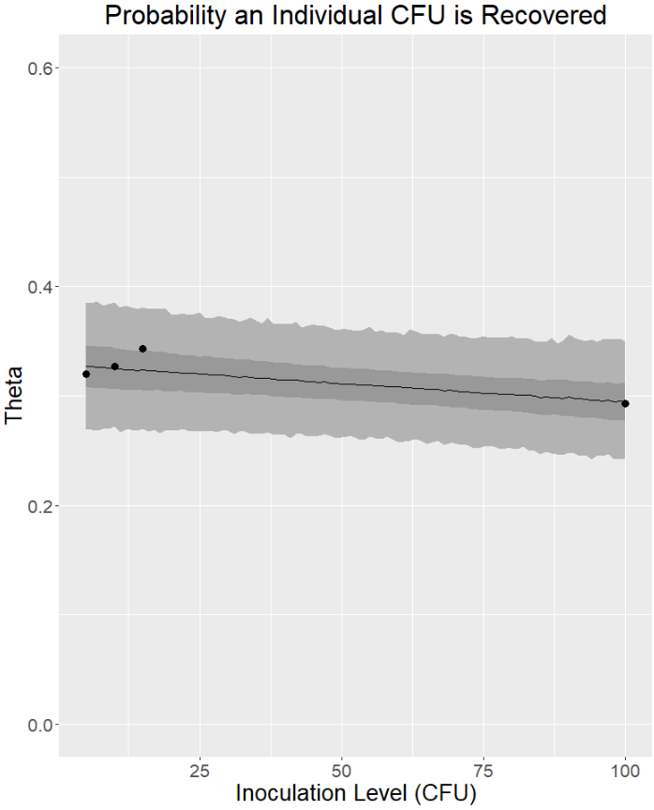
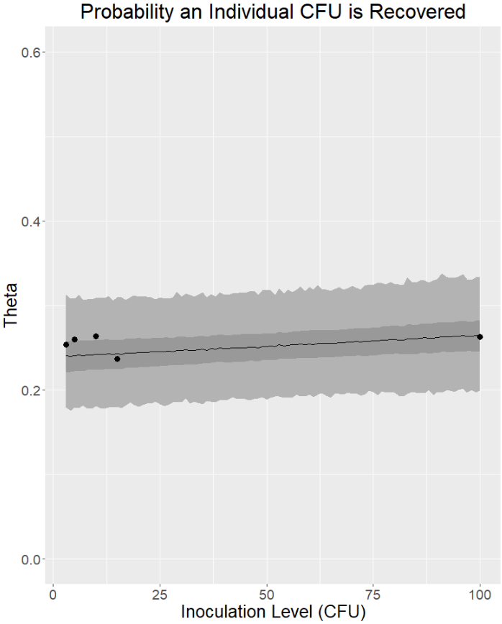
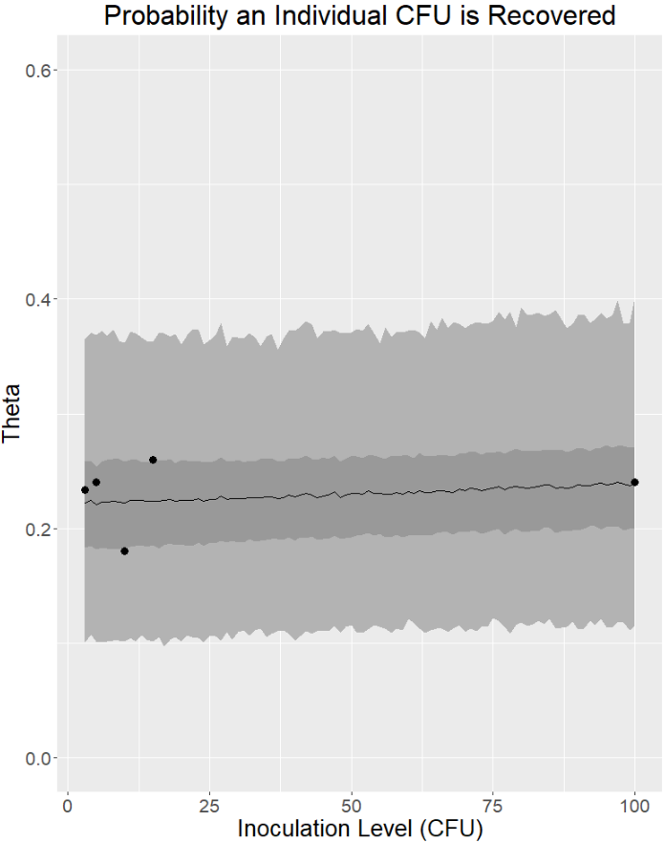
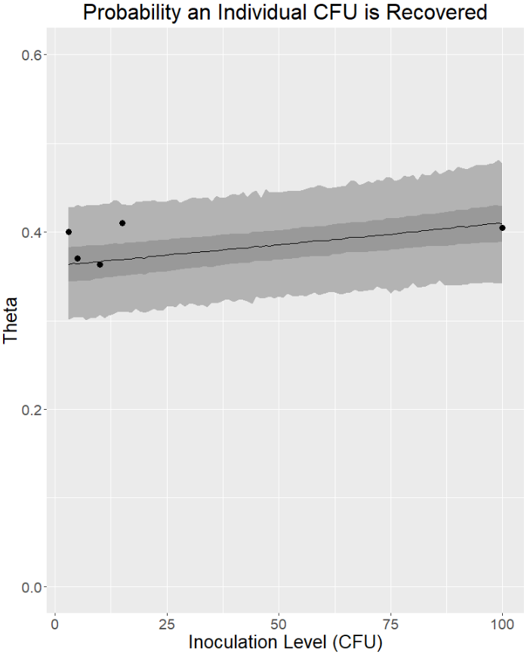
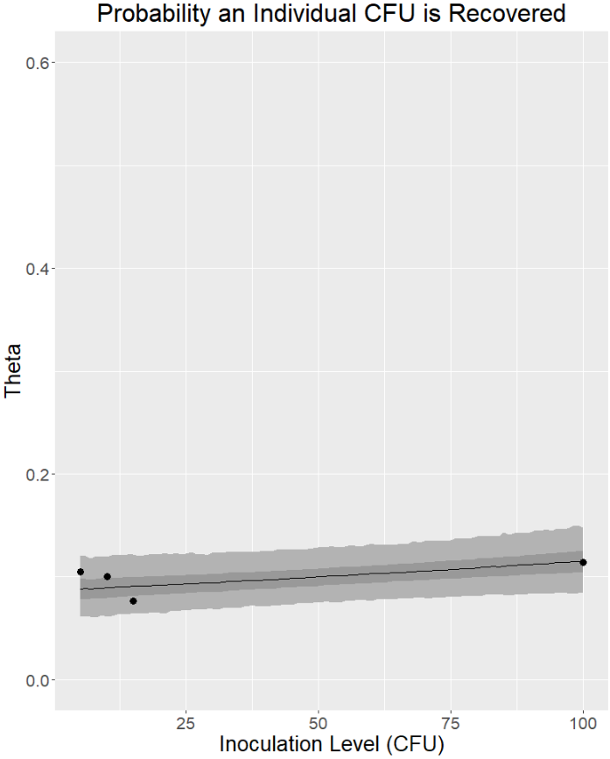
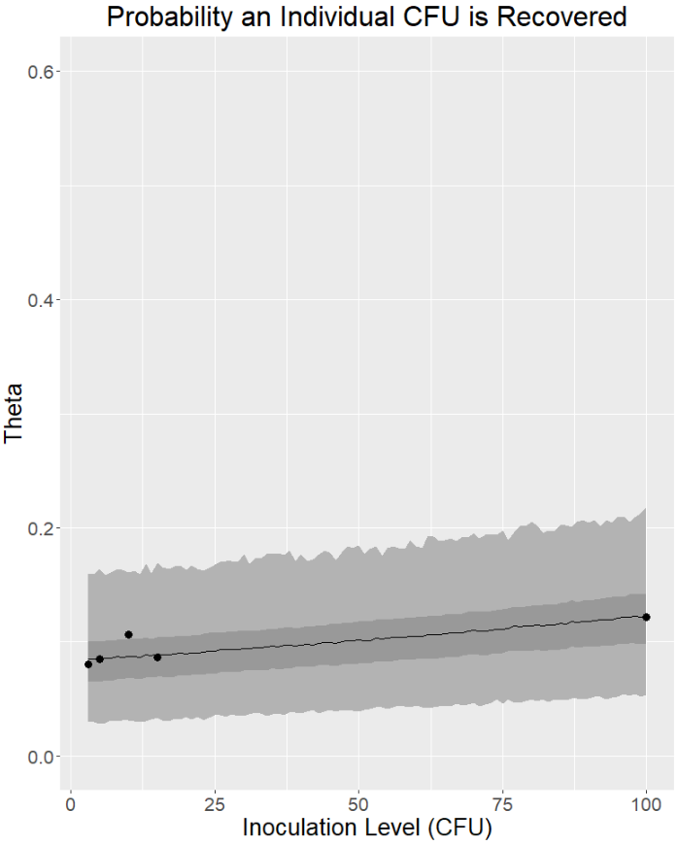
Sensitivity to Inoculation Level: Swabs
Probability an Individual CFU is Recovered
*as judged by the 95 percent credibility interval
Trend: not statistically significant*
Trend: of borderline statistical significance*
Trend: not statistically significant*
Trend: not statistically significant*
Trend: not statistically significant*
Trend: of borderline statistical significance*
Cotton Puritan Swab
NASA Standard
B. atrophaeus
NASA
No data at Inoculation Level = 3 CFU
Cotton Puritan Swab
NASA Standard
B. atrophaeus
ESA
Nylon-flocked Swab
NASA Standard
B. atrophaeus
ESA
Lower # of replicates relative to other cases
Nylon-flocked Swab
ESA Standard
B. atrophaeus
ESA
Cotton Copan Swab
NASA Standard
B. atrophaeus
ESA
No data at Inoculation Level = 3 CFU
Polyester Swab
ESA Standard
B. atrophaeus
ESA

Slide 12
Sensitivity to Inoculation Level: Swabs
Probability an Individual CFU is Recovered
*as judged by the 95 percent credibility interval
Trend: not statistically significant*
Trend: of borderline statistical significance*
Trend: not statistically significant*
Trend: not statistically significant*
Trend: not statistically significant*
Trend: of borderline statistical significance*
Cotton Puritan Swab
NASA Standard
B. atrophaeus
NASA
No data at Inoculation Level = 3 CFU
Cotton Puritan Swab
NASA Standard
B. atrophaeus
ESA
Nylon-flocked Swab
NASA Standard
B. atrophaeus
ESA
Lower # of replicates relative to other cases
Nylon-flocked Swab
ESA Standard
B. atrophaeus
ESA
Cotton Copan Swab
NASA Standard
B. atrophaeus
ESA
No data at Inoculation Level = 3 CFU
Polyester Swab
ESA Standard
B. atrophaeus
ESA
No statistically significant trend between recovery efficiency and inoculation level

Slide 13
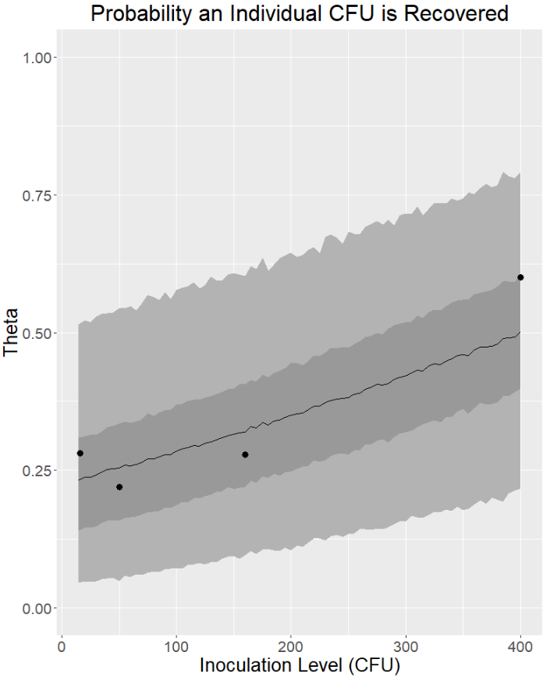
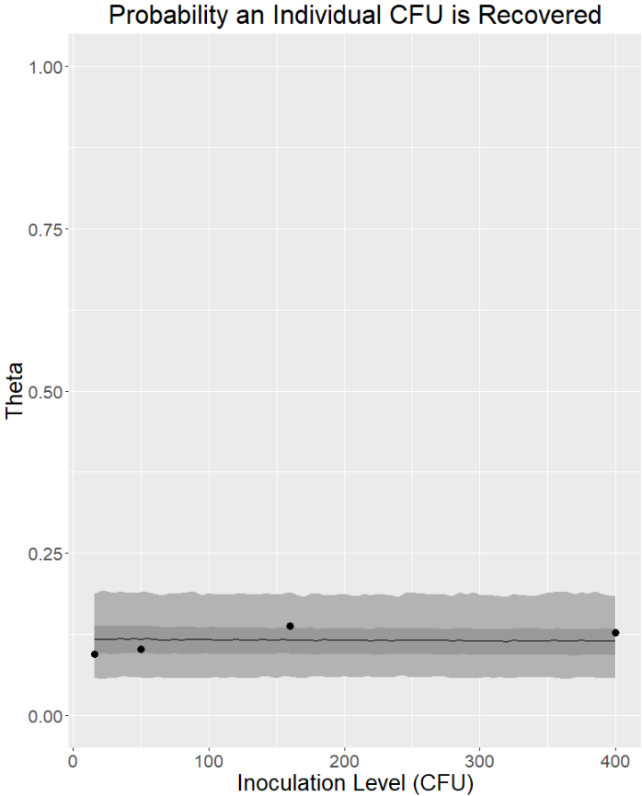
Sensitivity to Inoculation Level: Wipes
Probability an Individual CFU is Recovered
*as judged by the 95 percent credibility interval
There is a significant trend observed with the TX3221 wipe (left)
TX3211 wipe’s recovery efficiency may increase at some inoculation level between 160 and 400 CFU
The TX3224 wipe (right) appears to provide a much more stable, albeit lower recovery efficiency than the TX3211 wipe
Recovery efficiency at the inoculation level of 400 CFU (red arrows) are of less practical value to bioburden estimation applications (for Mars bound missions) since this result many times leads to cleaning of the hardware and resampling prior to bioburden being estimated.
However, this is not always the case, and inoculation levels up to 1000 CFU should be considered in the future.
Trend: statistically significant*
Trend: not statistically significant*
TX3211 Wipe
NASA Standard, Milliflex
B. atrophaeus
NASA
Data at Inoculation Level = 400 CFU drives trend
TX3224 Wipe
NASA Standard, Milliflex
B. atrophaeus
NASA

Slide 14
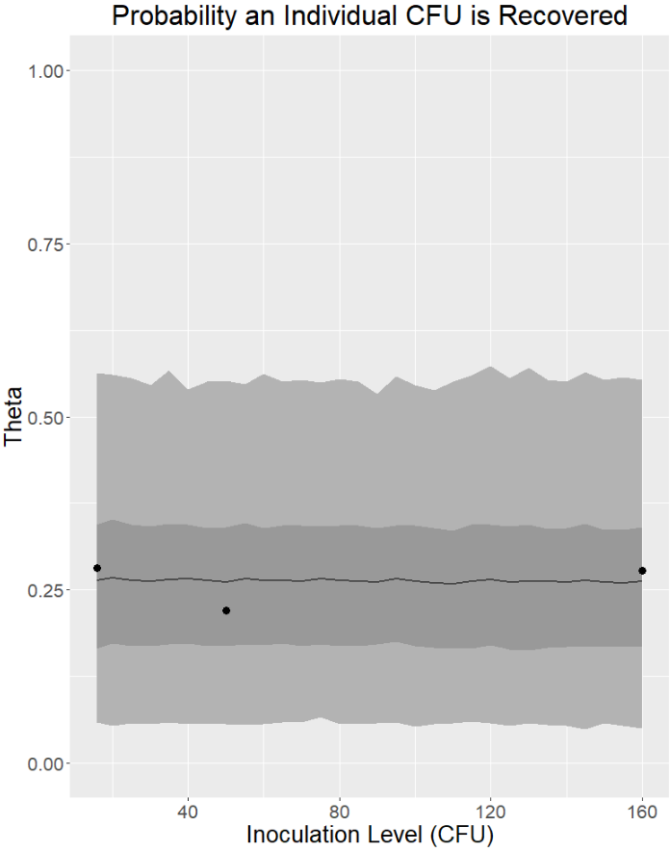
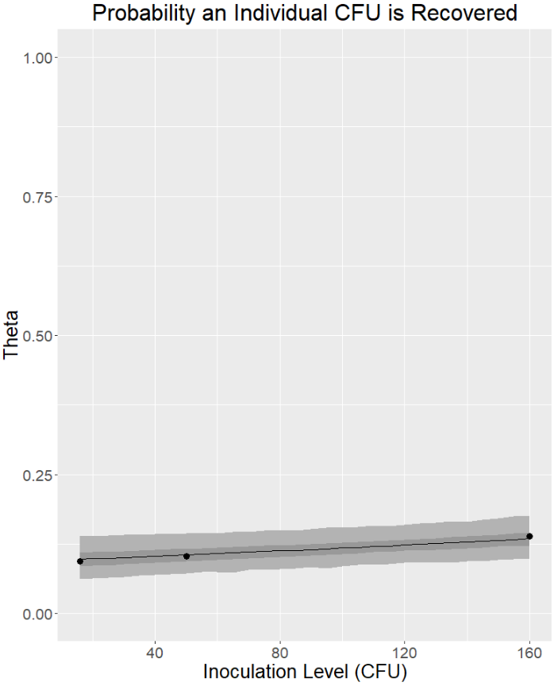
Sensitivity to Inoculation Level: Wipes (ex 400)
Probability an Individual CFU is Recovered
Trend: not statistically significant*
Trend is of borderline statistical significance*
*as judged by the 95 percent credibility interval
No statistically significant trend between recovery efficiency and inoculation level
TX3211 Wipe
NASA Standard, Milliflex
B. atrophaeus
NASA
Excludes data with inoculation level = 400 CFU
TX3224 Wipe
NASA Standard, Milliflex
B. atrophaeus
NASA
Excludes data with inoculation level = 400 CFU

Slide 15
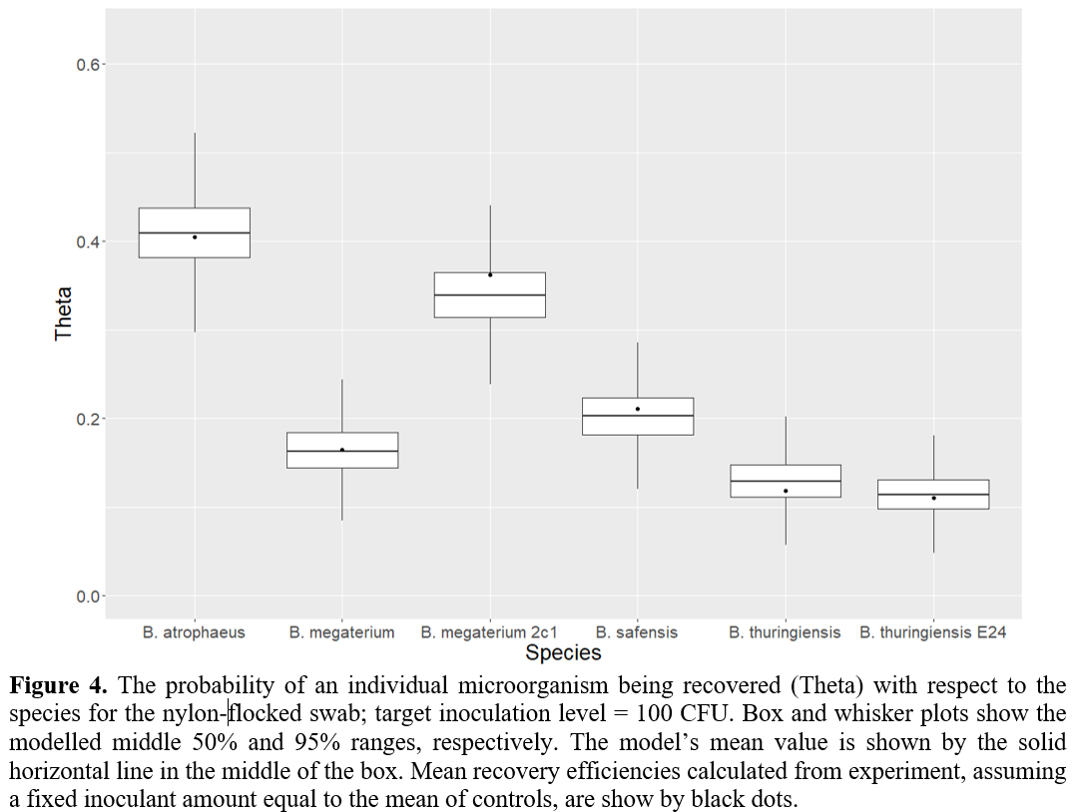
Sensitivity to Species: Nylon Flocked Swab
There are significant differences in the recovery efficiency when the sampling device is applied to different species.
Results for the nylon flocked swab are shown here, but other swabs and wipes show similar behavior
The reasons for variations in recovery efficiencies are unclear, but it seems possible that different physiochemical adhesive properties, such as hydrophobicity or the molecular composition of spore sheaths, can affect the release of spores from surfaces [Rönner U., et al., 1990].
Further experimentation and better knowledge of the distribution of species in cleanrooms is necessary to integrate this variability into bioburden estimation models
DiNicola, M., Seuylemezian, A., et al. “Modeling of Recovery Efficiency of Sampling Devices used in Planetary Protection Bioburden Estimation”, PSAM16 Conference Paper, June 2022.

Slide 16
Conclusions
The Nylon Flocked Swab processed with the ESA standard was the preferred assay method by the model’s criteria
Puritan cotton swabs processed with the NASA Standard took a respectable second and third place by the model’s criteria
Recovery Efficiency & Inoculation Level:
  No trends of practical importance appear to be significant for swab methods analyzed by this study
  No trends of practical importance appear to be significant for wipe methods analyzed by this study at lower inoculation levels (<160 CFU)
  More work is necessary to understand the sensitivity of wipes to inoculation level at higher inoculations levels (up to 1000 CFU)
Recovery Efficiency & Species:
  Further experimentation and better knowledge of the distribution of species in cleanrooms is necessary to integrate this variability into bioburden estimation models
  The development of molecular based microbial detection techniques may play a critical role in providing a more comprehensive distribution of species present
Additional controlled studies comparing sampling devices (particularly wipes) using both NASA and ESA protocols as well as Milliflex filtration vs standard plating processes may strengthen existing datasets and help improve the mathematical modelling
The mathematical modeling developed in this study provides the foundation for a rigorous probabilistic tool that can be made available to microbiologists when assessing recovery efficiency and performing bioburden estimation from assays analyzed in the lab.

Slide 18
Backup

Slide 19
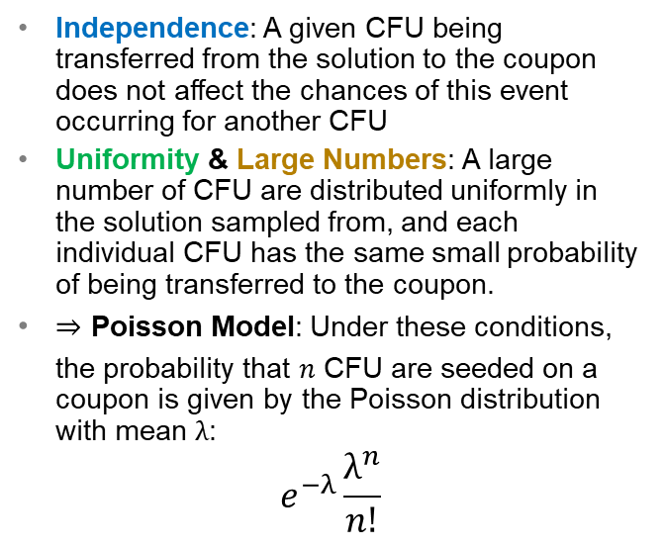
Model Assumptions: Seeding
How Experimental Design Validates Assumption
Assumption
Independence: A given CFU being transferred from the solution to the coupon does not affect the chances of this event occurring for another CFU
Uniformity & Large Numbers: A large number of CFU are distributed uniformly in the solution sampled from, and each individual CFU has the same small probability of being transferred to the coupon.
Poisson Model: Under these conditions, the probability that $n$ CFU are seeded on a coupon is given by the Poisson distribution with mean $λ$:
$$e^{−λ}\frac{λ^{n}}{n!}$$
Stock solution is sonicated prior to seeding
  Avoids clumping of CFU (independence)
  Creates a uniform titer in the solution
> millions of spores in stock solution
Solution prepared with the same species according to the same protocols
  Uniformity of species
Reagents tested for sterility according to manufacturer’s recommendations
  Avoid outside contamination that could introduce non-uniformities/heterogeneity of species
Same seeding procedure applied to a given coupon
  Uniformity/consistency of seeding process; avoids outside contamination

Slide 20
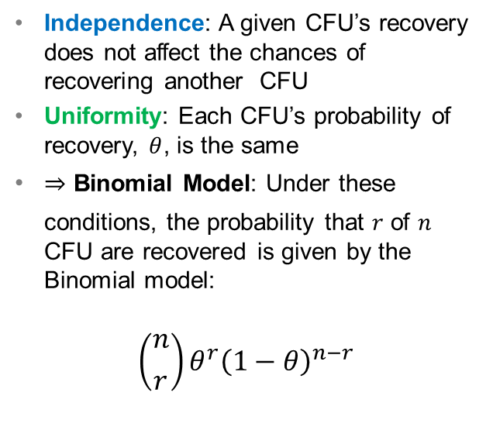
Model Assumptions: Recovery
How Experimental Design Validates Assumption
Assumption
Independence: A given CFU’s recovery does not affect the chances of recovering another CFU
Uniformity: Each CFU’s probability of recovery, $θ$, is the same
Binomial Model: Under these conditions, the probability that $r$ of $n$ CFU are recovered is given by the Binomial model:
$$\left({n \atop r}\right)θ^{r}{\left(1−θ\right)}^{n−r}$$
Solution used to seed coupon is sonicated prior to seeding
  Avoids clumping of CFU or CFU attaching to other materials; e.g. hair (independence)
Coupons seeded with the same species according to the same protocols
  Uniformity of inoculant
Coupons of the same material type, size and from the same manufacturer
  Uniformity of the surface sampled
Swabs/wipes applied to a given coupon of the same type and from the same manufacturer
  Uniformity of materials used to acquire samples
Reagents tested for sterility according to manufacturer’s recommendations
  Avoid outside contamination that could introduce non-uniformities/heterogeneity of species
Same recovery procedure applied to all replicates of a given experiment
  Uniformity/consistency of process (NSA or ESA assay processes); avoids outside contamination

Slide 21

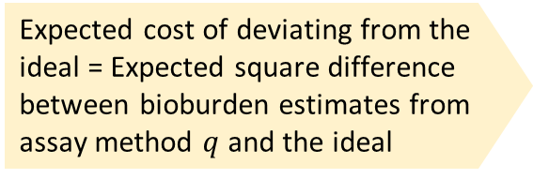
Cost Function
Compare how well the method compares with an ideal method for purposes of estimating bioburden
  Ideal Method: A swab or wipe with a mean recovery efficiency of 100% and 0 variability
“Better” does not consider other factors not quantified by the modeling
  Such as practicality of using a particular device, handling constraints, accessibility controls and resources required to revamp processes
Expected cost of deviating from the ideal = Expected square difference between bioburden estimates from assay method $q$ and the ideal
$$E_{r}^{∗}\left(q\right)=σ_{q,r}^{2}+{\left(μ_{q,r}−r\right)}^{2}$$
Penalty for higher variance in a method’s mean recovery efficiency
Penalty for a method having a smaller mean recovery efficiency

