Slide 1
Model-Based Reliability Engineering
of Automotive Drivetrain Architectures
with Multi-Trajectory Simulation
16th Probabilistic Safety Assessment & Management
Summer 2022, Honolulu
Sascha Schmidt and Armin Zimmermann
Computer Science, Systems and Software Engineering
Technische Universität Ilmenau, Germany

Slide 2
Motivation
Finding of crucial design issues concerning reliability, safety and availability in an early phase of the system design
Strict requirements on functional safety and its certification
Tradeoffs between
  Safety Requirements vs. Cost Efficiency
  Highly Reliable Single Modules vs. Redundant Solutions
Searching for a (best) overall system design

Slide 3
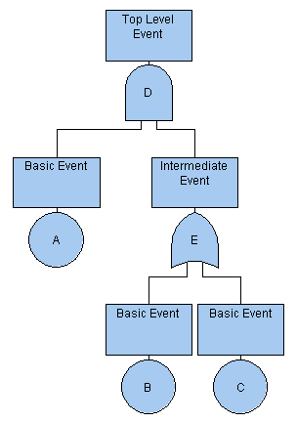
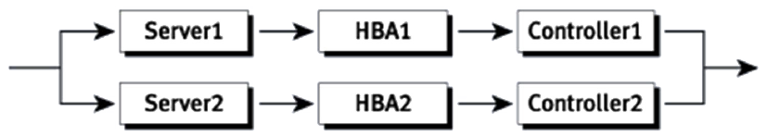
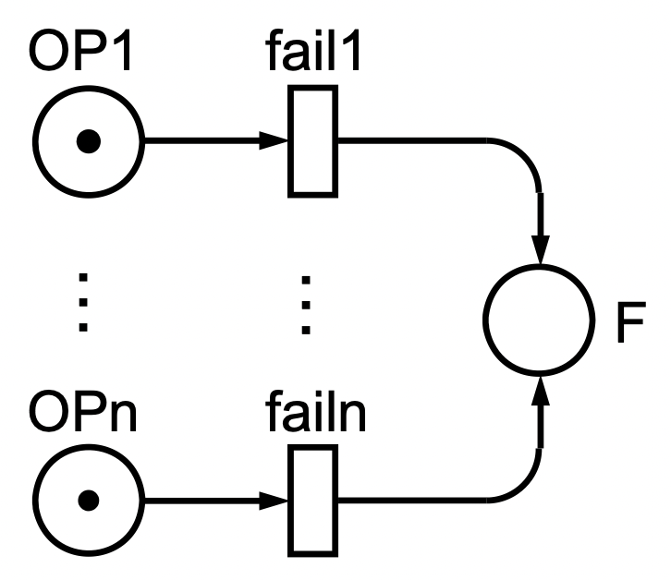
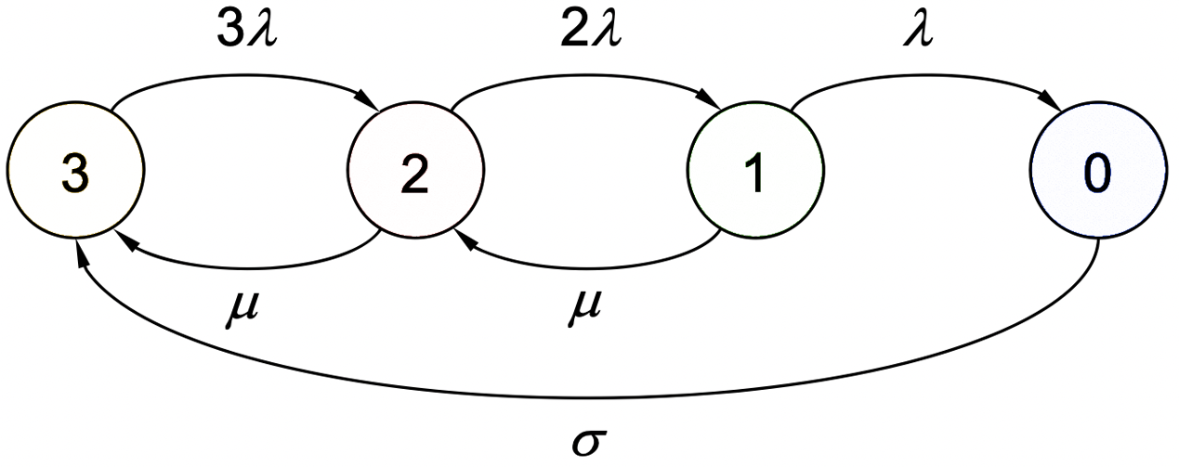
Complex and Dynamic System Models
Limits of Fault Trees and Reliability Block Diagrams
Dynamic models need to consider States, Discrete Events, Probabilistic Choices and Stochastic Delays
➔ Markov Chains and Stochastic Petri Nets (IEC 62551)

Slide 4
Evaluation Methods
Two dimensions of (Markovian) problems
Importance Sampling
Splitting
rare-event
simulation
simulation
number of states
numerical analysis
rarity of measure samples

Slide 5
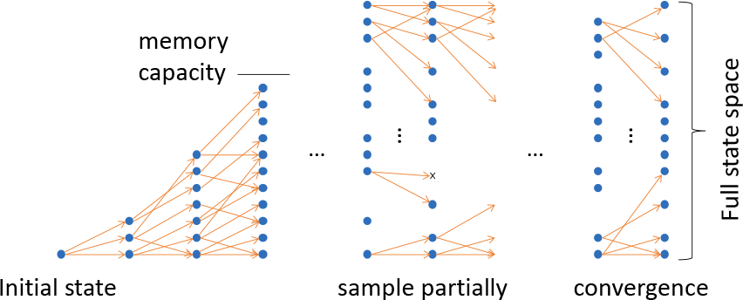
Hybrid Multi-Trajectory Simulation
An Integrated Algorithm
  Keep advantages of simulation and numerical analysis
  Work like numerical analysis, as long as memory suffices
    “split” particle step following all possible state changes
    distribute state probability over destination states
  Select state transition like simulation if not
    probabilistic step of trajectory
    merge trajectories leading to stored state

Slide 6


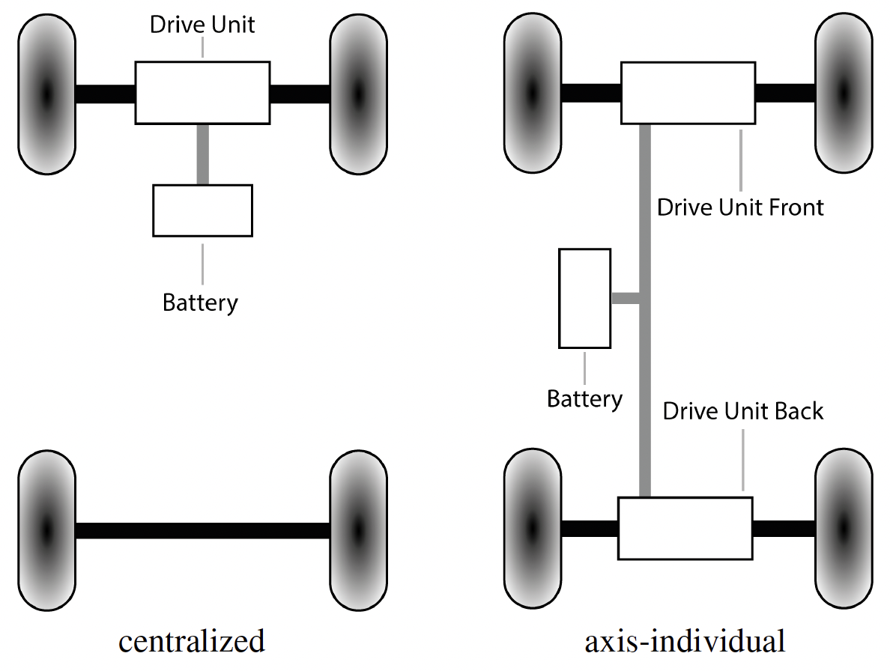
Application Example
Contribution out of the German BMWK Project AnRox on
“Fail-safe and Efficient Electric Drive System for Robot Cabs“
Vehicle Topologies
  Referring to common 2WD and 4WD
  Similarities
    Two Axles, Four Wheels, One Battery
  Differences
    Centralized vs. Axis-Individual Drive Units

Slide 7
Stochastic Petri Net Model

Slide 8
Stochastic Petri Net Model

Slide 9
Stochastic Petri Net Model

Slide 10
Stochastic Petri Net Model

Slide 11
Stochastic Petri Net Model

Slide 12
Stochastic Petri Net Model
Model-Based Reliability Engineering of Automotive Drivetrain Architectures with Multi-Trajectory Simulation
12

Slide 13
Stochastic Petri Net Model
Stochastic Petri Net Model
Model-Based Reliability Engineering of Automotive Drivetrain Architectures with Multi-Trajectory Simulation
13

Slide 14
Stochastic Petri Net Model
System Performance Measures
  Mathematical Expressions for
    Expected Value, Probability, Throughput
    (#P) (#P>x) (#T)
  Conditional Measures
    (#P1) IF (#P2>2)
  Application Example of Costs and Earnings
    Costs
      Initial Investment
      Repairs and Replacement
      Penalty
    Earnings
      Fees paid by passengers

Slide 15
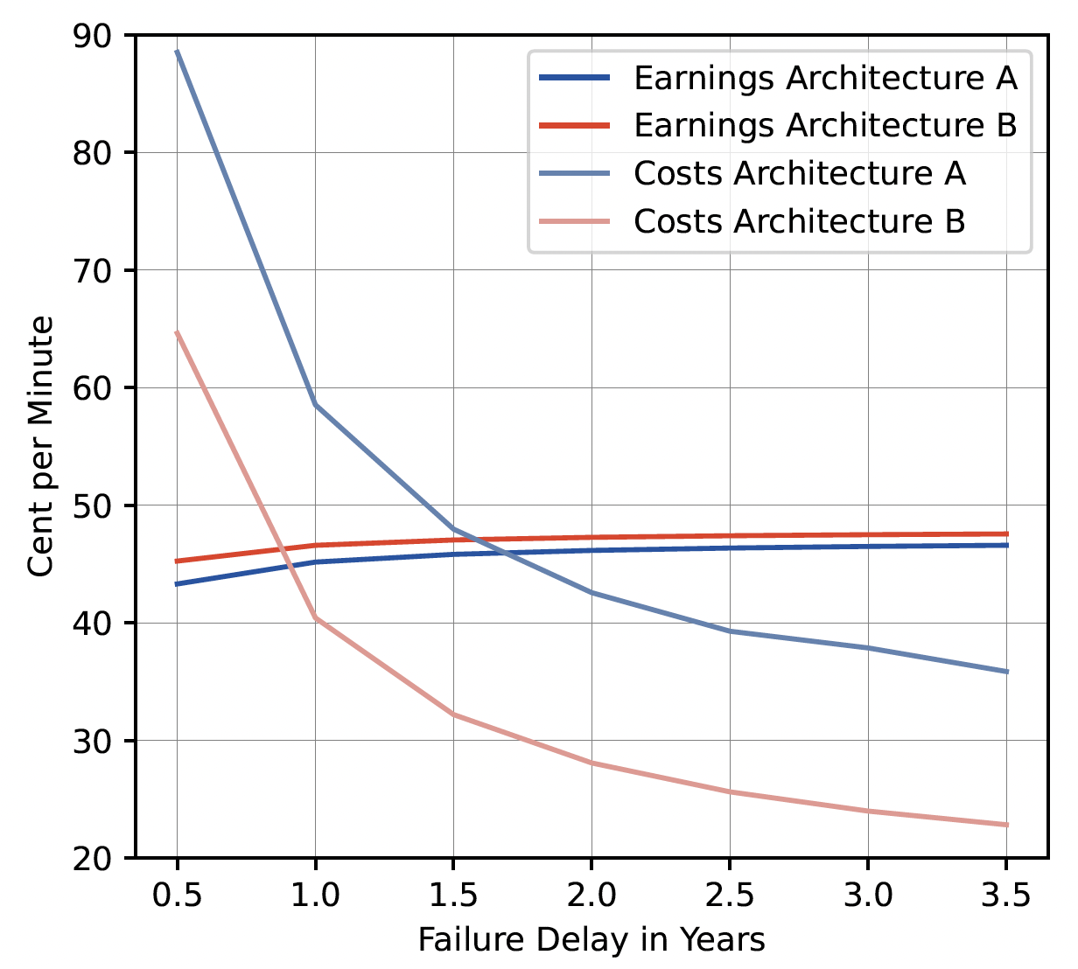
Comparison of Architectures
Evaluation Results

Slide 16
Efficiency of the Multi Trajectory Algorithm
Experiments
  A: Effect of the Reachability State Space
Overall Runtimes
Tangible States | 544 | 1573 | 4954 | 15538 | 49054 | 154992
Numerical Analysis [s] | 1 | 1.5 | 2.1 | 4.1 | 23 | 188
Simulation [s] | 8 | 9 | 8 | 8 | 9 | 9
Multi-Trajectory Simulation [s] | 1 | 1 | 1 | 1 | 1 | 1
Overall run times of evaluation algorithms for varying state space size.

Slide 17
Efficiency of the Multi Trajectory Algorithm
Experiments
  B: “Rareness” of reliability results / Rare-Events
Overall Runtimes
Failure delays (in thousand minutes) | 50 | 150 | 250 | 350 | 450 | 550 | 650 | 750 | 850
Numerical Analysis [s] | 2 | 2 | 2 | 2 | 2 | 2 | 2 | 2 | 2
Simulation [s] | 7 | 23 | 30 | 47 | 79 | 73 | 88 | 102 | 116
Multi-Trajectory Simulation [s] | 1 | 1 | 1 | 1 | 1 | 1 | 1 | 1 | 1
Overall run times of evaluation algorithms for varying failure delays.

Slide 18
Conclusion
Model-Based Systems Engineering for Reliability and Safety of Drivetrain Architectures for Future Autonomous Electric Cab Designs
Modular Stochastic Petri Net Application Example
Evaluation of Design Tradeoffs
Efficiency of Multi Trajectory Simulation
  Prototype tool implementation in TimeNET
  Future work
    Heuristics for rare-event problems with large state space
    Extension to non-Markovian models

Slide 19
Further Information
Tool
  http://timenet.tu-ilmenau.de/
Background and Details
  A. Zimmermann and T. Hotz: Integrating simulation and numerical analysis in the evaluation of generalized stochastic Petri nets, ACM TOMACS 29(4) 2019.
  A. Zimmermann, T. Hotz, and A. Canabal Lavista: A hybrid multi-trajectory simulation algorithm for the performance evaluation of stochastic Petri nets, Quantitative Evaluation of SysTems, QEST 2017.
More Application
  A. Zimmermann, T. Hotz, V. Hädicke, and M. Friebe: Analysis of safety-critical cloud architectures with multi-trajectory simulation, accepted for publication at RAMS 2022.

Slide 20
Tool Implementation
Stochastic Petri net tool – available at timenet.tu-ilmenau.de

