Slide 1
Availability and Reliability Analysis of Independent Core Cooling at Oskarshamn 3

Slide 2
What we do
We actively challenge convention to achieve great things. We believe in working hand in hand with clients to tackle complex and multi-layered challenges head-on. Our deep knowledge and earned expertise is driven by a profound passion for achieving engineering excellence. We improve your operational performance, mitigate risk, optimise cost and facilitate better decision making, in an ever-changing world.
Improve operational performance
Optimise costs
Reduce risk
Informed decision making
www.vysusgroup.com

Slide 3
Presentation outline
Introduction
Definitions
Methodology – Focus of the presentation
Some results
Focus on power operation
Conclusions

Slide 4
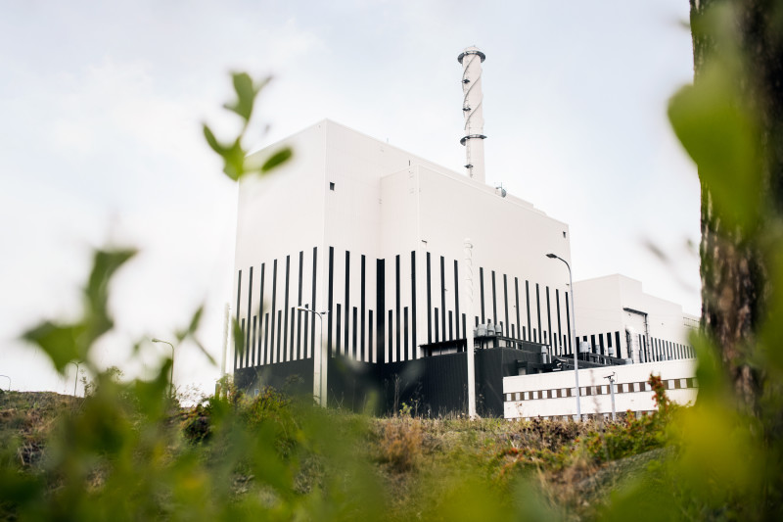
Introduction
All nuclear power plants in Sweden need to be equipped with Independent Core Cooling (“OBH”) by December 31st 2020.
The NPP Oskarshamn unit 3 has been equipped with a system powered by its own dedicated diesel generator and cooling water supply that is independent from the rest of the plant.
A significant effort during the process has been to update the Safety Analysis Report (SAR) including the Emergency Operating Procedures (EOP) and Severe Accident Management Guidelines (SAMG) and of course the baseline PSA (refer to paper FR84)
In addition, analysis has been performed of the reliability and availability of the OBH function. This presentation focus on the challenges that were encountered and how they were managed.

Slide 5
Definitions
Availability – The ability of a system to be in a condition at the onset of a scenario so that it is able to fulfil its functional requirements for the scenario in question.
Functional Safety – The ability of a system to fulfil its functional requirements during the time period it has been designed for (mission time) and the conditions that will prevail during this time.
Reliability – Combining the concepts of availability and reliability as outlined above yields a system’s reliability.
In addition, the systems maintainability is also to be considered when determining the reliability of a system.
Separate study not included in this presentation.
These definitions may not be 100% in line with conventional perceptions of each measure.
They are somewhat “tailored” in order to respond to the specific questions from the Swedish Radiation Safety Authority (SSM).

Slide 6
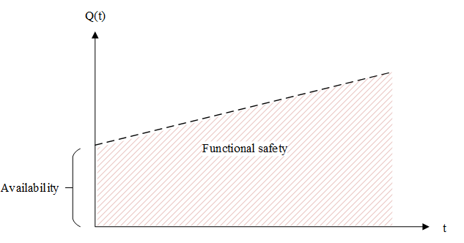
Methodology – Formulas
The baseline PSA model (Level 1, internal events) was used as a basis (20 h mission time).
Needed to be extended to 72 hours mission time.
Functional safety:
Q_{72h} – Failure probability during 72 hours MT.
Unavailability:
Q_{Test} – Unavailability due to ongoing tests
Q_{M} – Unavailability due to ongoing maintenance
Q_{Syst} – Unavailability due to system failures
Availability = 1 - Unavailability
$$R= 1−Q_{72h}$$
$$Q_{T=0}= Q_{Test}+Q_{M}+\left[1−\left(\left.Q_{Test}+Q_{M}\right)\right.\right]×Q_{Syst}$$
The above graph visualises a system which has a certain probability of failure at the onset of a scenario and how the failure probability then increases with the mission time

Slide 7
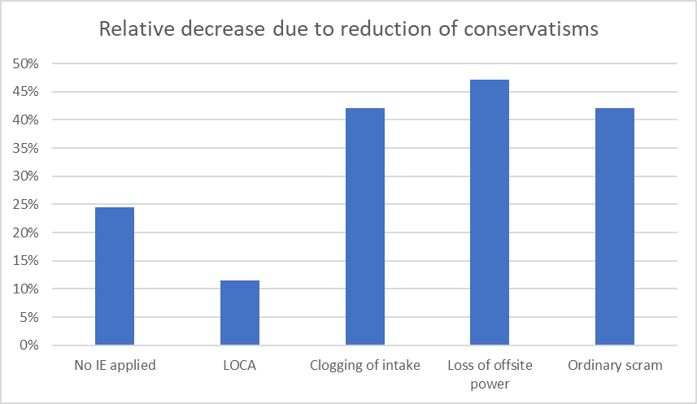
Methodology – Initiating events & conservatisms
Initiating events
The OBH function at Oskarshamn 3 has specifically been designed to handle ELAP scenarios.
Extended Loss of all AC Power
Taking a probabilistic approach would in principle mean that all initiating events (IE’s) are considered.
Not practically possible
A subset of IE’s were therefore selected (power and low power conditions):
No specific IE
Large top break LOCA
SCRAM with no other conditions
Loss of off-site power
Clogging of cooling intake
For refuelling outage only loss of residual heat removal was considered.
PSA conservatisms
Before any specific analysis was made, a review was conducted of the cutsets generated by the baseline PSA model for the OBH function.
The purpose was to identify possible conservatisms that would have significant impact on the results and complicate result interpretation.
Two different type of conservatisms were identified:
Combination of specific events, often including Human Failure Events (HFE’s)
Assessment of likelihood that components are unavailable due to corrective maintenance.
The baseline model was updated so that the impact of identified conservatisms was reduced.
Reduction factor of 1/10
Experience data for repair times instead of Allowed Outage Time (AOT) according to Tech. Spec.

Slide 8
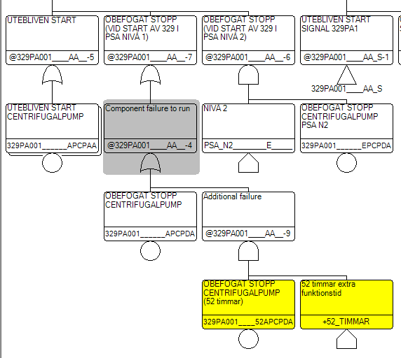
Methodology – Increase of mission time
As the analysis should encompass a 72 hours mission time it was necessary to add 52 hours the 20 hours in the baseline model.
Baseline PSA included ~800 basic events modelled with mission time …
An iterative screening process was applied in order to eliminate basic events which could be excluded from the extension to 72 hours.
Fuses, measurement devices and similar “electrical” components were screened out.
A total of 74 basic events (~100 fault trees) remained.
The Macro Language tool in RiskSpectrum was used to update the fault trees as shown to the right.

Slide 9
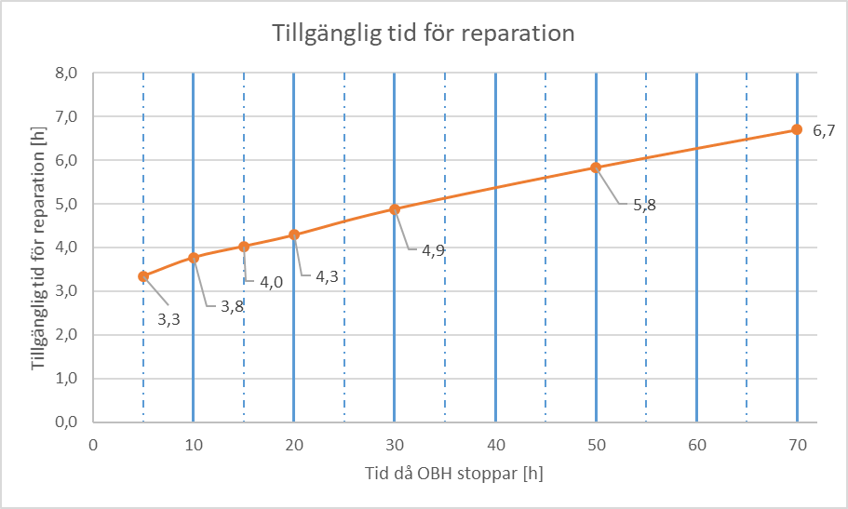
Methodology – Available repair time
Available repair time (y axis) as a function of time when OBH fails (x axis).
As the mission time was extended to 72 hours mission time, credit for repair of failed components could be taken.
No credit in baseline PSA (20 hours MT)
An important aspects to determine is the available repair time.
A number of MAAP cases were setup where the only system function that was in operation was the OBH function (T=0).
At a certain point in time the OBH function was failed and MAAP was used to determine how long after core damage occurred.
Two time intervals were defined:
0-20 hours: Available repair time of 4 hours
21-72 hours: Available repair time of 6 hours

Slide 10
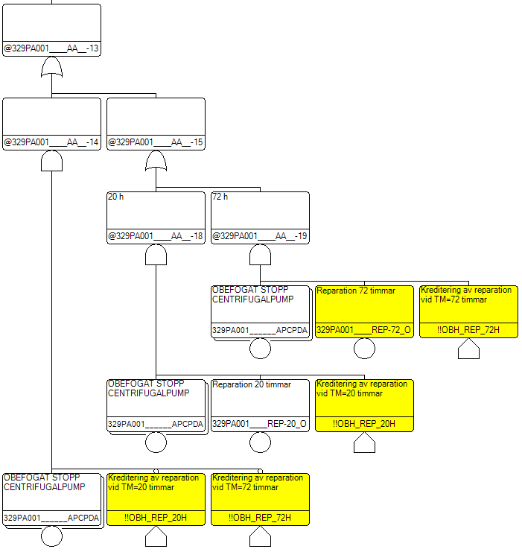
Methodology – Modelling of repair
A simplified approach was used to calculate the likelihood of failed repair:
Where
Q_{rep} – Likelihood of failed repair
T_{a} – Available time for repair
MTTR – Mean Time To Repair
Repair was only considered for components that were accessible (i.e. no repair on components located inside the containment)
House events were used in order to switch on/off repair in the fault trees in the two time intervals (0-20 hours and 21-72 hours)
$$Q_{rep}=e^{−{T_{a}}/MTTR}$$

Slide 11
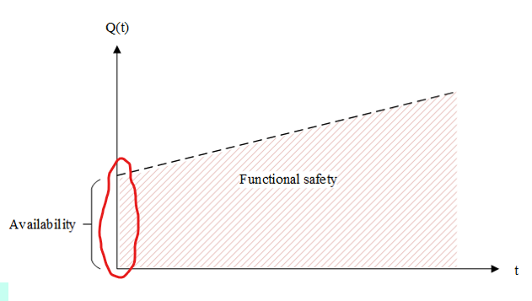
Methodology – Model adaption for availability analysis
According to the definitions outlined the availability analysis should only consider “failure to start at time zero” failure modes.
Non-relevant failure modes therefore need to be eliminated (assigned Q=0/demand).
All mission time component failures and Category C HFE’s were assigned Q=0 (Exchange Events in RiskSpectrum)
A failure mode that is not included in the baseline PSA is component unavailability during to functional tests.
A review was made of the Tech. Spec. to identify what tests are made for components relevant for the OBH function.
For components that are unavailable during functional tests the duration of their unavailability were determined based upon test duration.
Seven components were assigned a Q_{Test} unavailability.

Slide 12
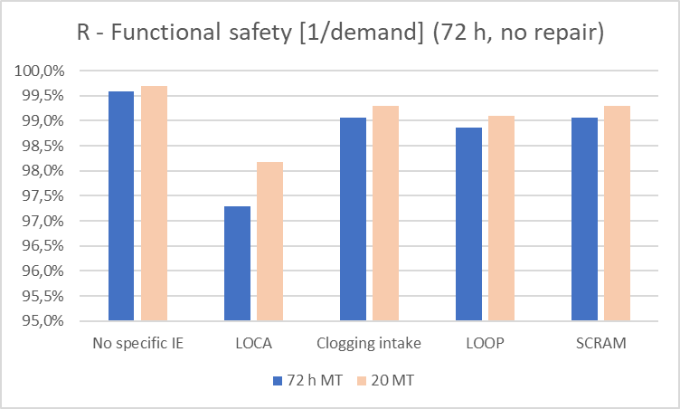
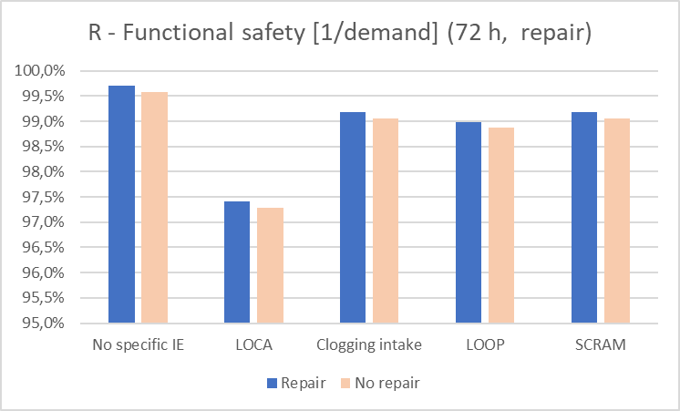
Results – Functional safety, power operation
Increase of mission time from 20 hours to 72 hours has impact, especially for LOCA scenarios due to higher dependency on components with spurious stop as failure mode (make-up water pumps).
LOCA scenarios also have higher dependency on manual actions (hence lower functional safety).
Repair was taken into account for two components based upon component importance and accessibility.
In general, small positive impact on the results.

Slide 13
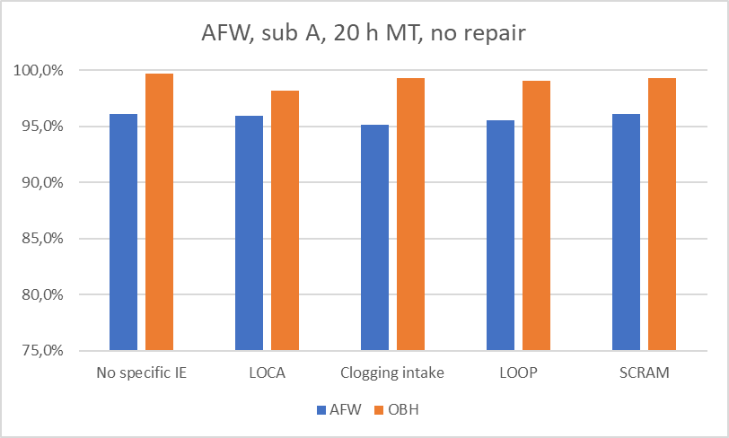
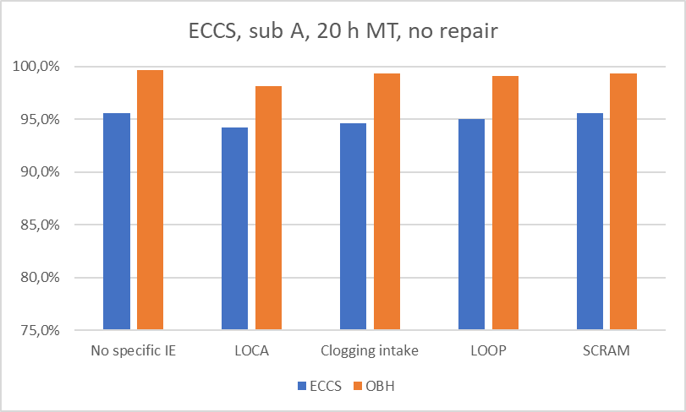
Results – Comparison with AFW and ECCS
The OBH function is in general a one train system with some redundancies in make-up water supply.
To be able to judge if the functional safety is in line with what can be expected a comparison was made with one train in the Auxiliary Feedwater System (AFW) and Emergency Core Cooling System (ECCS).
AFW – High pressure system
OBH and ECCS – Low pressure systems
The comparison showed that the functional safety of the OBH function is similar, or slightly better, than for one train in AFW and ECCS systems.
Mainly due to the redundancies in make-up water supply for the OBH function

Slide 14
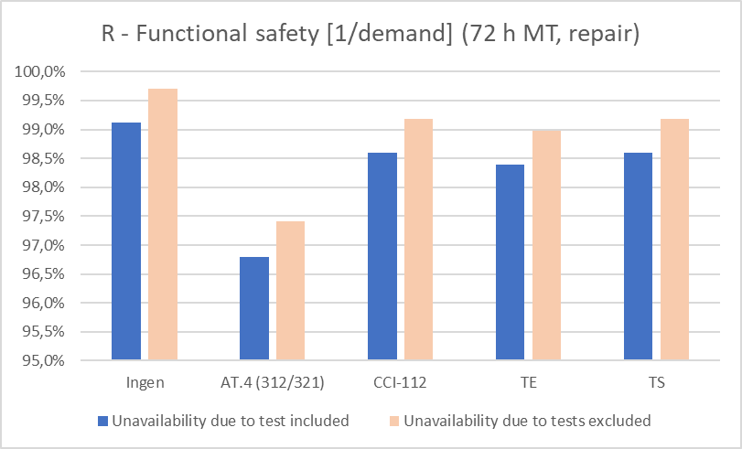
Results – Importance of component tests
The “true” functional safety was calculated by incorporating component unavailability due to functional tests into the analysis.
The results show that functional tests has an impact less than 1%
Uncertainty analysis gave that with 95% confidence (95th percentile), the functional safety of the OBH function in this case was not less than 97% (LOCA scenario)

Slide 15
Conclusions
Conducted analysis has shown that the functional safety of the OBH function is similar, or even better than, one train in already existing core cooling safety functions (AFW and ECCS).
With a confidence of 95%, the reliability (availability + functional safety) of the OBH function is not less than 97% for analysed scenarios (LOCA, SCRAM, LOOP and “clogging of intake”).
Analysis has also shown that the OBH function is well designed to handle an ELAP scenario (not included in this presentation, refer to paper AN79).
Altogether, the analysis have provided a good basis for OKG to conclude that the reliability of the OBH function should be as high as can be expected.

Slide 16
Anders Olsson
Principal Consultant / VP Nuclear
+46 (0)70 733 43 08
Anders.Olsson@vysusgroup.com

