Slide 1




“Transformative Benefits” emerging from
NASA OSMA’s
Data Centric and Model-Based
Frameworks
NASA DIGITAL
TRANSFORMATION
PSAM 2022
PRESENTED BY: Tony DiVenti, NASA R&M Technical Fellow
CONTRIBUTORS: Matt Forsbacka, Nancy Lindsey, Jeannette Plante, Kevin Rainbolt, Steve Cornford (JPL), & many others ☺
Notes:
Thank PSAM for the opportunity to present here today.
Thank the Contributors (list here) who helped put together this presentation (directly or indirectly)
Personally, delighted to share how NASA OSMA is working to harness “Digital/Digitization” and evolving Data-Centric and Model-Based Frameworks to transform NASA

Slide 2
Outline
National Aeronautics and Space Administration
www.nasa.gov
Background – The Perfect Storm
  Why is NASA here?
  NASA’s Digital Transformation Program
  NASA’s emerging Interoperable Environment
  Conditions “ripe” for Transformation Changes
OSMA’s adoption of a Transformative Vision build upon Data and Model-Centric principles and technologies
  Eliminate the N-1 Problem
  OSMA’s SMA Digital Transformation Roadmap
  Building a Digital Framework
Transformational Activities and Emerging Benefits underway
Mission MissMission Assurance Standards and Capabilities Division
OSMA HQ-GD000

Slide 3
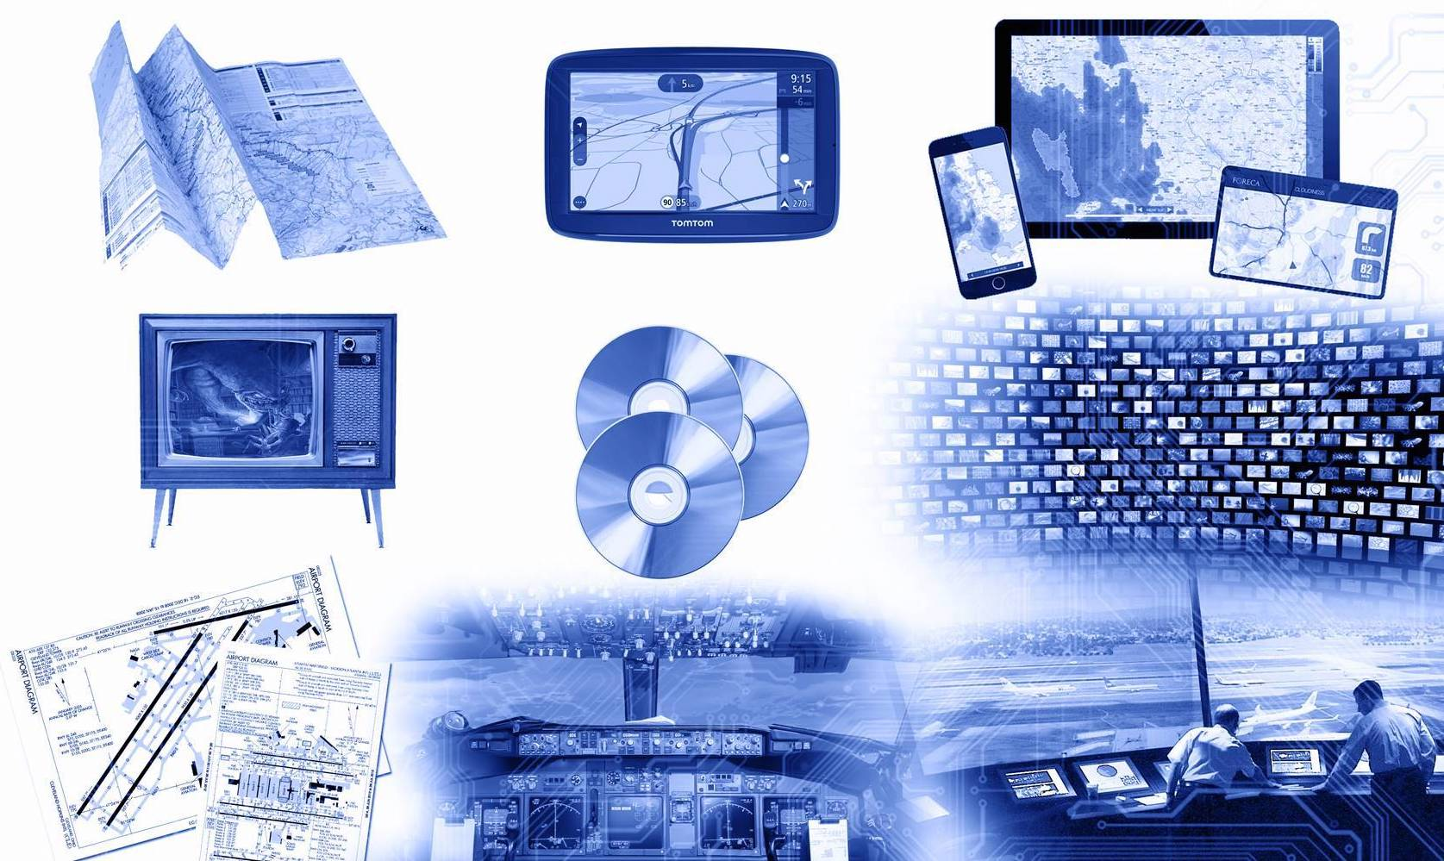
Background – The Perfect Storm
National Aeronautics and Space Administration
www.nasa.gov
Mission Assurance Standards and Capabilities Division
OSMA HQ-GD000
Notes:
Theme 1 - Background
Quick Transition Page

Slide 4

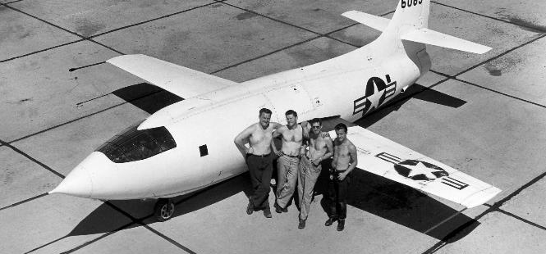
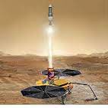
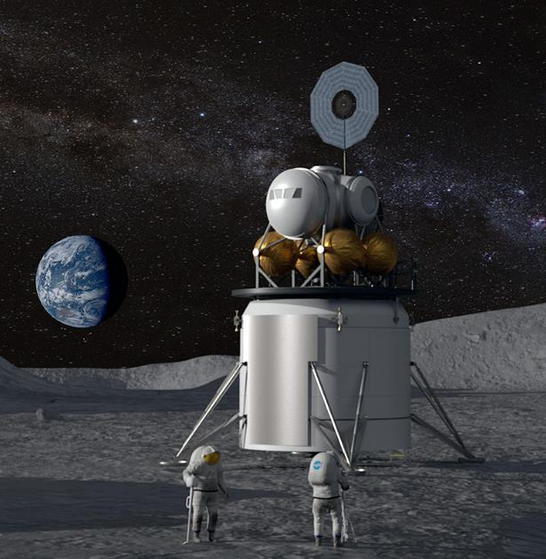
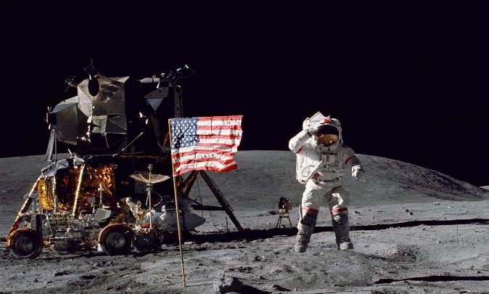
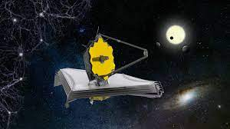
Notes:
The first point I want to make is….Why is NASA even here! …Well, I think it is to do and enable the hard stuff!!
Since its inception, NASA has and continues, to transform our understanding of the universe and our place in it for decades, all by pushing the frontiers of technology to do what has never been done before (e.g., The first manned supersonic flight, Chuck Yager mission, in 1947……; Putting the 1st Human on the Moon in 1969; revealing how Stars are formed, as illustrated by Hubble’s Eagle Nebula image taken in 2015 from an event some 6,500-7,000 light years from Earth; or by launching JWST launch in 2021) or the bold mission work currently underway such as creating a permanent presence on the Moon (Click), returning the first samples of MARs rock/rock dust back to Earth in the 2026 – 2028 timeframe (Click) or putting the first humans on MARS in the late 2030’s or early 2040’s.
With these new missions there are number of Safety and Reliability Challenges…………….
What will take to keep and sustain human life on the moon for not only days, but for months and years, as we look to establish a permanent presence?
How do we create a sustainable supply chain to space? What type of life support and sustainment systems will be needed? What type and with what frequency are diagnostics and repairs needed to maintain these systems? How will we continue to launch and service spacecrafts and stations in a space environment where the amount of space debris continues to increase around earth?
And then, on the other end of the spectrum, doing more under constrained and/or shrinking budget conditions? For example
Launching more spacecraft with an ever increasing cadences (CubeSats and SmallSats)
Accepting more commercial development, novel practices, and industry / consensus stds
With these types of challenges, what is needed more than ever from our community is the ability to generate, integrate, and/or deliver high fidelity and relevant, Safety and Reliability information to more rapidly to enable critical decision making (whether it be for planning, design, or operations) on or before when such decisions are made and needed. Far too often, I have seen our analysis coming in too late.

Slide 5
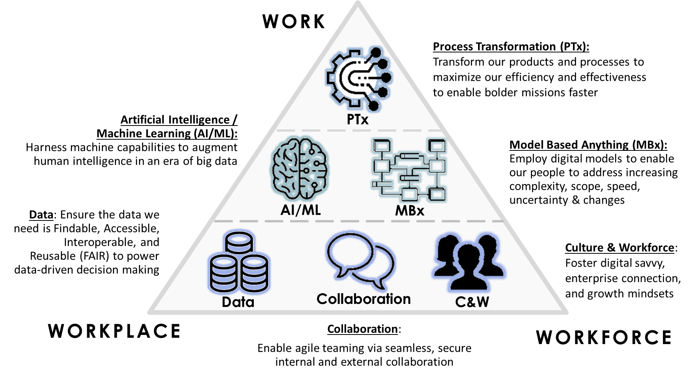



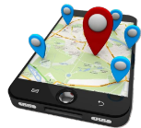
Digital Transformation (DT)
[dij-i-tl trans-fer-mey-shuhn] noun:
Employing digital technologies to change a process, product, or capability so dramatically that it’s unrecognizable compared to its traditional form.
TRADITIONAL
DIGITIZED
TRANSFORMED
NASA DT
6 Foundational Elements
From Maps to Apps…
Digital Transformation
has already changed our world
Notes:
The second point I want to make is that NASA has embraced “digital transformation” not only at a local organizational/center lever, but at an Enterprise Initiative led out of NASA HQ and the OCIO.
Describe what NASA means by “Digital Transformation” – see chart
Now, each organization being asked to respond to the HOW – what are they are going to do to transform their organizations (in my case….S&MA and R&M )

Slide 6
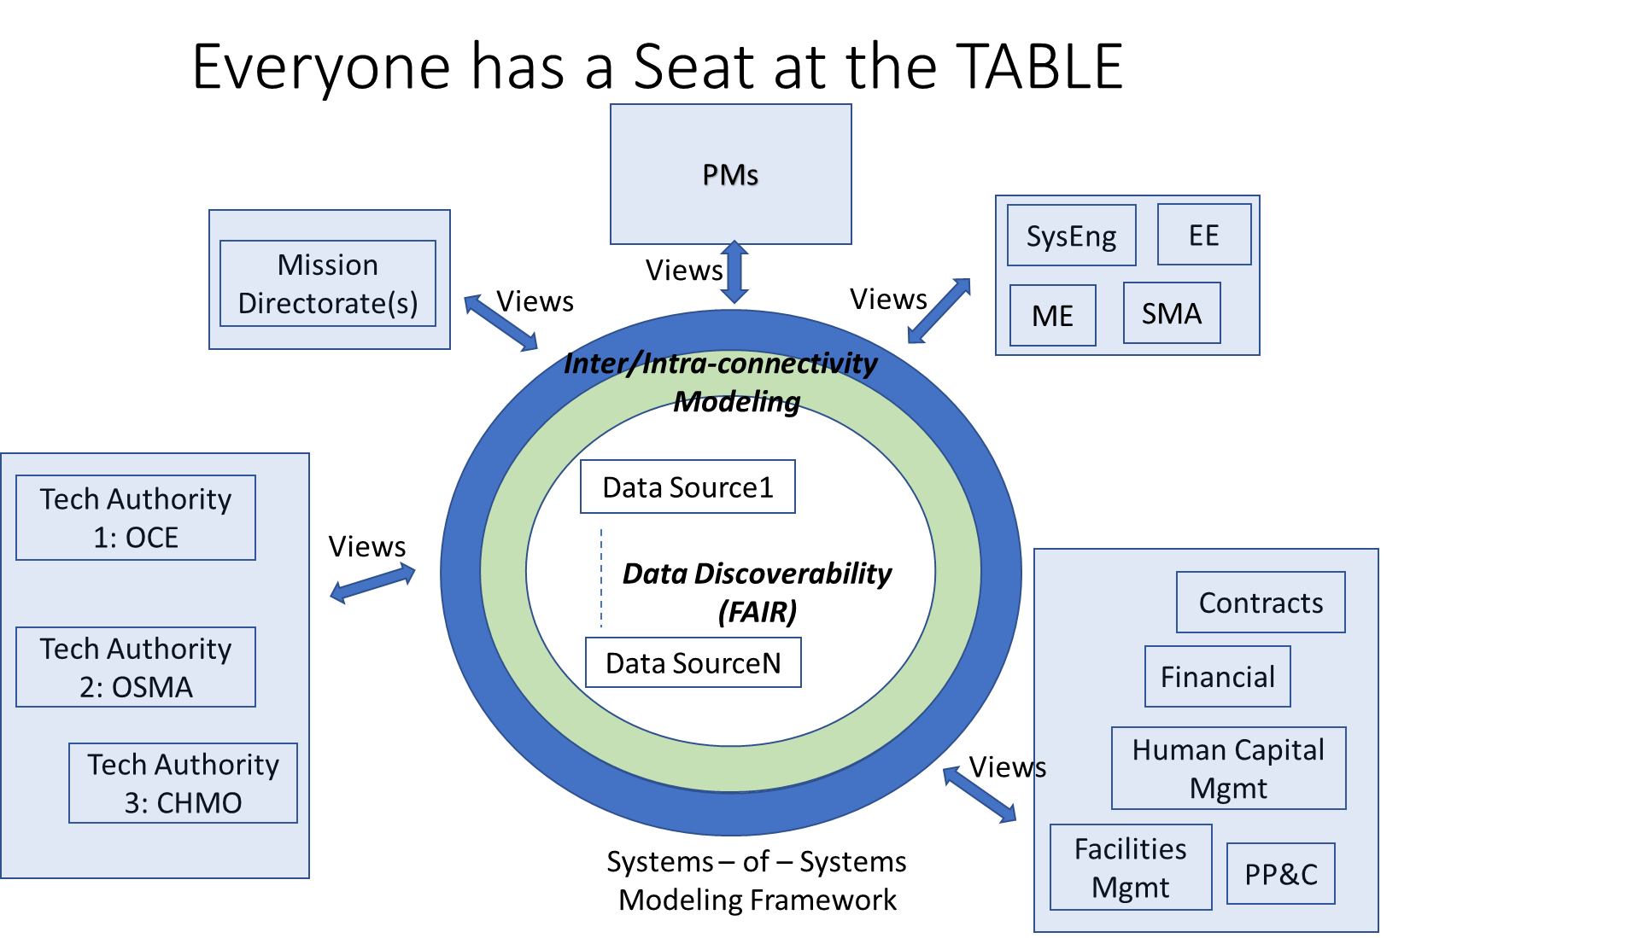
Interoperability
National Aeronautics and Space Administration
www.nasa.gov
Authoritative Source of Truth
Mission MissMission Assurance Standards and Capabilities Division
OSMA HQ-GD000
Notes:
The third point I want to me is the NASA and OSMA have embraced the concepted of Interoperability build upon Data-Centric and Model-Based methods. While many of you have probably heard of Digital Engineering or MBSE, Oother Project and/or Mission Development entities such SMA (Click) need to part of this framework.
At the Fundamental Data level, we are in pursuit of the FAIR principle. Making our data Findable, Accessible, Interoperable, and Reusable (i.e. FAIR)
At the next level up, we are in pursuit of Model-Based methods (i.e., inter/intra-connectivity Modeling) to connect data from different processes to different output products to the custom views needed by different customers/stakeholders as part of an Interoperable Enterprise Environment.

Slide 7
Conditions “ripe” for transformational change
Notes:
The final point, which I hope is becoming clear, is that the conditions are right to enable the transformations needed to do our business (e.g., Space Flight, Oil Drilling, etc), which includes Safety and Mission Success related activities…….
In NASA’s case, for example , read first line (this statements applies to not only technological developments, but also to the complex partnerships we’re forming with Industry (e.g., Space-X, Blue-Origin), International Partners, etc.
And so and so on…..

Slide 8
OSMA’s adoption of a
Transformative Vision built upon
Data and Model-Centric principles and technologies
National Aeronautics and Space Administration
www.nasa.gov
Mission MissMission Assurance Standards and Capabilities Division
OSMA HQ-GD000
Notes:
Quick Transition Page – So with this confluence of conditions, NASA OSMA is embracing a number of foundational principles and technological advances to transform what we do!

Slide 9
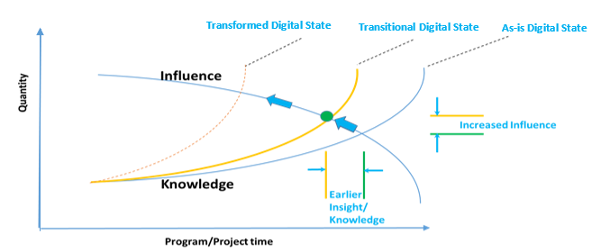
Knowledge vs Influence Curve
SMA Impact on “Critical Decision Making”
National Aeronautics and Space Administration
www.nasa.gov
Mission MissMission Assurance Standards and Capabilities Division
OSMA HQ-GD000
Notes:
At the heart of OSMA’s Transformation Vision is the need to eliminate the N – 1 problem. What do I mean by that…..
People often say that many Catastrophes or Near-Catastrophes could have been eliminated if there was earlier and more robust delivery of key reliability/ safety/ risk / hazard related knowledge to Decision-Makers. My experience in the Safety & Reliability realm is that our delivery of relevant information is often lagging that of design or systems engineering to enable the best or optimal decisions. For example.
Could the issues or human threatening conditions encountered by ISS’s Astronaut Parmitano (i.e., when his Helmet filled up with water in space) have been avoided. As another example,
On a more common basis, could many of the mission cost over-runs experience have been avoided by having earlier access to supply chain issues, poor quality indicators, reliable reliability estimate characterizations or the lack there-of, etc.

Slide 10

Evolving SMA Digital Transformation (DT) and MBMA Roadmap
Transform Critical
Decision Making and Risk Acceptance
1. Increased Decision Velocity,
2. Risk Integration and Robust Contextualization
3. Maximize Efficiency
APPG – AC
Assisted AIM/
SMAP
Insight Mgmt
Focus Area 1: Product Evolution
Logic
Fragments
APPG-AIM/SMAP
SPARTA
ASOT/Data
EDP
Actionable Policy Templates
Augmented Engineering
Agency Data/
Process Model
APPG-HQA/R&M
Integrated
SMS Framework
DT Training
Data and Tools
SMA GSN/AC Integration
Semantic Integration
SMA Data/Process Model
AC Pilots
OMG/RAAML
8705
Acronyms
SMA Data Steward
APPEL Updates
AC = Assurance/Safety Case
AIM = Assurance Implementation matrix
ANASWA=R&M Logic Fragment Engine
APPG = Automated Program Plan Generator
C&C = NSC Content and Collaboration Project
CRM = Continuous Risk Management
DT = Digital Transformation
EDP – Enterprise Data Platform
FAIR = Findable, Assessable, Interoperable and Reusable
FMEA=Failure Modes Effects Analysis
FTA=Fault Tree Analysis
GSN = Goal Structuring Notation
HQA = Hardware Quality Assurance
MB = Model-Based
MBMA+ = Model-Based Safety and Mission Assurance
RAAML = Risk Assessment and Modeling Language
RIDM = Risk Informed Decision Making
SMA = Safety and Mission Assurance
SMAP = SMA Plan
SPARTA=Smart Project and Reviews with Transformative Analytics (SPARTA)
Focus Area 2: Domain Representation, Digital Twin/Thread
SMA Tool Survey
Data/Process Integration
8705.2/.4
NASA C&C
8705.X
MBMA+ Advisory Board
Goals and Processes
8705.4A (AIM)
Publications
SATERN/APPEL
Human/Paper Integration
8729.1A (GSN)
Focus Area 3: Policy Evolution
SMA/DT Virtual
Collaboration Team
SMA Champion
LEGEND
APPEL Training
Completed
Culture
Focus Area 4: Outreach and Training
SMA-2022/23 InProgress
SMA- 2023 Start
DT-In Progress
Research Needed
MASTER 4.15.22
Notes:
Another other key element is translating our Vision (elimination of the N-1 problem) into a Series of the Top Level Transformational Goals (read…_), from which a Digital Transformation Roadmap can be developed.
Our NASA SMA Roadmap is built around 4 evolutionary paths (i.e.,x,x,x,x), all leading to the transformational outcomes being sought.
As Yogi Berra once said, if you…….., you may end up somewhere else.

Slide 11
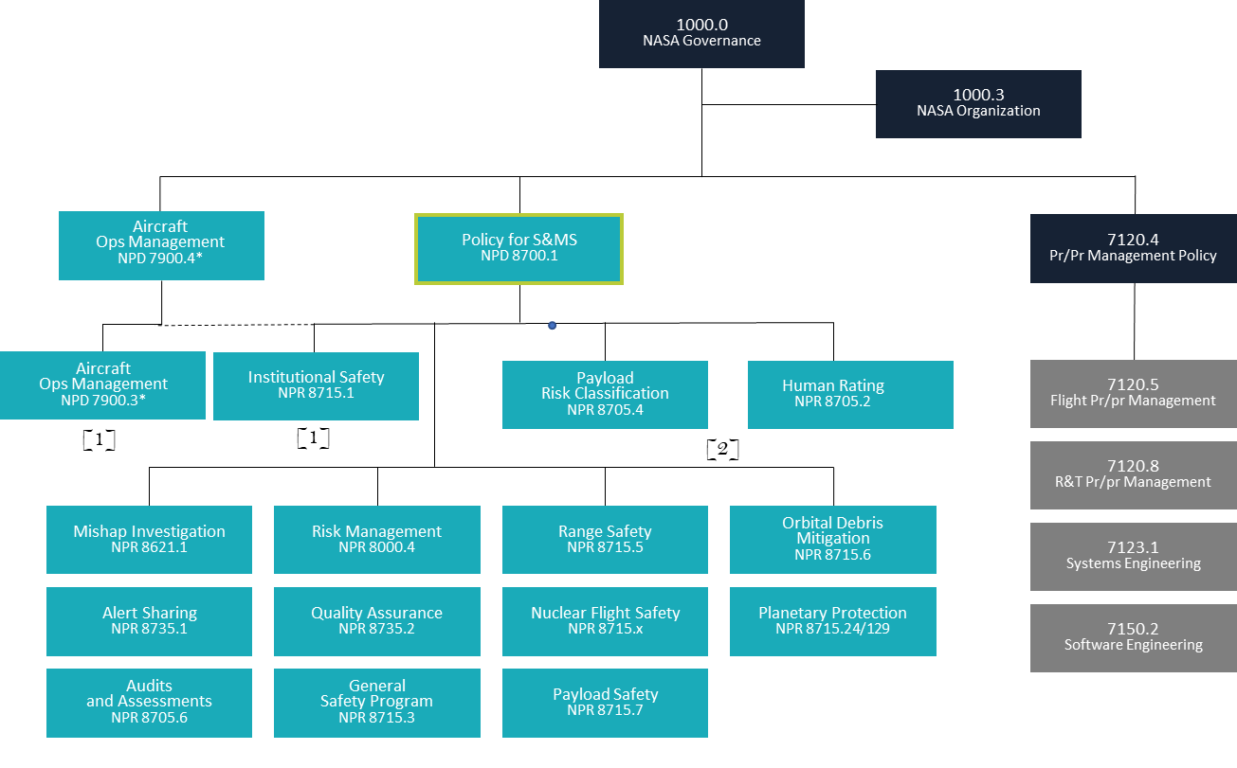
Policy Enabled Objectives Hierarchy
On-Ramp for SMA Interoperability
SMA’s Policies and STDs
SMA’s Objectives Hierarchy
8700
Obj 1
Obj 2
Obj 3
8705.4
8705.2
Obj 1 ………………………. Obj N
Obj 1 ………………………. Obj N
Correlating to the related SMA Discipline Areas
(e.g., 8705.4A Appendix D , NPR 8705.2, HEOMD-003, others)
Supporting STDs and NPRs
STD 1 ……………… STD 2 ……………………… STD 3 …………………STD N
Obj 1 … Obj N
Obj 1 … Obj N
Obj 1 … Obj N
Obj 1 … Obj N
SMA STANDARDS
Activities and Supporting Evidence
Activity 1 …………………………………………………………………………………………………Activity N
Notes:
Finally, I want to highlight foundation element starting with NPD 8700, and it 3 Top OSMA Objectives, and the Objectives Hierarchy that follow to build an Interoperable Environment for SMA.
This Hierarchical Structure is being used to build an SMA Framework from which information can be digitally integrated and interconnected with other domains (Project Management, Design Engineering, Systems Engineering, etc) using an Objectives-Based Ontology for SMA.
The Top 3 8700 objectives (CLICK) are decomposed into the objectives laid out in Appendix D of NPR 8705.4 (which are being expanded as part of Rev B) for Uncrewed missions and those that will be laid out in NPR 8705.2 for Human Rated missions
CLICK – These objectives are then decomposed into supporting NPRs and STDs addressing the different SMA discipline areas
CLICK – And These objectives are then decomposed into any lower-level objectives and/or supporting evidence, and so –on and so –on as applicable.

Slide 12
SMA Transformational Activities and
Emerging Benefits
National Aeronautics and Space Administration
www.nasa.gov
Mission MissMission Assurance Standards and Capabilities Division
OSMA HQ-GD000
Notes:
Quick Transition Page

Slide 13
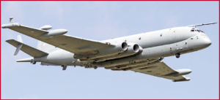
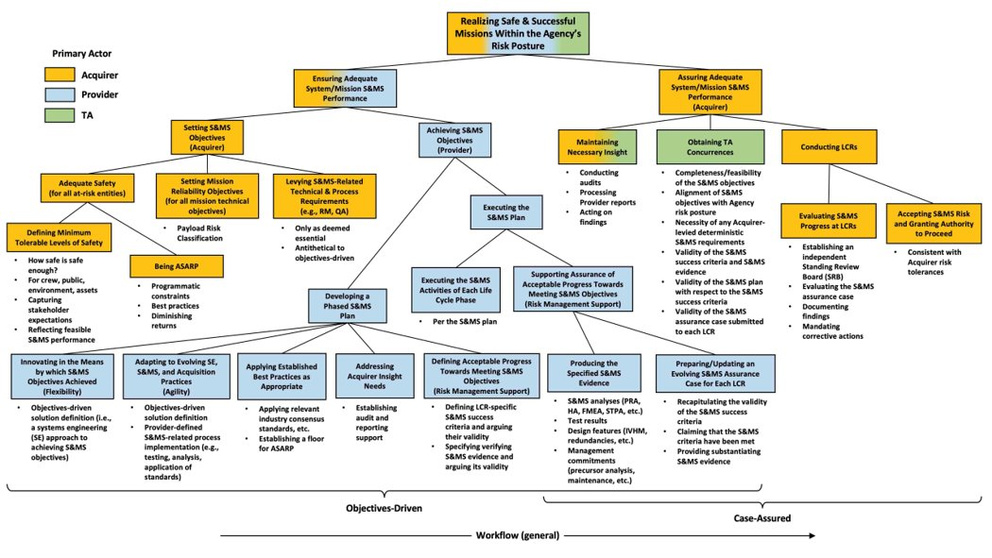
Objectives-Driven Hierarchy
An Assurance Case is an organized argument that a system is acceptable for its intended use with respect to specified concerns
“The Nimrod Safety Case represented the best opportunity to capture the serious design flaws …which had lain dormant for years. If the Nimrod Safety Case had been drawn up with proper skill, care, and attention, the catastrophic fire risks …,
They contrast with “prescriptive” requirements (must do X, Y, Z)
Argument
Objectives
would have been identified and dealt with, and the loss of XV230 in September 2006 would have been avoided”²
Activities
Evidence
Assurance Cases, starting from Objective Hierarchies, enable our “transformed” SMA Framework
Notes:
And the The Good news!! – is that a complete Objectives Hierarchical Framework provides the key elements of what is needed for an Assurance Case and our emerging SMS Assurance Framework
Consider Checklist
graphic

Slide 14
Definitions and Shaping Concepts
Safety Case (reference Wikipedia) – A structured argument, supported by evidence, intended to justify that a system is acceptable safe for a specific application in a specific operating environment.
NASA System Safety Handbook- Vol 1 (2011), (H. Dezfuli et al) – “The safety case concept has also been extended to apply to additional system attributes beyond just safety, resulting in “Assurance Cases” and “Dependability Cases”
Assurance Case (reference “A Short Introduction to Assurance Cases, University of York, 2013) – A reasoned and compelling argument, supported by a body of evidence, that a System, Service, or organization will operate as intended for a defined application in a defined environment.
New Tool for Developing Safety Assurance Case Arguments (OSMA Article, 2020), (Ewen Denny and Ganesh Pai/ARC’s KBR Wyle Services) –
“Traditionally, a safety case is a static thing,” said Denney. “But really, what it should be is an active document you use to govern your activities, so you update it when you learn more about your hazards and the effectiveness of your mitigations and so on”
“The structured arguments are given in a graphical notation called Goal Structuring Notation (GSN), which has elements for capturing claims, reasoning strategies, evidence and contextual information. GSN-based arguments have close connections to the objective hierarchy's approach promulgated by NASA’s Office of Safety and Mission Assurance.”
“AdvoCATE [an ARC developed Tool] connects all the pieces. It provides hazard analysis and risk assessment, safety and assurance requirements, structured argument development, safety architecture and development, traceability and consistency, and evidence management and analytics through dashboards.”

Slide 15
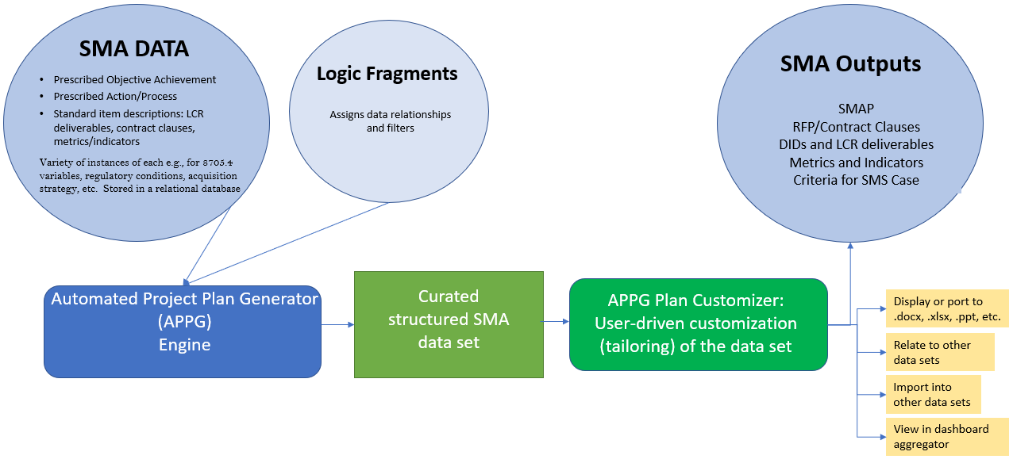
Automated Project Plan Generator (APPG) Engine
Repeatable, SME-curated, OSMA-endorsed recommendations on demand
OJT: Learn as tool is used
Project experts have direct access to editing (tailoring) capability.
Project personnel only spend time tailoring, not building content from the ground up.
Authoritative Source traceable to OSMA Policy
Back-end analysis of data sets for improvements, trends, risk awareness
Data architecture can be expanded over time: attach templates, related policy statement*, etc.
Content held as a data set. Can be related to other data sets and support analytics.

Slide 16
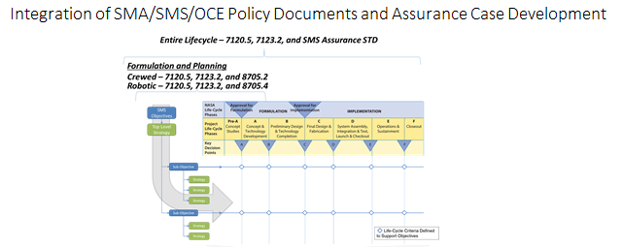
Definitions and Shaping Concepts
SMA Digital Future – Objectives Hierarchy/Assurance Case Framework
Objectives Hierarchy
Objective Driven Reqts &
Accepted STDs
APPG SMA Plan Generation
(part of Project Plan)
INITIAL Assurance Case Argument
OPERATIONAL Assurance
Case
Design Assurance Case
I&T Assurance Case
Implementation Assurance Case
Assurance Case Evolution
Notes:
When combine…..Click for Circles….we create a framework to measure and track progress toward meeting Objectives around a Safe and Successful mission over the project life cycle.

Slide 17



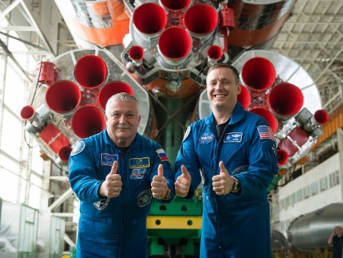
National Aeronautics and Space Administration
www.nasa.gov
Data Survey/ Data Interconnectivity
Data Types
Data Locations
Robust Information for Decision Making
Communicate Risks of Failure
Identify/
Connect/
Integrate
FMECA/FMEA
FTA
On-Orbit
GRound.Testing
Supplier
Other
?
NAS
Industry
Other Govt Agencies
Data Service Companies
In the 2020
e.g., the R&M Data Survey revealed that there are many failure mode and other data sources for analysts to leverage.
Traditional Analyses still depend greatly on robustness and depth of information available
With Current State data structures these data are virtually impossible to individually digest given desired response times
Mission Assurance Standards and Capabilities Division
OSMA HQ-GD000
Notes:
Ad hoc state was the motivation for developing a digital dictionary
Why are we talking about data mining? To use the best knowledge to support projects. But individual data mining is effectively impossible since
Access to Data Sources hard to acquire
Data spread out among many different Sources
Sources may or may not have usable Data
No standard framework or ontology
Making SMA work analyst dependent not analyst agnostic.
This Photo by Unknown Author is licensed under CC BY-NC-ND
This Photo by Unknown Author is licensed under CC BY-NC
This Photo by Unknown Author is licensed under CC BY-SA-NC
This Photo by Unknown Author is licensed under CC BY-SA-NC
Blue circle indicates now at best and the challenge

Slide 18
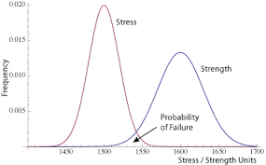
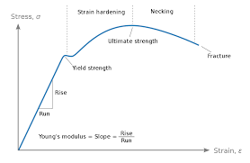
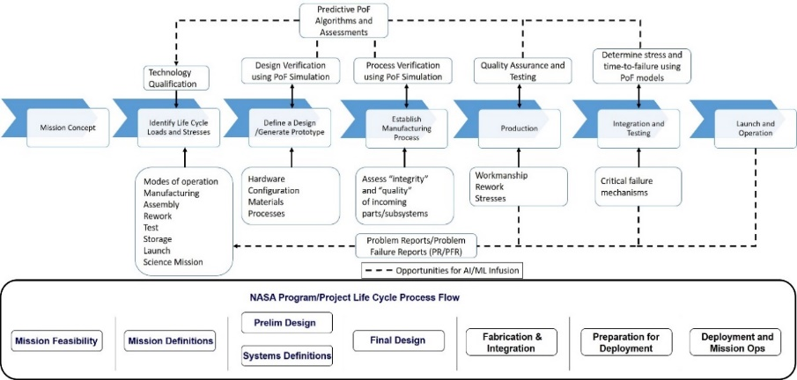
National Aeronautics and Space Administration
www.nasa.gov
Physics of Failure (PoF) framework
Past
Data Access
AI/ML Infusion
Advanced Multi-Physics
QMU
Computing Power (HEC)
Full Digital Utilization
Future
Adhoc
Digital Enabled Analysis/Performance Interoperable Environments/Models
Digital Handbooks/
Guidance
SMA Requirements and Plans
QA Inspection Criteria
Hazard
Analyses
R&M Analyses (FTA, FMECA, PRA & CILs)
Today
Application Framework(s)
Integrated Body of Knowledge
Mission Assurance Standards and Capabilities Division
OSMA HQ-GD000
Notes:
Emphasize the importance of reliability engineering's role in developing the likelihood of success/failure in assessing risk. with that, the focus our PoF efforts has been bridge the interconnective between Probability estimates and PoF analysis.
In the past, much of our reliability and PoF activities have been adhoc in nature, whether doing empirical Strength vs Stress statistical analysis, deterministic fatigue analysis, or doing PoF related simulations through an engineering tool/platform.
Today, from a Reliability perspective, we are moving the ball forward with developing an integrated body of knowledge and application frameworks to support advanced and consistent Reliability support of mission throughout their life cycle. For example, we have developed an RMA knowledge portal and we are continually expanding our training and method advancement knowledge sharing via frameworks (PMD, PoF. Maintainability). This is allowing Reliability to raise the knowledge curve and push it to the left .
Tomorrow, our evolutionary vision is that of Full Digital Utilization!!! Many of you have probably heard about the evolving DT principles and applications being applied across associated with making our DATA/Knowledge F.A.I.R and linking necessary requirements, processes, data, and products together using Model-Based tools and methods, it is with these DT activities that we can begin building digital threads between PoF analysis describing and predicting how items can fail and corresponding analysis products such as FTA or FMEA/FMECA/CILs, which provide decision makers with necessary information when decided whether to accept or continue mitigating failure risks to Mission Success or Safety. Furthermore, with FULL digital utilization, whether it is access to Orders of Magnitude more data than ever before through use of sensor or other means, or Order of Magnitude improvements to our computing power and speed (including High End Computing (HEC)), we have real opportunities to utilize Model-based engineering and AI/ML and other advancements as part of our day-to-day applications. This will allow Reliability and SMA to raise the knowledge curve and further to the left .
Reliability is not waiting for full digital transformation begin transforming. We are already creating and providing Digital Handbooks and Guidance (emboldened text) to practitioners and stakeholders. One of these efforts has been the conversion of the PoF body of knowledge into a NASA handbook, which is available digitally and provides a potential common window/portal to access needed information for particular PoF applications. It is this Digital window that provides the basis for a new NASA framework to continually build our PoF body of knowledge complete with actual use-case examples across the NASA life cycle. At this time, I just want to emphasize how excited we are share this work with both the SMA and Engineering communities as part of today’s meeting. Collectively, we have a tremendous opportunity to bring both best practices and evolving PoF tools/applications/methods together to match Needs across all of NASA’s lifecycle applications. I know myself, Nancy, and her team are very excited to work with you and others on this effort.
Keeping these opportunities in mind, I am excited to turn the mic over to Nancy who will share the work done by there team in developing the PoF Handbook and basis for our evolving NASA PoF application framework……
References:
[1] Infusing Big Data as part of a NEW Physics of Failure (PoF) Framework, Anthony DiVenti, Bhanu Sood PhD, & Prince Kalia, NASA, Doug Sheldon PhD, NASA JPL, California Institute of Technology

Slide 19
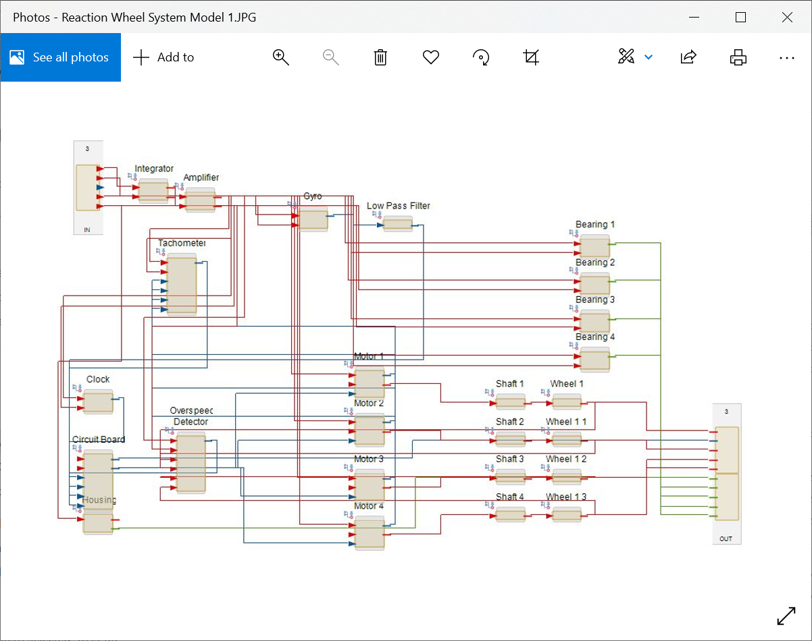
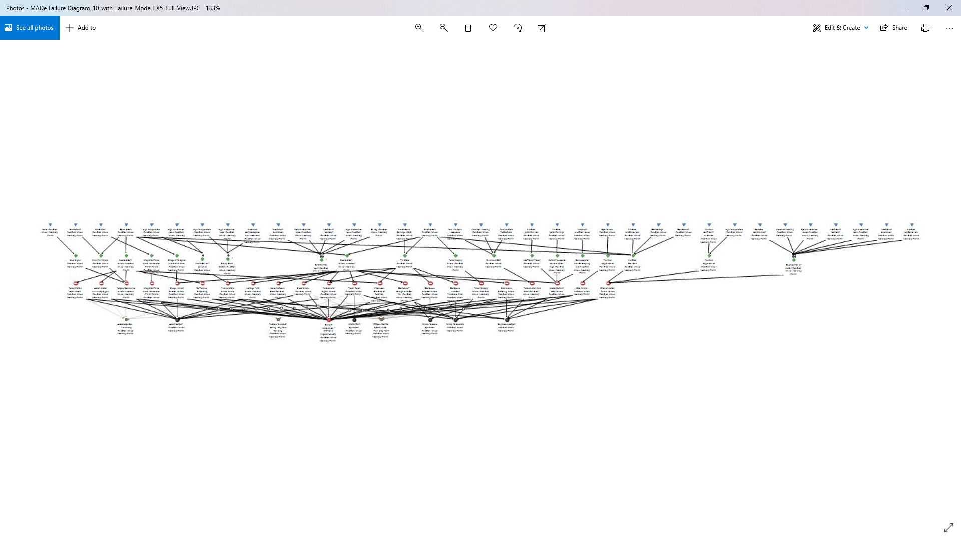

National Aeronautics and Space Administration
www.nasa.gov
MB Integration/Risk Informed Decision Making
SMA Factors
Mission Risk Mgt
Optimized Design/Ops for the Mission
e.g., RMA - Perform Model-Based Failure Analyses
Communicate Risks of Failure
Design &
ConOp
Refinement,
Go / No-Go,
Etc.
FMECA/FMEA
FTA
Etc.
Manage
Mitigate
Track
Etc.
Digital
Example
Model-Based RMA Analyses can leverage NASA-wide Knowledge for potential failure postulation. Analyses are timelier, sync’d with SEs/Engineering more, and have greater influence on missions.
Digital Dictionaries can be used to create Model-Based Libraries of NASA components and/or other information.
With libraries of NASA Components in Model-based tools Failure Modes (mechanisms, causes, local effects) can be automatically populate for consideration.
Mission Assurance Standards and Capabilities Division
OSMA HQ-GD000
Notes:
Status? In work… Prototyping
Work to be Done? Define how and what other modeling tools or RMA Tools need to ingest library information.
Observations so far –
Have Already collected significant amount of Data for use MB-applications; importing is possible.
Can already create large scale models of Spacecraft Systems, Subsystems, and Components effectively/efficiently with libraries.
These models will be a “Single Source of Truth” and the final product of this work
Blue Star indicates what could be with full MBMA enabled tools
Modeling picture courtesy of GSFC MBSMAI Team
This Photo by Unknown Author is licensed under CC BY-NC-ND
This Photo by Unknown Author is licensed under CC BY-NC
This Photo by Unknown Author is licensed under CC BY-SA-NC
This Photo by Unknown Author is licensed under CC BY-SA-NC

