Slide 1
Risk-Informed Process for Evaluations Expansion and Use Antonios M. Zoulis
PSAM16
16th International Probabilistic Safety Assessment and
Management Conference
Honolulu, HI
June 27 – July 1, 2022

Slide 2
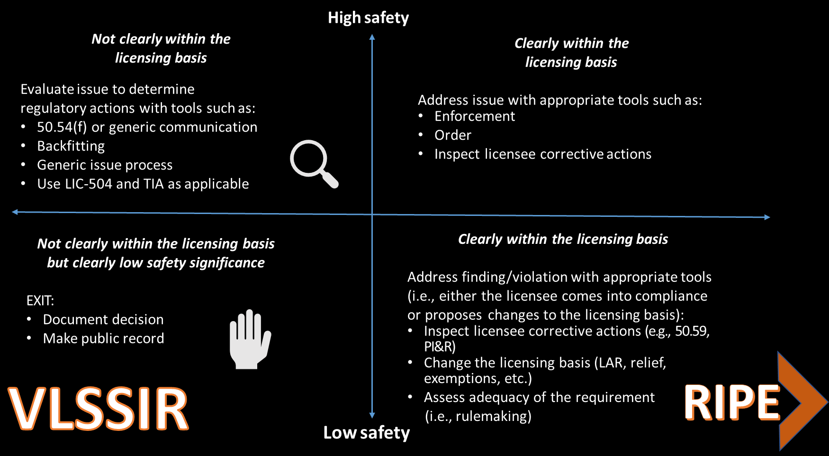
Map of Universe of Issues

Slide 3
Leverage Existing Regulations & Processes
IDP
PRA
RIPE
(using existing regulations)
Integrated Decision-making Panel (IDP) Reviews Key Engineering Principles
Demonstrated Probabilistic Risk Assessment (PRA) Acceptability

Slide 4
Implementation of RIPE
Define licensing issue
Evaluate using IDP and assess plant-specific risk
Assess cumulative risk
Identify risk management actions as necessary
Licensee Actions
Request via streamlined
licensing process
Review and Approval

Slide 5
Safety Impact Characterization
Consider risk management actions
Assess the cumulative risk
Is the risk impact minimal?
Characterize the issue as having a minimal safety impact
All of the following must apply to characterize an issue as having a minimal safety impact:
ΔCDF less than 1 x 10⁻⁷ / year.
ΔLERF less than 1 x 10⁻⁸ / year.
The issue screens to no impact or minimal impact using the screening questions.
Cumulative risk is acceptable.
Characterize the issue as having a more than minimal safety impact
Notes:
The plant IDP reviews the issue until it has confidence that the safety impact characterization results would not change if additional information was obtained or developed.
Next, RMAs are considered for any issues that have a minimal safety impact. However, the impacts of RMAs may not included be in the quantitative risk results.
Then, the cumulative risk impact is evaluated based on the plant-specific baseline core damage frequency (CDF) and large early release frequency (LERF) once the proposed change is incorporated.
All of the following must apply in order to characterize an issue as having a minimal safety impact that can submitted to the NRC for a streamlined RIPE review:
The issue contributes less than 1 x 10⁻⁷/year to CDF.
The issue contributes less than 1 x 10⁻⁸/year to LERF.
The issue screens to no impact or minimal impact using the screening questions.
Cumulative risk is acceptable.
If the issue can be characterized as having a minimal safety impact, it can be submitted for a RIPE streamlined review.

Slide 6
Expansion of RIPE
TSTF-425 Surveillance Frequency Control Program
Technical Specifications

Slide 7
PRA Acceptability
50.69 & TSTF 505
IDP Equivalent and TSTF-505
TSTF-425
Streamline Review – No review of PRA or deterministic review
Streamline Review – Must demonstrate very few, or no, open F&Os and previously reviewed PRA for external events

Slide 8
Application of RIPE
First RIPE exemption request for review January 2021​
Exemption from 10 CFR 50.62(c)(1) (ATWS Rule)
The ATWS Rule includes the following three requirements in 50.62(c): (1) the diverse auxiliary feedwater actuation, (2) diverse turbine trip, (3) diverse reactor scram as well as the existing safety related actuation of Auxiliary Feedwater System and the reactor protection system reactor/turbine trip under the conditions of an ATWS
The RIPE submittal requested a partial exemption to eliminate the Diverse Auxiliary Feedwater Actuation System requirement only
Acceptance review did require request for clarifying information
SE completed and issued on March 23, 2022, within 8½ weeks

Slide 9
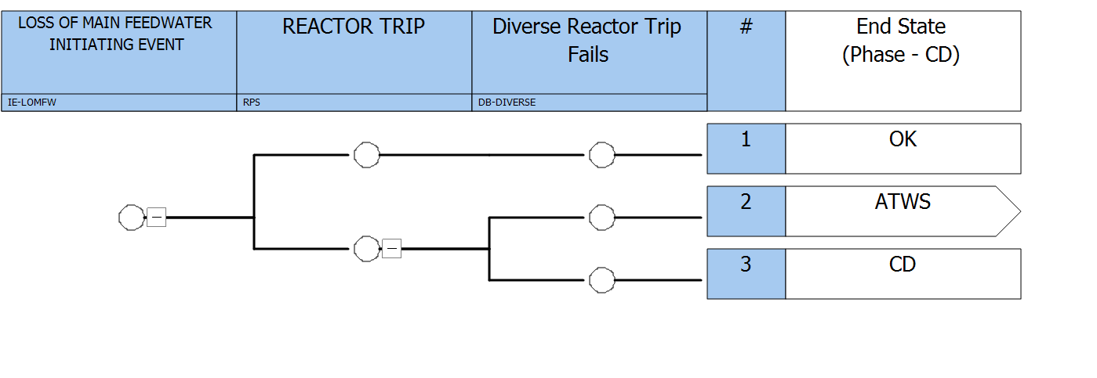
Application of RIPE
Notes:
The resultant core damage frequency (CDF) for this scenario is approximately 1E-10 per year. This assumed no other mitigating actions such as emergency boratian or other actions that could mitigate the consequences of the accident but would not preclude core damage.
The resultant core damage probability, assuming failure of the reactor protection system, successful actuation of the diverse reactor trip system, and failure of the operators to actuate auxiliary feedwater system given the failure of the automatic system, was approximately 8E-11 CDF/year

Slide 10
Application of RIPE - Timeline
1st Pre-Submittal Meeting
Sept 2021
NRC Staff Observation of IDP
Sept 2021
2nd Pre-Submittal Meeting
Nov 2021
Application Received
Jan 2022
NTO Review Complete / Draft RCIs Submitted
Jan 2022
RCI Responses Received
Feb 2022
Exemption Issued
March 2022
Notes:
Application review from Jan-Mar expended about 100 hours.
Lessons learned feedback session held with PV reviewers in April.

Slide 11
Application of RIPE
Successful Implementation
First-of-a-kind exemption request
Lessons-Learned
Continuous Improvement
RIDM Workshops
Enhanced guidance
~ 100 hours of staff review
Identified Challenges

Slide 12
Lessons-Learned
Lessons Learned
Revise Internal Staff Guidance
Model SE
Internal RIDM Workshops
IDP Observation and Results

Slide 13
Why RIPE?
Focuses NRC and licensee resources on the most safety significant issues
Address low safety significant issues in an efficient and predictable manner
Leverage existing regulations and risk informed initiatives
Incentivize the further development and use of PRA models and risk-informed applications

Slide 14
References
U.S. Nuclear Regulatory Commission. “Expansion Of Risk-Informed Process For Evaluations (Low Safety Significance Issue Resolution Recommendation 5),” (ADAMS Accession No. ML22088A129), (2022).
U.S. Nuclear Regulatory Commission. “NRC Guidelines for Characterizing the Safety Impact of Issues, Rev. 2” (ADAMS Accession No. ML22088A135), (2021).
U.S. Nuclear Regulatory Commission. 2021. “TSG-DORL-2021-01 Rev. 2, NRR Temporary Staff Guidance, Risk-Informed Process for Evaluations,” (ADAMS Accession No. ML22088A136), (2021).
Nuclear Energy Institute. “NEI 04-10, Revision 1, "Risk-Informed Technical Specifications Initiative 5b Risk-Informed Method for Control of Surveillance Frequencies," (ADAMS Accession No. ML071360456), (2007).
RIPE Submittal (ADAMS Accession No. ML22014A415) (2022).
RIPE Exemption and Safety Evaluation (ADAMS Accession No. ML22054A004) (2022).

Slide 16
Acronyms
ATWS – Anticipated Transient without a Scram
CD – Core Damage
CDF – Core Damage Frequency
F&Os – Facts and Observations
LAR – License Amendment Request
LERF – Large Early Release Frequency
NRC – Nuclear Regulatory Commission
NTO – No Technical Objection
PI&R – Problem Identification and Resolution
PRA - Probabilistic Risk Assessment
RCI – Request for Clarifying Information
RIDM – Risk-Informed DecisionMaking
RIPE – Risk-Informed Process for Evaluation
SE –Safety Evaluation
TIA - Task Interface Agreement
TSTF – Technical Specifications Task Force
VLSSIR – Very Low Safety Significance Issue Resolution

