Slide 1
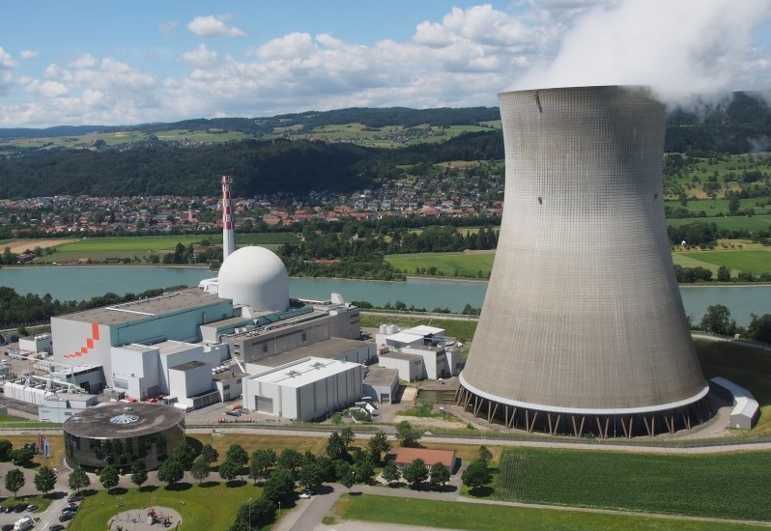
16th Probabilistic Safety Assessment & Management Conference PSAM 16
Honolulu, Hawaii
June 2022
Seismically Induced Internal Fire and Flood (SIFF) Events Assessment at Leibstadt, Switzerland
ID: AL239
Albena Stoyanova
Department of Nuclear Safety, Section ST
Leibstadt Nuclear Power Plant

Slide 2
Outline
PSAM 16
Seismically Induced Internal Fire and Flood (SIFF) Events Assessment
Background
Guidelines and References
Objectives and Scope
SIFF Methodology
Consolidation of Inputs/Outputs
Screening Process and Results
Independent International Peer Review
Summary
Questions

Slide 3
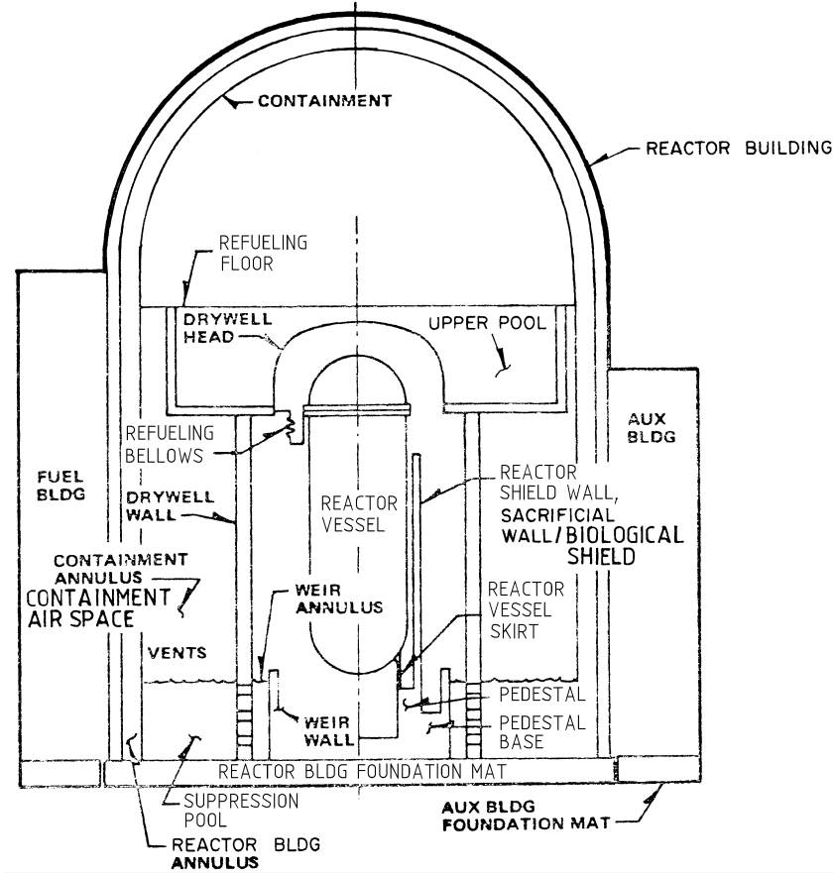
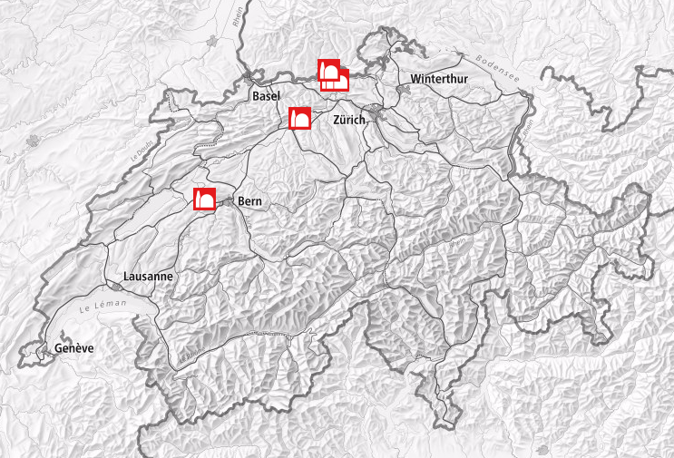
Leibstadt Nuclear Power Plant (KKL)
Located in northern part of Switzerland
General Electric BWR/6 with Mark III Containment
3600 MW_{th} (Net electric output 1233 MW)
Commercial operation since 1984
Containment
Drywell
Folie

Slide 4
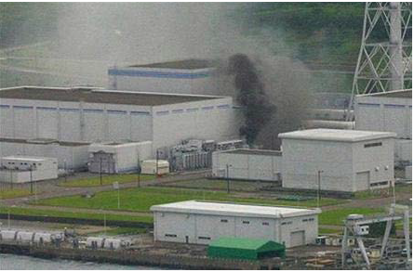
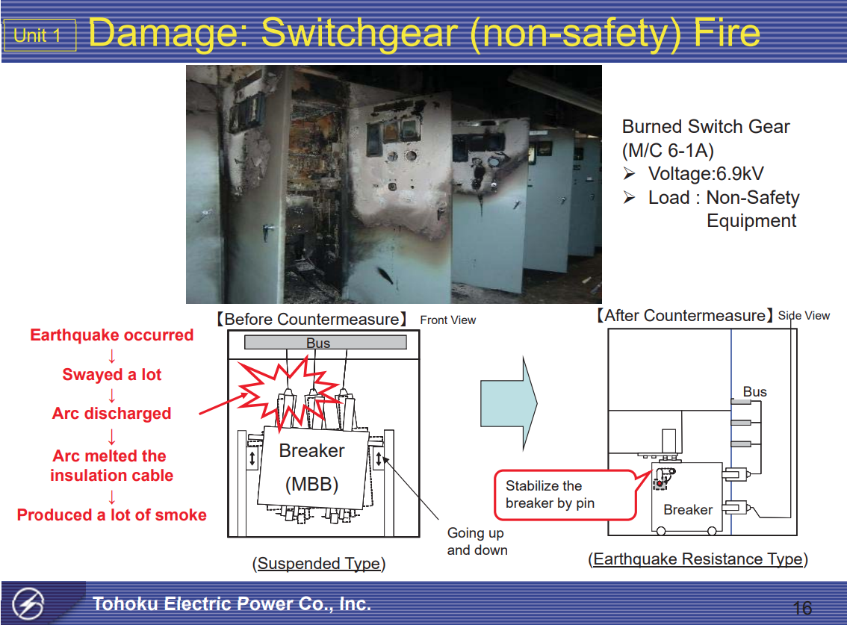
Background
Motives behind SIFF Assessment
SIFF gained greater attention after the following incidents:
  Seismic-induced fire events at Kashiwazaki-Kariwa NPP (2007) and Onagawa NPP (2011)
  Fukushima Daiichi NPP accident, 2011
Recommendations from international organisations to perform SIFF assessment:
  USNRC Near Term Task Force (NTTF)
  Updated code case of ASME PRA Standard
  WENRA Safety Reference Levels
  European (EU) Stress Tests
ENSI also mandated re-evaluation of seismic adequacy of NPPs (including combinational hazards like SIFF).
Electrical transformer fire at Unit 3 of Kashiwazaki-Kariwa, 2007
Fire in Unit 1 of Onagawa NPP in 6.9 kV non-safety switchgear cabinet, 2011

Slide 5
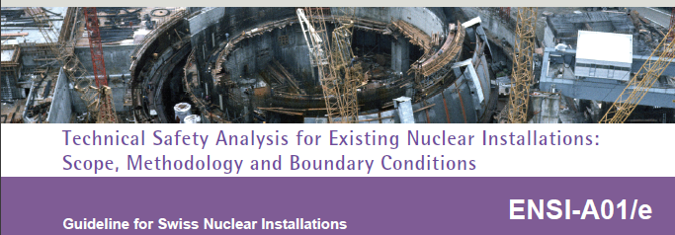
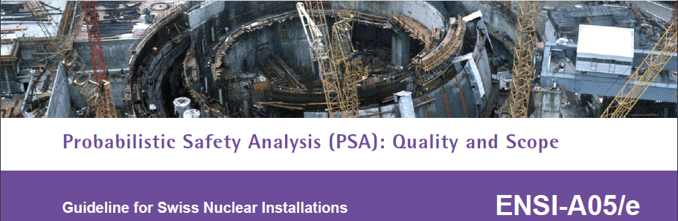
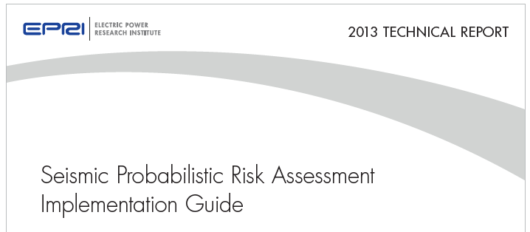
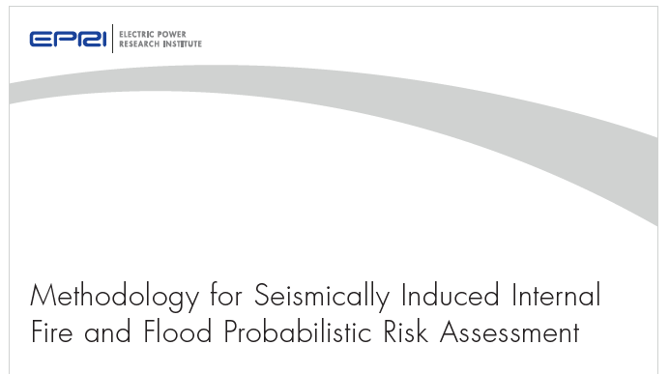
Guidelines and References
  SWISS Regulatory Requirements and Guidelines:
    Deterministic (ENSI-A01)
    Probabilistic (ENSI-A05)
    Seismic (ENSI-AN-8567)
EPRI 3002000709 “Seismic Probabilistic Risk Assessment Implementation Guide”
EPRI 3002012980 “Methodology for Seismically Induced Internal Fire and Flood Probabilistic Risk Assessment”

Slide 6
Objectives and Scope
Development of KKL specific SIFF methodology (based on EPRI method) to address both deterministic and probabilistic perspectives in an integrated manner;
Evaluate the impacts of seismically-induced internal fires / floods;
Analyse the risk from explosive materials and seismic interactions;
Address the radiological concerns associated with SIFF;
Identify plant areas/locations which are risk significant from SIFF perspective at the end of study;
Demonstrate the safe shutdown capability i.e., robustness of seismic safe shutdown paths (deterministic);
Provide a quantitative evaluation of the risk from SIFF (probabilistic).

Slide 7
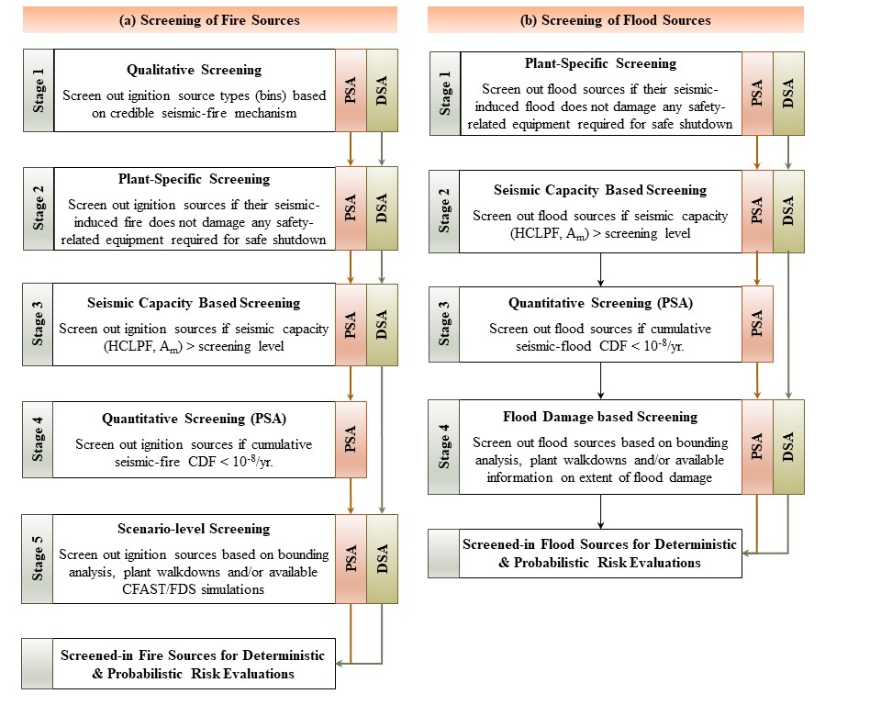
SIFF Methodology - Overview
Application of top-down screening approach with combination of qualitative and quantitative steps, covering both probabilistic and deterministic objectives:
Identification of fire and flood sources using interdisciplinary insights from the latest deterministic and probabilistic safety studies conducted at KKL (seismic, internal fire and internal flooding) and their related databases;
Qualitative screening of ignition sources at bin level with focus on seismically induced ignition mechanism; (this step is not applicable to flood sources screening)
Plant-specific screening with evaluation of potential consequences from each SIFF source;

Slide 8
SIFF Methodology - Overview
Seismic capacity-based screening with comparison of seismic capacities (High Confidence Low Probability of Failure [HCLPF] and Median Capacity [A_{m}] values) of SIFF sources against the defined screening levels:
  Deterministic criteria: HCLPF > 0.35g
  Probabilistic criteria: HCLPF > 1.2g AND A_{m} > 3.0g
Quantitative screening, applicable only to the probabilistic scope with criteria for cumulative seismic-fire/flood CDF <10⁻⁸/yr., (corresponding to less than 1% of plant seismic CDF)
Scenario-level screening, based on bounding analysis, plant walkdown and CFAST/FDS simulations;
Deterministic demonstration of safe shutdown capability and probabilistic evaluation of risk from retained fire / flood sources!

Slide 9
Consolidation of Inputs
Comprehensive lists of fire and flood sources cross-checked with Seismic Equipment List (SEL):
  Fire/flood sources identified in accordance with NUREG and EPRI guidance;
  472 fire compartments with 3900+ fire ignition sources in 34 buidlings (2410 rooms);
  62 flood compartments with 9100+ flood sources in 26 buildings (700 rooms);
  Comparison with 12100+ SSCs in SEL.
  Various generic and plant-specific data: location, oil quantity, power/voltage rating, medium, length/diameter, etc.
  Fire/Flood impacts evaluation and scenario assessment from the recent deterministic and probabilistic internal fire and flood analysis (including analysis of 33000+ cables);
  Walkdown observations and resolutions to address seismic interactions;
  Detailed fragility analysis (HCLPF, A_{m}) from the latest seismic analysis;
  Seismic safety analysis (probabilistic and deterministic);
  Existing studies on explosive materials and their specification sheets;
  Radiological accident analysis related to seismic;
NUREG/CR-6850
NUREG-2169
EPRI-1019194
Fire PSA
239 fire impact files
Flooding PSA
54 flood impact files
1600+ fire scenarios (at-power)
135 flood scenarios (at-power)
10 flood scenarios (shutdown)
2300 fire scenarios (shutdown)

Slide 10
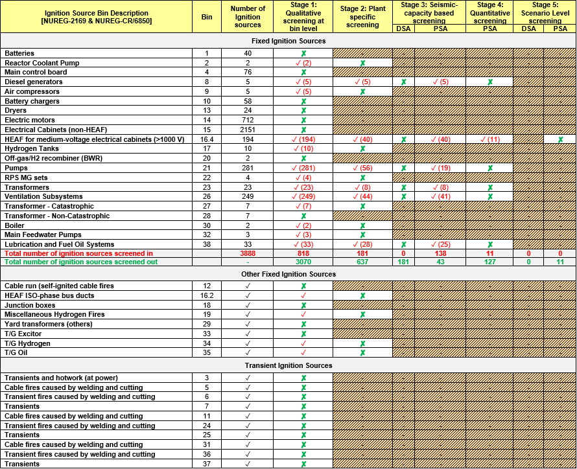
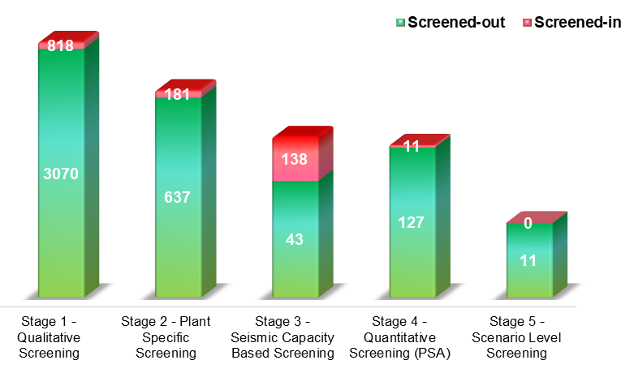

Stage-wise Screening of Fire Ignition Sources (IS)
Some examples of screening:
Batteries, non-HEAF cabinets / transformers, etc. do not have credible seismic-fire mechanism
Air compressors and pumps with oil quantity less than 0.5 gallons or motors rated power < 5 HP
Classified equipment (like emergency DGs) with seismic capacity greater than the screening level
Ignition sources with small zone of influence or low risk significance (i.e., damaging very few targets)

Slide 11
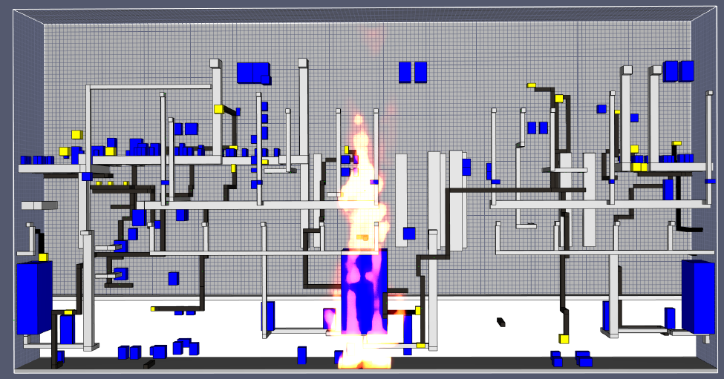
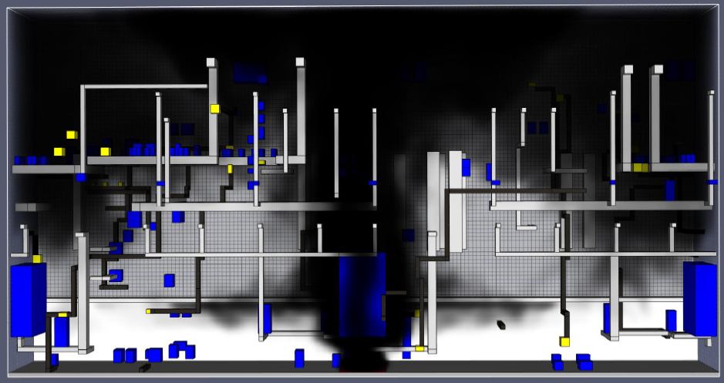
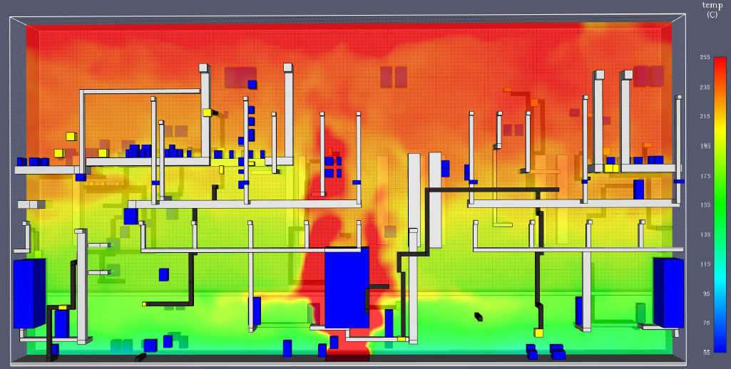
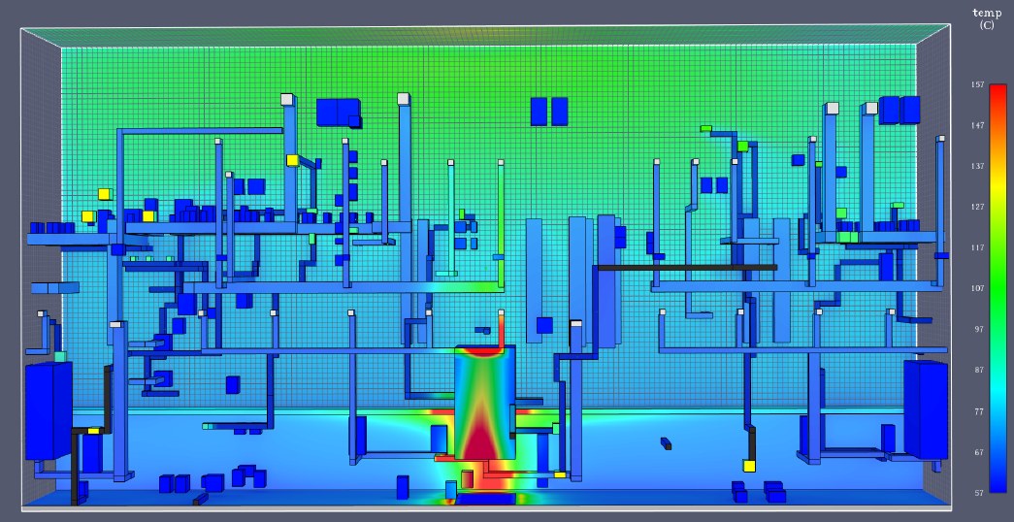
RRS Pump Lube Oil Fire in Drywell – FDS Simulation
270⁰
Drywell Sumps
Drain Channel
180⁰
0⁰
Drain Channel
90⁰
Oil reservoir is inside pump motor casing - hermetically sealed. A hypothetical (worst-case) fire scenario was postulated in drywell.
Spontaneous ignition is not possible if oil spills (ignition temp. of oil is > RRS temp., and oil cooling by the floor surface).
Oil leak flows into the drains to drywell sumps (covered by solid steel plates) → poor burning conditions.
Fire propagation is limited to one sector and damages equipment in the same sector only.

Slide 12
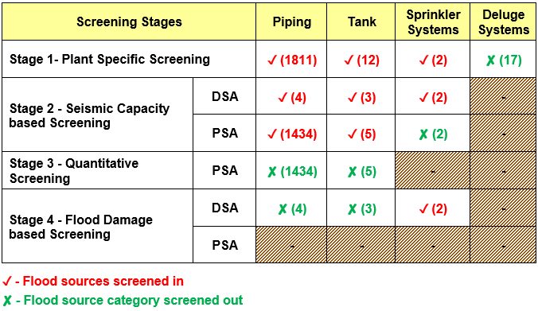
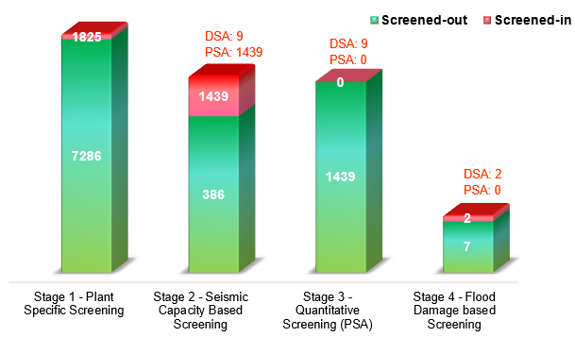
Stage-wise Screening of Flood Sources
Some examples of screening:
Flood sources located in non-safety areas such as MCW building, turbine building, non-safety divisions 10 & 20, etc.
Classified equipment (like primary side piping, tanks, etc.) with seismic capacity greater than the screening level
Flood sources with low risk significance (i.e., damaging very few targets or safety equipment in the vicinity)

Slide 13
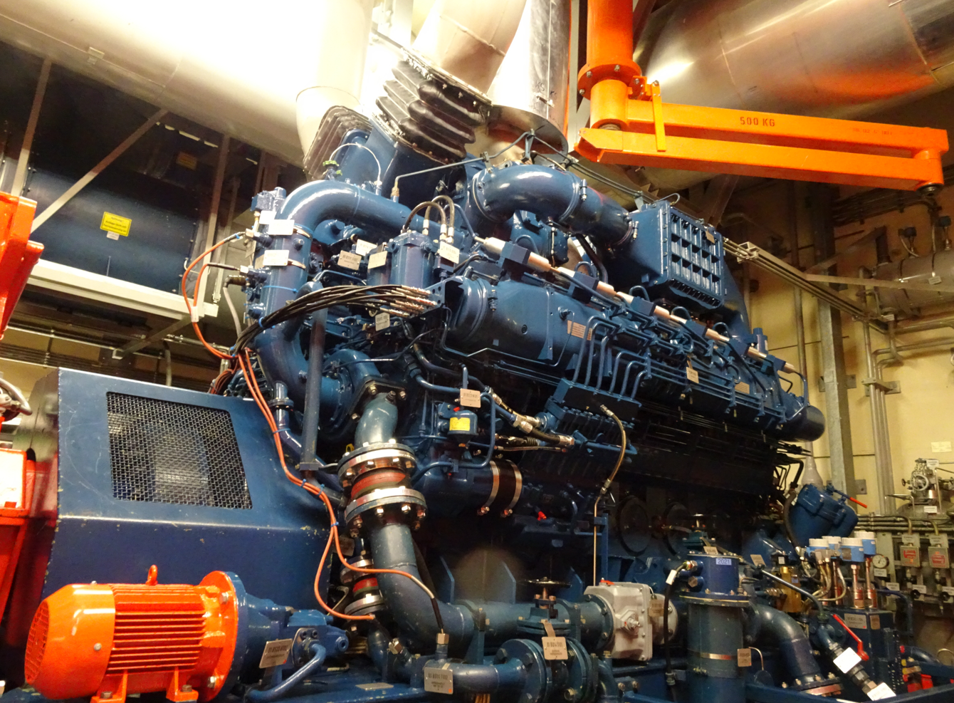
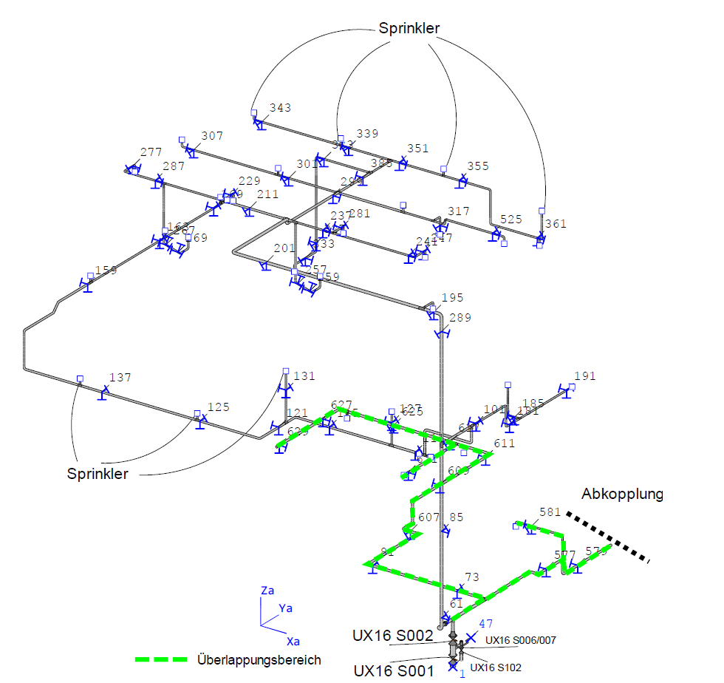
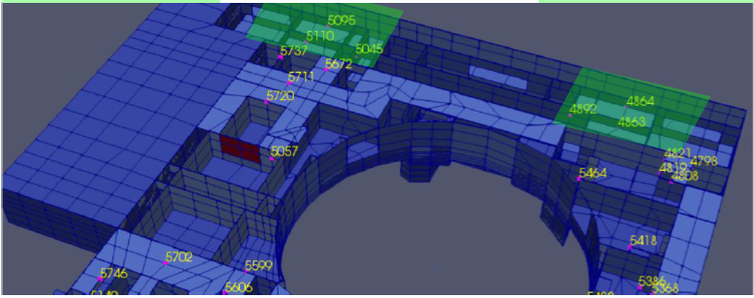
Screened-in SIFF Sources
Only 2 fire sprinklers were screened-in for deterministic evaluation (fragility data unavailable).
Highly hypothetical scenario;
Overall flow rate – Approx. 47-55 m³/hr;
Damages nearby targets via spray mechanism;
KKL conducted dedicated walkdown in the compartment and anchorage calculations for sprinkler supports (to conclude that these will not lead to flooding).
Hypothetically, if these sprinklers were to lead to seismic induced flooding → No impact on the safe shutdown capability of the plant… (multiple shutdown paths available)

Slide 14
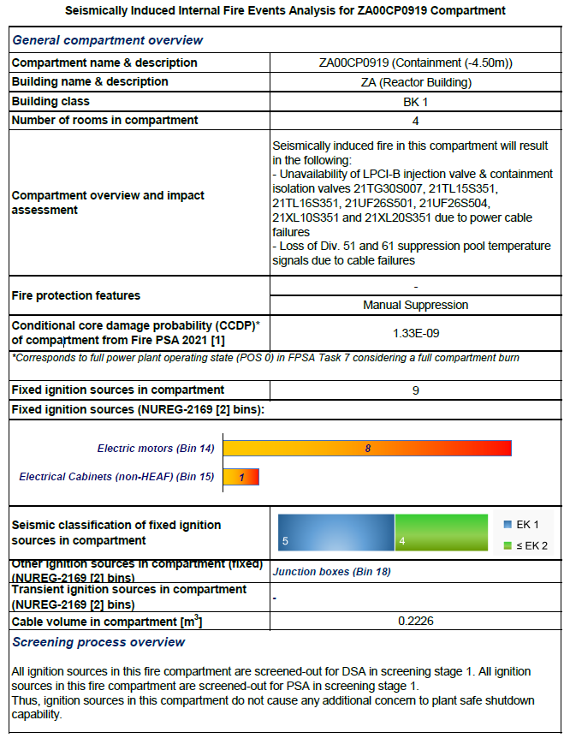
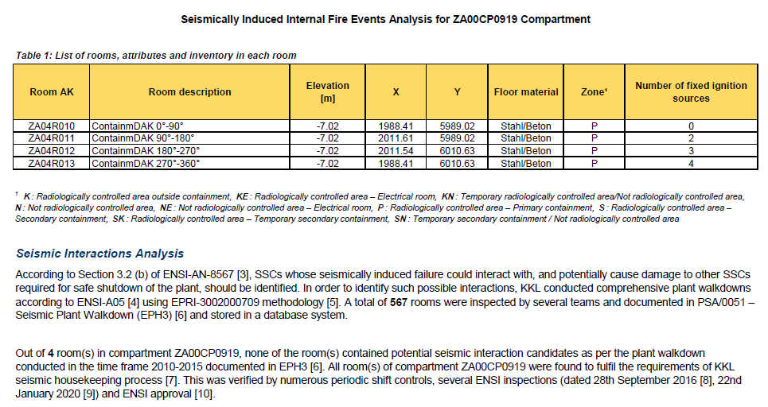

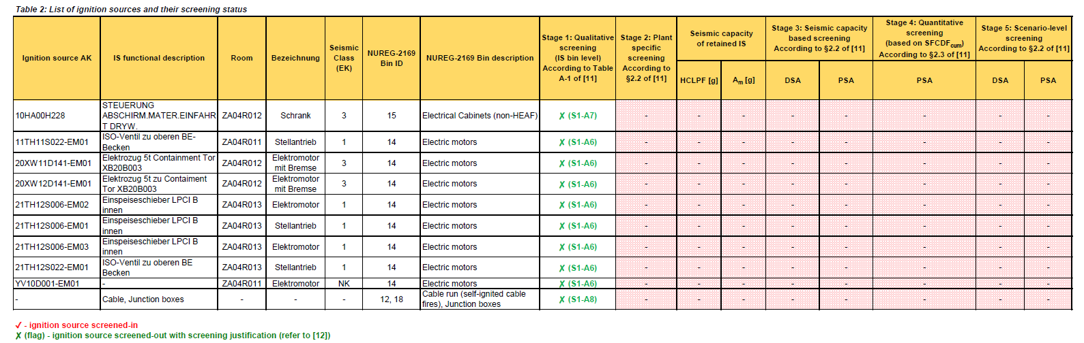
Consolidated Outputs - Compartment-wise Fact Sheets
458 Fire Compartment Fact Sheets
56 Flood Compartment Fact Sheets
  Automated generation of fact sheets using MS Excel (VBA) in-house tool

Slide 15
Analysis of Explosive Materials & Seismic Interactions
Possibility of seismic-induced explosions deemed unlikely based on:
Review of safety, design and operational aspects related to hydrogen trailers, oxygen tanks;
Use of non-combustible materials in the vicinity of valves, pipes, etc.;
Adequate ventilation to prevent formation of ignition mixture;
Leak sniffers to isolate leakages (manual / automatic) and alarms;
Located away (or shielded) from safety buildings.
Seismic interactions:
Potential candidates identified during plant walkdown;
All findings were resolved as per seismic housekeeping practices;
Resolutions for findings verified by ENSI inspections.
Seismic Interactions
Unsupported pipes
Unrestrained cylinders
Unanchored tanks
Non-qualified tables/desks
Weakly supported cable trays

Slide 16



Independent International Peer Review
Objectives of the independent peer review:
Provide technical comments and feedback on the application of EPRI SIFF methodology;
Verify the application of the state-of-art practices;
Verify the validity of results from the screening process;
Provide feedback on latest international experience, statistical data and scientific papers.
Two rounds of independent peer review by experts from:
Jensen Hughes (USA);
TEPCO / TEPSYS / NRRC (Japan).
Study recieved positive feedback from both peer reviews.

Slide 17
Summary
Effective and practical application of SIFF methodology to both deterministic and probabilistic SIFF assessment in KKL.
All fire and flood sources screened out due to:
  no credible seismic-fire/flood failure mode;
  adequate seismic margins;
  low risk-significance.
Negligible risk of SIFF - bounded by overall plant seismic risk.
Remote possibility of seismic-induced explosions from explosive materials based on the existing design and control measures which provide sufficient protection.
All findings related to seismic interactions resolved.
No additional contribution from radiological releases in case of a seismically induced fire or flood to the risk already considered in the radiological analysis of seismic events.

Slide 18

Questions
Multiple Simultaneous Fires and Floods
EPRI 3002012980:
“…multiple seismic induced fires are very unlikely. Even if seismic damage to multiple identical components is assumed to occur, ignitions as a result of seismic damage are considered to be largely independent. Thus, the risk associated with seismically-induced fire damage to components at higher accelerations is expected to be small compared to that associated with direct damage to multiple components from the seismic event alone."
EPRI 3002000709:
"The approach is not intended to reproduce the internal fires PRA and the internal floods PRA with seismically induced versions of fire ignition frequencies and pipe break frequencies and then to apply seismically induced boundary failures and mitigation impacts. Such an approach would be unwieldy, would be a potentially unsolvable problem (that is, probabilistically postulating multiple simultaneous internal fires and/or internal floods as well as probabilistic sets of compartment boundary failures), and would not provide insights commensurate with the effort that would be required."
According to EPRI recommendations, the simultaneous SIFF scenarios in same fire / flood compartment are covered by following conservative assumptions:
  Fire risk is calculated at a fire compartment level with an assumption that fire from an ignition source regardless of its fire potential and location will damage all SSCs (including safety-related SSCs) in the compartment without giving credit to fire suppression means and/or mitigation operator actions.
  Flood risk is calculated at a flood scenario level per flood compartment. The flood scenarios are developed by grouping similar type of pipes located in the same flood compartment that are correlated on certain attributes (system, safety classification, etc.) with worst-case flood consequences - failure of all equipment in this flood compartment. For example, seismically-induced rupture of any pipe in a flood scenario is considered to result in a major flood (out of the three flooding modes: spray, flood and major flood).

Slide 19
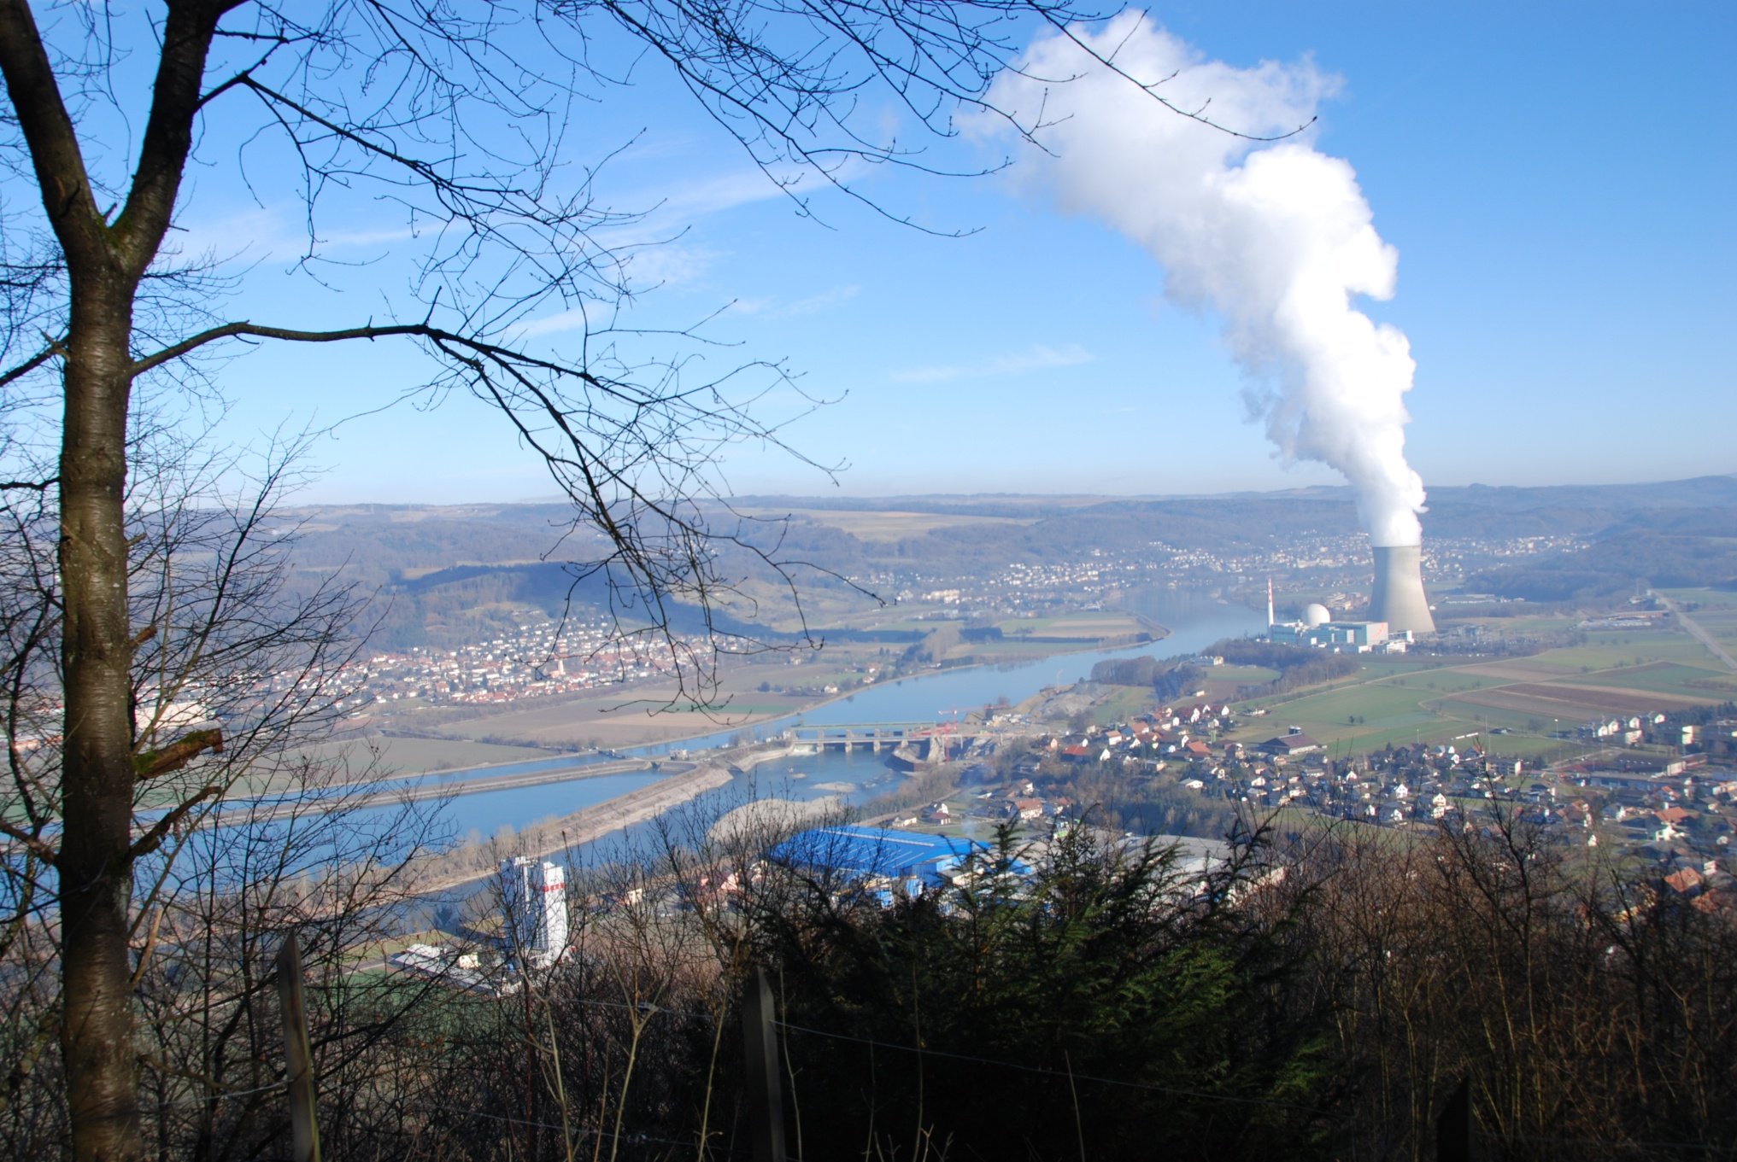
Thank you for your attention!
  Albena.Stoyanova@kkl.ch
  +41 56 267 8523
  Co-authors:
  Olivier Nusbaumer, Pavol Zvoncek, Devi Kompella, Karthik Ravichandran and Rahul Agarwal

