Slide 1
Support Vector Analysis for Computational Risk Assessment, Decision Making, and Vulnerability Discovery in Complex Systems
Andrei Gribok, Curtis L. Smith
Idaho National Laboratory, Idaho Falls, ID, USA
The Probabilistic Safety Assessment and Management Conference (PSAM 16)
June 26-July 1, 2022
Honolulu, O’ahu, Hawaii USA

Slide 2
Project Objective: Automate the discovery of vulnerabilities in complex systems via machine learning and fault tree analysis
Technical challenges:
The safety of nuclear power plants is very important.
Safety is evaluated through risk assessment
Risk assessment generates insights into potential scenarios involving system vulnerabilities.
Historically modeled by human experts
However, the process and models are complex
The number of possible paths to failure for a system with 100 components is 1,267,650,600,228,229,401,496,703,205,376
Humans are not good analyzing these situations.
And we make mistakes!
Approach:
The overwhelming majority of AI/ML applications produce either classifications or predictions.
Research into AI/ML capabilities is needed to:
analyze logical constructs
find logical fallacies
augment humans' logical capabilities
We propose to develop AI/ML methods to analyze paths to failure in order to help human analysts.
The methodology will auto-detect possible vulnerabilities in system designs.
We can use this technology to:
find previously unseen issues (thus reducing human errors)
reduce costs
focus on critical areas by intelligently and efficiently sampling the system “state space”

Slide 3
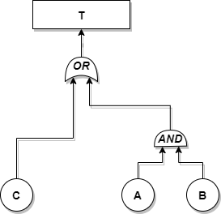
Research methodology – fault trees
T= C OR (A AND B) – binary fault tree (FT): A,B,C,T=0/1
The top undesirable event in this case is T = no water flow to the reactor. The primary initiating events that can cause the top event to happen are: A = pump A fails to run, B = pump B fails to run, and C = valve C fails to open. The minimal cut-set expression for the top event in this example is T = C˅A˄B; that is, “no water flow to reactor” will occur if either valve C fails to open or both pumps A and B fail.

Slide 4
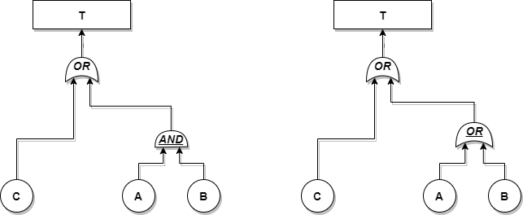
Research methodology – fault trees
T= C OR (A AND B)
T= C OR (A OR B)
Notes:
The reason the rewired fault tree is of interest is that it represents a situation where a common cause failure for the two pumps was overlooked while developing the original fault tree.
If there is a common cause failure for the two pumps, then failure of one is effectively implying a failure of the other, thus changing the gate to an OR gate.

Slide 5
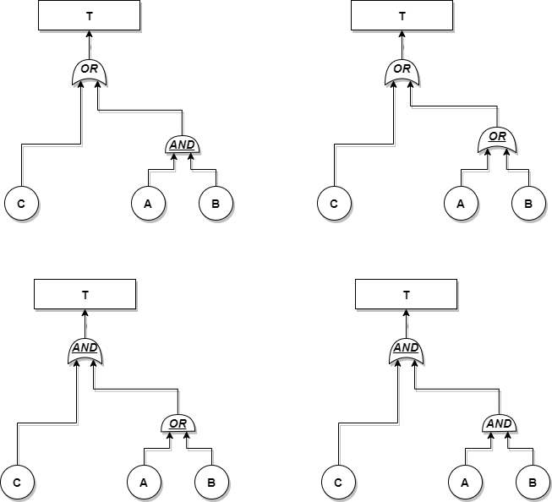
Fault tree rewiring
T = C OR (A AND B)
T = C OR ( A OR B )
T = C AND ( A OR B)
T = C AND ( A AND B)

Slide 6
Research methodology – support vector machines
Notes:
It is for illustration purpose only as the higher dimensional spaces that will be used in this project are not possible to visualize.
Even for the water pumping system in Figure 1, the input space will be five dimensional as there are three Boolean variables representing basic events and two logical gates.
In the proposed novel methodology, training data will represent insights from fault trees so the algorithm will find support fault trees.
The support vectors are the input data that are the most important for separating the two classes—failure versus non-failure—and, most notably, they represent only a very small portion of the input data.
Since, in this case, the input data are characterizations of the fault trees, the SVM training will produce system configurations that are the “borderline” between failure and non-failure scenarios. Not all vectors on the border.
These support trees will be further scrutinized to gain insights into the logical vulnerabilities and risks for a system.

Slide 7
Truth tables
T = C OR (A AND B)
A | T | T | T | T | F | F | F | F
B | T | T | F | F | T | T | F | F
C | T | F | T | F | T | F | T | F
T=C˅(A˄B) | T | T | T | F | T | F | T | F
Truth density = 5/8 = 62.5%
T = C OR ( A OR B )
A | T | T | T | T | F | F | F | F
B | T | T | F | F | T | T | F | F
C | T | F | T | F | T | F | T | F
T=C˅(A˅B) | T | T | T | T | T | T | T | F
Truth density = 7/8 = 87.5%
T = C AND ( A OR B)
A | T | T | T | T | F | F | F | F
B | T | T | F | F | T | T | F | F
C | T | F | T | F | T | F | T | F
T=C˄(A˅B) | T | T | F | F | T | F | F | F
Truth density = 3/8 = 37.5%
T = C AND ( A AND B)
A | T | T | T | T | F | F | F | F
B | T | T | F | F | T | T | F | F
C | T | F | T | F | T | F | T | F
T=C˄(A˄B) | F | F | F | F | F | F | F | T
Truth Density = 1/8
= 12.5%

Slide 8
All possible configurations for the two-pump system—the logical gates are coded OR = 1 and AND = 0
Configuration | C | Gate(2) | A | Gate(1) | B | T
1 | 0 | 1 | 0 | 0 | 0 | 0
2 | 1 | 1 | 0 | 0 | 0 | 1
3 | 0 | 1 | 1 | 0 | 0 | 0
4 | 1 | 1 | 1 | 0 | 0 | 1
5 | 0 | 1 | 0 | 0 | 1 | 0
6 | 1 | 1 | 0 | 0 | 1 | 1
7 | 0 | 1 | 1 | 0 | 1 | 1
8 | 1 | 1 | 1 | 0 | 1 | 1
9 | 0 | 0 | 0 | 0 | 0 | 0
10 | 0 | 0 | 1 | 0 | 0 | 0
11 | 1 | 0 | 0 | 0 | 0 | 0
12 | 0 | 0 | 1 | 0 | 1 | 0
13 | 0 | 0 | 0 | 0 | 1 | 0
14 | 1 | 0 | 1 | 0 | 1 | 1
15 | 1 | 0 | 1 | 0 | 0 | 0
16 | 1 | 0 | 0 | 0 | 1 | 0
17 | 1 | 1 | 1 | 1 | 1 | 1
18 | 1 | 1 | 0 | 1 | 1 | 1
19 | 1 | 1 | 0 | 1 | 0 | 1
20 | 0 | 1 | 0 | 1 | 0 | 0
21 | 1 | 1 | 1 | 1 | 0 | 1
22 | 0 | 1 | 0 | 1 | 1 | 1
23 | 0 | 1 | 1 | 1 | 0 | 1
24 | 0 | 1 | 1 | 1 | 1 | 1
25 | 1 | 0 | 1 | 1 | 0 | 1
26 | 1 | 0 | 0 | 1 | 1 | 1
27 | 0 | 0 | 1 | 1 | 1 | 0
28 | 1 | 0 | 1 | 1 | 1 | 1
29 | 0 | 0 | 0 | 1 | 0 | 0
30 | 0 | 0 | 0 | 1 | 1 | 0
31 | 1 | 0 | 0 | 1 | 0 | 0
32 | 0 | 0 | 1 | 1 | 0 | 0

Slide 9
Support vector configuration histogram for the two-pump system

Slide 10
SVM analysis of the Boolean expression A&B|C|D&E|F&G|J&K
Number of inputs used for training | Percent of all input vectors | Number of SVs | Percent of used training inputs | Percent of all input vectors | Loss | Time (sec) | Kernel function
512 | 0.3906 | 110 | 21.4844 | 0.0839 | 0.2056 | 23.5 | polynomial
516 | 0.3937 | 89 | 17.2481 | 0.0679 | 0.3968 | 24.3 | polynomial
548 | 0.4181 | 120 | 21.8978 | 0.0916 | 0.2376 | 87.6 | polynomial
612 | 0.4669 | 110 | 17.9739 | 0.0839 | 0.1428 | 71.1 | Gaussian
708 | 0.5402 | 141 | 19.9153 | 0.1076 | 0.1308 | 63.3 | polynomial
836 | 0.6378 | 339 | 40.5502 | 0.2586 | 0.1234 | 49.6 | Gaussian
996 | 0.7599 | 197 | 19.7791 | 0.1503 | 0.1013 | 56.6 | polynomial
1188 | 0.9064 | 291 | 24.4949 | 0.2220 | 0.0910 | 75.2 | Gaussian
1412 | 1.0773 | 282 | 19.9717 | 0.2151 | 0.0866 | 52.3 | polynomial
1668 | 1.2726 | 413 | 24.7602 | 0.3151 | 0.0673 | 56.6 | Gaussian
1956 | 1.4923 | 359 | 18.3538 | 0.2739 | 0.0671 | 83.3 | polynomial
2276 | 1.7365 | 423 | 18.5852 | 0.3227 | 0.0445 | 247.9 | polynomial
2628 | 2.0050 | 460 | 17.5038 | 0.3510 | 0.0459 | 98.7 | polynomial
3012 | 2.2980 | 462 | 15.3386 | 0.3525 | 0.0374 | 94.9 | polynomial
3428 | 2.6154 | 538 | 15.6943 | 0.4105 | 0.0398 | 2011.5 | polynomial
3876 | 2.9572 | 384 | 9.9071 | 0.2930 | 0.0344 | 84.6 | polynomial
4356 | 3.3234 | 642 | 14.7383 | 0.4898 | 0.0194 | 104.9 | polynomial
4868 | 3.7140 | 648 | 13.3114 | 0.4944 | 0.0220 | 126.6 | polynomial
5696 | 4.3457 | 713 | 12.5176 | 0.5440 | 0.0139 | 163.0 | polynomial
6288 | 4.7974 | 769 | 12.2296 | 0.5867 | 0.0101 | 697.7 | polynomial
6912 | 5.2734 | 830 | 12.0081 | 0.6332 | 0.0097 | 194.9 | polynomial
7568 | 5.7739 | 834 | 11.0201 | 0.6363 | 0.0093 | 1020.9 | polynomial
8256 | 6.2988 | 826 | 10.0048 | 0.6302 | 0.0058 | 212.3 | polynomial
8976 | 6.8481 | 1059 | 11.7981 | 0.8080 | 0.0101 | 192.8 | Gaussian
9728 | 7.4219 | 965 | 9.9198 | 0.7362 | 0.0056 | 1112.2 | polynomial
10512 | 8.0200 | 1017 | 9.6747 | 0.7759 | 0.0028 | 1163.8 | polynomial
11328 | 8.6426 | 979 | 8.6423 | 0.7469 | 0.0027 | 414.3 | polynomial
12176 | 9.2896 | 980 | 8.0486 | 0.7477 | 0.0043 | 1130.7 | polynomial
13056 | 9.9609 | 1019 | 7.8048 | 0.7774 | 0.0040 | 1071.0 | polynomial
13968 | 10.6567 | 1020 | 7.3024 | 0.7782 | 0.0021 | 998.9 | polynomial

Slide 11
Conclusions
A support vector machine (SVM) is trained to classify failure from non-failure for a given fault tree (Boolean expression).
The number of support vectors important for correct classification is just a fraction of the percent of the total number of configurations
The percent of support vectors does not depend on the SVM’s kernel.
About half a percent of the total number of configurations is necessary to distinguish between failure and non-failure.
Once found, the support configurations can be further scrutinized for vulnerabilities.
The methodology allows for focusing on what is important, ignoring the configurations that are safe.
While the application of SVM to regression and classification problems is a very well-researched topic, the utility of SVs themselves is less understood, constituting a research gap in machine learning.
Autodetection of logic paths and possible vulnerabilities in system designs will improve risk quantification by revealing previously unseen issues, minimizing human error in regard to the completeness of the risk assessment, and enabling subject matter experts to focus on critical areas, thanks to intelligent and efficient sampling of the system’s parameter space.

