Slide 1
The project is co-financed by European Regional Development Fund (ERDF) under the Smart Growth Operational Programme
Analysis of human errors in the cargo logistics process in the airport zone
Agnieszka Tubis, Szymon Haładyn, Artur Kierzkowski, Tomasz Kisiel, Franciszek Restel, Łukasz Wolniewicz
Wroclaw University of Science and Technology
Honolulu, USA – June 28th, 2022
Projekt: „Wykorzystanie środowiska wirtualnej rzeczywistości w systemie szkolenia pracowników handlingu w zakresie obsługi towarów przewożonych drogą powietrzną”
Project: „The use of a virtual reality environment in the training system of handling employees in the field of handling goods transported by air” POIR.04.01.04-00-0072/20

Slide 2
The project is co-financed by European Regional Development Fund (ERDF) under the Smart Growth Operational Programme
Agenda
Introduction
Methodology of research works
Identification of undesirable events
Risk analysis
Evaluation of risk
Changing direction of training process
Results of analysis
Conclusions
Projekt: „Wykorzystanie środowiska wirtualnej rzeczywistości w systemie szkolenia pracowników handlingu w zakresie obsługi towarów przewożonych drogą powietrzną”
Project: „The use of a virtual reality environment in the training system of handling employees in the field of handling goods transported by air” POIR.04.01.04-00-0072/20

Slide 3
The project is co-financed by European Regional Development Fund (ERDF) under the Smart Growth Operational Programme
Introduction
High employee turnover increases the risk of human error due to new employees' lack of knowledge and experience but the existing employees who already have the necessary experience and knowledge are also exposed to the risk of making mistakes.
For this reason, many logistics operators point to the need for changes in the systems of training new employees and training experienced employees.
In this case we are looking for solutions that allow employees to improve the required competencies related to their daily duties faster and more effectively.
The preferred employee training system is active forms of teaching that enable employees to acquire the required knowledge and improve the necessary skills in practice.
Projekt: „Wykorzystanie środowiska wirtualnej rzeczywistości w systemie szkolenia pracowników handlingu w zakresie obsługi towarów przewożonych drogą powietrzną”
Project: „The use of a virtual reality environment in the training system of handling employees in the field of handling goods transported by air” POIR.04.01.04-00-0072/20

Slide 4
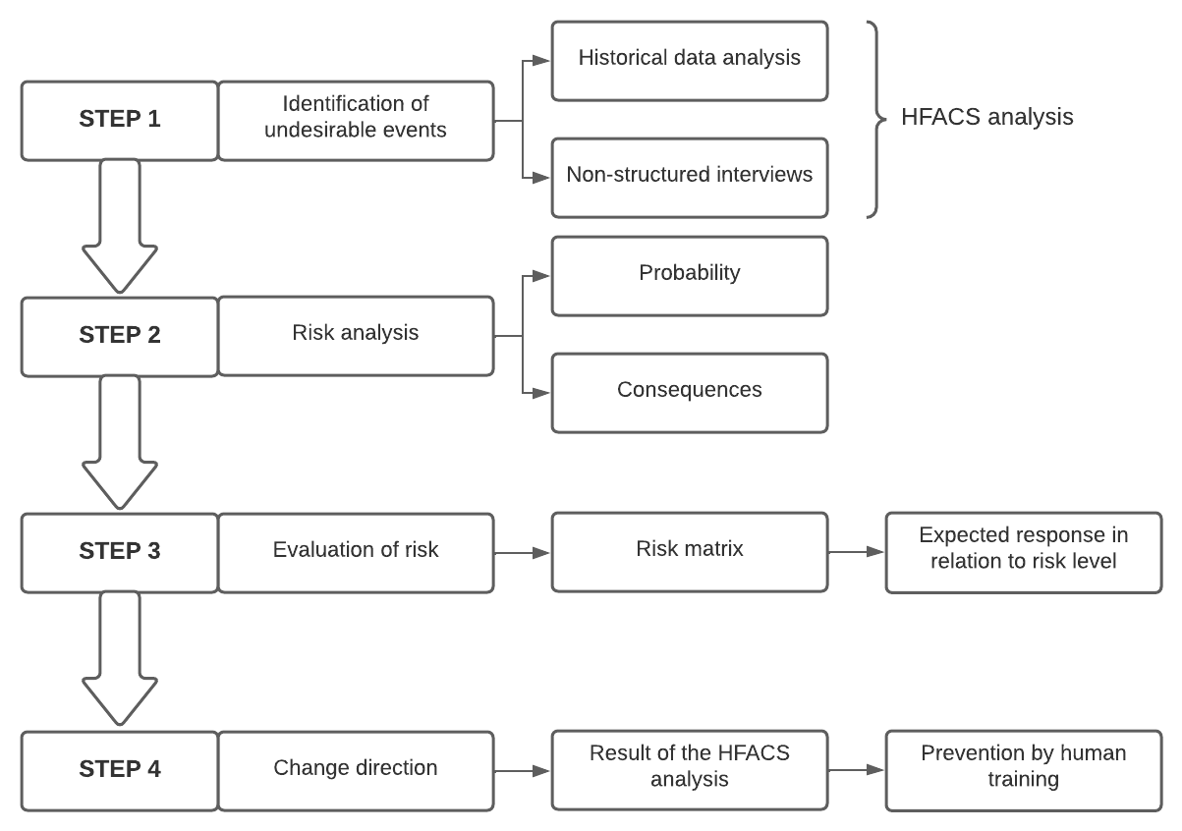
The project is co-financed by European Regional Development Fund (ERDF) under the Smart Growth Operational Programme
Methodology of research works
Research on the identification of adverse events using the HFACS framework and risk assessment was carried out in a selected cargo warehouse in one of the airports in Poland.
The research on risk assessment was qualitative and quantitative and was carried out in four steps.
Projekt: „Wykorzystanie środowiska wirtualnej rzeczywistości w systemie szkolenia pracowników handlingu w zakresie obsługi towarów przewożonych drogą powietrzną”
Project: „The use of a virtual reality environment in the training system of handling employees in the field of handling goods transported by air” POIR.04.01.04-00-0072/20

Slide 5
The project is co-financed by European Regional Development Fund (ERDF) under the Smart Growth Operational Programme
STEP 1: Identification of undesirable events
Identification of adverse events was carried out based on two sources of information:
historical data recorded in the internal documentation of the warehouse
unstructured interviews conducted among the staff and managers responsible for servicing the CARGO warehouse. Brainstorming was used for unstructured interviews, and adverse events were generated according to the structure of the HFACS analysis.
Projekt: „Wykorzystanie środowiska wirtualnej rzeczywistości w systemie szkolenia pracowników handlingu w zakresie obsługi towarów przewożonych drogą powietrzną”
Project: „The use of a virtual reality environment in the training system of handling employees in the field of handling goods transported by air” POIR.04.01.04-00-0072/20

Slide 6
The project is co-financed by European Regional Development Fund (ERDF) under the Smart Growth Operational Programme
STEP 2: Risk analysis
The analysis of the risk of adverse events was carried out based on a structured interview. Its purpose was to determine the frequency and effects of each of the analyzed events. Structured interviews were conducted among managers responsible for servicing the CARGO warehouse.
Step 2
Probability
Consequences
Projekt: „Wykorzystanie środowiska wirtualnej rzeczywistości w systemie szkolenia pracowników handlingu w zakresie obsługi towarów przewożonych drogą powietrzną”
Project: „The use of a virtual reality environment in the training system of handling employees in the field of handling goods transported by air” POIR.04.01.04-00-0072/20

Slide 7
The project is co-financed by European Regional Development Fund (ERDF) under the Smart Growth Operational Programme
STEP 2: Risk analysis – probability
Historical data recorded in the internal documentation of the airport was used to estimate the initial frequency of each event. However, due to some adverse events (no measurement or the requirement to record their occurrence), the estimated frequency was verified by the managers participating in the study. The frequency of occurrences estimated by managers was expressed by linguistic variables and a numerical value was assigned to each variable to calculate the risk index.
Scale for assessing the frequency of adverse events
Rating Category | Value | Description
RARE (F1) | 1 | Could happen but probably never will
UNLIKELY(F2) | 2 | Not likely to occur in normal circumstances
POSSIBLE (F3) | 3 | May occur at some time
VERY LIKELY (F4) | 4 | Expected to occur at some time
CERTAIN (F5) | 5 | Expected to occur regularly under normal circumstances
Projekt: „Wykorzystanie środowiska wirtualnej rzeczywistości w systemie szkolenia pracowników handlingu w zakresie obsługi towarów przewożonych drogą powietrzną”
Project: „The use of a virtual reality environment in the training system of handling employees in the field of handling goods transported by air” POIR.04.01.04-00-0072/20

Slide 8
The project is co-financed by European Regional Development Fund (ERDF) under the Smart Growth Operational Programme
STEP 2: Risk analysis – consequences
The potential effects of adverse events were also determined by management cooperating with a group of researchers. The consequences were related to the aspects of logistics services expressed mainly by the indicator of timely delivery and damage to the cargo. The scale of assessed adverse event effects estimated by managers was expressed by linguistic variables and a numerical value was assigned to each variable to calculate the risk index.
Scale for assessing the consequences of adverse events
Rating Category | Value | Punctuality | Cargo
NEGLIGIBLE (C1) | 1 | Without affecting the process | Damaged packaging without affecting the cargo
MODERATE (C2) | 2 | Delay at the reloading airport | Damage to the cargo
HIGH (C3) | 3 | Delay at the destination airport | Total cargo loss
CATASTROPHIC (C4) | 4 | --- | Negative effect of the cargo on the environment (fire, spillage)
Projekt: „Wykorzystanie środowiska wirtualnej rzeczywistości w systemie szkolenia pracowników handlingu w zakresie obsługi towarów przewożonych drogą powietrzną”
Project: „The use of a virtual reality environment in the training system of handling employees in the field of handling goods transported by air” POIR.04.01.04-00-0072/20

Slide 9
The project is co-financed by European Regional Development Fund (ERDF) under the Smart Growth Operational Programme
STEP 3: Evaluation of risk – risk matrix
For the risk evaluation, a risk matrix was used, on which the individual levels of probability and effects were mapped. Based on direct interviews with the management staff, the level of risk acceptance was determined, and thresholds for the remaining values of the estimated risk were set. The matrix distinguishes three levels of risk evaluation along with the required response of managers.
Scale for assessing the consequences of adverse events
Rating Category | Value | Acceptance level | Description
LOW (RL1) | 1 - 2 | Acceptable risk | The risk should be monitored in the following periods
MEDIUM (RL2) | 4 – 7 | Unacceptable risk | Risk mitigation measures should be implemented with due regard to economic viability
HIGH (RL3) | 8 - 20 | Unacceptable risk | Risk mitigation measures should be put in place immediately, no matter what the cost
Projekt: „Wykorzystanie środowiska wirtualnej rzeczywistości w systemie szkolenia pracowników handlingu w zakresie obsługi towarów przewożonych drogą powietrzną”
Project: „The use of a virtual reality environment in the training system of handling employees in the field of handling goods transported by air” POIR.04.01.04-00-0072/20

Slide 10
The project is co-financed by European Regional Development Fund (ERDF) under the Smart Growth Operational Programme
STEP 4: Change direction of training process
The last stage of the research procedure: determine the directions of the required improvements necessary to be implemented to reduce the risk.
The critical aspect of the proposed changes were preventive measures, primarily aimed at reducing the probability of occurrence of adverse events, the risk index of which exceeded the acceptable level of acceptance. In the case of other events, protective measures should also limit the potential consequences of their occurrence.
Projekt: „Wykorzystanie środowiska wirtualnej rzeczywistości w systemie szkolenia pracowników handlingu w zakresie obsługi towarów przewożonych drogą powietrzną”
Project: „The use of a virtual reality environment in the training system of handling employees in the field of handling goods transported by air” POIR.04.01.04-00-0072/20

Slide 11
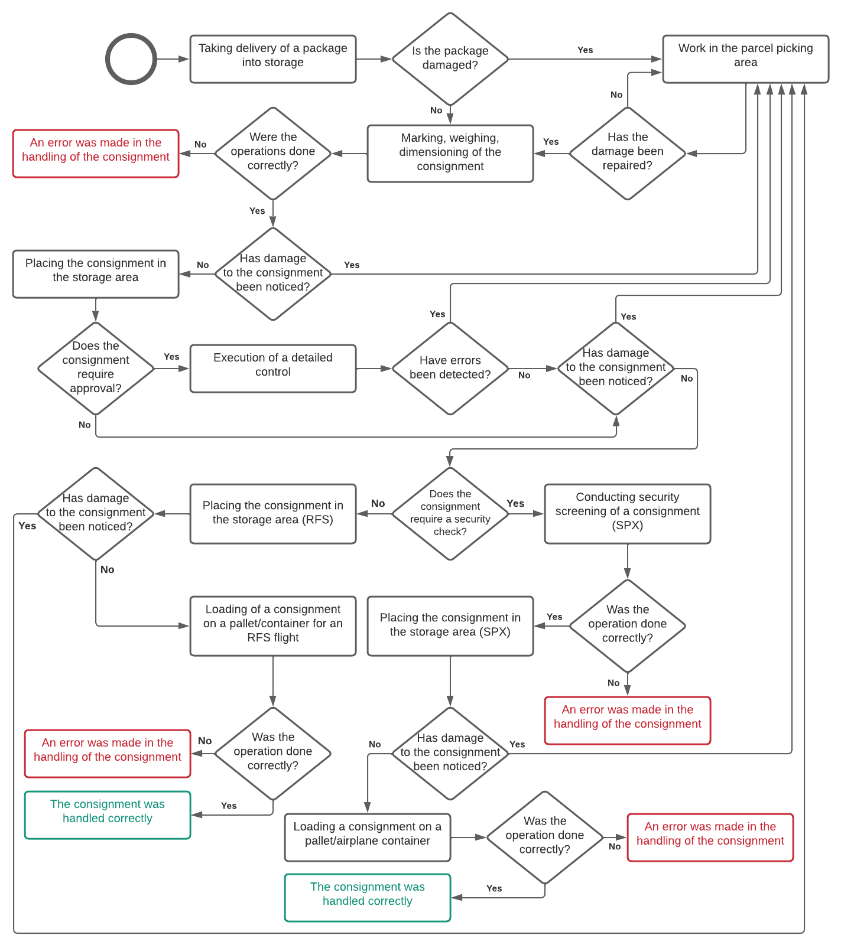
The project is co-financed by European Regional Development Fund (ERDF) under the Smart Growth Operational Programme
Results
A research procedure was carried out for the selected CARGO airport. The analysis concerned the cargo export process. In total, 65 adverse event scenarios were identified. 12 adverse events were selected for analysis. These events belong to different groups in the HFACS framework.
For each scenario, the estimated frequency and consequences of its occurrence were indicated, and the risk index was calculated:
$${RI}_{S\left(n\right)}=F_{S\left(n\right)}×C_{S\left(n\right)}$$
where:
${RI}_{S(n)}$ – risk indicator for the scenario n
$F_{S(n)}$ – the frequency of the scenario n
$C_{S(n)}$ – consequences of the occurrence of the scenario n
Projekt: „Wykorzystanie środowiska wirtualnej rzeczywistości w systemie szkolenia pracowników handlingu w zakresie obsługi towarów przewożonych drogą powietrzną”
Project: „The use of a virtual reality environment in the training system of handling employees in the field of handling goods transported by air” POIR.04.01.04-00-0072/20

Slide 12
The project is co-financed by European Regional Development Fund (ERDF) under the Smart Growth Operational Programme
Results
Classification of scenarios according to the HFACS framework
No scenario | Description of scenario | $$F_{S(n)}$$ | $$C_{S(n)}$$ | $${RI}_{S(n)}$$
S(1) | Admitting to work of employees not fully trained | 3 | 3 | 9
S(2) | Lack of knowledge of special cargo procedures | 2 | 4 | 8
S(3) | Numerous overtime hours due to a shortage of personnel | 4 | 2 | 8
S(4) | Lack of proper control of airline or state restrictions | 3 | 3 | 9
S(5) | Incorrectly planned servicing of forklifts - in the use of a device that is not fully functional | 3 | 1 | 3
S(6) | Lack of proper control of the securing of cargo with hazardous materials | 2 | 4 | 8
S(7) | No current markings | 2 | 2 | 4
S(8) | Work under time pressure | 5 | 2 | 10
S(9) | Handing over a new employee a non-standard task to be performed | 2 | 3 | 6
S(10) | Incorrect arrangement of the goods on the pallet | 3 | 2 | 6
S(11) | Diversion of cargo to the wrong flight | 3 | 3 | 9
S(12) | Fall of cargo during picking or handling | 2 | 2 | 4
Projekt: „Wykorzystanie środowiska wirtualnej rzeczywistości w systemie szkolenia pracowników handlingu w zakresie obsługi towarów przewożonych drogą powietrzną”
Project: „The use of a virtual reality environment in the training system of handling employees in the field of handling goods transported by air” POIR.04.01.04-00-0072/20

Slide 13
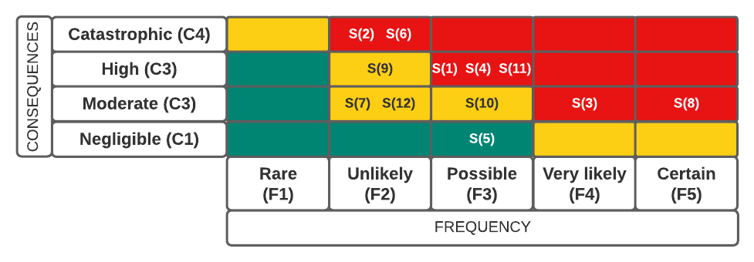
The project is co-financed by European Regional Development Fund (ERDF) under the Smart Growth Operational Programme
Results
Based on the risk analysis, a risk evaluation matrix was created, which allows for prioritizing the implemented changes related to reducing the level of risk.
Projekt: „Wykorzystanie środowiska wirtualnej rzeczywistości w systemie szkolenia pracowników handlingu w zakresie obsługi towarów przewożonych drogą powietrzną”
Project: „The use of a virtual reality environment in the training system of handling employees in the field of handling goods transported by air” POIR.04.01.04-00-0072/20

Slide 14
The project is co-financed by European Regional Development Fund (ERDF) under the Smart Growth Operational Programme
Results
Due to the high turnover rate of employees responsible for handling CARGO loads in the examined warehouse, it is necessary to implement training tools that will allow you to effectively acquire the required theoretical knowledge and practical skills in a relatively short time.
There is a need to implement active forms of employee training, which allow them to acquire the required skills in a shorter time and more effectively than in the case of traditional training. One of such solutions is the use of virtual reality technology both in the process of training new employees and in improving the skills of employees with extensive experience.
In the case of experienced employees, training programs should be focused on improving selected skills related to the response to non-standard or random events. Their mapping in virtual reality will allow the trainee to get used to the emotions accompanying a given situation.
In the EU co-financed project, research is conducted to develop training scenarios implemented in a virtual reality environment that will meet the needs of warehouse operators at airports.
Projekt: „Wykorzystanie środowiska wirtualnej rzeczywistości w systemie szkolenia pracowników handlingu w zakresie obsługi towarów przewożonych drogą powietrzną”
Project: „The use of a virtual reality environment in the training system of handling employees in the field of handling goods transported by air” POIR.04.01.04-00-0072/20

Slide 15
The project is co-financed by European Regional Development Fund (ERDF) under the Smart Growth Operational Programme
Conclusion
The studies carried out on the risk assessment related to the handling of cargo in a selected airport prove that the cause of many adverse events is employees' lack of knowledge and skills.
Inference based on the results of the risk assessment showed that most adverse events occur due to a lack of knowledge and skills that can be acquired through properly prepared training.
In the project "The use of a virtual reality environment in the training system of handling employees in the field of handling goods transported by air", research is conducted to develop training scenarios implemented in a virtual reality environment that will meet the needs of warehouse operators at airports.
The use of the HFACS framework additionally allowed researchers to focus their attention of researchers primarily on events, the risk of which may be limited by an appropriately selected training system.
Projekt: „Wykorzystanie środowiska wirtualnej rzeczywistości w systemie szkolenia pracowników handlingu w zakresie obsługi towarów przewożonych drogą powietrzną”
Project: „The use of a virtual reality environment in the training system of handling employees in the field of handling goods transported by air” POIR.04.01.04-00-0072/20

Slide 16
The project is co-financed by European Regional Development Fund (ERDF) under the Smart Growth Operational Programme
An innovative system for predictive operation of the locomotive-environment system using augmented reality technology
Innowacyjny system predykcyjnej eksploatacji układu lokomotywa-otoczenie z wykorzystaniem technologii rozszerzonej rzeczywistości
Projekt: „Innowacyjny system predykcyjnej eksploatacji układu lokomotywa-otoczenie z wykorzystaniem technologii rozszerzonej rzeczywistoścį”
Project: „An innovative system for predictive operation of the locomotive-environment system using augmented reality technology” POIR.01.01.01-00-0158/21

Slide 17
The project is co-financed by European Regional Development Fund (ERDF) under the Smart Growth Operational Programme
Analysis of human errors in the cargo logistics process in the airport zone
Agnieszka Tubis, Szymon Haładyn, Artur Kierzkowski, Tomasz Kisiel, Franciszek Restel, Łukasz Wolniewicz
Wroclaw University of Science and Technology
Honolulu, USA – June 28th, 2022
Projekt: „Wykorzystanie środowiska wirtualnej rzeczywistości w systemie szkolenia pracowników handlingu w zakresie obsługi towarów przewożonych drogą powietrzną”
Project: „The use of a virtual reality environment in the training system of handling employees in the field of handling goods transported by air” POIR.04.01.04-00-0072/20

