Slide 1
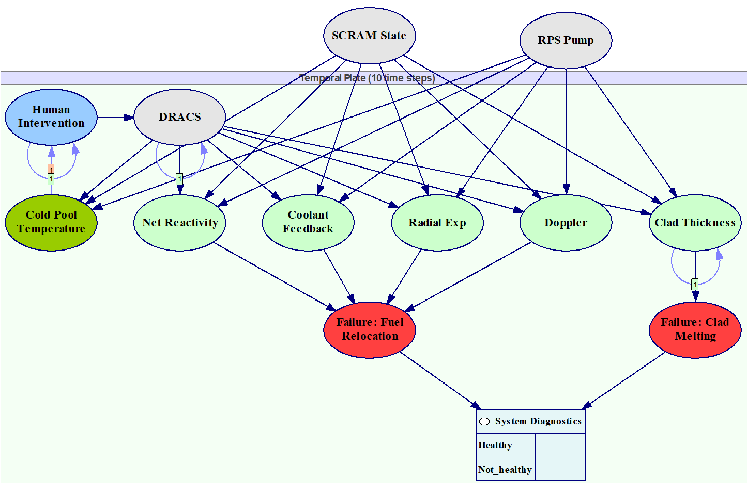
High-level presentation structure
Background, Motivation, and Research Problem
Methodology
Results
Conclusion and Future Work

Slide 2

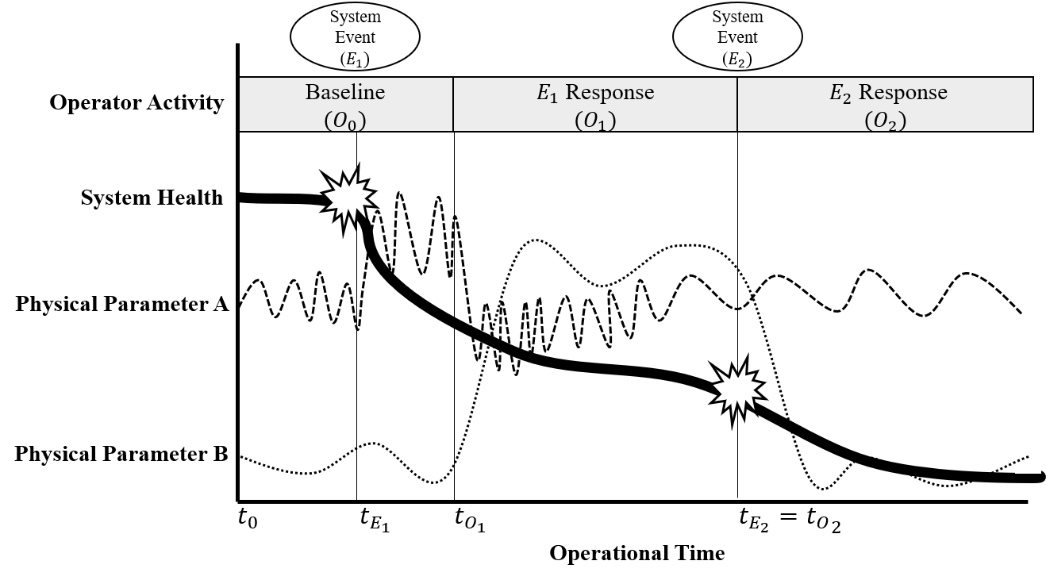
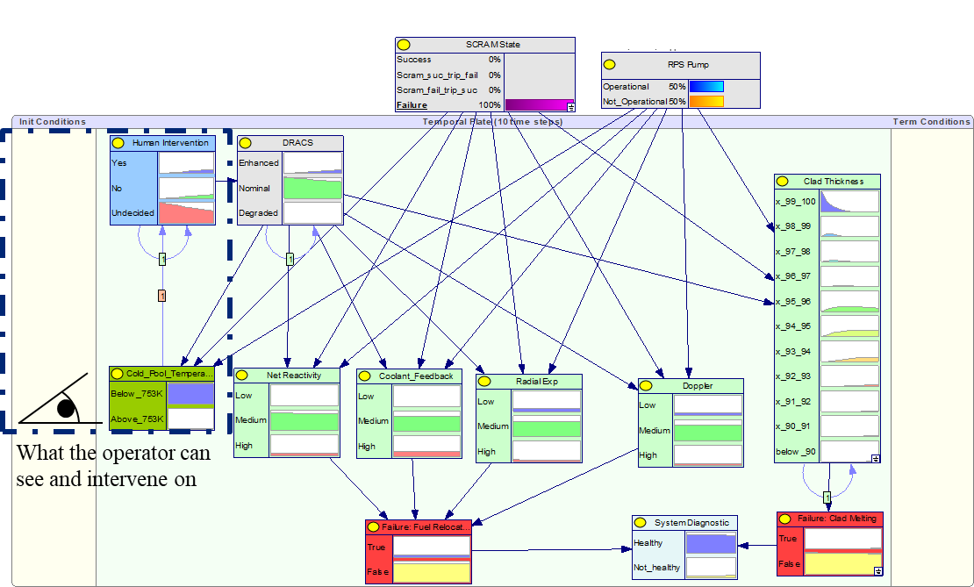

Impact of Complex Engineering System Data Stream Discretization Techniques on the Performance of Dynamic Bayesian Network-Based Health Assessments
Austin Lewis and Katrina Groth
Systems Risk and Reliability Analysis Lab
Center for Risk and Reliability
University of Maryland
PSAM 2022, Honolulu, HI, June 28, 2022

Slide 3
Summary: Dynamic Bayesian networks as a health monitoring tool for complex engineering systems
Goal: Understand how different approaches to system data collection impact DBN performance.
  Nuclear power plant case study includes best-available data from:
    Sandia nuclear and thermodynamic simulations
    Dynamic Event Trees from previous research
  Data science algorithms & Bayesian causal reasoning framework
  DBNs are flexible, adaptive model – can “learn” as we gather data, knowledge
This is an equation and a picture!
DBNs can integrate models and information about system failure modes and probabilities.
Useable for quantifying system risk – and identifying how to reduce it
Notes:
MVC software architecture -- multiple user views can be built on same underlying models
Transformed “v0” (FY13 Matlab implementation) of QRA algorithm into “v1” (a useable tool for industry, per C&S/QRA workshop)

Slide 4
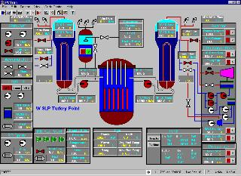
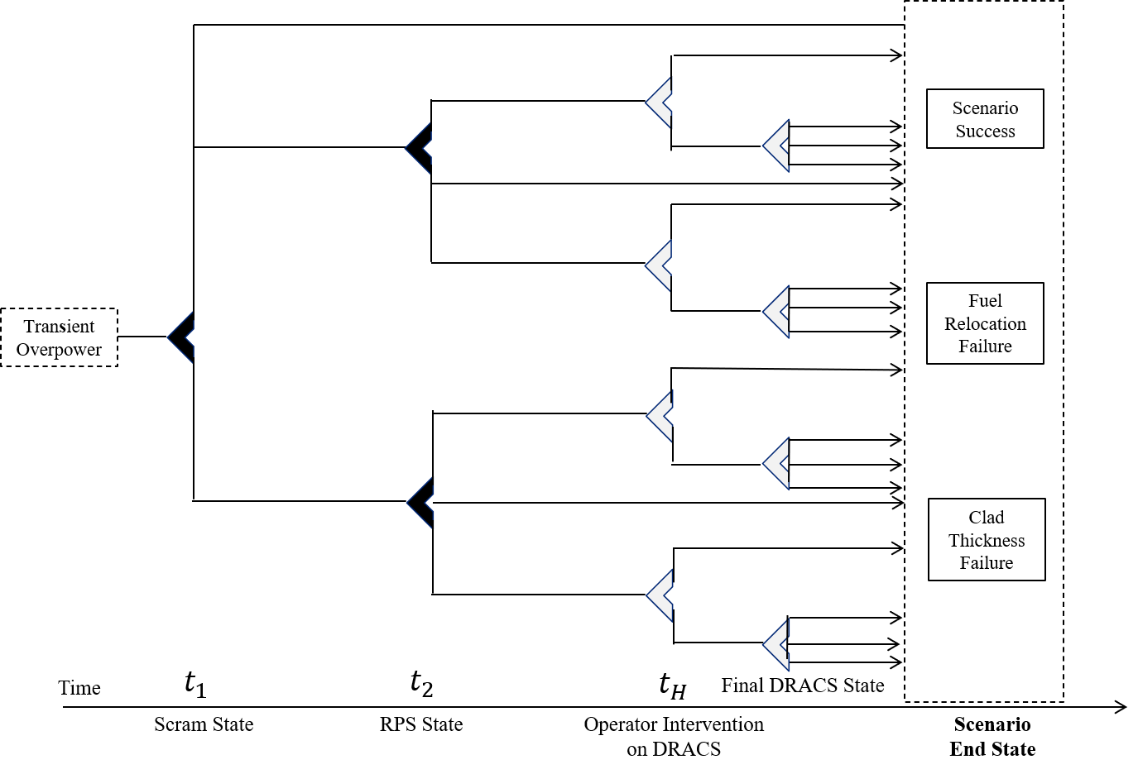
There’s a long-standing goal to have updated health and risk statuses for complex engineering systems (CESs)…
System
Models
Operational
System
System
Representation
System data
Model outputs
…but how we model the system shapes how we see system health.

Slide 5
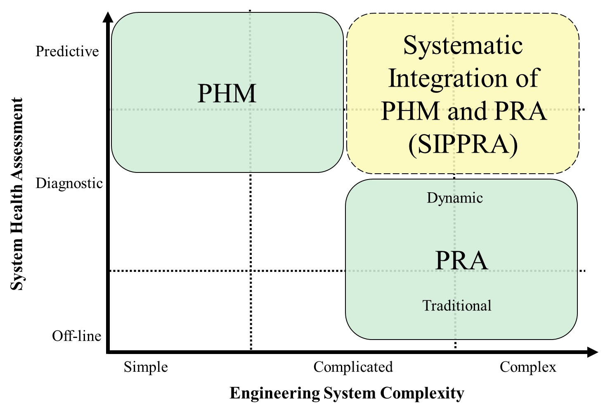
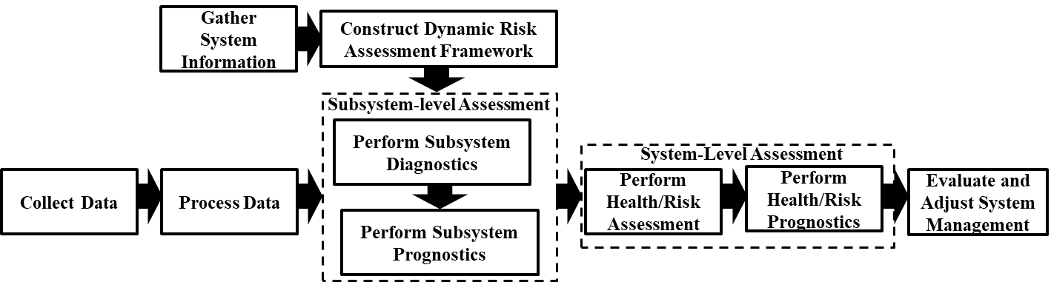
Systematic integrations of PHM and PRA (SIPPRA) address limitations of both techniques
SIPPRA health management promotes:
  Clarity and scalability
  Incorporation of operational data and context for predictive health assessments
PRA Process
PHM Process
Modified from Moradi and Groth, 2020
Moradi, R & Groth, KM, “Modernizing risk assessment: A systematic integration of PRA and PHM techniques,” Reliability Engineering and System Safety, 2020, 204
How can SIPPRA models be constructed to effectively provide insight into system health?

Slide 6
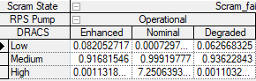
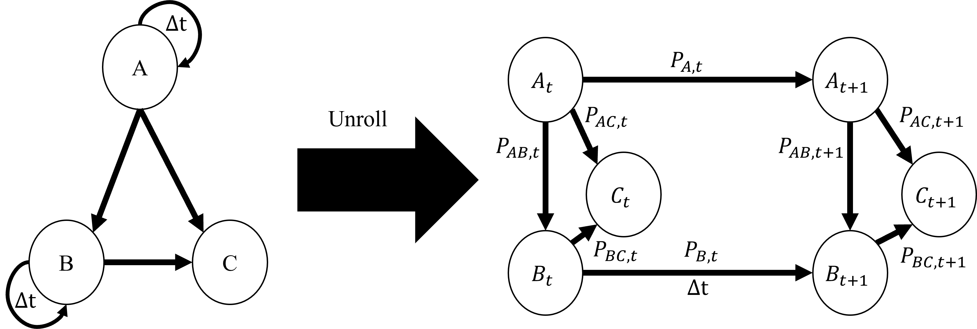
Dynamic Bayesian networks (DBNs)
Directed acyclic graphs that describe temporal dependency relationships between its nodes through conditional probabilities
DBNs are increasingly being used in reliability and safety research (Cai et al, 2017; Özgür-Ünlüakın et al, 2019; Zhao et al, 2020; Lewis and Groth, 2020)
This arc describes conditional probabilities that define the causal relationship between the nodes
How does changing DBN time-steps impact our ability to understand system health?

Slide 7
What types of questions can be supported by DBNs?
Predictive
Diagnostic
Explanatory
  Will this system information (operational context, data) lead to an increased probability of system failure?
  What was the likely cause of this system failure?
  If there is system failure and additional information was known, now what was the likely cause of the failure?
Evidence
Posterior
Posterior
Evidence
Posterior
Failure Mode 1
Failure Mode 2
Failure Mode 1
Failure Mode 2
Failure Mode 1
Failure Mode 2
System Failure
System Failure
System Failure
Posterior
Evidence
Evidence
Findings from these types of questions can lead to changes in system management practices and requirements.

Slide 8
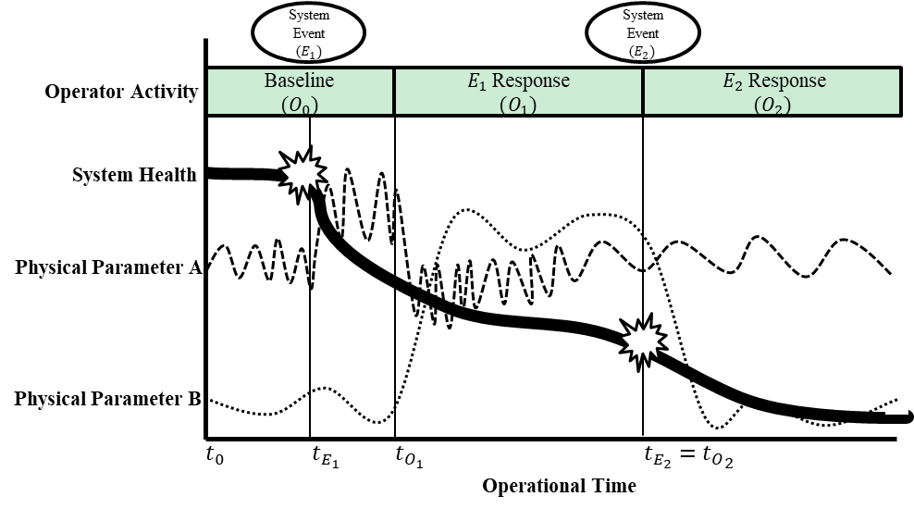
What are different ways to discretize a continuous-time accident sequence?
How is data collected in here…
…informing operational behavior and system health predictions?

Slide 9
Research problem
There is a need for model designers to develop effective CES health monitoring models for improved system management.
Modeling CESs through a SIPPRA approach allows for operational data to be used within a scalable and clear logic structure
However, there are questions surrounding effective model designs for SIPPRA health management, particularly for Dynamic Bayesian Networks (DBNs).
This work rigorously evaluates how different approaches to discretizing operational system data streams for DBN construction and updating impact model performance in multiple dimensions.

Slide 10
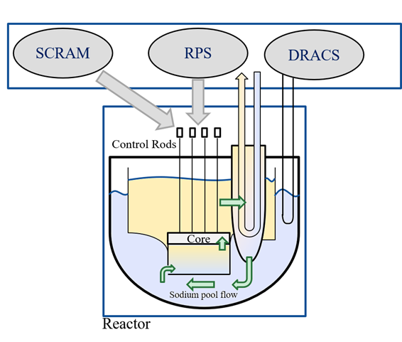
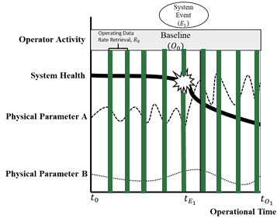
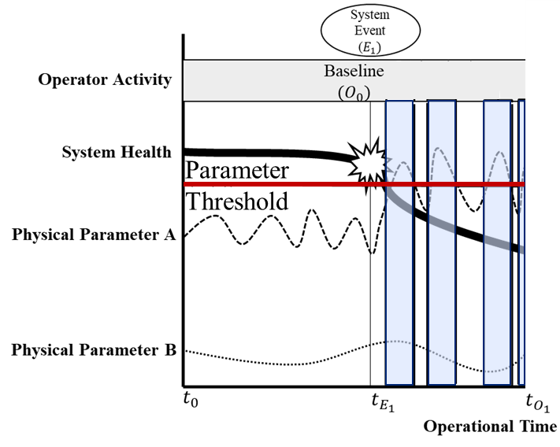
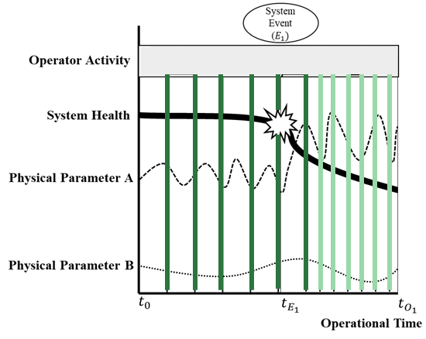
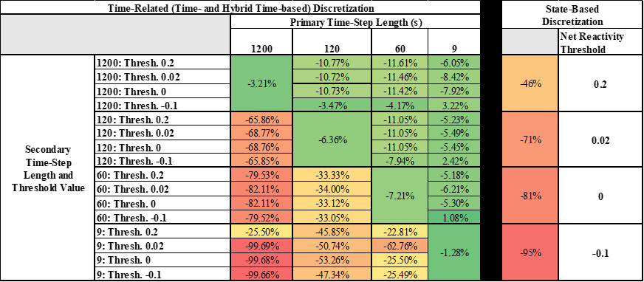
Research Methodology
Case Study DBN Node Structure
Discretization Strategies
Performance Metric
Enables consistent basis for comparing discretization strategies viz-a-viz multiple performance metrics relevant to system-level PHM

Slide 11
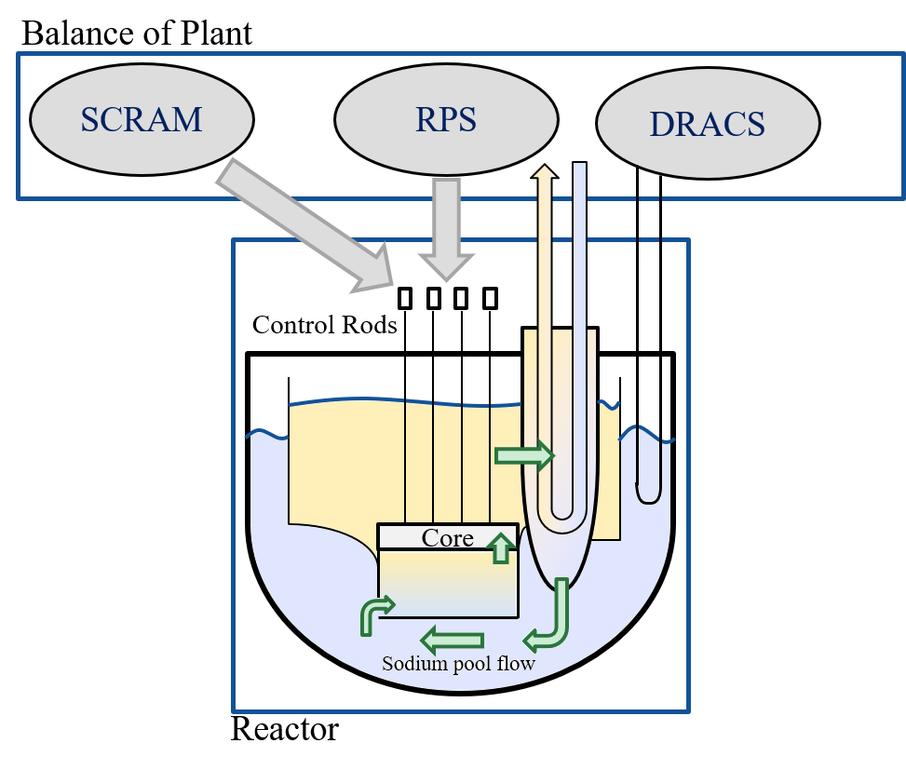
Case study: sodium fast reactor (SFR) experiencing a transient overpower (TOP)
Case study published in: Lewis and Groth (2020) based on modified Level I PRA by Jankovsky et al. (2020) further simplified to enable DBN analysis
The failures considered are fuel relocation and thermal clad failure that may occur over the course of 24 hours (86,400s).
Transient Overpower (TOP)
Generalized SFR
Lewis, AD & Groth, KM “A Dynamic Bayesian Network Structure for Joint Diagnostics and Prognostics of Complex Engineering Systems,” Algorithms, 2020, 13, 64+

Slide 12
DBN node structure used in the study
System Component State
Human Involvement
System Information/Sensor Data
System Failure Mode/Prognostics
System Health/Diagnostics
Lewis, AD & Groth, KM “A Dynamic Bayesian Network Structure for Joint Diagnostics and Prognostics of Complex Engineering Systems,” Algorithms, 2020, 13, 64+

Slide 13
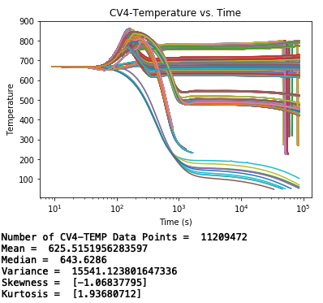
Case study data is simulated from dynamic event tree (DET) branches
The DET provides structure and probabilities for 1,920 different scenarios that follow distinct outcomes of the tree’s branch conditions
Nuclear reaction simulations
(SAS4A)
Thermodynamic simulations
(PRIMAR4)
Modified DET used to define SFR health outcome [modified from work presented by Jankovsky et al. [1]
Different values of cold pool temperature across the different scenarios
Data derived from scenarios constructed from this tree are used to define the conditional probability tables in the DBN.
Lewis, AD & Groth, KM “A Dynamic Bayesian Network Structure for Joint Diagnostics and Prognostics of Complex Engineering Systems,” Algorithms, 2020, 13, 64+

Slide 14
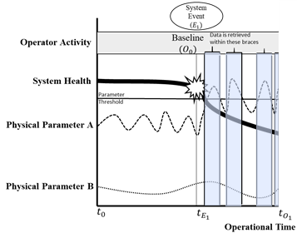
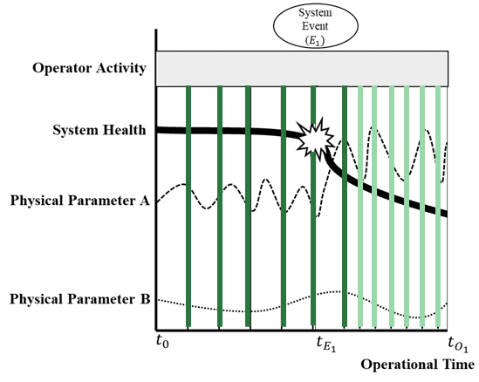

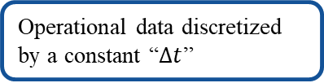
Three different kinds of discretization techniques applied
Time-based Discretization
State-based Discretization
Hybrid Time-based Discretization
Operational data discretized by a constant “$Δt$”
Operational data discretized by threshold values of system parameters
Operational data discretized by a constant “$Δt$” until threshold value reached; then discretized by another constant “$Δt$”

Slide 15
Metrics for comparison could be: taxonomy of 35 performance metrics for health monitoring models
Input Metrics
Assessment Metrics
Model Structure Metrics
Computational Metrics
User/ Usability Metrics
Age of information/ data
Assessment accuracy
Ease of model modification for new failure modes
Data processing time
Expertise required for use
Availability of data collection equipment
Assessment forecast window
Information content per sampling rate
Data storage requirements
Model and processing explainability
Data coverage
Assessment precision
Model construction/ operational costs
Processing equipment requirements
Model and processing traceability
Data redundancy
Assessment sensitivity
Model coverage/ completeness
Time required for assessment
Model output interpretability
Information/ data collection costs
Response time to anomalies
Number of data sources (total and inferred)
Sampling rate frequency
System state requirements for assessments
These metrics provide a comprehensive set across SIPPRA phases and model functional groups.
Lewis, AD & Groth, KM “Metrics for evaluating the performance of complex engineering system health monitoring models,” Reliability Engineering & System Safety, 2022, 223, 108473

Slide 16
Performance Metric: Alignment of system safety prior with baseline DET estimate
Compare to the estimate from here?
How does the prior value of this node….

Slide 17
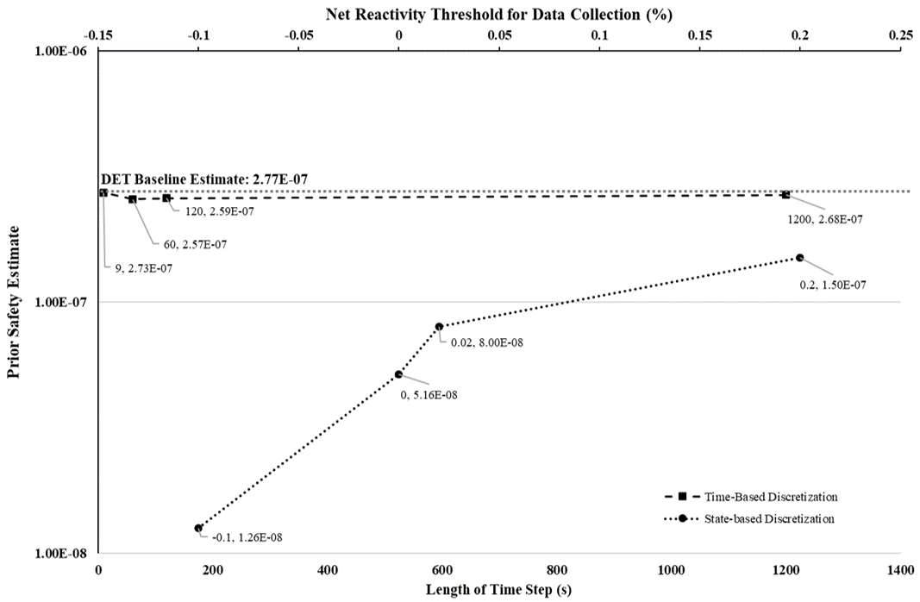
Results of discretization comparison (Time-based and state-based)
DET Baseline Estimate: 2.77E-07
Time-based discretization consistent across time steps used
State-based discretization is less consistent and varies more with different thresholds used

Slide 18
Heat map enables comparison across all three discretization approaches
Time-Related (Time- and Hybrid Time-based) Discretization |  |  |  |  |  |  | State-Based Discretization
 |  | Primary Time-Step Length (s)
 |  | 1200 | 120 | 60 | 9 |  |  | Net Reactivity Threshold
Secondary Time-Step Length and Threshold Value | 1200: Thresh. 0.2 | -3.21% | -10.77% | -11.61% | -6.05% |  | -46% | 0.2
 | 1200: Thresh. 0.02 |  | -10.72% | -11.46% | -8.42%
 | 1200: Thresh. 0 |  | -10.73% | -11.42% | -7.92%
 | 1200: Thresh. -0.1 |  | -3.47% | -4.17% | 3.22%
 | 120: Thresh. 0.2 | -65.86% | -6.36% | -11.05% | -5.23% |  | -71% | 0.02
 | 120: Thresh. 0.02 | -68.77% |  | -11.05% | -5.49%
 | 120: Thresh. 0 | -68.76% |  | -11.05% | -5.45%
 | 120: Thresh. -0.1 | -65.85% |  | -7.94% | 2.42%
 | 60: Thresh. 0.2 | -79.53% | -33.33% | -7.21% | -5.18% |  | -81% | 0
 | 60: Thresh. 0.02 | -82.11% | -34.00% |  | -6.21%
 | 60: Thresh. 0 | -82.11% | -33.12% |  | -5.30%
 | 60: Thresh. -0.1 | -79.52% | -33.05% |  | 1.08%
 | 9: Thresh. 0.2 | -25.50% | -22.92% | -11.40% | -1.28% |  | -95% | -0.1
 | 9: Thresh. 0.02 | -99.69% | -50.74% | -99.68%
 | 9: Thresh. 0 | -99.68% | -53.26% | -99.68%
 | 9: Thresh. -0.1 | -99.66% | -53.26% | -99.6%
Shorter primary rates produced more aligned safety assessments
Most consistent with baseline
Least consistent

Slide 19
Different models map enables comparison across all three discretization approaches
Time-Related (Time- and Hybrid Time-based) Discretization |  |  |  |  |  |  | State-Based Discretization
 |  | Primary Time-Step Length (s)
 |  | 1200 | 120 | 60 | 9 |  |  | Net Reactivity Threshold
Secondary Time-Step Length and Threshold Value | 1200: Thresh. 0.2 | 2,478.6s | 3,545.1 | 4,791.9 | 17,645.1 |  | 58.30s | 0.2
 | 1200: Thresh. 0.02 |  | 3,808.4 | 4,831.1 | 17,147.0
 | 1200: Thresh. 0 |  | 3,735.4 | 4,796.1 | 17,179.5
 | 1200: Thresh. -0.1 |  | 18,820.6 | 36,783.1 | 229,696.3
 | 120: Thresh. 0.2 | 2,780.0 | 23,032.9 | 26,513.9 | 38,295.7 |  | 813.20 | 0.02
 | 120: Thresh. 0.02 | 6,727.2 |  | 26,202.7 | 38,234.9
 | 120: Thresh. 0 | 12,791.7 |  | 26,797.3 | 39,515.8
 | 120: Thresh. -0.1 | 24,134.4 |  | 44,420.4 | 236,564.0
 | 60: Thresh. 0.2 | 2,632.1s | 26,159.5 | 46,053.5 | 61,993.4 |  | 11,117.20 | 0
 | 60: Thresh. 0.02 | 10,884.9 | 46,278.3 |  | 62,689.6
 | 60: Thresh. 0 | 24,947.4 | 48,627.0 |  | 62,689.4
 | 60: Thresh. -0.1 | 47,889.3 | 49,458.4 |  | 249,578.4
 | 9: Thresh. 0.2 | 2,725.0 | 26,930.4 | 53,125.0 | 299,708.8s |  | 35,319.80s | -0.1
 | 9: Thresh. 0.02 | 62,493.2 | 295,423.2 | 281,304.2
 | 9: Thresh. 0 | 155,729.9 | 304,475.5 | 310,824.5
 | 9: Thresh. -0.1 | 312,802.7s | 311,795.6 | 310,895.7
Significant increase as time-step decreases
Increase varies by data amount above threshold

Slide 20
3 metrics are used to compare DBNs in this paper
Selected 3 from broader list of 35 metrics developed in Lewis & Groth 2022
Performance metric | Metric applied to the case study
Assessment Accuracy | Alignment of system safety prior with baseline DET estimate
Preliminary Model Construction Costs | CPT development time
Information Content per Sampling Rate | Average conditional entropy per sampling rate
Comparing models across different performance metrics helps identify opportunities for selecting effective models for SIPPRA health management.

Slide 21
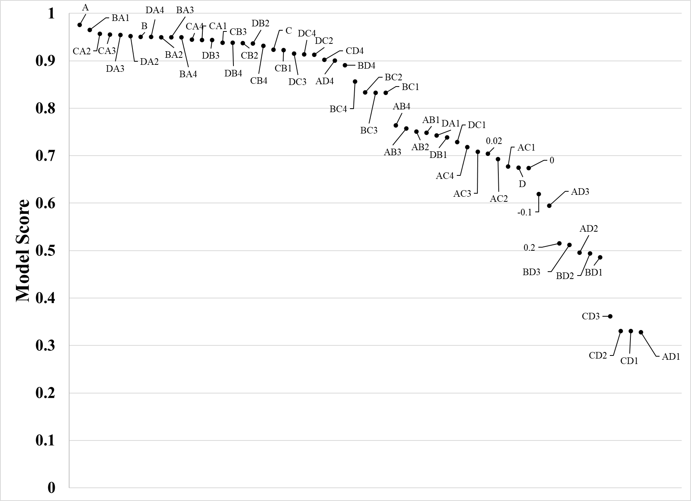
Combined, these metrics provide a more nuanced approach to evaluating performance
Model swing-weight scoring with no attribute preference
Swing-weights or similar multi-attribute utility analyses enables ranking model designs by desired performance values.

Slide 22
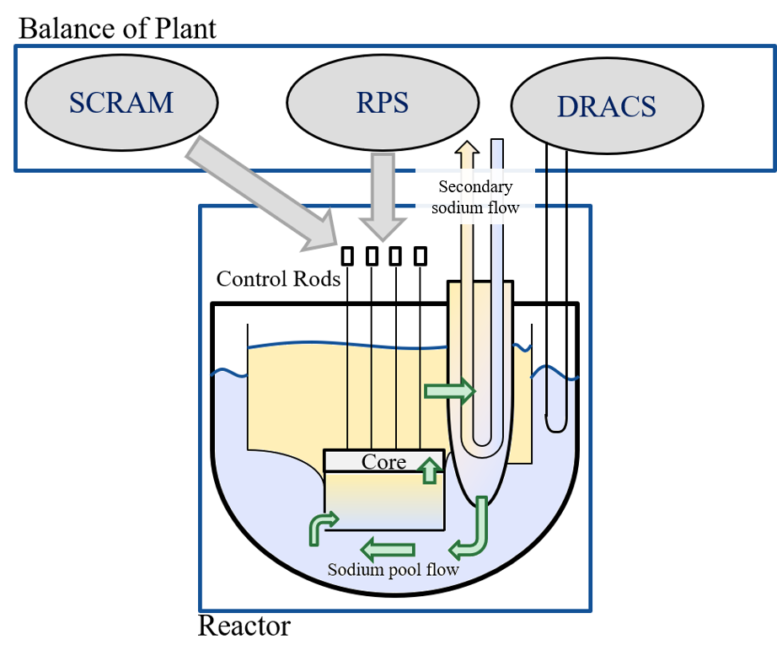

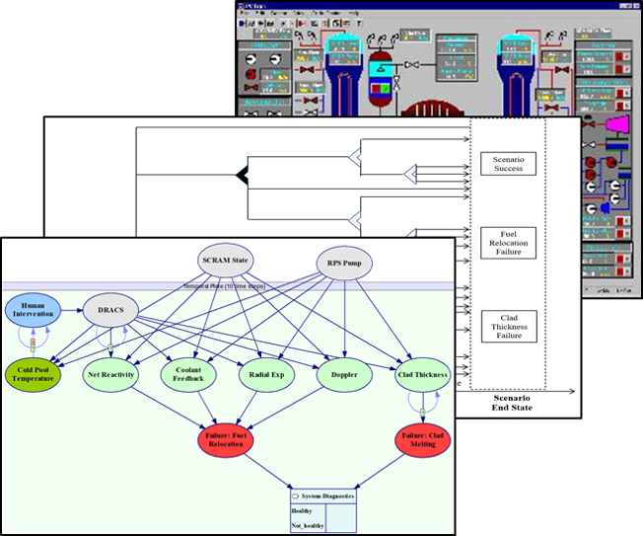
Next steps &future research
1. Expanding the SFR CES case study
Expand node structure within model (further and more detailed instances of operator interventions)
Apply other performance metrics (e.g., outcome accuracy, prognostic horizon) to better understand differences in discretization values
Apply different forms of the hybrid time-based discretization strategy and evaluate the results
2. Performing additional CES case studies
Apply similar methodology to different reactor types or other system safety risks
Carry out CES case study outside of the nuclear context (processing plant, non-nuclear power plant, etc)
3. Improving DBNs and expanding CES health management
Implement probabilistic programming to construct networks that better reflect operational realities
Apply similar methodology to machine learning models, data processing techniques, and the construction of neural networks

Slide 23
Conclusions
DBNs provide a strong basis for creating SIPPRA models, enabling PHM and PRA benefits to be extended to more complex systems than before.
Modeling decisions impact model performance – new NPP case study allowed us to explore those impacts both quantitatively and in multiple dimensions
Multiple metrics beyond assessment accuracy should be considered when evaluating the performance of CES health monitoring models.
Impact: Case study combined with multidimension metrics allows SIPPRA model developers to design more meaningful models for improved CES risk and health management.

Slide 24
Questions?
Case Study DBN Node Structure
Discretization Strategies
Performance Metric
Contact Information: Austin Lewis (adlewis@umd.edu); Katrina Groth (kgroth@umd.edu)

