Slide 1
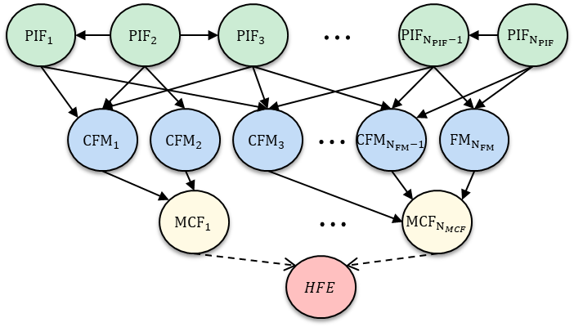
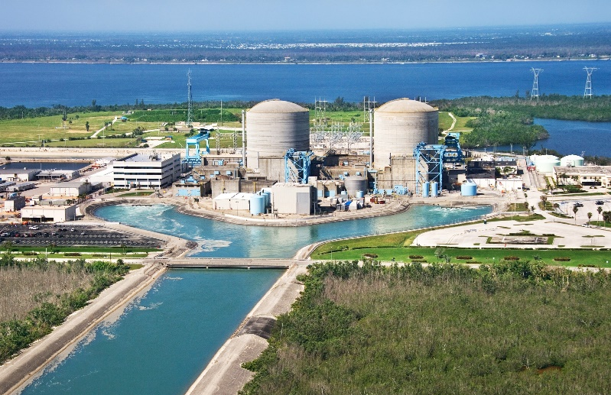
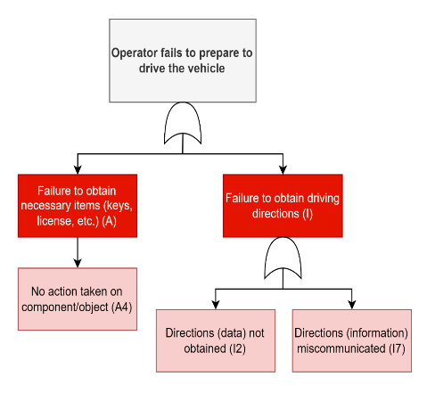
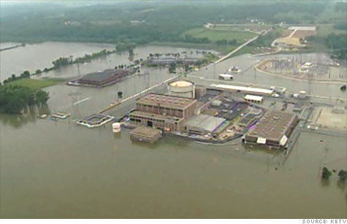
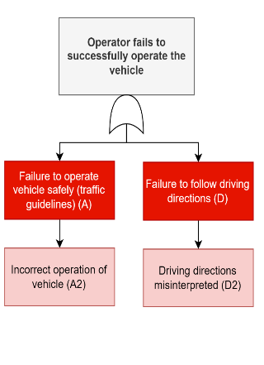
Identifying Human Failure Events (HFEs) for External Hazard Probabilistic Risk Assessment
Ahmad Al-Douri, Camille S. Levine, Katrina M. Groth
Systems Risk and Reliability Analysis (SyRRA) Lab
Center for Risk and Reliability
University of Maryland, College Park
This material is based upon work supported in part by the Department of Energy Office of Nuclear Energy under Award Number DE-NE0008974. This report was prepared as an account of work sponsored by an agency of the United States Government. Neither the United States Government nor any agency thereof, nor any of their employees, makes any warranty, express or implied, or assumes any legal liability or responsibility for the accuracy, completeness, or usefulness of any information, apparatus, product, or process disclosed, or represents that its use would not infringe privately owned rights. Reference herein to any specific commercial product, process, or service by trade name, trademark, manufacturer, or otherwise does not necessarily constitute or imply its endorsement, recommendation, or favoring by the United States Government or any agency thereof. The views and opinions of authors expressed herein do not necessarily state or reflect those of the United States Government or any agency thereof.

Slide 2
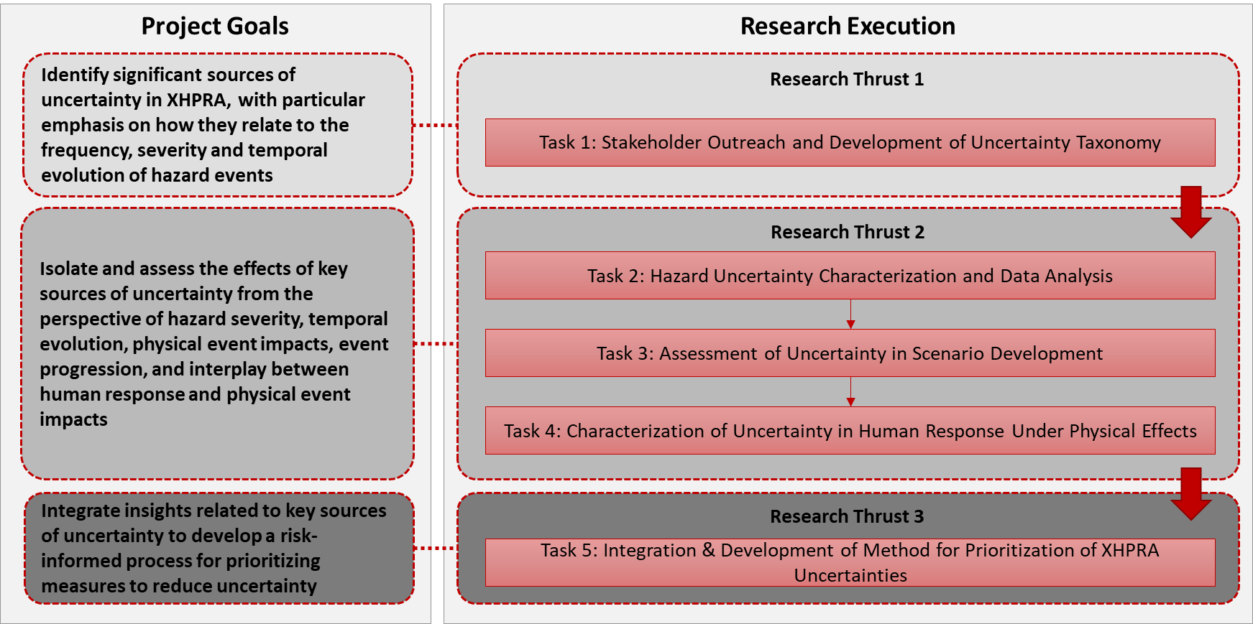
Project Objective & Approach
MB157- Tuesday, 1:30 PM, External Events I
MB290- Tuesday, 10:30 AM, Infrastructure II
MB158- Tuesday, 3:30 PM, External Events II
Objective: Development of a technically-sound method for identifying and prioritizing potentially risk significant uncertainty contributors in external hazard probabilistic risk assessment.
Michelle T. Bensi, Katrina M. Groth, Zeyun Wu, Zhegang Ma, Hongbin Zhang, Ray Schneider: Identifying and Prioritizing Sources of Uncertainty in External Hazard Probabilistic Risk Assessment (2020). DOE Office of Nuclear Energy Award DE-NE0008974

Slide 3
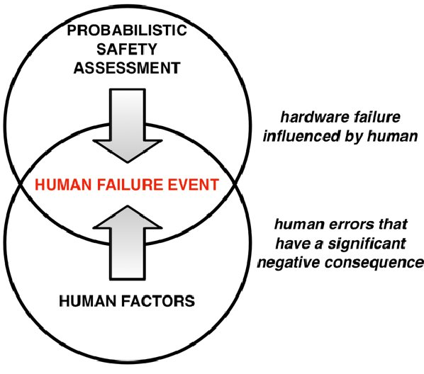
Task 4 Objective & Approach
Characterization of Uncertainty in Human Response Under Physical Effects
Human and human-machine actions and decisions involved in plant response.
Focus on factors relevant to modeling/quantifying human-machine performance in flooding hazard response.
Encode causal relationships using Bayesian networks (BNs)
T4.1 Identification of human failure events (HFEs)
T4.2 Identification of performance influencing factors (PIFs)
T4.3 Development of framework for PIF-human failure mechanisms for XHPRA
Research, education, and industry engagement
Provide a structure to enable inclusion of HRA within the framework for prioritizing hazard uncertainty drivers
Al-Douri, Levine & Groth 2022
Notes:
We’re conducting two main research activities that feed into an applied activities to impact codes and standards.
This arrangement is in line with our program focus on identifying R&D needs, performing high-priority R&D, and impacting codes and standards.
Three pieces: Developing the methods, developing scientific models, and piloting the application of the methods and models.

Slide 4
Evolution of HRA Methods
2005
SPAR-H
1950s
US Air Force weapons safety projects
1987
ASEP
1996
ATHEANA
2016
Phoenix
1962
THERP
1998
CREAM
2007
IDAC
1st generation 2nd generation 3rd generation
Cognition,
Context,
Commission
Dynamic PRA
Al-Douri, Levine & Groth 2022
Notes:
Status of SPAR-H as a first or second generation method?

Slide 5
Motivation & Objectives
Responses to a hazard event are reliant on human actions to a significant degree.
Human response and human-plant interactions are key elements of successful prioritization of uncertainties within any PRA.
Most existing human reliability analysis (HRA) models are built for control room (CR) actions.
During a flooding event, most of the response actions are ex-CR.
How to identify potential human failure events and associated uncertainties given available tools?
To address this shortcoming, we will modify and exercise the cognitive-based Phoenix model to support identification of human activities, causal factors, and uncertainties.
Al-Douri, Levine & Groth 2022

Slide 6
Methods: IDAC
Information, Decision, and Action in Crew Context (IDAC) method considers three main stages of human response, all affected by mental state:
Incoming information
Outgoing actions
(I) Information pre-processing, observation
(D) Problem-solving and decision-making
(A) Executing actions
Mental State
Allows for a nested structure: each block can contain I, D, and A sub-processes
I
D
A
Chang, Y. H. J., & Mosleh, A. (2007). Cognitive modeling and dynamic probabilistic simulation of operating crew response to complex system accidents: Part 1: Overview of the IDAC Model. Reliability Engineering & System Safety, 92(8), 997-1013.
Notes:
Nested structure: For example, when gathering information, the operator must first recognize the incoming information (I-in-I), decide how to process the information (D-in-I), and passing this information to their decision-making strategy (A-in-I).

Slide 7
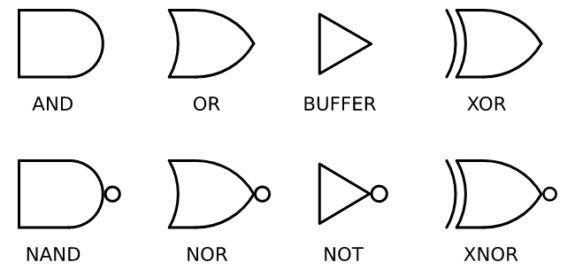
Methods: Phoenix
The Phoenix HRA method builds upon this as a layered qualitative analysis
Initiating Event
Success
Branch Point 1 (BP1)
BP2
Crew
Response
Tree
Failure 2
Failure 1
Fault
Tree
Human Failure Event 1
HFE2
HFE3
Crew Failure Mode 1
CFM2
CFM3
CFM4
Ekanem, N. J., Mosleh, A., & Shen, S. H. (2016). Phoenix–a model-based human reliability analysis methodology: qualitative analysis procedure. Reliability Engineering & System Safety, 145, 301-315.
Notes:
Mention BN component but outside scope

Slide 8
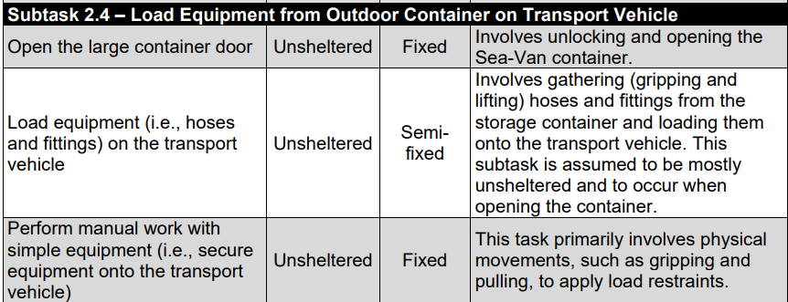
Task Data
Few task analyses available for NPP ex-control room actions
NUREG-7256, “Effects of Environmental Conditions on Manual Actions for Flood Protection and Mitigation”, contains hierarchical task analyses of three representative flooding mitigation actions:
  Install a portable pump
  Install flood barriers on structure exterior walls
  Build a sandbag berm around service water strainer pit
Identifies manual actions via NRC staff assessments and plant-specific procedures
Al-Douri, Levine & Groth 2022
Notes:
Notes on how the task decomposition was obtained:
Simple HTA down to specific actions- however, any more granular and it would become site specific
Goal of this HTA was to assess environmental conditions, NOT estimate HEPs or identify an individual’s errors
Identified manual actions via NRC staff assessments and five plant-specific flood protection procedures
Although tasks usually decomposed to the point where prob*cost of error would be very small, this is slightly coarser
Using research team group discussion and consensus building
We’ll focus on the task decomposition for “Installing a portable pump” in this paper.
Task decomposition includes:
Specific action
Degree of sheltering
Location
Comments on task content

Slide 9
Crew Failure Mode Identification
19 Phoenix CFMs: Generic functional modes of failure
  Aggregated from a variety of sources: operating experience, relevant literature, expert discussion, and NRC-defined failure modes from SACADA
ID | Crew Failure Modes in “I” phase | ID | Crew Failure Modes in “D” phase | ID | Crew Failure Modes in “A” phase
I1 | Key alarm not responded to (intentional or unintentional) | D1 | Plant/system state misdiagnosed | A1 | Incorrect timing of action
I2 | Data not obtained | D2 | Procedure misinterpreted | A2 | Incorrect operation of component/object
I3 | Data discounted | D3 | Failure to adapt procedures to the situation | A3 | Action on wrong component/object
I4 | Decision to stop gathering data | D4 | Procedure step omitted (intentional)
I5 | Data incorrectly processed | D5 | Inappropriate transfer to a different procedure
I6 | Reading error | D6 | Decision to delay action
I7 | Information miscommunicated | D7 | Inappropriate strategy chosen
I8 | Wrong data source attended to
I9 | Data not checked with appropriate frequency
Ekanem, N. J., Mosleh, A., & Shen, S. H. (2016). Phoenix–a model-based human reliability analysis methodology: qualitative analysis procedure. Reliability Engineering & System Safety, 145, 301-315.
Notes:
- Covers three macrocognitive phases- Information Decision Action

Slide 10
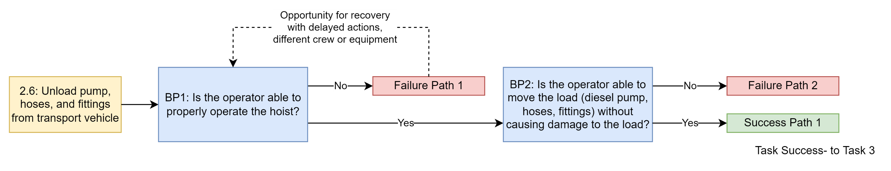
Development of CRTs from Hierarchical Task Decomposition
Subtask 2.6 – Unload Pump, Hoses, and Fittings from Transport Vehicle
Specific Actions | Degree of Sheltering | Location | Comments
Operate the powered hoist to unload the pump and other equipment from the transport vehicle | Sheltered | Fixed | Involves positioning the hoist over the load, and lifting, moving, and lowering the load using the hoist controls and physical movements.
Portable pumps at the Diablo Canyon NPP ready for deployment.
Al-Douri, Levine & Groth 2022
U.S. Nuclear Regulatory Commission (2018). Safety Enhancements after Fukushima
Notes:
Used comments column on task analysis to guide identification of branching points

Slide 11

Results: Development of CRTs
Subtask 2.5 – Drive Transport Vehicle to Reactor Building Location Where Equipment Will Be Unloaded
Specific Actions | Degree of Sheltering | Location | Comments
Enter the transport vehicle | Unsheltered | Fixed | Personnel must unlock and open the vehicle.
Operate the transport vehicle from the equipment storage container location to the reactor building | Semi- sheltered | Variable | Includes driving the transport vehicle from the storage container location to the reactor building where the pump will be unloaded. Considered semi-sheltered because weather could affect visibility and hearing.
Exit the transport vehicle | Semi- sheltered | Fixed
Communicate electronically outside the reactor building (i.e., to get the high bay door open) | Semi- sheltered | Semi-fixed | Involves communication and coordination with individuals in the reactor building to have the high bay door opened.
Operate the transport vehicle to move it inside the reactor building | Semi- sheltered | Semi-fixed | Includes driving transport vehicle into the reactor building.
Exit the transport vehicle | Semi- sheltered | Fixed
Al-Douri, Levine & Groth 2022

Slide 12
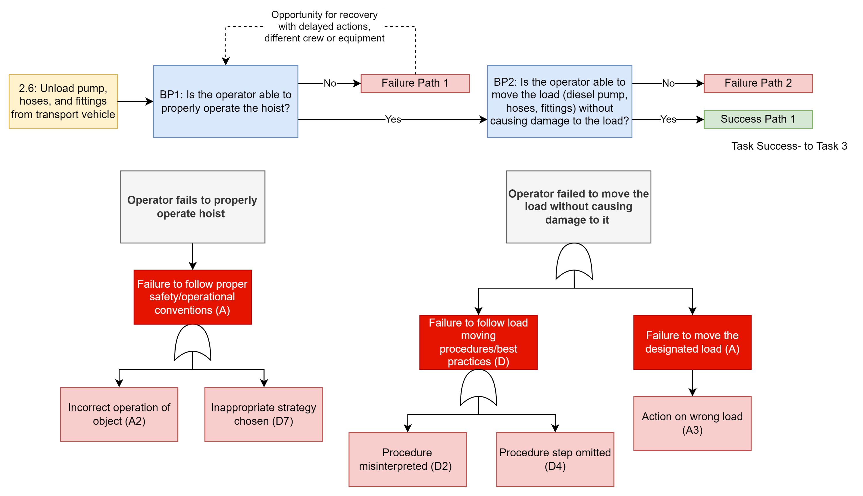
Results: Development of FTs
HFE
CFM
Al-Douri, Levine & Groth 2022
Notes:
Emphasize that the HFEs and CFMs are at different levels

Slide 13
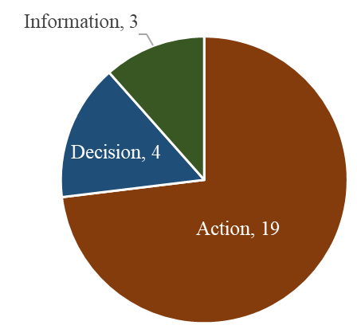
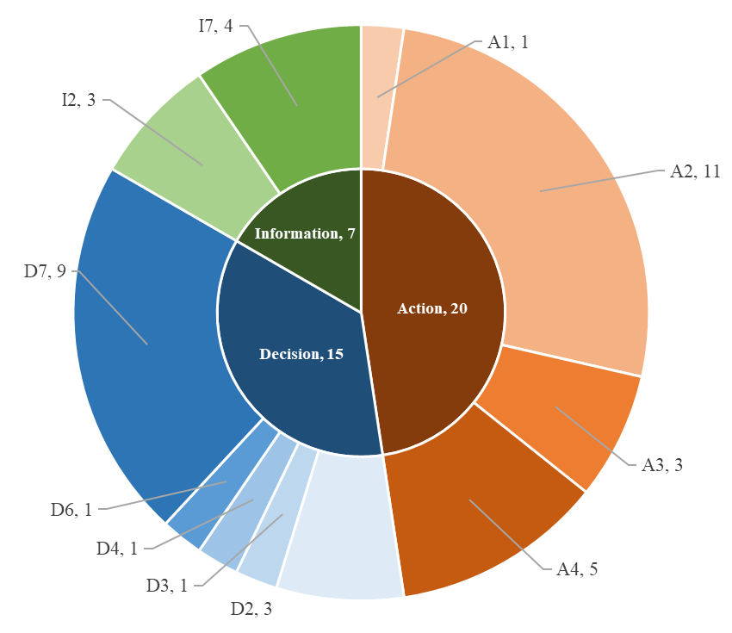
Results: Phase & CFM Occurrences
HFE Phases
CFM Phases
ID | Crew Failure Modes in “I” phase | ID | Crew Failure Modes in “D” phase | ID | Crew Failure Modes in “A” phase
I2 | Data not obtained | D2 | Procedure misinterpreted | A1 | Incorrect timing of action
I7 | Information miscommunicated | D3 | Failure to adapt procedures to the situation | A2 | Incorrect operation of component/object
 |  | D4 | Procedure step omitted (intentional) | A3 | Action on wrong component/object
 |  | D6 | Decision to delay action | A4 | No action taken
 |  | D7 | Inappropriate strategy chosen
Al-Douri, Levine & Groth 2022
Notes:
Main takeaway: CFMs are applicable
Need for a fourth Action CFM
Potential need for more CFMs to consider everything
Out of 26 total HFEs; 42 total CFMs
Relate the condensed CFM table to the second pie chart

Slide 14
Contributions
Demonstrated applicability of Phoenix method to ex-CR actions
  Cognitive-based methods (third-generation HRA) are better suited than older methods (first- and second-generation HRA)
CFMs provided in method are mostly relevant
  Further refinement needed for Action phase CFMs, but Information and Decision CFMs sufficient to describe scenarios
This work sets the stage for a systematic treatment of human actions in external environments, allowing for the future development of the causal basis of HRA.
Al-Douri, Levine & Groth 2022

Slide 15
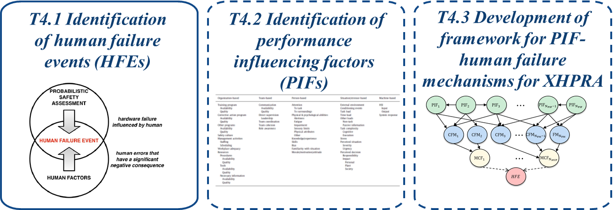
Future Work Directions
Validation on two more ex-CR tasks
  Then, seeking expert feedback on these analyses
Issue of coordination & communication between multiple teams or individuals
  Introduces complexities not currently modeled
Mapping of PIF causal chains to identified CFMs (Task 4.2)
  Using Groth’s 2012 PIF hierarchy and Phoenix CFMs
Quantification through resultant Bayesian Network (Task 4.3)
Al-Douri, Levine & Groth 2022

Slide 16

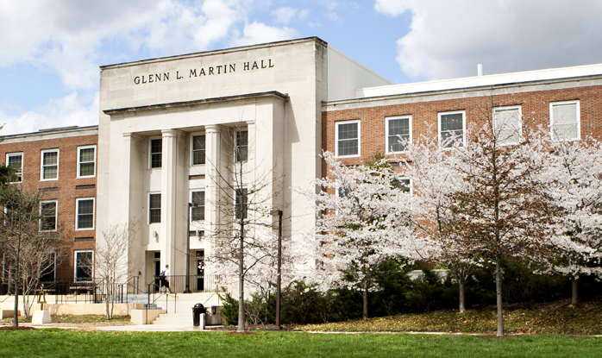


Thank you!
Ahmad Al-Douri
aaldouri@umd.edu
Camille S. Levine
clevine1@umd.edu
Katrina M. Groth
kgroth@umd.edu

Slide 17
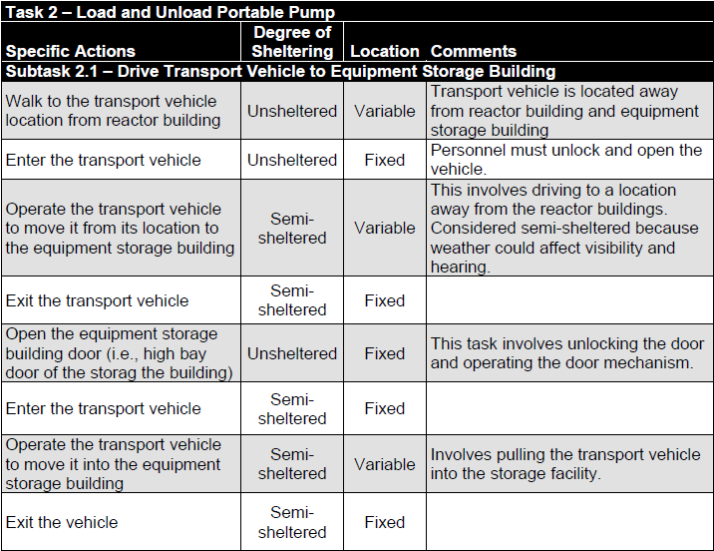
NUREG-7256 Task Analysis for Task 2
Al-Douri, Levine & Groth 2022

Slide 18
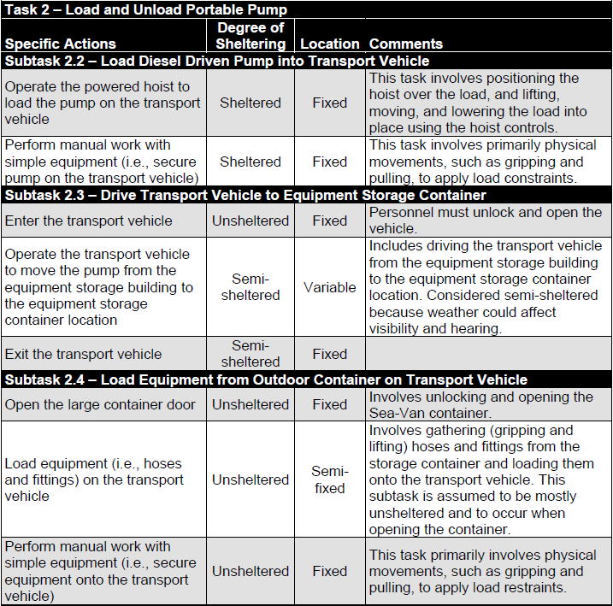
NUREG-7256 Task Analysis for Task 2
Al-Douri, Levine & Groth 2022

Slide 19
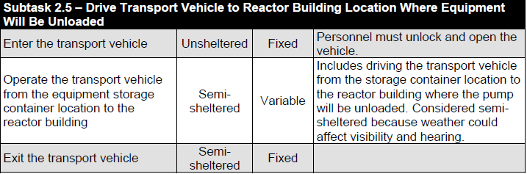
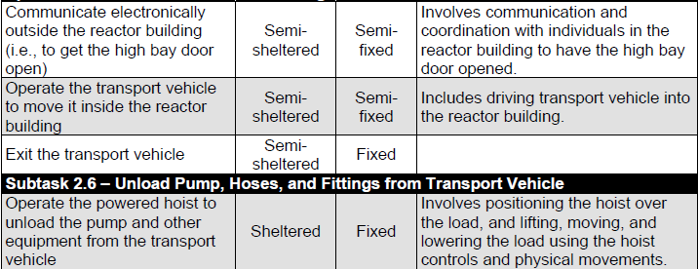
NUREG-7256 Task Analysis for Task 2
Al-Douri, Levine & Groth 2022

Slide 20
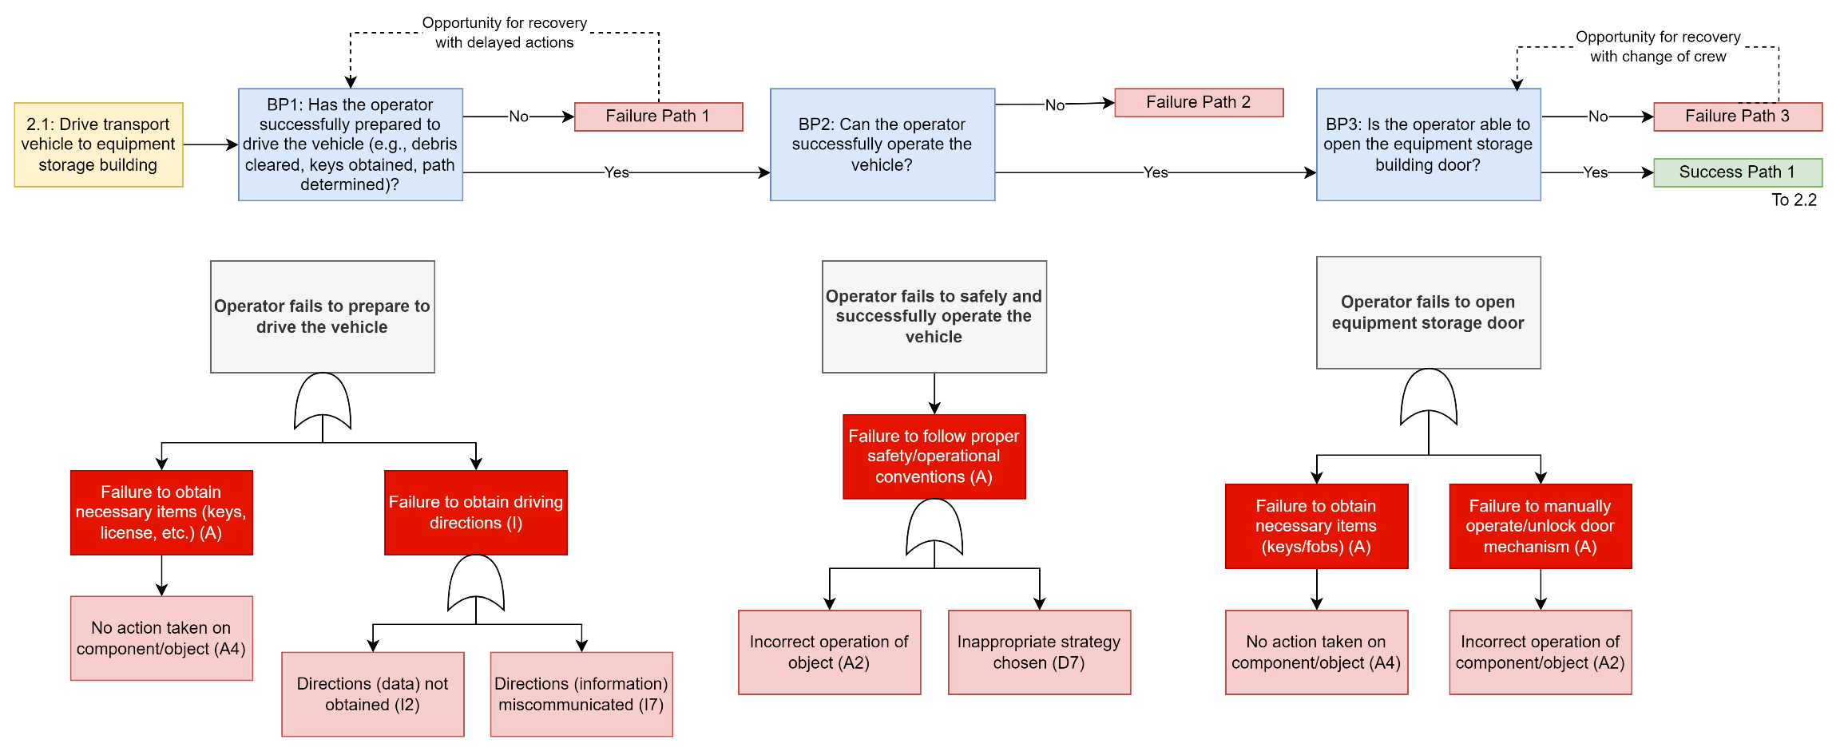
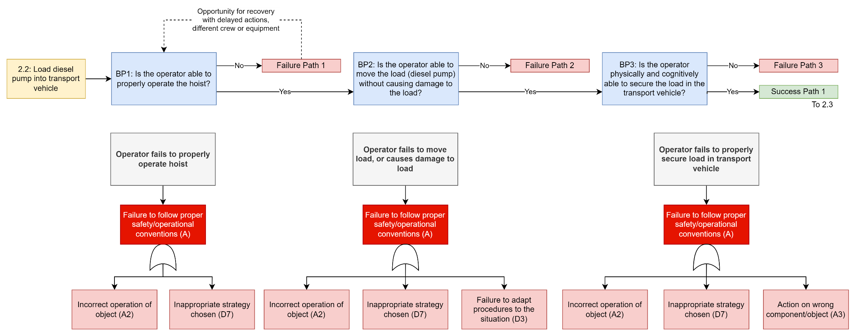
All CRTs & FTs
Task 2.3
Task 2.4
Al-Douri, Levine & Groth 2022

Slide 21
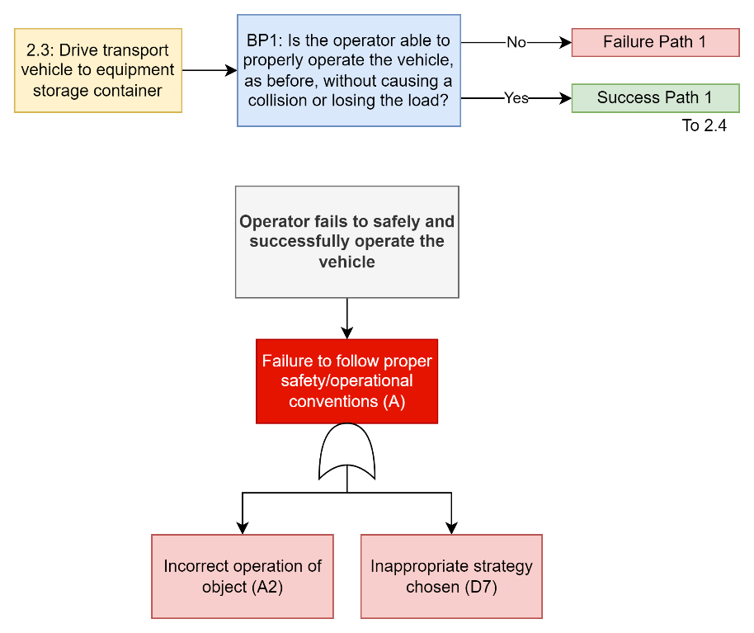
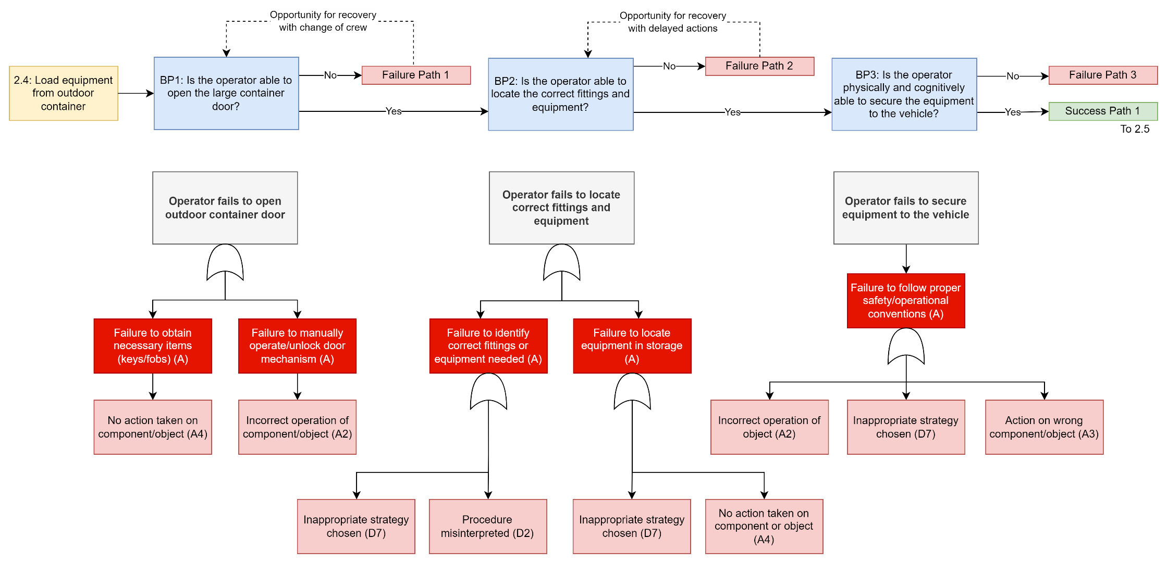
All CRTs & FTs
Task 2.3
Task 2.4
Al-Douri, Levine & Groth 2022

Slide 22

All CRTs & FTs
Task 2.5
Al-Douri, Levine & Groth 2022

Slide 23

All CRTs & FTs
Task 2.6
Al-Douri, Levine & Groth 2022

